Slide 1
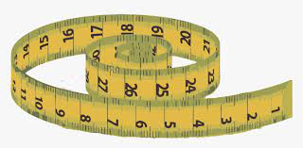
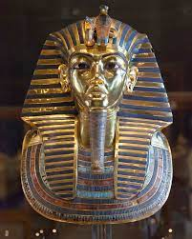
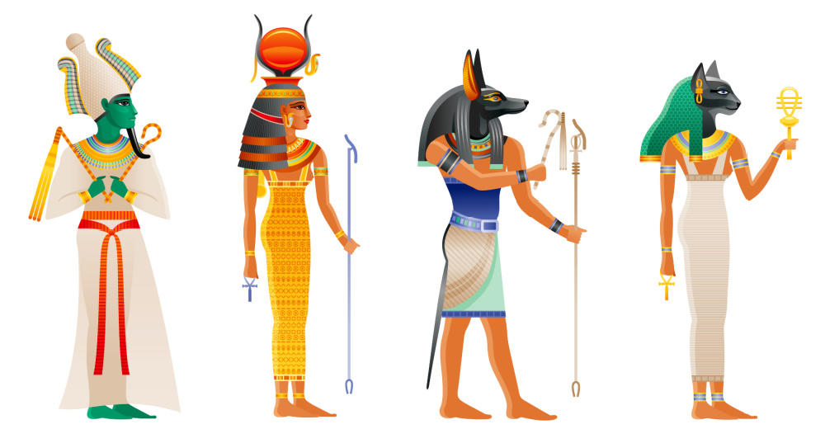
Computing
English
Logo: Selection in quizzes
Creating quizzes in scratch
Using if… then… questions to support coding.
Planning an effective quiz including topic, question and answers.
Testing a quiz on scratch using criteria.
Science
We are reading:
Living things and their life cycles
biology
Lesson 1: The life cycle of apes
Lesson 2: The work of Jane Goodall
Lesson 3: How the environment is being changed
Lesson 4: The life of naturalist David Attenborough
Lesson 5: Puberty
Narrative: Poetry
Week 1 - children to use a poem ‘recipe’ to write about the Highwayman’s crime
Week 2 - group / whole class poem - make use of elements from different children’s poems to write a class version
Non-narrative: Non-chronological report
Children to write non-chronological report about leopards & the impacts of poaching on their declining numbers (children can add in general information about poaching and its impact on a range of animals)
Non-narrative: Recount
Diary entry in the role of Ruby as she is on the boat travelling from Australia
History
Ancient Egypt
Who were the Ancient Egyptians?
What were the features of Ancient Egyptian culture?
What can we learn from primary sources?
What do historians say about how the Ancient Egyptians changed the world?
Discuss historical contrasts - How did the Ancient Egyptians change the world?
A balanced discussion - How did the Ancient Egyptians change the world?
Measurement
Converting between units of time
Answers problems in context involving time
Converting between units of length
Geometry
Plot coordinates on a grid
Draw 2D shapes on a grid from given coordinates
Translate and reflects 2D shape
Number
Mental strategies to add and subtract involving decimals
Formal written strategies to add, subtract and multiply involving decimals
Maths

Slide 2
Trip to a religious place of worship, Library Visit, Bow Arts Project!
Physical Education (PE)
This term your PE will be on: Thursday
Fundamental Focus |  | Static balance and dynamic balance
Sport Specific Focus |  | Athletics
Whole child focus | Learning to: | Preparing for activity
 | Learning about: | Long term effects of different types of training
Religious Education
What do religions and worldviews believe about God?
To consider why some people do not believe in God
Muslim beliefs about God
Hindu beliefs about God
Sikh beliefs about God
Christian beliefs about God
Curriculum Enrichment
Music
PSHE
Design and Technology
Growing and Changing
To explore the functions and importance of the heart and lungs through movement and discussion
To find out how the brain is like a control centre
To identify childhood illnesses and explore safety with regard to syringes.
To focus on the effects of eating or drinking to excess.
To explain how girls’ and boys’ bodies change during puberty and understand the importance of looking after myself physically and emotionally
Lifting Devices
ANCIENT EGYPT
Lesson 1- Analyse lifting mechanisms
Lesson 2- Explore structures and mechanisms
Lesson 3- Design a model lifting device
Lesson 4- Construct a lifting device
Lesson 5- Test and evaluate a design
Click here to go back to the main page

