Slide 1
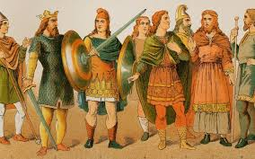
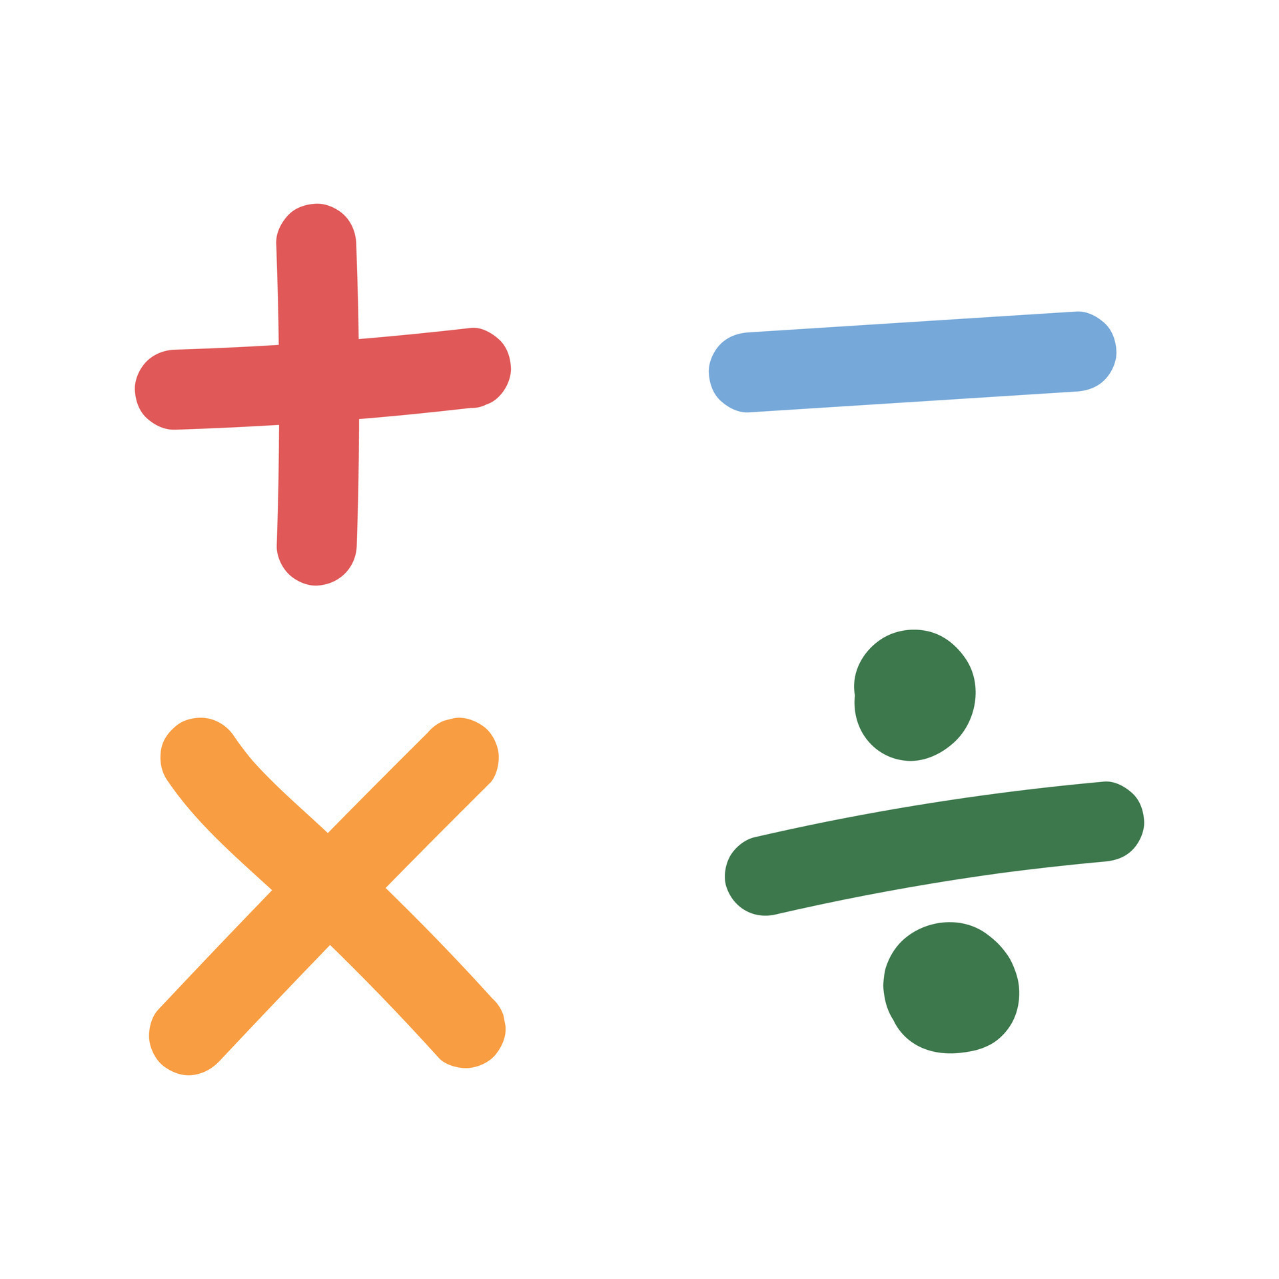
Year 4
English
Anglo-Saxons: How much difference did they make to our country?
Lesson 1: Who were the Anglo-Saxons?
Lesson 2: What were the features of the Anglo-Saxon period in Britain?
Lesson 3: What can we learn from primary sources?
Lesson 4: What do historians say about the significance of the Anglo-Saxon period in Britain?
Lesson 5: Debate historical contrasts - What was significant about the Anglo-Saxon period in Britain?
Science
History
Styles of writing to be covered
Balanced discussion
Recount
Explanation
Grammar
Begin to link sentences with a range of subordinating and coordinating conjunctions.
Introduce the use of the ‘Passive voice’.
Power of three used to show action and pace.
Electricity
To identify common appliances that run on electricity.
To construct a simple series electrical circuit, identifying and naming its basic parts.
To identify whether or not a lamp will light in a simple series circuit.
Investigate how to change the brightness of a bulb.
To recognise some common insulators and conductors.
We are reading:
Computing
Creating a video-Canva
To design and create digital content
To present digital material
To edit a film
Maths
Position and Direction
Reading and plotting coordinates of polygons
Translation of points
Reasoning with patterns and sequences
Exploring number systems
Investigating number sequences
Solving problems involving patterns and sequences
3D shapes
Applying understanding of 3D shapes
Solving problems involving 3D shapes

Slide 2
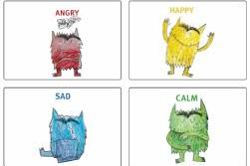
Physical Education (PE)
This term your PE will be on:
Fundamental Focus |  | Dynamic balance to agility Static balance
Sport Specific Focus |  | Athletics
Whole child focus | Learning to: | Explaining how to exercise
 | Learning about: | Different types of exercise and training
Music Concert
Sports day
What happens when someone gets married?
Understand the purpose and significance of wedding celebrations and the reasons why people choose to get married.
Learn about marriage vows and their meanings in the context of a wedding ceremony.
Identify and understand the important actions that take place in a Hindu wedding ceremony.
Explore the symbolism behind the seven steps in a Hindu wedding.
Understand the beliefs of Muslim people regarding marriage.
Learn about the customs and practices of a Muslim wedding.
Religious Education
Curriculum Enrichment
Music
Growing and Changing
To learn about the different feelings and emotions people experience
To understand how feelings and emotions change and what helps people to feel good
To learn about ways of expressing feelings and emotions
To recognise why it is important for people to express their feelings
To know about managing feelings and emotions in different situations
To recognise that help, advice and support about feelings comes from different sources
DT
Performance
Use and understand staff and other musical notations
Listen with attention to detail and recall sounds with increasing aural memory
Play and perform in solo and ensemble contexts
PSHE
Drawstring Pouches
Analyse clothing and font design
Experiment with stitching
Create logo designs
Evaluate a design
Develop a pouch design
Click here to go back to the main page

