Slide 1
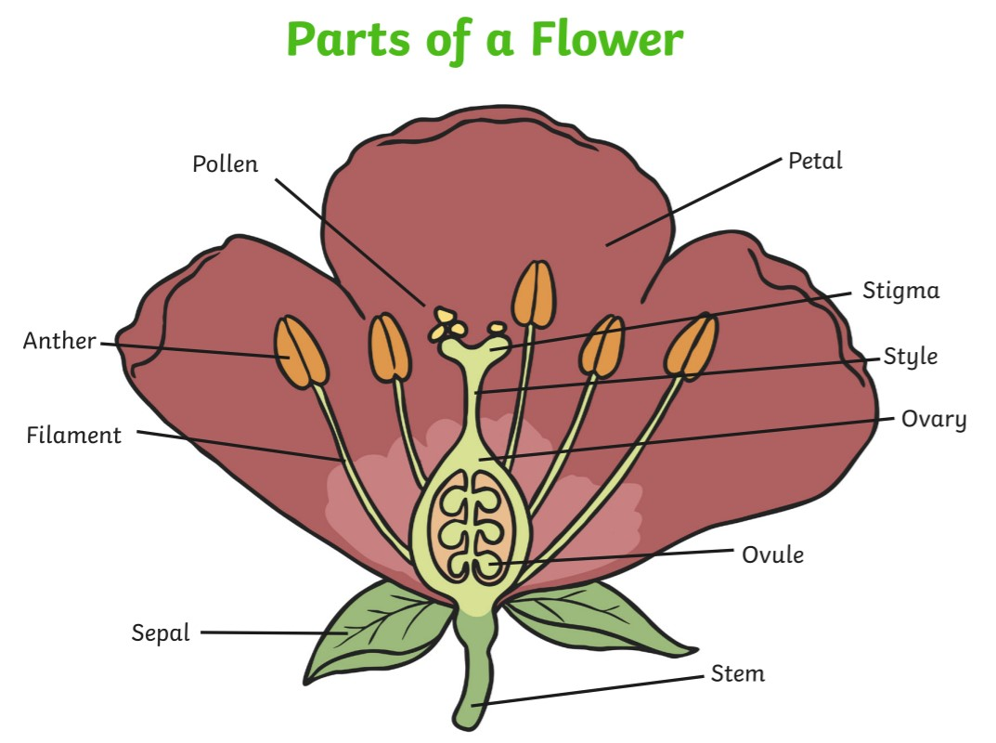


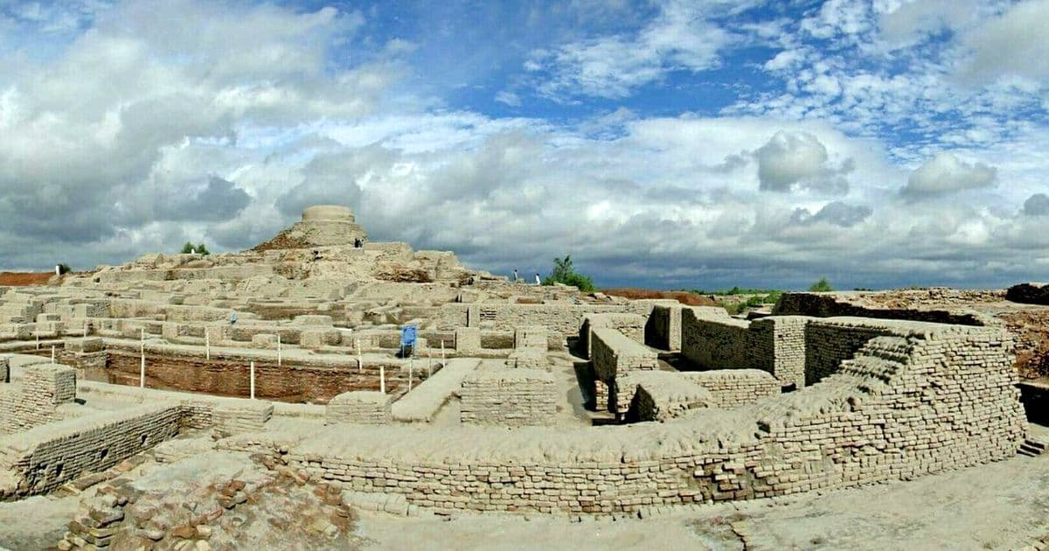
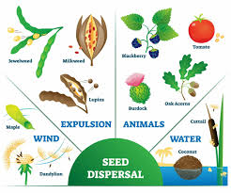
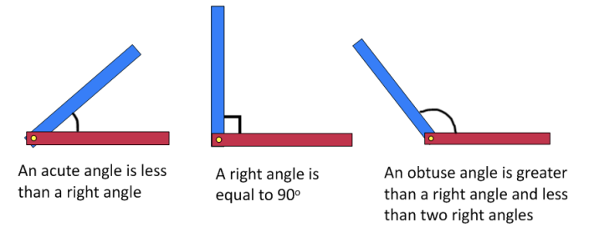
Computing
English
News Report
Online Safety: Age restrictions on games
News Report (continued)
How do I record a video?
How do I write a script?
How to perform in a video
How to edit a video
Science
We are reading:
Biology: Plants
How seeds are formed in plants
How are seeds dispersed by plants?
Compare the different factors affecting plant growth.
How plant variation changes requirements for growth
Grammar and punctuation focus:
-Dashes and brackets for parenthesis
-Fronted adverbials to begin a sentence
-Possessive apostrophes for singular and plural nouns
- Add detail accurately using an expanded noun phrase
Writing outcomes:
Non-narrative recount
Setting description
Balanced discussion
History
What caused the decline of the Indus Valley civilisation?
Who were the people of the Indus Valley?
What were the features of life in the Indus Valley?
What can we learn from primary sources?
What do historians say about the decline of the Indus Valley civilisation?
What caused the decline of the Indus Valley civilisation?
Maths
Angles and Shapes
Use angles to describe turns and explore properties of shapes.
Identify angles inside a 2-D shape.
Recognise right angles and their relationship to quarter turns.
Understand the terms ‘acute’ and ‘obtuse.’
Identify parallel and perpendicular lines.

Slide 2





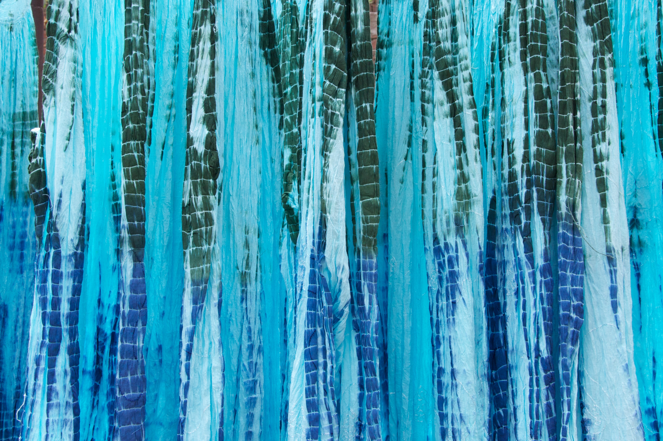


Trip to Gurdwara
Physical Education (PE)
This term your PE will be on: Wednesday
Fundamental Focus
Sport Specific Focus |  | Athletics
Whole child focus | Learning to: | Explaining why we exercise
 | Learning about: | Short and long term effects of exercise
Religious Education
Sikh sayings and Sikh beliefs
-Identify and understand the importance of symbols in our lives.
-Explore the reasons why Sikh people wear symbols and their significance.
-Learn about the most important symbol for Sikh people.
-Understand key Sikh sayings that describe the nature of God.
-Reflect on and identify personal sayings that hold significant meaning in life.
Curriculum Enrichment
Music
PSHE
Design and Technology
Year 3 will be learning to strum chords on the ukulele. We will be working towards a performance in our summer assembly where we will showcase all of the skill we have learnt.
Growing and Changing
To recognise cycles of life in nature.
To tell you about the natural process of growing from young to old.
To recognise how my body has changed since I was a baby.
To understand what it might be like to have a baby in the family.
To understand there are different types of touch and tell you which ones I like and don’t like.
Bandhani Garments
Analyse fabric designs
Experiment with dye-resist techniques
Create a fabric design
Evaluate a design
Develop a garment design
Click here to go back to the main page

