Slide 1
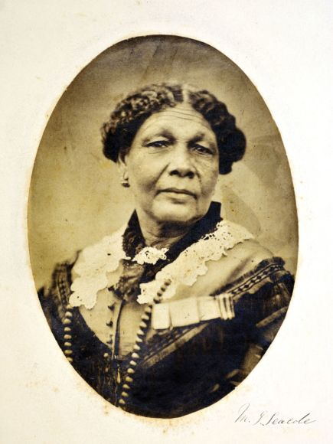
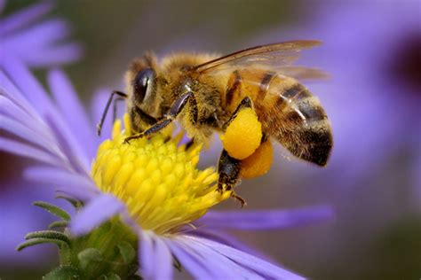

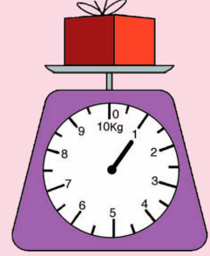
Year 2
English
History
In History children will be learning about Mary Seacole and other significant women. They will learn about:
Who Mary Seacole was.
Why she was significant.
Comparisons between Mary Seacole and Florence Nightingale.
Who Rosa Parks was and why she was significance.
How significant women of the past empower future women.
Science
We will be reading many exciting texts and developing our writing skills, including:
Subordinating conjunctions
Relative clause
Inverted commas
Apostrophes for possession
Powerful adjectives
Full stops, capital letters, exclamation marks and question marks
Sentence starters
Embedded clauses
Adverbs for place
We are reading:
Little Leaders
Molly Rogers
Year 2 will be learning all about plants. Some of the aspects their learning will cover are:
The function of different parts of a plant.
How plants transport water and nutrients.
Role of the flower in self pollination.
Role of insects in cross pollination.
The basic structure of a tree.
Computing
Interpret and construct simple pictograms, tally charts, block diagrams and simple tables
Ask and answer simple questions by counting the number of objects in each category and sorting the categories by quantity
Ask and answer questions about totalling and comparing categorical data
Maths
In Maths we will be recapping important topics that we have learnt throughout the year including:
Times tables
Recapping times table facts of the 2, 5 and 10 times tables, using the inverse to solve division problems.
Measuring Mass: Kilograms, grams and interpreting scales
Exploring calculation strategies: solving addition and subtraction equations. Solving part-whole problems.

Slide 2
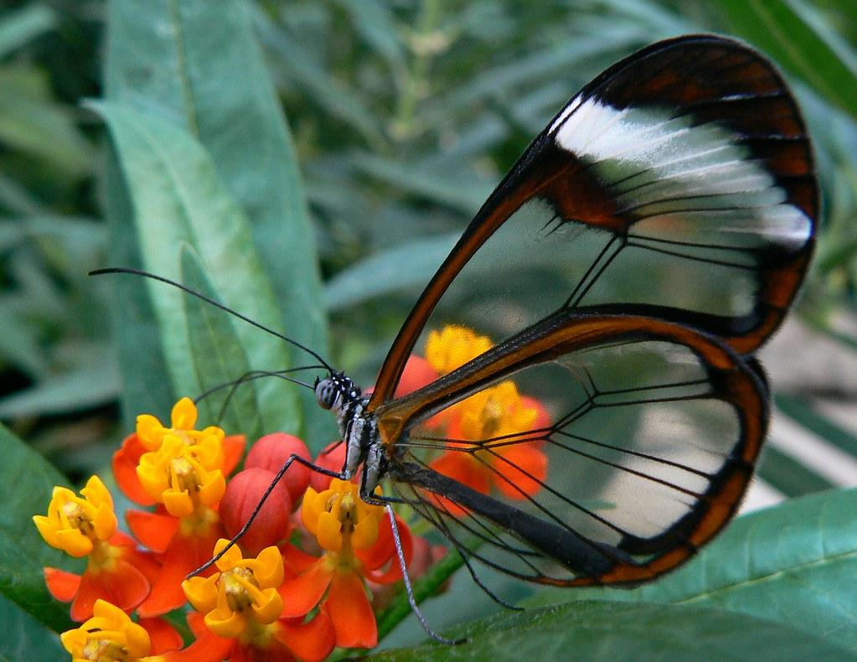


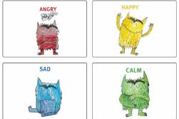

Museum of London (Docklands)
China Town
Sports day
Religious Education
Physical Education (PE)
This term your PE will be on: Health and Fitness
Fundamental Focus |  | Static Balance - One leg Coordination Footwork
Sport Specific Focus |  | Athletics
Whole child focus | Learning to: | Keep trying
 | Learning about: | The effects of exercise on the body
Where does the world come from and how should we look after it?
-Understand the concept and meaning of creation across different cultures and religions.
-Learn about the creation stories told by Jewish, Christian and Muslim people.
-Explore the specific creation stories of Adam and Eve as told in Jewish and Christian traditions.
-Discover the creation stories told by Hindu people.
-Reflect on and express personal beliefs about the origins of the world.
Curriculum Enrichment
Music
We will be continuing with our
Samba drumming with a specialist tutor from Newham Music.
We will also be enhancing our performing skills as we prepare for our end of year assembly. We will be focusing on:
-singing clearly and loudly
-BSL signs
-smiling
Make sure you come see us!
Growing and Changing
-To recognise and name some feelings that they might have
-To explain how feelings can make their bodies feel inside; to describe how others might be feeling
-To understand that people feel differently about events and situations
-To explain what can change their feelings (from good to not so good and from not so good to good)
-To recognise that feelings can intensify (get stronger) and to describe how ‘big’ feelings can affect their behaviour.
DT
PSHE
M and E Systems: The children will design and make a toy ambulance. Create an eye-catching vehicle that is bright and colourful and has a medical symbol on it. They will explore structures and mechanisms.
Click here to go back to the main page

