Slide 1
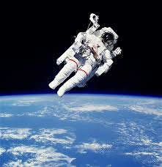
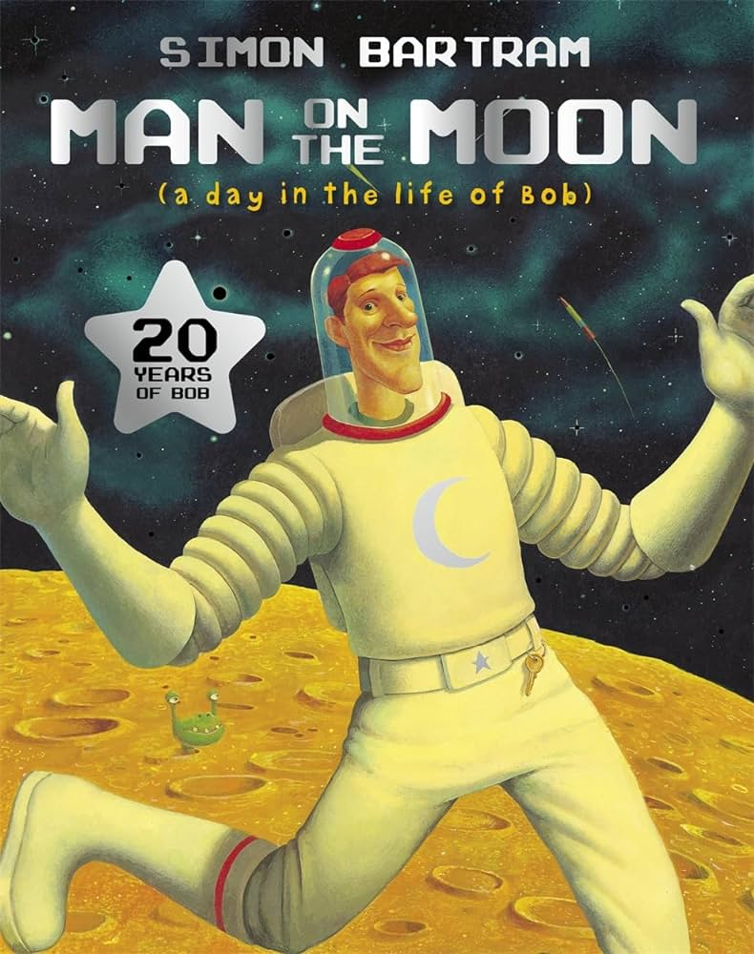
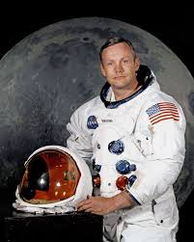
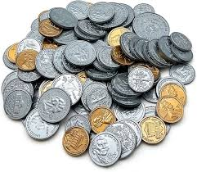
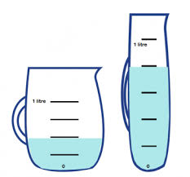
Year 1
English
History
Science
How did Neil Armstrong change the world?
How did Neil Armstrong become an astronaut?
How did Neil Armstrong walk on the moon?
What can we learn from primary sources?
What is the story of Neil Armstrong’s life?
How did Neil Armstrong change the world?
Styles of writing to be covered
Narrative description
Non-narrative explanation
Narrative short story
Non-narrative recount
Non-narrative persuasive letter
Grammar
Begin to use subordinating conjunctions to join sentences (‘while’, ‘as’, ‘until’).
Revise all punctuation taught throughout the year.
We are reading:
Plants (biology)
Investigating plant seeds
What do plants need to stay healthy?
Identify parts of a plant
What is the purpose of a flower?
The life cycle of flowering plants
Investigate a local park garden
Computing
Grouping Data
To become familiar with and explore ScratchJr
To begin to create simple programs by following algorithms
Learners will begin to amend and change a code to observe its impact
Create their own programs
that reflect a specified topic
Maths
Money
- recognising coins
- Comparing money
- Adding and subtracting money
- Money in the real world
Multiplication and division
- Exploring arrays
- Grouping and sharing
Capacity and volume
- Comparing capacity and volume
- Using weight length and volume

Slide 2
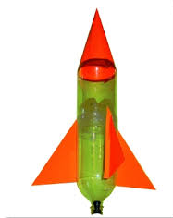
Gardening Sessions
Sports Day
Trip to West Ham
Trip to a mosque
Physical Education (PE)
This term your PE will be on:
Fundamental Focus |  | Dynamic balance Stance
Sport Specific Focus |  | Athletics
Whole child focus | Learning to: | Explain the benefits of exercise
 | Learning about: | Types of exercise
Religious Education
What does it mean to belong to Islam?
Understand the key elements that define and build a community.
Learn about the life and significance of Muhammad in Islam.
Identify and appreciate the objects that hold special significance for Muslim people.
Explore the ways in which Muslim people express their identity and belonging to Islam.
Gain knowledge about the major celebrations and festivals observed by Muslim people.
Comprehend what it means to be a Muslim and the core beliefs and practices of Islam.
Curriculum Enrichment
Music
Changing me
To understand the life cycles of humans and animals
Recognise things about yourself that have changed and stayed the same
To know how I have changed since I was a baby
To understand that some parts of my body are private
To understand that every time I learn something new I change a little
To tell you about changes that have happened in my life
DT
We will be focusing on our performing skills this term as we prepare for our end of year assembly. We will be focusing on:
-Singing together
-BSL signs
-Smiling
Make sure you come
see us!
PSHE
Analyse DIY instructions for children
Design bottle rockets
Make bottle rockets
Test and evaluate products
Create a set of instructions
Click here to go back to the main page

Slide 3
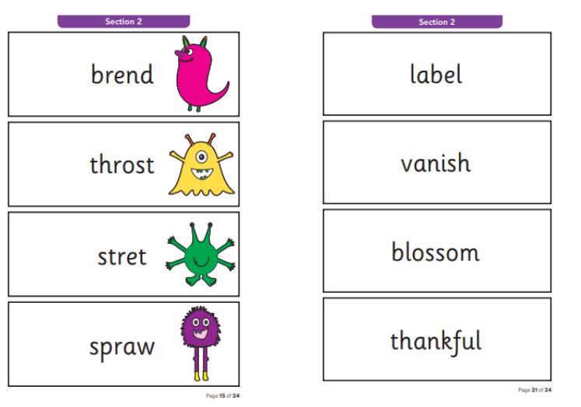
A reminder that the Year 1 Phonics Screening Check will take place in the week beginning Monday 10th June. In order to prepare, please practise reading real and ‘alien’ words at home.
All past papers can be accessed here.
(https://www.sats-papers.co.uk/phonics-screening-tests/)
Click here to go back to the main page

