Slide 1
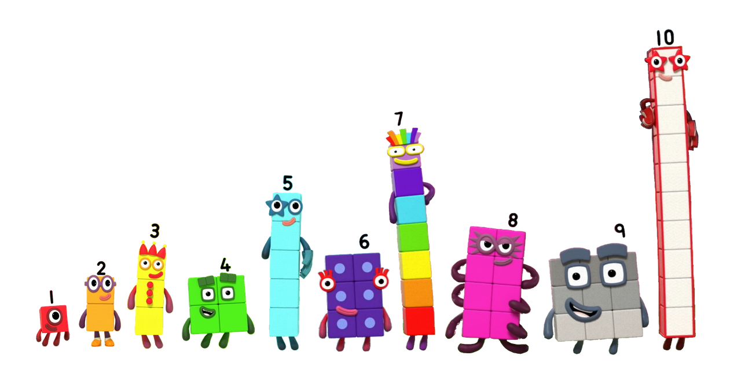
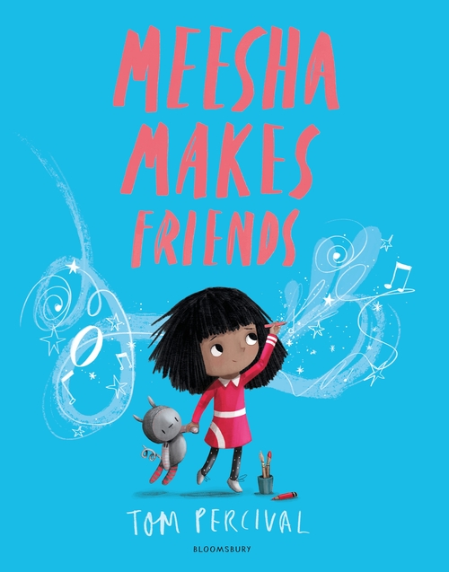

Butterfly, bumblebee and ladybird
Maths
Reading and Writing
We are reading:
Butterfly
In their Reading lessons Butterfly class will be exploring a range of stories focussing on books that are based on the themes of exploring growing and changing. Using the Colourful Semantics program, they will be using descriptive language to write instructions on how to be a good friend as well as listing qualities of what they like in a friend. The children will make their own 3D friend using junk modelling just like Meesha.
When reading ‘The Bog Baby’, the children will be writing a fact file, stating how they have changed from a baby to the age they are now.
Butterfly
As part of their basic maths skills, Butterfly will be practising their times tables in lessons alongside developing their number knowledge. We will be continue learning about money, including exchanging money, using notes and coins together, giving change. They will also be solving addition and subtraction money problems using pence and pound. Butterfly will spend time preparing for their next academic year and recapping key skills needed to continue developing their mathematical knowledge including 3D shapes, number bonds, timetables and division facts.
Bumblebee
In their Reading lessons Bumblebee class will be exploring a range of stories , focussing on books that are based on the theme of exploring growing and changing. Using the Colourful Semantics program, they will be using descriptive language to write instructions on how to be a good friend. The children will make their own 3D friend using junk modelling just like Meesha.
When reading ‘The Bog Baby’, the children will be identifying how they have changed from a baby to the age they are now and writing a fact file.
Bumblebee
This term Bumblebee will be focusing on counting in sequence to the value of twenty and using objects to understand its value. The children will be practising counting on from any given number and begin to explore counting using money. We will also be looking more at measurements, particularly capacity and encourage the children to use words such as full, nearly full and empty. This will include making comparisons.
Ladybird
In their Reading lessons Ladybird class will be exploring a range of stories, focussing on books that are based on the theme of exploring growing and changing. The children will take part in interactive story times based on repetition and song. In addition, e children will be taking part in activities focused on developing their social communication skills, emotional regulation and transitional support. The adults will be following the children’s interests and intensive interaction strategies to develop their joint attention skills.
Ladybird
In Ladybird, children will be continuing to focus on developing their understanding of number upto ten. The children will continue to count up to ten objects. Represent, order and explore numbers to ten through number rhymes. The children will also be exploring grouping objects in a given number and practise ‘one more’.

Slide 2
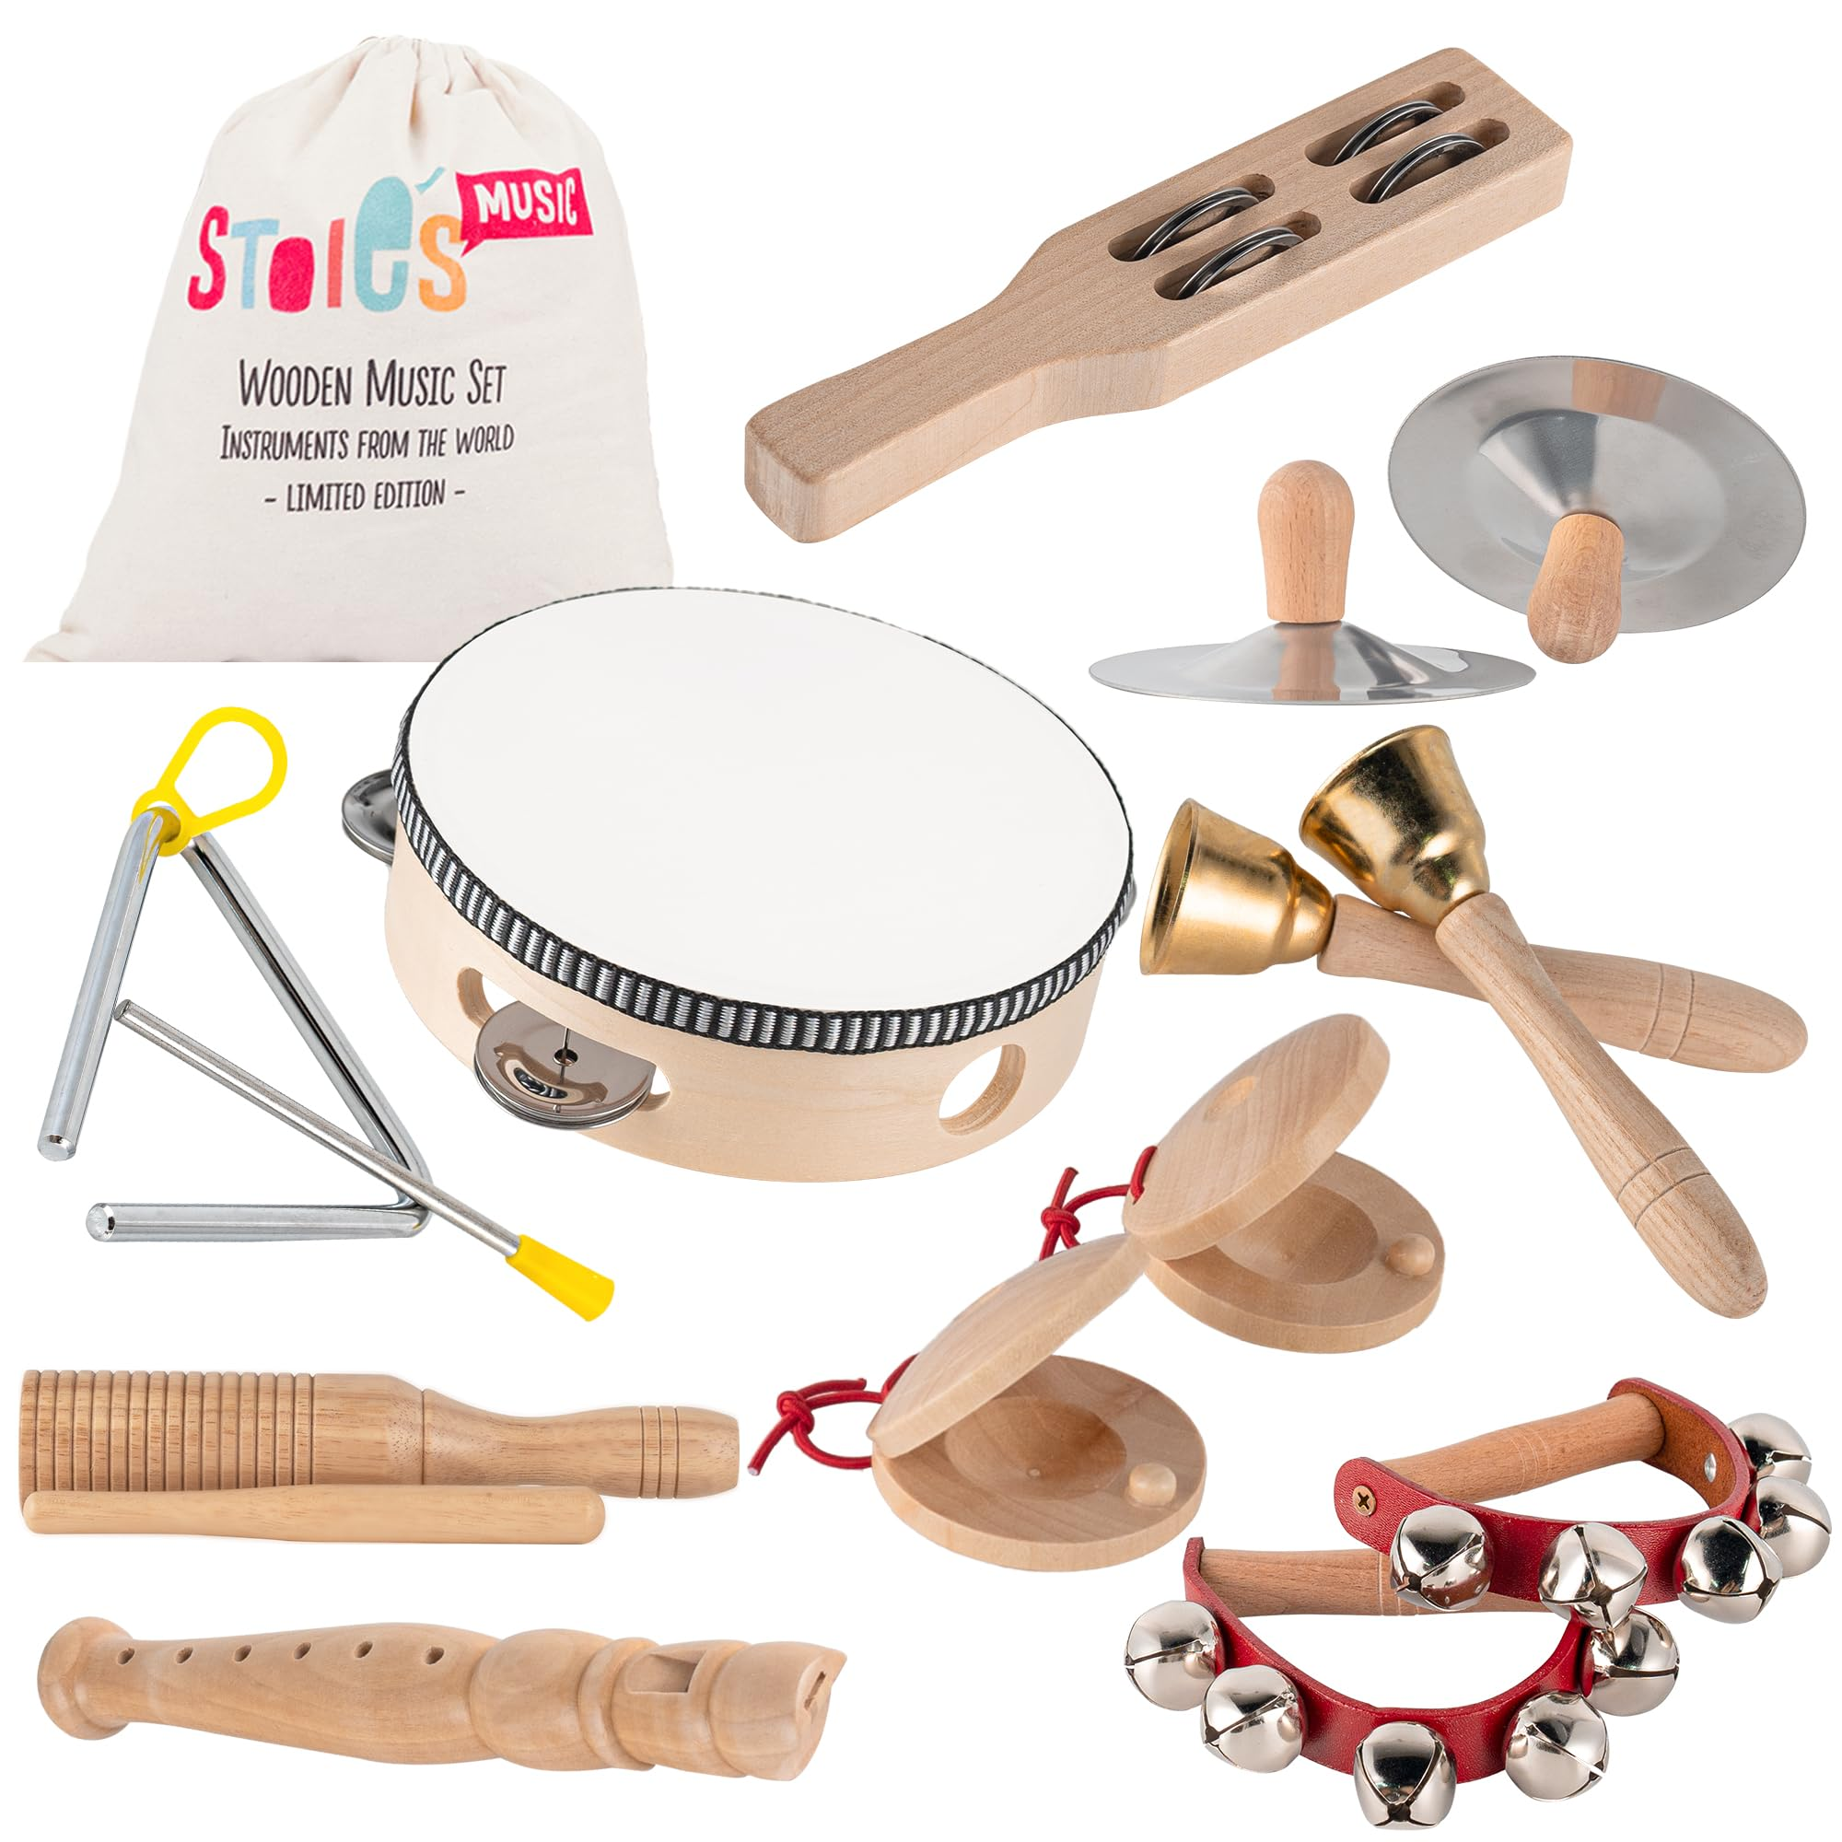
Butterfly, bumblebee and ladybird
Communication
Understanding of the world
Physical development
PSED
Geography
Gross Motor:
- Gives others space
- Use cutlery to eat food
Fine Motor Skills:
- Demonstrates control over pressure
- Snips with scissors
This half term children will be:
- To know how we change from birth to adult.
- To name body parts and know some ways in which our bodies change over time.
- To be aware of touch.
- To know how to deal with different types of touch.
Listening, attention and understanding:
- Expresses what they are doing and give a reason, using words, signs or symbols.
-Verbalises or shows feelings of anger, fear, happiness, love and sadness-
- Follows direction from a member of staff
Speaking:
-Asks a simple ‘why’ question
-Describe an object they have in their hand, giving more than one property
- Responds to an adult when offered a selection of motivating items.
Geography
- European Study focussing on the following countries: United Kingdom, Ireland, France, Italy, Spain, Netherlands and Greece.
Science
How humans stay healthy focusing on the following topics: fruit, vegetable, exercise, healthy mind, and wellbeing.
Expressive art and design
Art and Design
- Selects a colour to start painting a picture.
- Uses coloured paper to create a person.
Music
- Use their imagination in: music, dance and stories.
- Improvises a simple rhythm.
- Uses a widening range of musical instruments.
Click here to go back to the main page

