Slide 1
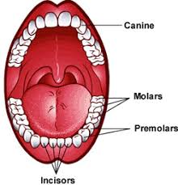
English
Computing
Science
Promotional video for Yorkshire
To design and create digital content
To present digital material
To edit a film
We are reading:
Animals - including humans
Identify the different types of teeth in humans and their simple functions.
Compare different types of teeth suggesting reasons for differences.
Describe the simple functions of the basic parts of the digestive system in humans.
Construct and interpret a variety of food chains.
Style of writing to be covered:
Letter writing
Narrative description
Persuasive
Grammar:
Choose nouns or pronouns appropriately for clarity and cohesion to avoid repetition.
Use brackets, dashes or commas to mark parenthesis with accuracy
Use fronted adverbials to begin a sentence with some accuracy.
Geography
Yorkshire
Where is Yorkshire?
What is Yorkshire’s cultural significance?
What are Yorkshire’s physical features?
What are Yorkshire’s human features?
Why should people travel to Yorkshire?
Maths
Area and perimeter
Perimeter in centimetres and millimetres.
Drawing 2-D shapes.
Perimeter in metres and centimetres
Perimeters of composite shapes in centimetres and millimetres.
Areas of rectangles
Area in square centimetres and meters.

Slide 2
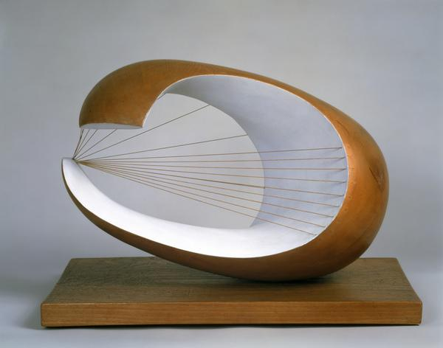
Physical Education (PE)
This term your PE will be on: Tuesdays
Fundamental Focus
Sport Specific Focus |  | Cricket
Whole child focus | PE award for: | Showing empathy
 | Learning about: | Empathising with others
Geography Fieldwork
Using an ordnance survey map to navigate the Olympic Park
Religious Education
What makes me the person I am?
-Understand how different people or factors shape our lives, using examples like St. Francis.
-Learn about the influences that shaped Pandurang Shastri Athavale's life and contributions.
-Discover personal interests and values within our community.
-Explore ways to contribute positively to our community and initiate small acts of improvement.
Curriculum Enrichment
PSHE
Music
Art
Changing relationships
To recognise situations which can cause
jealousy in relationships.
To know how most people feel when they lose someone or something they love.
To understand that we can remember people even if we no longer see them.
To recognise how friendships change, know how to make new friends and how to manage when I fall out with my friends.
To recognise that most children make choices.
To know how to show love and appreciation to the people and animals who are special to me.
Abstract sculpture
Focus on expressive and automatic drawing
Using charcoal, chalk and decoupage and sculpting in wire, clay and modroc.
Create abstract sculptures inspired by Barbara Hepworth and Henry Moore.
Play and perform in solo and ensemble contexts, using their voices and playing musical instruments
Improvise and compose music for a range of purposes listen with attention to detail and recall sounds with increasing aural memory
use and understand staff and other musical notations
Click here to go back to the main page

