Slide 1
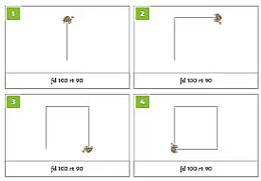
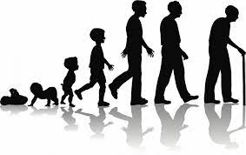
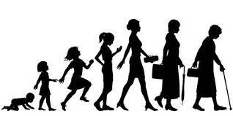
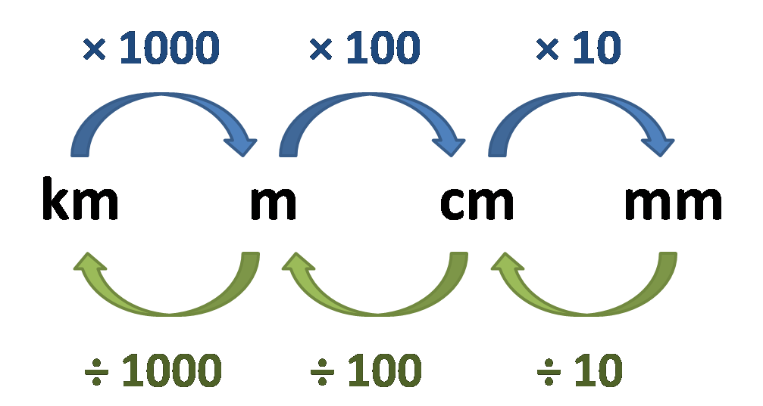
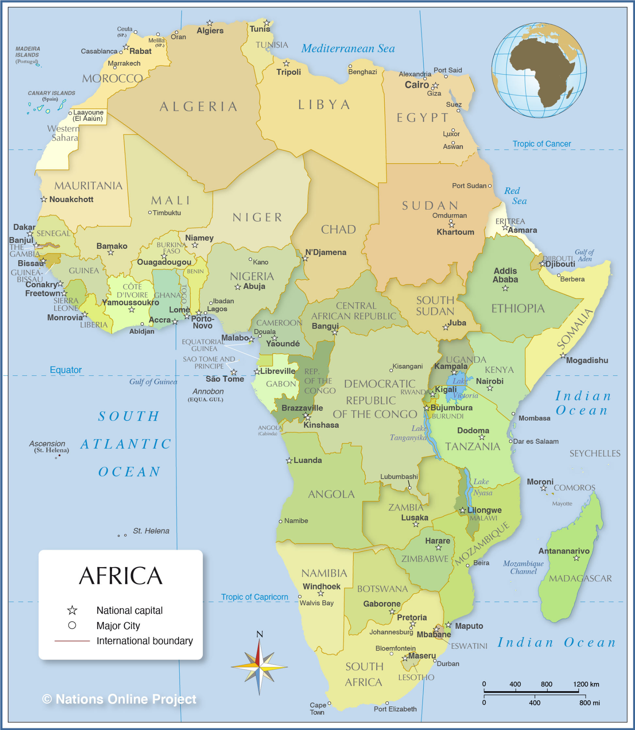
English
Computing
Science
Logo:Use repetition to create shapes
Create algorithms to draw letters and shapes in a computer program
Recognise that repetition and loops can be used to do a task more efficiently
Online safety: cyberbullying
We are reading:
Living things and their life cycles
How gestation differs in different animals
How humans develop and grow
What changes between birth and childhood
How the body changes as we grow older
Reading shared text:Journey to Jo’Burg
Styles of writing to be covered
Non-narrative: Explanation
Non-narrative: Recount
Non-narrative: Persuasion
Grammar
Developing the use of direct and indirect speech.
Using commas, brackets and dashes to separate clauses.
Geography
Africa
To recognise Africa’s role in the world
To describe physical geographical features of Africa
To identify human geographical features of Africa.
To analyse a source of geographical information
To explore the
diversity of Africa
Maths
Converting units
Units of time and length
Metric units of length
Conversion and perimeter
Converting miles and kilometers
Metric and imperial units of mass

Slide 2
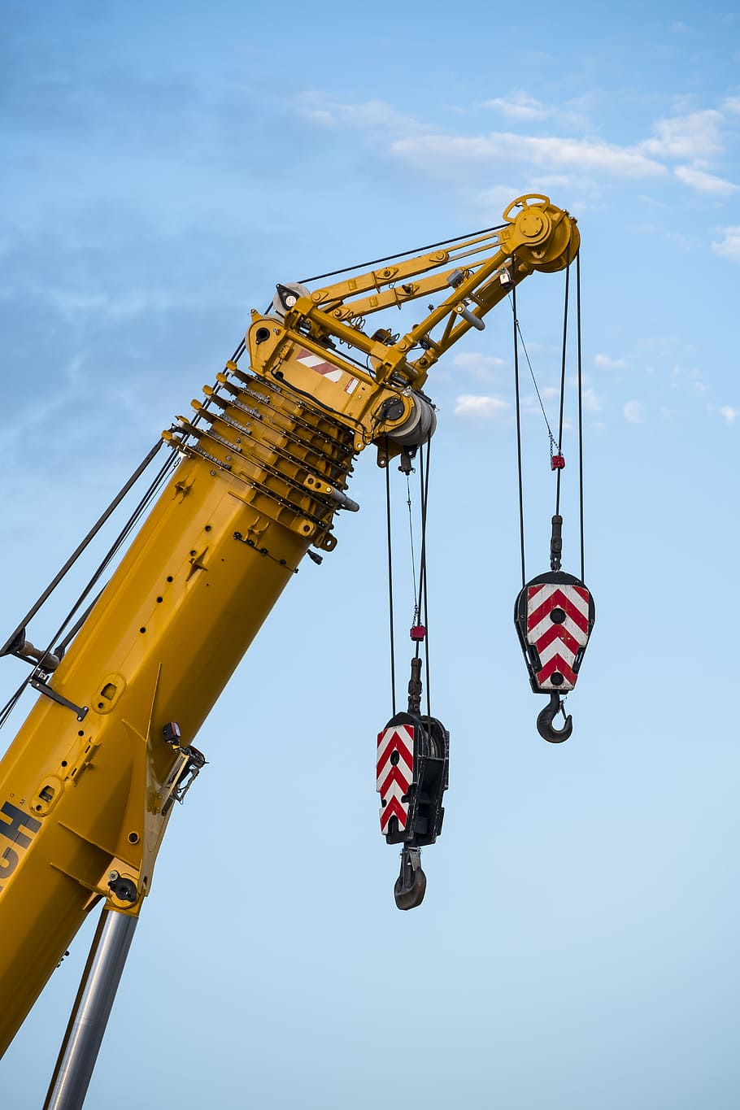
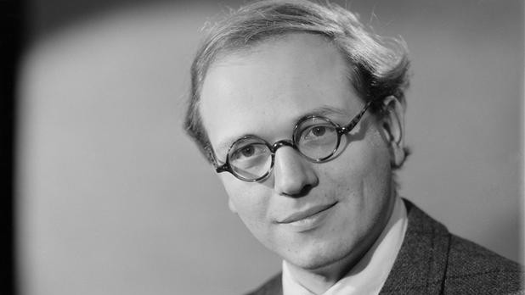
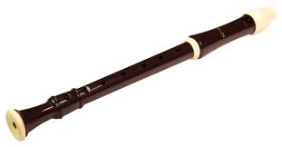
Gardening lesson this term!
Physical Education (PE)
This term your PE will be on: Thursday
Fundamental Focus
Sport Specific Focus |  | Tennis
Whole child focus | PE award for: | Labelling Other’s Emotions
 | Learning about: | Developing Emotional Vocabulary
Religious Education
Should all creatures be treated equally?
To consider if all animals are created equally
To consider if all animals have a case against humans
Muslim beliefs about the treatment of animals
Hindu beliefs about the treatment of animals
What can I do to improve the lives of animals?
Curriculum Enrichment
PSHE
Music
DT
We will be finishing off our abstract piece of music based on the composer Messiaen.
We will create number systems and use recorders to finish the themes in our piece.
My relationship with Money
Lesson 1: What makes a savvy consumer?
Lesson 2: What does it take to save money?
Lesson 3: Where should you keep your money?
Lesson 4: Do you really need this?
Lesson 5: Should you trust it?
Lesson 6: Think before you buy!
Lifting Devices
Analyse lifting mechanisms
Explore structures and mechanisms
Design a model lifting device
Construct a lifting device
Test and evaluate a design
Click here to go back to the main page

