Slide 1
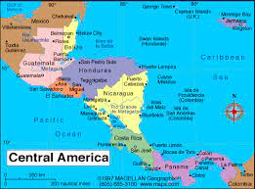
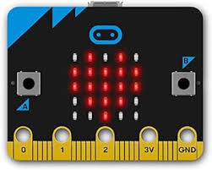
Year 6
English
Geography
Science
Central America
Where is Central America?
What are the physical features of Central America?
What are the human features of Central America?
How does the Panama Canal affect global trade?
Fieldwork: How can we map the landscape around a canal?
Styles of writing to be covered
Non-narrative: recount
Non-narrative: Newspaper report
Grammar
Be able to manipulate tense for effect.
Use rhetorical questions as a persuasive device.
Use the passive mood to change perspective or point of view.
Recognise vocabulary and structures that are appropriate for formal speech and writing, including subjunctive forms.
We are reading:
Living things and their habitats
Research animals and plants from a broad range of other habitats and decide where they belong in the classification system.
Describe how living things are classified into broad groups according to common observable characteristics and based on similarities and differences, including microorganisms, plants and animals.
Create an animal classification key.
Understand microorganisms and that although some make us ill, some are used deliberately.
Computing
Programming movements: Micro:bit
Understand how conditions are used in programs.
Use the ‘if...then...else…’ block
Plan a quiz using a storyboard
Design, write and debug programs that accomplish specific goals, including controlling or simulating physical systems; solve problems by decomposing them into smaller parts.
Use sequence, selection, and repetition in programs; work with variables and various forms of input and output.
Maths
SATs Revision
Addition, subtraction, multiplication and division
Converting between decimal, fraction and percentages
Fractions - equivalent fractions, adding and subtracting fractions with different denominators, multiplying and dividing fractions
Money problems
Measure problems
Perimeter problems
Angles and shape

Slide 2
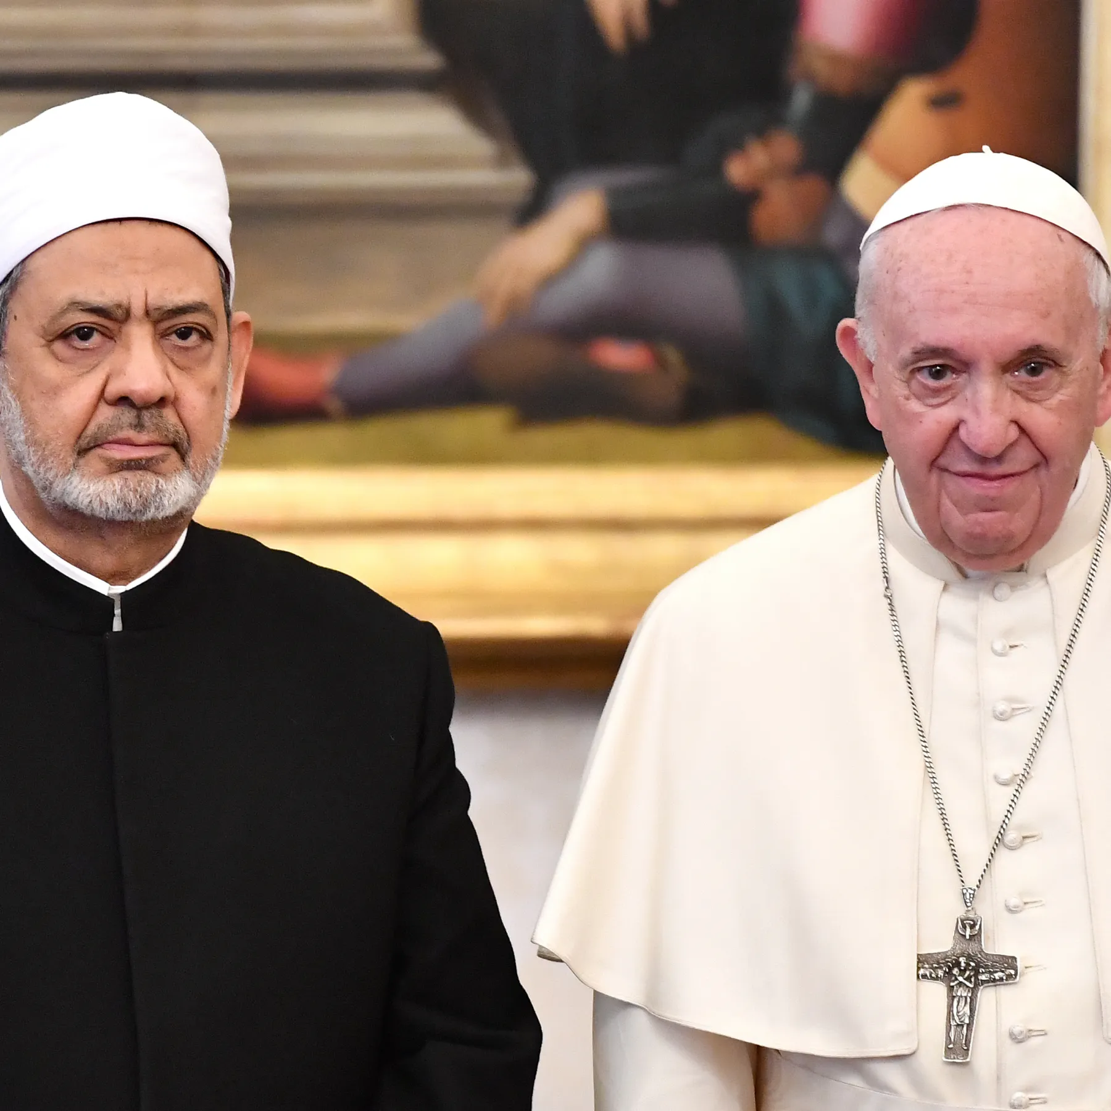
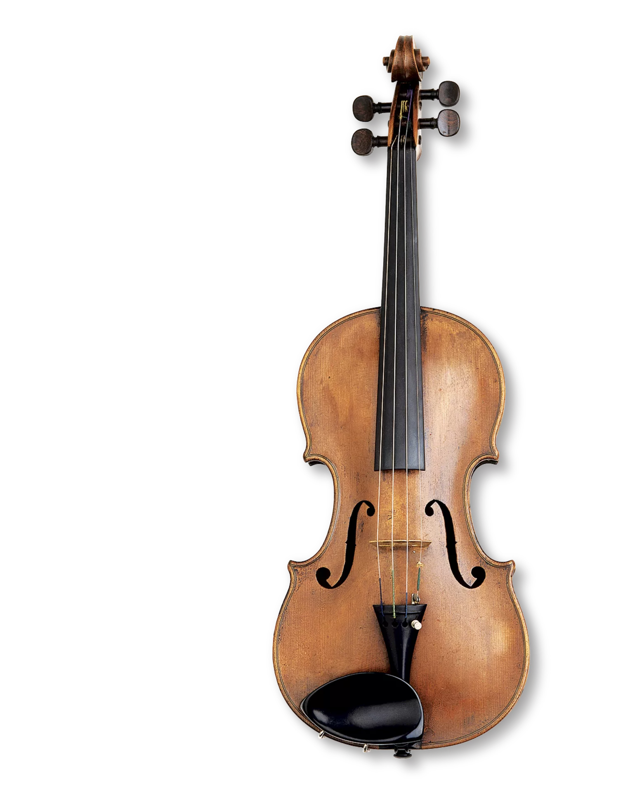
Geography Fieldwork - mapping a location by a canal.
Physical Education (PE)
This term your PE will be on: Wednesdays
Fundamental Focus
Sport Specific Focus |  | Rounders/Baseball
Whole child focus | PE award for: | Manage emotional wellbeing
 | Learning about: | Managing emotions under pressure
Religious Education
Explore the role of leaders and why they are important in communities and organisations.
Identify the qualities and characteristics that make someone an effective leader.
Learn about an important religious leader in the Newham community and their contributions.
Discover significant religious leaders from around the world and their impact on
their respective faiths.
Curriculum Enrichment
Music
In PSHE year 6 will be learning about relationships and healthy lifestyles:
Taking responsibility for their health
Making choices that will benefit their health well-being
Thinking about decisions that may put them in a vulnerable position.
Understand mental health and what it means to be emotionally well.
ART
The children will continue learning the violin, learning:
-how to play scales
-how to play in an ensemble
-how to play rhythms
PSHE
Year 6 will be learning about Aztec sculpture including ceramics, stone carvings and the Aztec Sun Stone. They will consider how ceramic artist Grayson Perry takes influence from ancient civilizations. They will also explore Rachel Whiteread’s plaster sculptures and develop designs and ideas using plaster and clay.
Click here to go back to the main page

