Slide 1
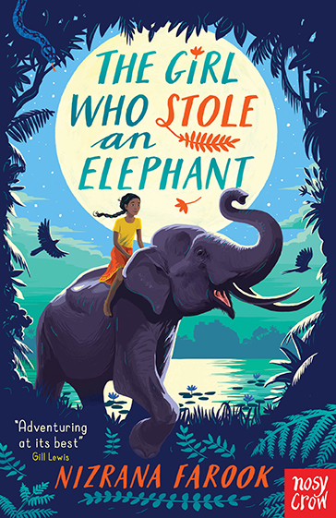
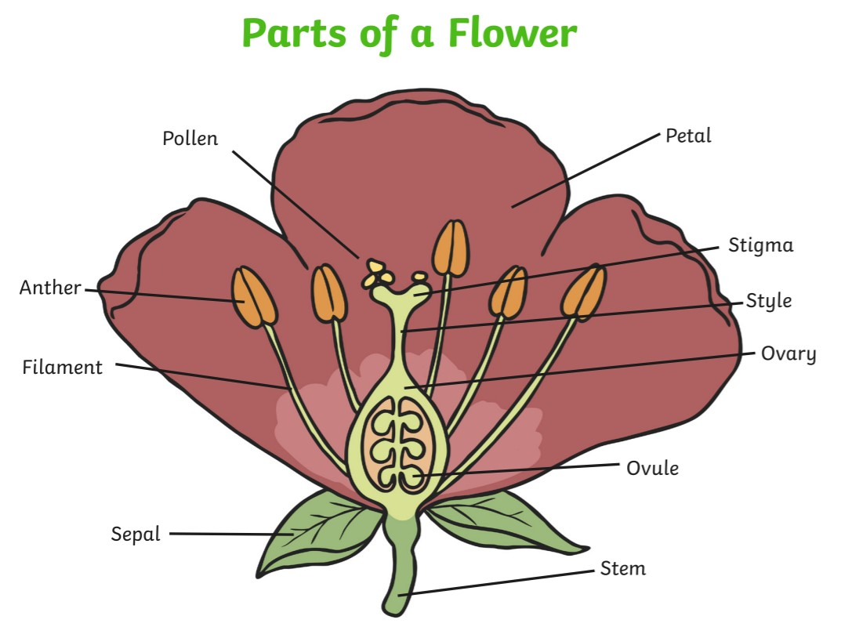
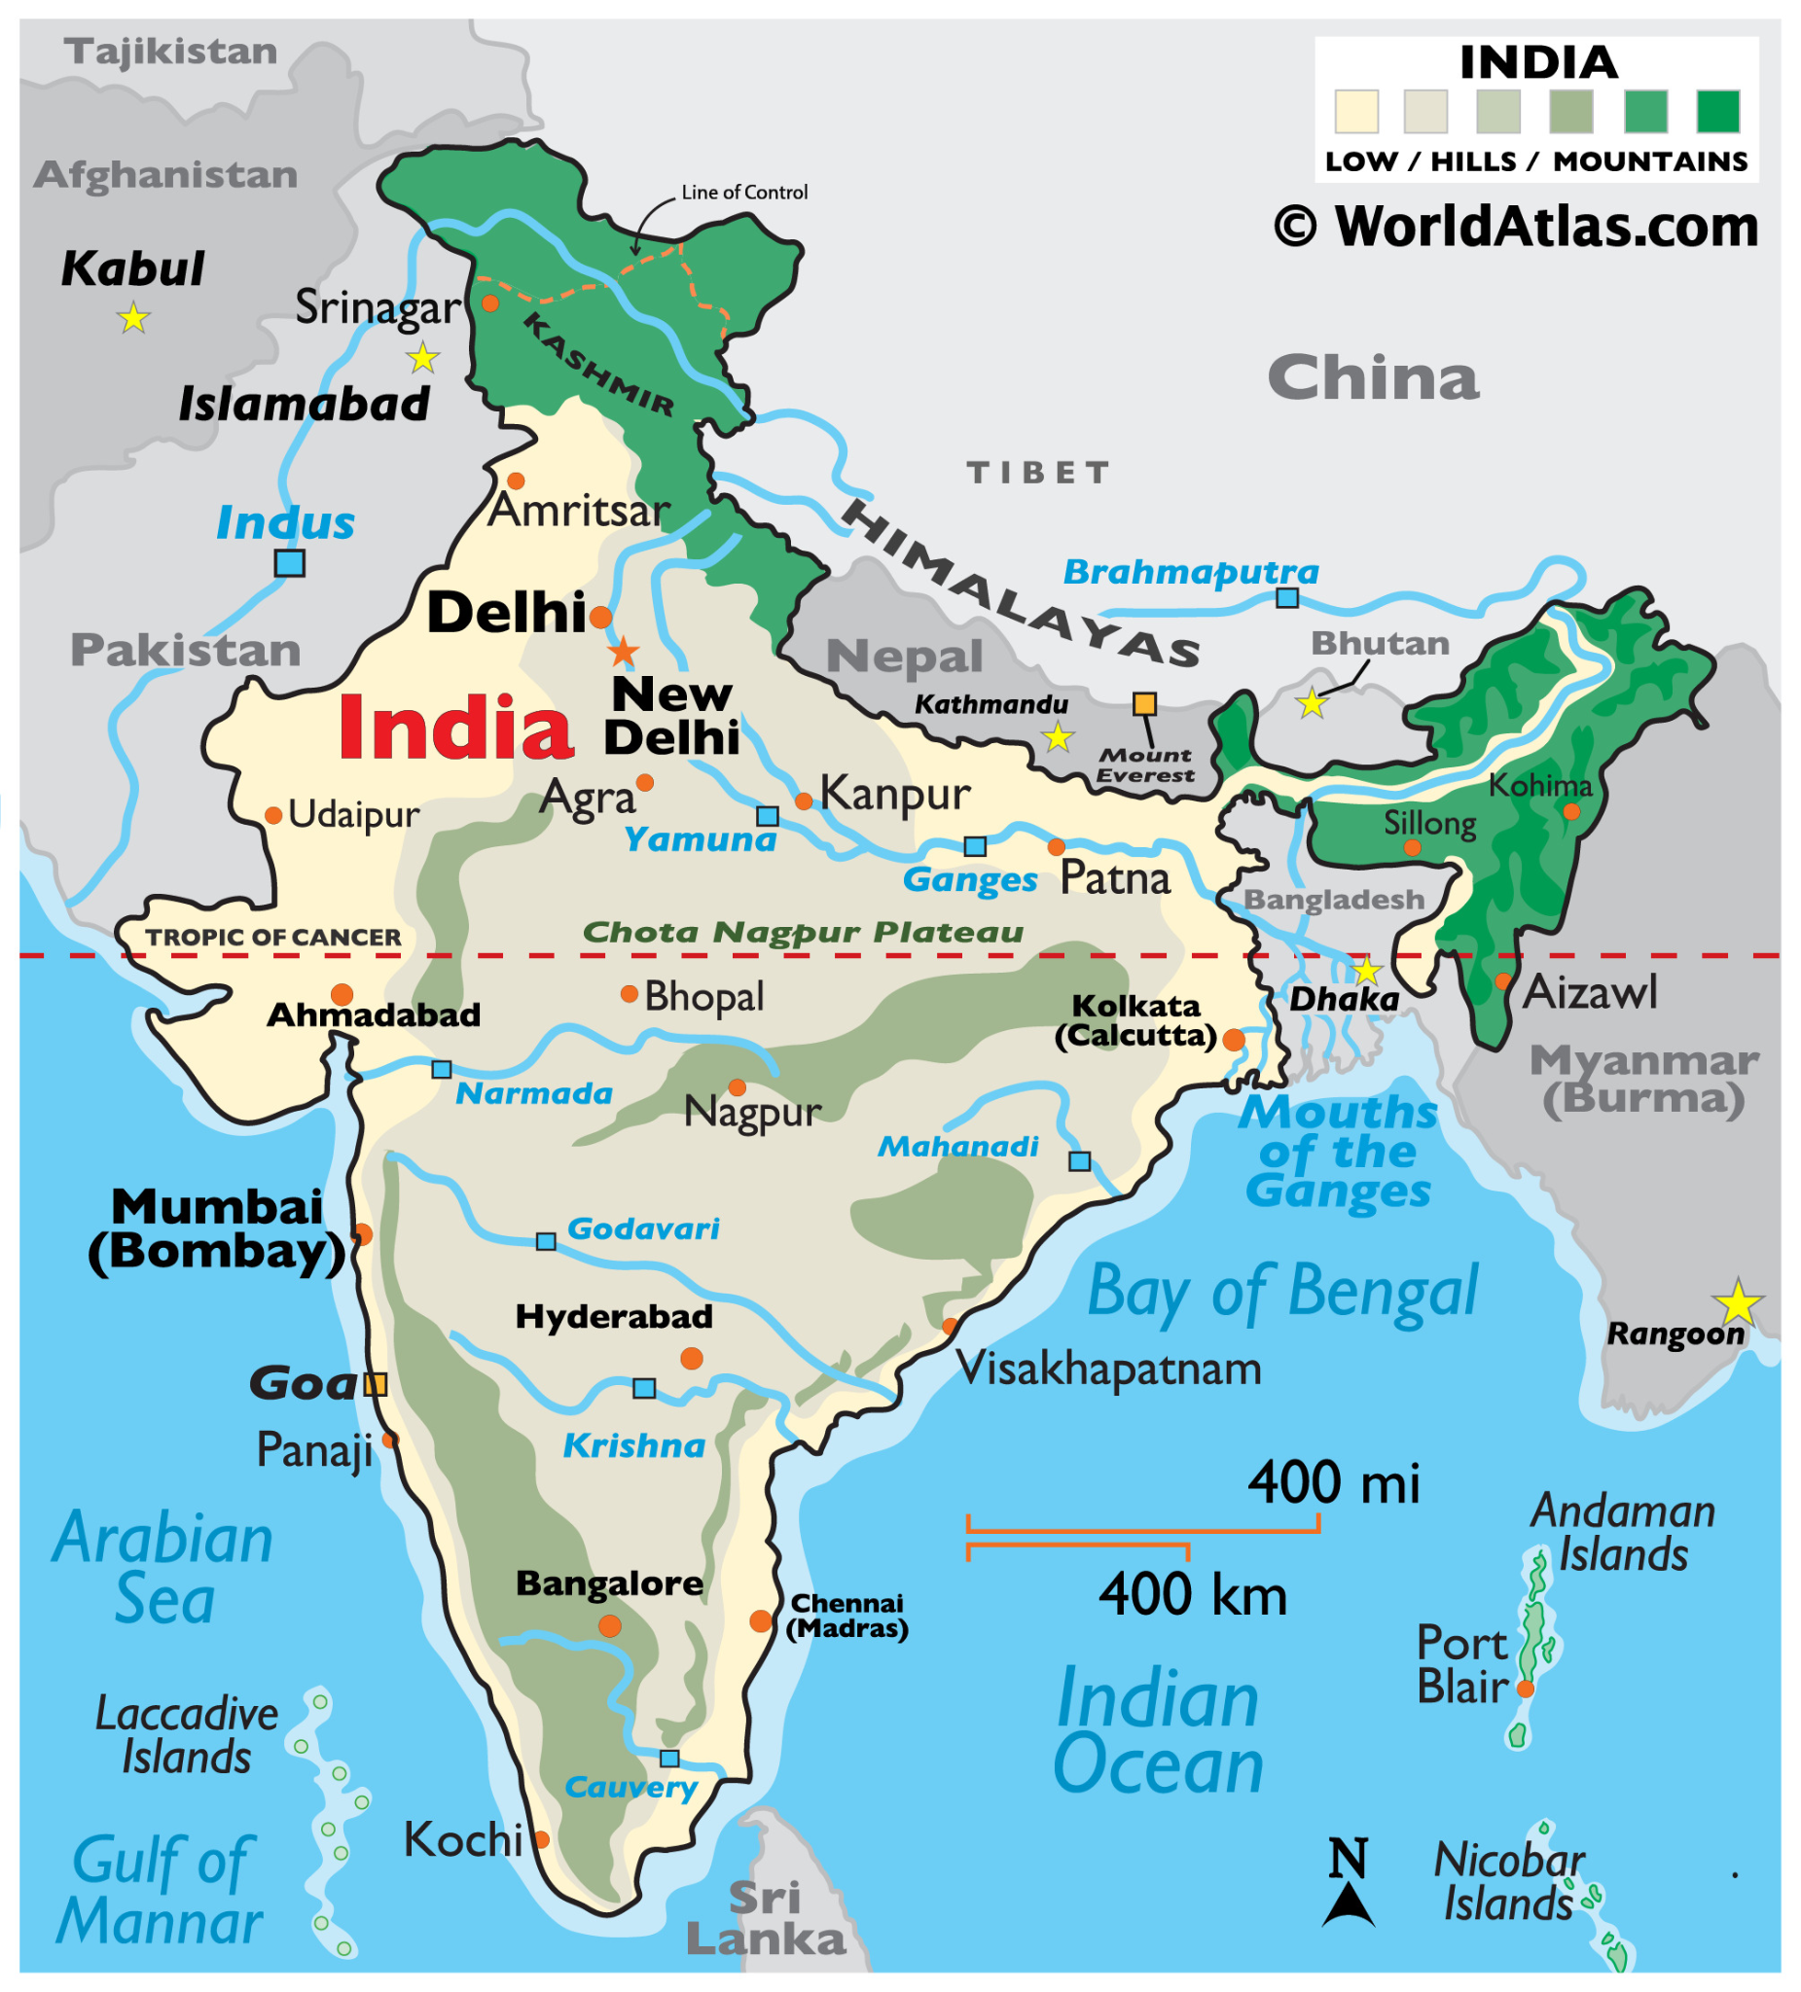
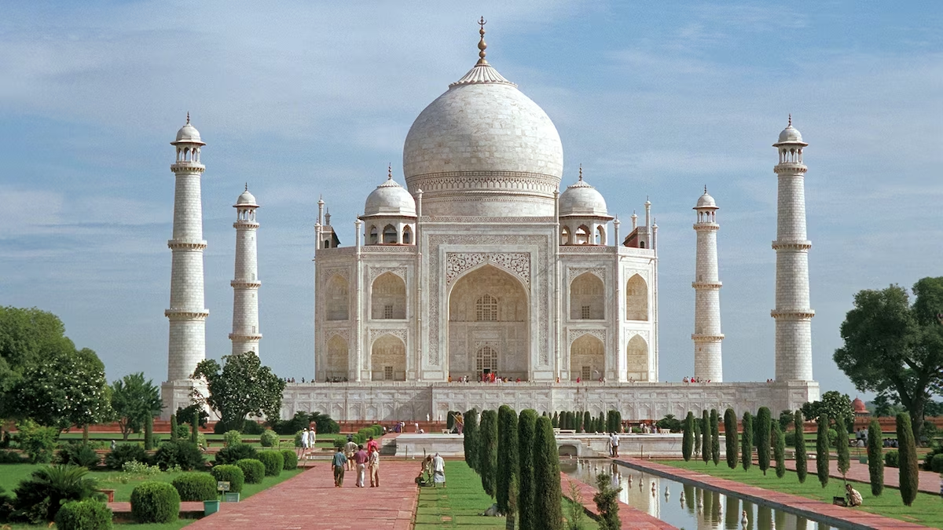
English
Computing
Science
News Report
Online Safety: Age restrictions on games
News Report (continued)
How do I record a video?
How do I write a script?
How to perform in a video
How to edit a video
We are reading:
Writing
Setting description
Recount
Persuasive letter
Grammar
Commas for embedded clauses
Relative pronouns and clauses
Subordinate clauses
Biology - Plants
The function of different parts of a plant.
How plants transport water and nutrients.
Observe a flower garden.
Role of the flower in a plant.
How plants are cross-pollinated.
Geography
India
Where is India?
Which city is India’s capital?
What are India’s physical features?
What are some of New Delhi’s physical features?
What is the weather like in New Delhi?
Maths
Fractions
Unit and non-unit fractions of shapes and quantities
Equivalent fractions
Adding and subtracting fractions
Geometry and angle
Acute and obtuse angles
Measuring angles
Regular and irregular polygons
Lines of symmetry

Slide 2
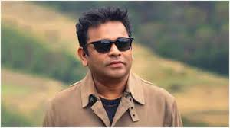
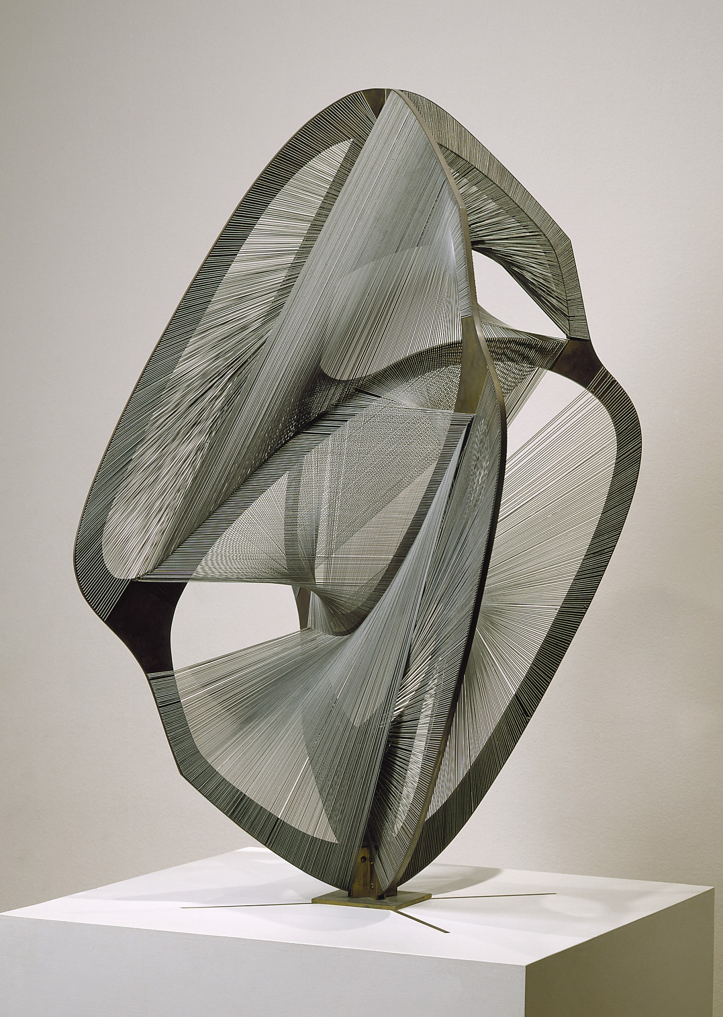
Gardening Workshop - Enterprise pop up sale.
Trip to West Ham Park linked to our Science topic.
Physical Education (PE)
This term your PE will be on: Thursday
Fundamental Focus
Sport Specific Focus |  | Tennis
Whole child focus | PE award for: | Labelling Other’s Emotions
 | Learning about: | Developing Emotional Vocabulary
Religious Education
What can we learn about special symbols and signs used in religions?
Learn the meanings behind common signs and symbols
Explore the symbolic meanings embedded in artefacts from Muslim culture.
Discover how art and symbols are used in Muslim places of worship and religious practices.
Identify the symbols present in stories from the Christian faith.
Understand the importance of the cross to Christian believers.
Learn how to craft Christian art pieces that hold personal and spiritual significance.
Curriculum Enrichment
Music
PSHE
Art
We continue listening to a wide range of music. This half term, we will be listening to famous Indian composer A. R. Rahman
We will also continue learning the ukulele. We will be strumming chords and trying out different strumming patterns.
Relationships
- To identify the roles and responsibilities of each member of my family.
- To identify and put into practice some of the skills of friendship.
- To know and use some strategies for keeping myself safe online.
- How some of the actions and work of people around the world help and influence my life.
- To understand how my needs and rights are shared by children around the world.
-To know how to express my appreciation to my friends and family.
Sculpting Abstract Forms
Analyse an artwork - Naum Gabo and Anish Kapoor
Draw abstract curves
Sculpt organic forms
Create and abstract sculpture
Decorate a sculpture
Click here to go back to the main page

