Slide 1
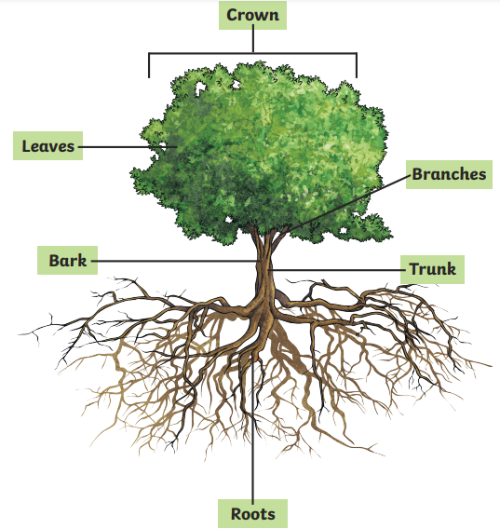
Year 1
English
Geography
Science
Hot and cold places
Where are the Earth’s poles and equator?
What are the features of the Arctic region?
How are the Arctic and Sahara similar and different?
How do we adapt to hot and cold places?
Styles of writing to be covered
Non-narrative explanation letter
Narrative description
Non-narrative recount
Non-narrative: Non-chronological report
Grammar
To begin to use the conjunction ‘and’ and ‘but’ to join ideas.
To use full stops and capitals more accurately and consistently.
Adjectives are used to describe and add detail to nouns.
We are reading:
-Mariama- different but the same
-Where the Wild Things are
-Conker the Chameleon
-Little Polar Bear: Where are you going Lars?
Plants (A)
How the weather changes
Understand seasonal weather
Understand the basic structure of a tree
Understand there are different types of trees
Explore the local environment
Computing
Programming animations
To become familiar with and explore ScratchJr
To begin to create simple programs by following algorithms
Learners will begin to amend and change a code to observe its impact
Create their own programs
that reflect a specified topic
Addition and subtraction
•Explore addition and subtraction involving
2- digit numbers and ones.
•Represent and explain addition and subtraction with regrouping.
•Investigate number bonds within 20.
Money
•Name coins and notes and understand their value.
•Represent the same value using different coins.
•Find change.
Maths

Slide 2
Trip to West Ham Park to explore the local area and the trees within it.
Trip to the Young V&A to develop our knowledge of ancient toys
Physical Education (PE)
This term your PE will be on: Tuesday
Fundamental Focus
Sport Specific Focus |  | Games - Net
Whole child focus | PE award for: | Relating to Emotions
 | Learning about: | Describing Types of Emotions
Religious Education
What does it mean to belong to Hinduism?
-Understand the importance of belonging in navigating life's challenges and experiences.
-Learn about the concept of karma and its impact on actions and consequences.
-Discover the significance of Brahman in Hinduism.
-Explore the life and teachings of Krishna.
-Discover how the practice of puja aids Hindus in leading a virtuous life.
-Understand the symbolism and significance of the Aum symbol in Hinduism.
Curriculum Enrichment
Music
Relationships
To identify the members of my family and understand that there are lots of different types of families.
To identify what being a good friend means to me.
To know appropriate ways of physical contact to greet my friends and know which ways I prefer.
To know who can help me in my school community.
To recognise my qualities as a person and a friend.
To tell you why I appreciate someone who is
special to me.
ART
Pitch
Exploring sounds in the environment
Singing in high and low voices
Adding instruments to storytelling
Writing down our music
Performing our music
PSHE
Sculpting the human figure
Analyse an artwork
Explore shadows
Draw elongated figures
Create a figure sculpture
Draw from a sculpture

Slide 3
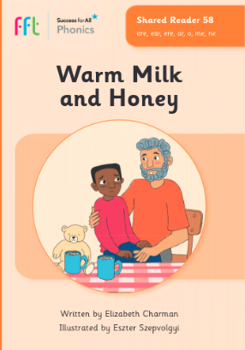
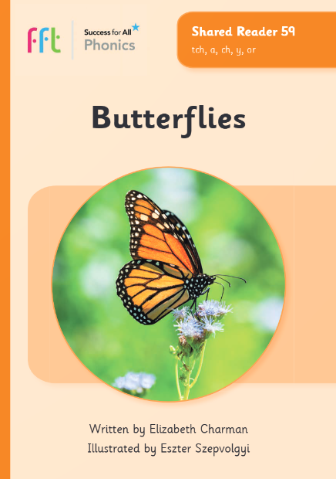
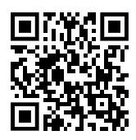
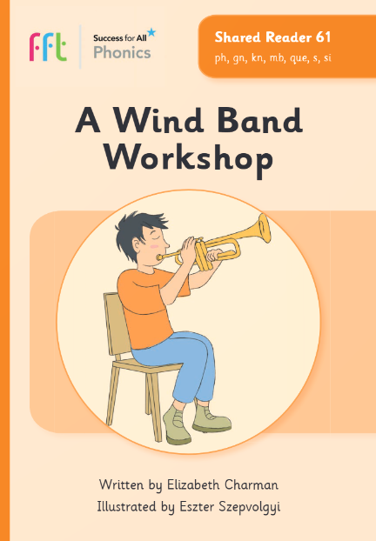
Phonics and reading to practise at home with your Year 1 child
Summer 1
Phonics GPCs
Red words
Reading books
are (care)
tch (watch)
oe (toe)
ph (phone)
people
again
their
through
climb
any
great
Click here or scan the QR code to see how to pronounce these GPCs.
deer heard
nightmare honey months
stretch itchy
Can your child apply their phonics to decode and read these words?
Watch out for your weekly phonics email with a link to our phonics books.

Slide 4
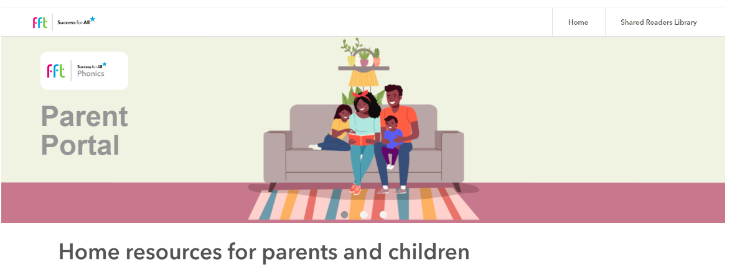
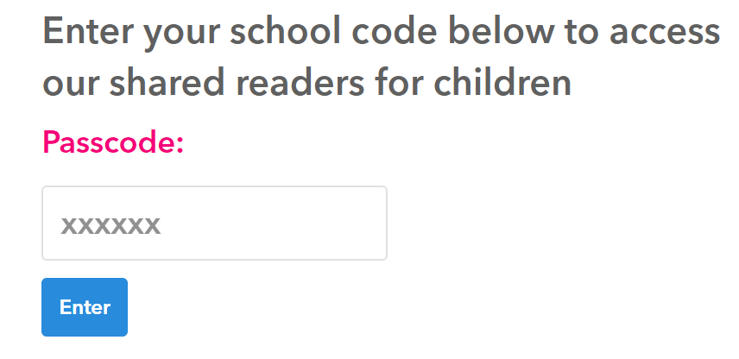
FFT Parent Portal
Access to Daily Readers and useful phonics videos.
Go to: https://parents.fft.org.uk/
Type in school code: z1f42n
Click here to go back to the main page

