Slide 1
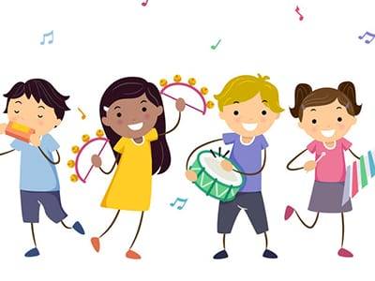
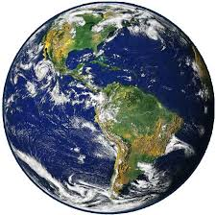
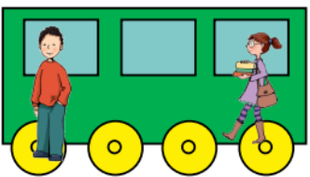
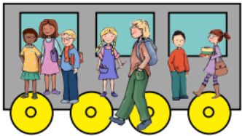
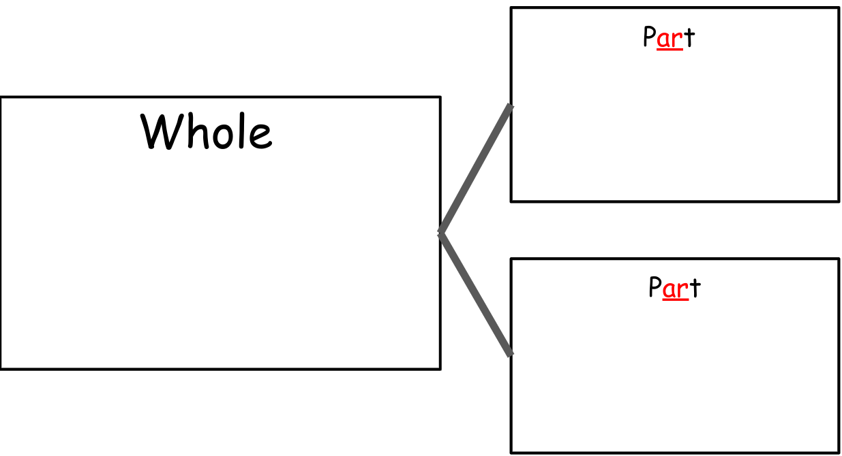
Reception’s
English
Physical development
-Further develop and refine a range of ball skills including: throwing, catching, kicking, passing, batting, and aiming.
-Develop confidence, competence, precision and accuracy when engaging in activities that involve a ball.
-Target games
We will read a variety of books with a focus on of space, including Beegu, When I Grow Up, Field Trip to the Moon and Toys in Space.
The texts will help us write descriptions, posters, instructions and explanation texts.
We will continue to segment and blend Phase 2 & 3 sounds.
We will teach children Phase 4 blends.
We will be focusing on finger spaces and capital letters in writing.
Expressive Arts and Design
We are reading:
Over the course of the half term we will learn about::
Being Imaginative:
play cooperatively as part of a group to act out a story.
initiate movements and gestures to express and respond to feelings, ideas and experiences.
Exploring and Using Media and Materials:
select appropriate resources and adapt work if needed.
use simple tools and techniques appropriately.
Create musical stories using appropriate instruments
Understanding the world
We will explore the world around us by:
People & Communities:
sharing our family customs and routines. ;
The World:
talking about our world (Planet Earth), learning why astronauts go into Space and what other might encounter….
Personal Social and Emotional Development
Maths
In our maths lessons this half term we will explore:
•Comparing two amounts
•Addition and subtraction facts
•Numbers to 20
This half term the topic is Relationships. The children will learn:
about different friendships
How to have healthy relationships with friends and within families
How to regulate our own emotions

Slide 2
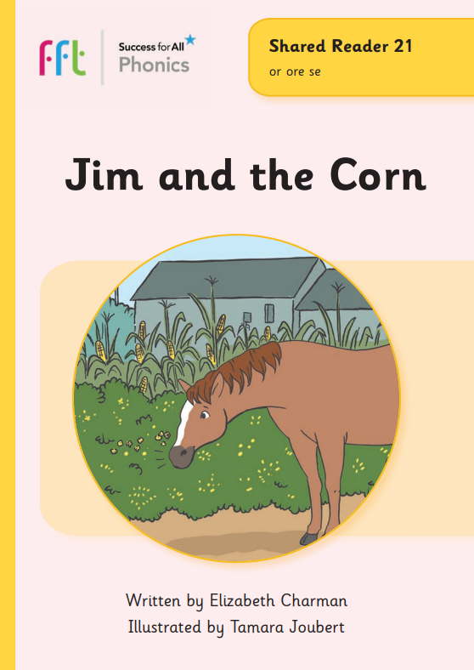
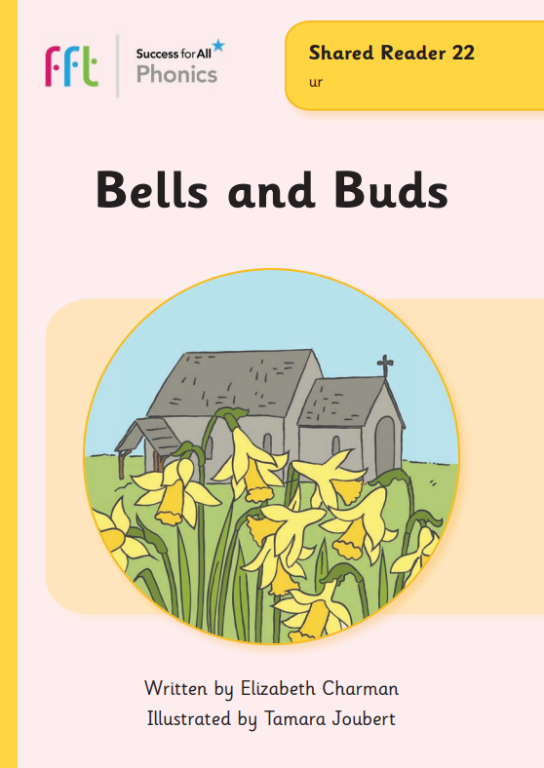
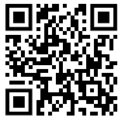
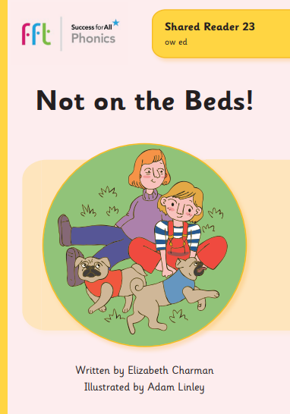
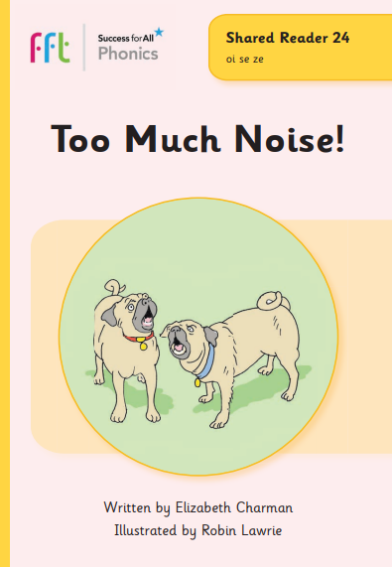
Phonics and reading to practise at home with your Reception child
Summer 1
Phonics GPCs
Red words
Reading books
or (corn)
ur (purple)
ow (cow)
oi (boil)
ear (clear)
here where today
when what come
some push pull
friend school
Click here or scan the QR code to see how to pronounce these phonemes.
Green words
Can your child apply their phonics to decode and read these words?
curl burn short for horse allowed noise soil fear
Watch out for your weekly phonics email with a link to our phonics books.

Slide 3
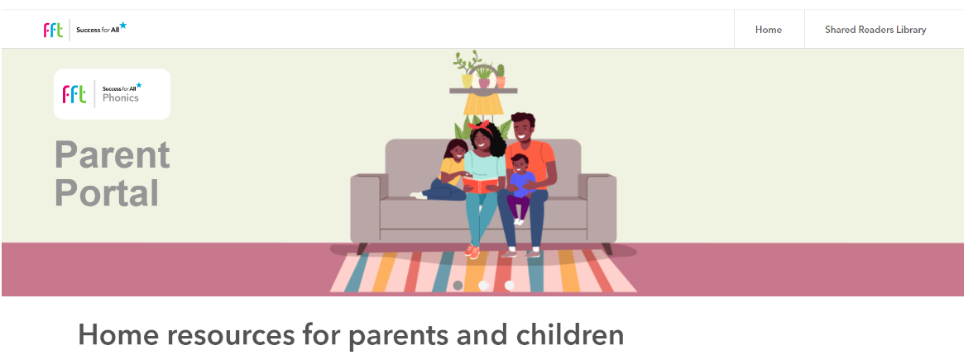
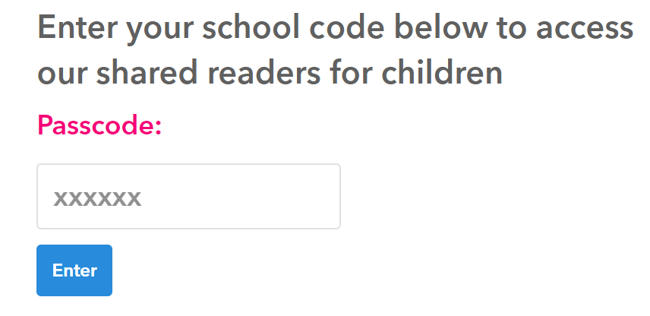
FFT Parent Portal
Access to Daily Readers and useful phonics videos.
Go to: https://parents.fft.org.uk/
Type in school code: z1f42n
Click here to go back to the main page

