Slide 1
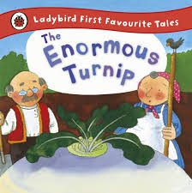
Butterfly, bumblebee and ladybird
Maths
Reading and Writing
We are reading:
Butterfly
This term Butterfly are producing a variety of different writing genres inspired by the books we are reading including a warning poster about an enormous turnip, a setting description and adverbs to indicate time. They will be developing their grammar skills; with a particular focus on consolidating capital letters and full stops.
Butterfly
As part of their basic maths skills, Butterfly will be learning about money and applying this to real life.
They will be recognising coins and notes and relating this to the value of money. They will also be comparing money and using basic maths skills to problem solve.
Bumblebee
This term Bumblebee will be exploring their stories through forms of role play and practical activities, they will be encouraged to enjoy a story independently. In writing they will develop their sentence structure using Colourful Semantics and begin to extend their sentences.
Bumblebee
As part of their basic maths skills, Bumblebee will be continuing to develop their understanding of measuring volume and capacity. They will be consolidating their understanding of fractions (half) and learning about quarters through a mixture of practical activities and formal learning. They will also be consolidating their understanding of number (1-50) and developing their knowledge of 50-100 and beyond.
Ladybird
This term Ladybird class will be exploring their stories through multi sensory resources, they will be looking at illustrations in the books and linking them to the colourful semantic keywords. In writing the Ladybirds will focus on their fine motor skills through practical and strengthening their grip through practical activities, they will have access to numerous writing tools.
Ladybird
In Ladybird, children will be focusing on developing their understanding of number in sequence. Children will be learning this through various number rhymes. For example, ‘One, Two, Three, Four, five once I caught a fish alive ’. They will also be introduced every day patterns around them and encouraged create their own simple patterns using colour and the sequencing toys

Slide 2
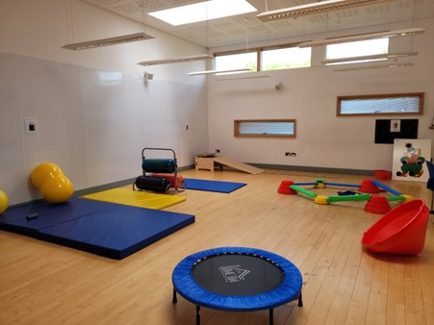
Butterfly, bumblebee and ladybird
Communication
Understanding of the world
Physical development
PSED
Geography
Topic: Hot and Cold Places
- Looking at the Earth’s poles and equator.
- Researching Sahara and Arctic.
- How we adapt to hot and cold places.
Science
Topic: Biology and Plants
- Looking at how plants grow.
- Exploring seeds.
Computing
Topic: Digital Music
- Exploring Chrome Music Lab
All the children will be participating in bespoke sensory circuits.
Building relationships
- Communicates what or who is special to them.
- Explain why something or someone is special to them.
- Demonstrates an awareness that not everyone feels like they do.
Managing self
-Accepts that others may join their activity.
- Accepts they may not be able to join an activity.
- Takes turns in a structures group discussion.
Self-regulation
- Makes requests to a member of staff
- Has a developing awareness of their own needs
Listening, attention and understanding:
-Communicates with appropriate intonation
- Listens as part of a group for short periods
-Listens in self-led discussions.
Speaking:
- Communicate in a manner that can be understood by a unfamiliar person.
- Express likes and dislikes.
- Express likes and dislikes giving simple reasons.
Expressive art and design
Art and Design
Explore, use and refine a variety of artistic effects to express their ideas and feelings. They will create work from their imagination and experiment to create visual effects that is also linked to their computing learning.
- Recognises and explores how sounds can be changed.
- Chooses an instrument which creates a specified sound.
- Communicates about how the music makes them feel.
Music
Click here to go back to the main page

