Slide 1
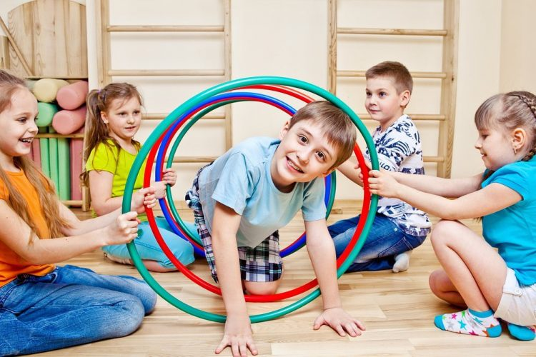
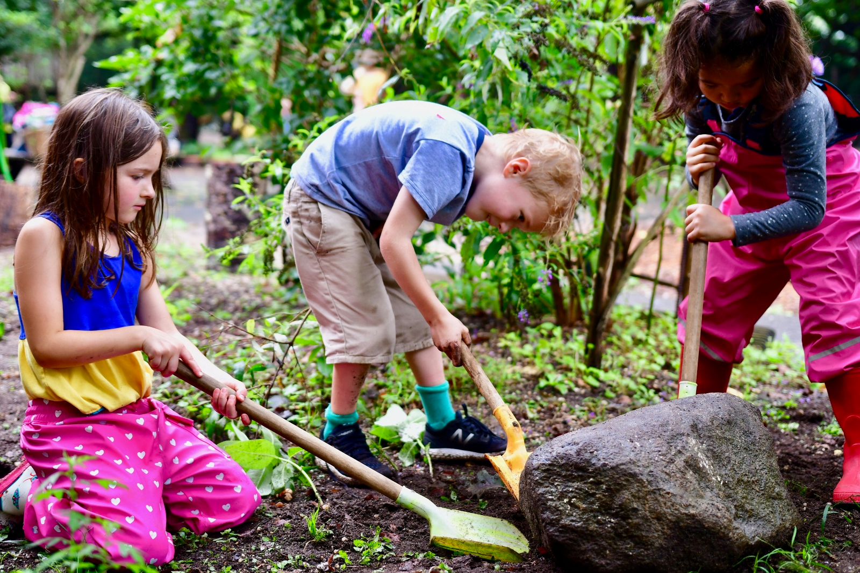
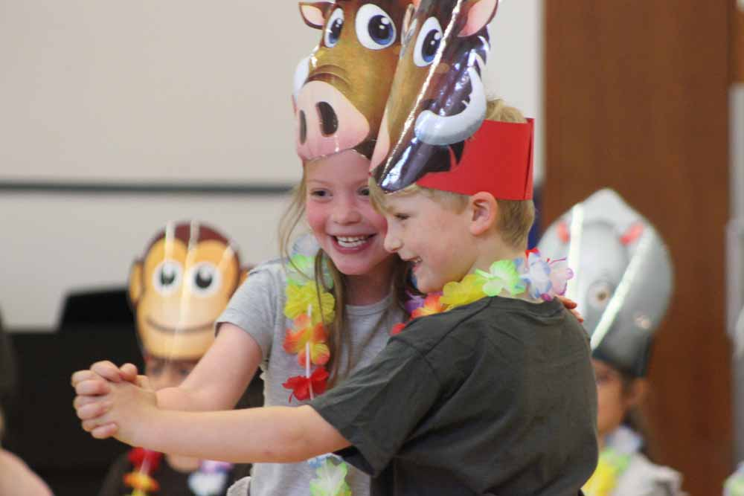
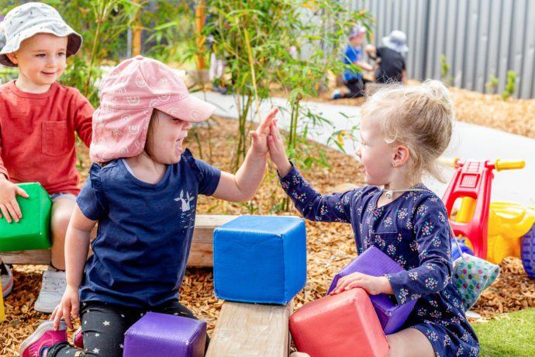
Nursery
We are reading:
Physical development
Understanding of the world
PSED
Literacy, communication and language
In free play we will:
Move in a variety of ways such as jumping, crawling and hopping.
Throw, catch and kick balls of different sizes.
Run with the ability to negotiate space, changing speed and direction.
Use a comfortable grip with good control when holding pens and pencils
We will explore the world around us by:
Finding out about what makes us the same and different to others.
Observing changes such as the changes in the weather and the appearance of trees and plants.
Talking about why things happen and how things work.
Looking at transport old and new
In gardening we will:
plant seeds and bulbs so children observe growth and decay over time
Through a range of different activities, children will learn to:
Share toys and equipment with each other
Involve other children in their play activities and games.
Start taking part in some group activities which they make up for themselves, or in teams.
Run with the ability to negotiate space, changing speed and direction.
Increasingly follow rules, understanding why they are important.
By reading fantasy and adventure texts we will learn to:
Listen to and retell stories
Ask and answer a range of questions about a story.
Write some recognisable letters and words.
Write a range of text types including letters, invitations and posters.
Expressive art and design
Explore different materials freely, to develop their ideas about how to use them and what to make.
Begin to develop complex stories using small world.
In Music Lessons, we will
Remember and sing entire songs.
Play instruments with increasing control to express their feelings and ideas.
Explore how we can change sounds when we use instruments.
Through games and activities we will:
Say one number for each item in order: 1,2,3,4,5 to 10
Use positional language (on , under, next to, on top.
Link numerals and amounts: for example, showing the right number of objects to match the numeral, up to 10
Talk about and explore 2D and 3D shapes
Compare quantities, which has more/less/same
Looking at measurements
Mathematics
Click here to go back to the main page

