Slide 1
English
Computing
Science
What is IT?
IT in school
IT in the world
The benefits of IT
Using IT in different ways
We are reading:
Year Two will be learning all about plants. Some of the aspects their learning will cover are:
Identifying parts of a plant
Explaining what plants need to stay healthy
Investigating the school garden
Investigating a plant seed
Observations of different plants (e.g. observational drawings and accurate labelling
Plant germination, growth and survival
This term the children will be writing a description and a recount.
Grammar:
-Commas in lists used accurately
-Begin to use apostrophes to show contractions
-Begin to use inverted commas to punctuate direct speech
Geography
In Geography, children will be learning about China and by the end of the topic, hosting an Chinese exhibition. They will be using maps to locate continents, seas and China on a map. They will describe the human and physical features of China.
To identify physical and human features of different countries
Identify seasonal and daily weather patterns in China
To describe aspects of Chinese life
Maths
Numbers within 1000
Capacity & volume
Mass
Exploring calculation strategies
Exploring multiplicative thinking

Slide 2
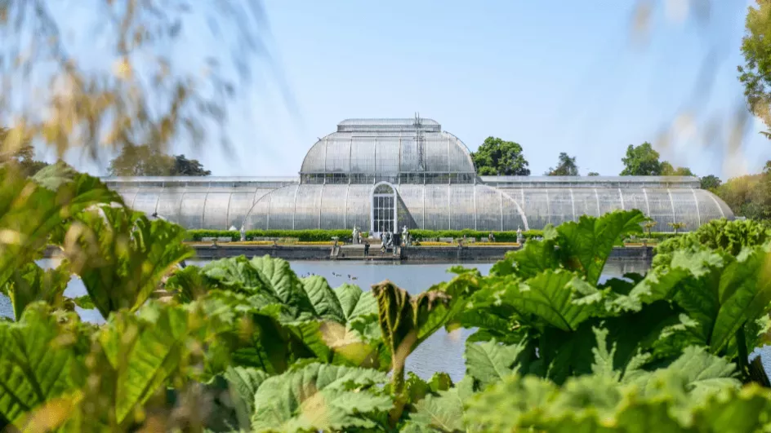
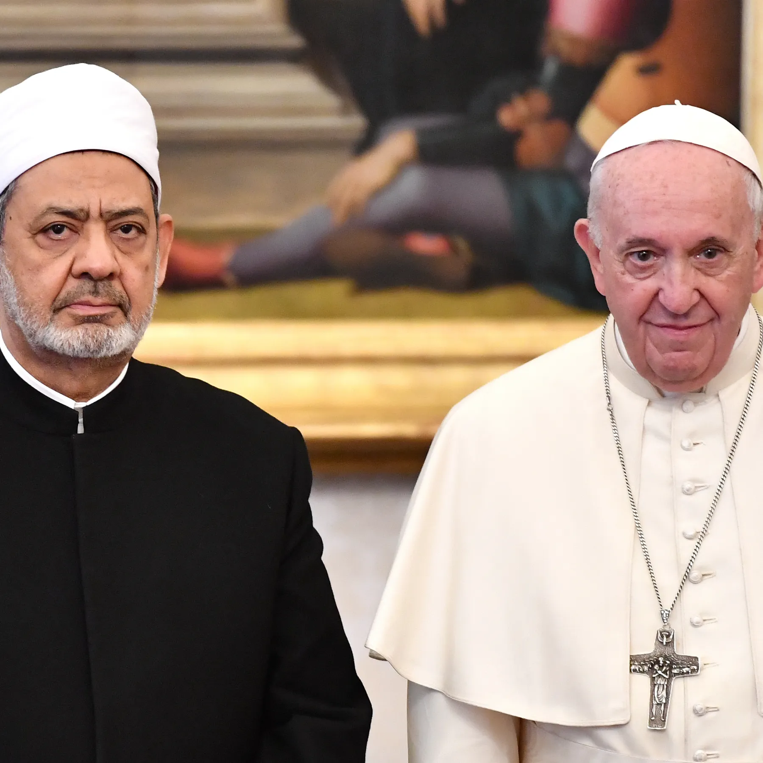
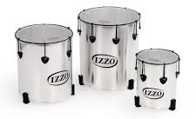
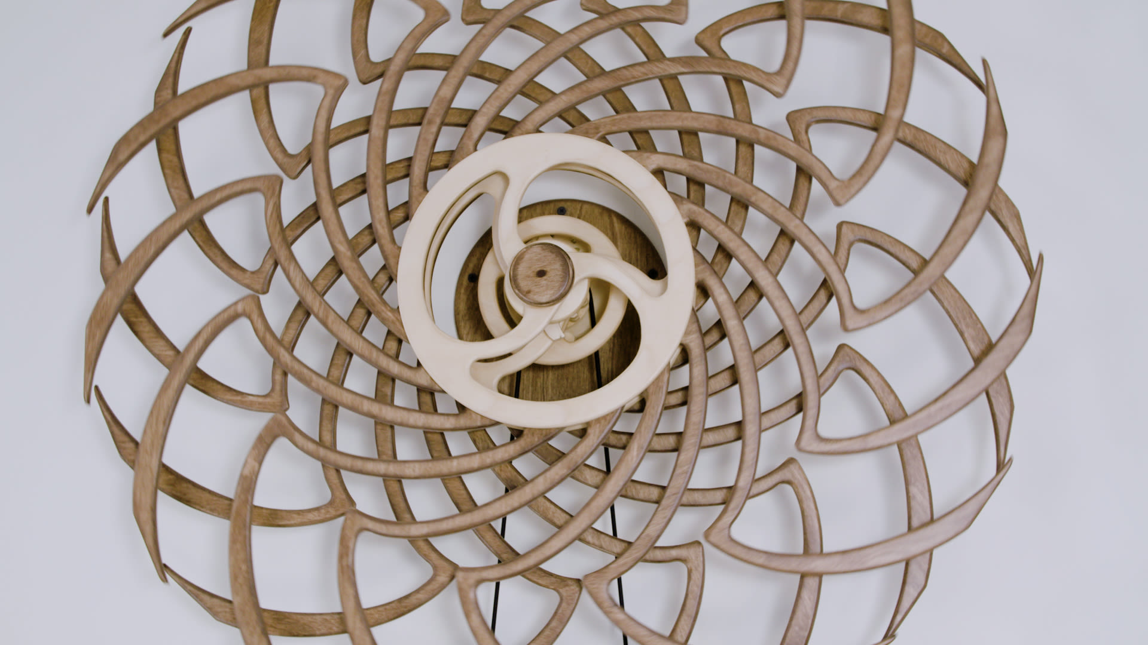
-A visit to Kew Gardens linked to our plants unit in Science
-A visit to China Town linked to geography)
Physical Education (PE)
This term your PE will be on: Tuesdays
Fundamental Focus
Sport Specific Focus |  | Striking games
Whole child focus | PE award for: | Regulating Emotions
 | Learning about: | Regulation Strategies
Religious Education
How does special food and fasting help people in their faith?
-Learn why people fast and its significance.
-Explore the potential physical and emotional effects of fasting on individuals.
-Discover why Muslims fast during Ramadan.
-Learn about the tradition of fasting during Lent and its spiritual significance for Christians.
-Reflect on the idea of fasting as a universal practice and its potential benefits or drawbacks for individuals and communities.
Curriculum Enrichment
Art
Year
Year 2 will be creating kinetic sculptures. In this project children will be asked to consider the Chinese tradition of mobile sculptures - dragon puppets and kites. They will then look at the work of Alexander Calder’s kinetic mobile sculptures, Ai Weiwei’s hanging stools and bicycles and Cornelia Parker’s explosion installations. Children will experiment making a variety of mobile sculptures including a final piece mobile.
Music
PSHE
We will be learning
Samba drumming with a specialist tutor from Newham Music.
We will learn to start and stop as a group and perform different rhythm patterns.
Relationships:
To identify the different members of my family, understand my relationship with each of them and know why it is important to share and cooperate.
To understand that there are lots of forms of physical contact within a family and that some of this is acceptable and some is not.
To recognise and appreciate people who can help me in my family, my school and my community.
Click here to go back to the main page

