Slide 1
Year 11 Information Morning

Slide 2
Aim
Supporting your son for GCSE exams
Learning styles
Revision timetable
Exam stress
Intervention timetable
College applications- references
Key dates
Questions

Slide 3
Supporting you Son for GCSE exams
Exam time can be very challenging and stressful for both students and their families.
Talk about it - thinking about what they know and then focus on what they can do.
Always encourage your child to ask for help at school on any parts of their work they do not understand.
Be positive even if they aren’t.
Offer praise and treats when they have reached revision milestones.
Have regular one-to-one conversations.
Let your child talk more than you and be attentive.

Slide 4
Learning Styles
Visual
Visual retain information best by viewing pictures or images and respond well to colours and mind maps.

Slide 5
Learning Styles
Kinaesthetic
Kinaesthetic learners are all about doing things physically. Role playing, using things like flashcards or carrying out the action physically can help them learn things better.

Slide 6
Learning Styles
Solitary
Solitary learners work best alone. Making notes and reciting them back are useful activities when studying by themselves. Most of us will have to do some solitary revision at some point in our lives.

Slide 7
Learning Styles
Auditory
Auditory learners absorb information primarily by hearing it. They:
Love verbal instructions and follow them easily
Are sensitive to tone of voice, pitch and rhythm
Understand and process information by talking it through
Would rather record a lesson than take notes
Are good at oral presentations
Learn better with music on, provided that it is not distracting
Thrive in group and panel discussions
Are easily distracted by auditory stimuli such as background noise or being spoken to

Slide 8
Revision Timetable
It is important to not leave revision to the last minute.
The earlier your son starts their GCSE revision, the better.
Many students underestimate the time needed for proper revision; this adds more stress and anxiety to the situation because they begin to overextend themselves to make up for the lack of time.

Slide 9
Revision Timetable
Teenagers are not known to be the most organised individuals but effective revision first begins with organisation. So parents, hopefully you are more organised than your child and can assist them with planning their revision time.

Slide 10
Revision Timetable
Revision planning begins with creating a revision timetable.
To be consistent, students should strive to study at least 5 days of the week.
On weekdays, this time would be after school and the choice is theirs on weekends.
Advise your child to breakdown the subjects by topics; so revising Mathematics on Tuesday night becomes revising quadratic equations instead.
Give priority to the subjects and topics that are most difficult; this means placing them early on in the timetable and allowing more revision time.

Slide 11
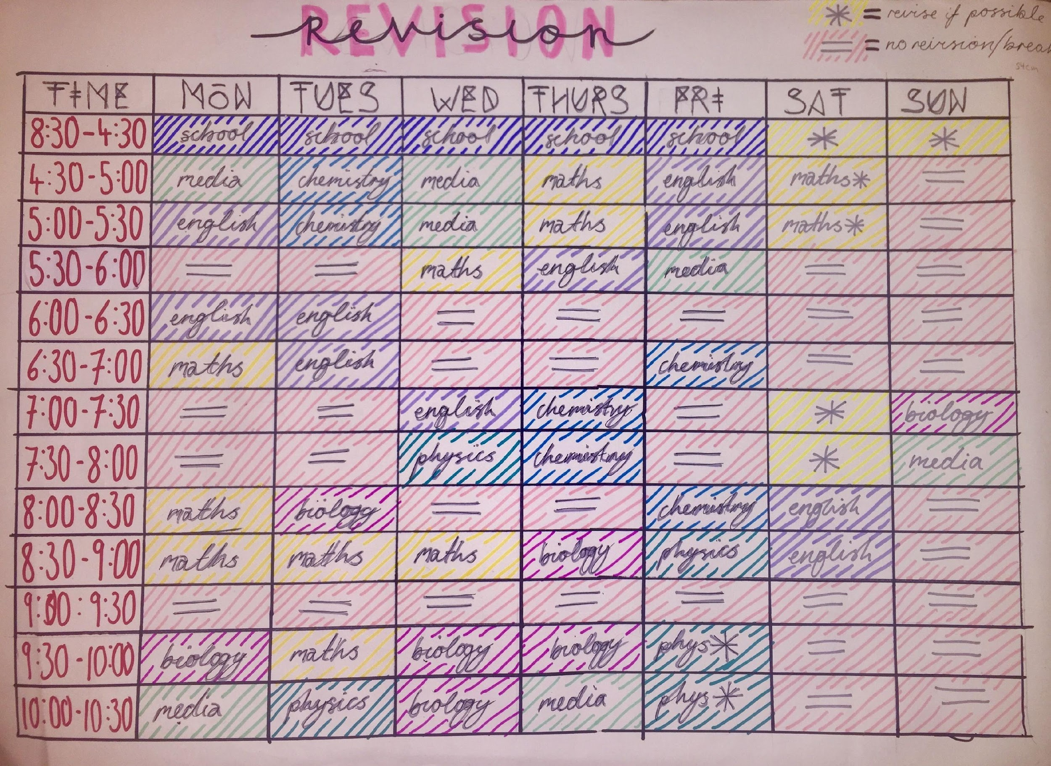

Slide 12
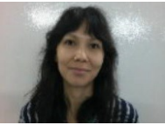
Place2Be
The Place2Be is a children’s mental health charity which has over 25 years’ experience of working with students, families and schools across the UK.
Irina Stevens will be our Mental Health Practitioner, working two days a week (Wednesdays and Thursdays).
Irina will work with students who are struggling with anxiety, low mood or anger and will provide 1-1 and group counselling.

Slide 13
Place2Talk
What is Place2Talk?
Place2Talk is a self-referral service for students who have worries or concerns that they want to talk about. They can come alone or with a friend.
When?
Place2Talk appointments are around 15- 20 minutes and take place during breaks and lunchtimes on Wednesdays and Thursdays. These need to be pre-booked. If your matter is urgent you should speak to the safeguarding team or your Year Coordinator.
How?
Students self-refer by putting a request into the Place2Talk box located in the library. There are slips of paper next to the box where students need to put their name and year. I will be checking the box every week and then will be contacting the students to offer a session, which will normally be the following week. Students will be given a note if they have attended a session in case they are late for class, so the teachers will know that they have a reason for being late.
This new service complements the existing counselling service.

Slide 14
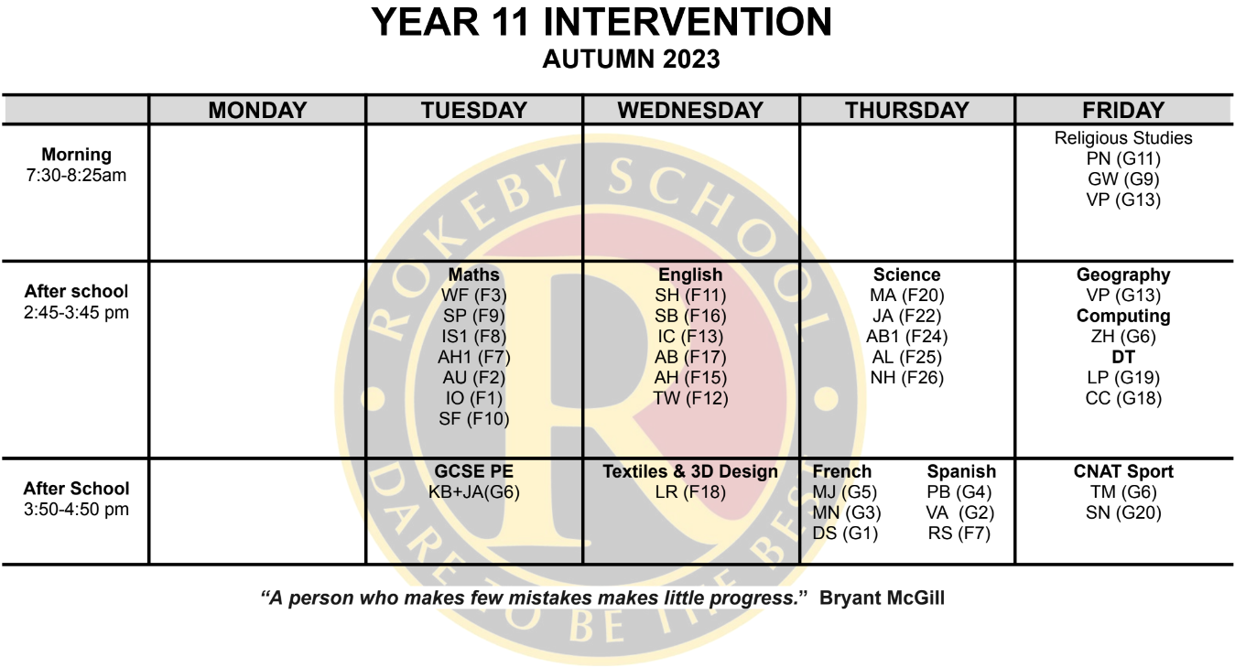
INTERVENTION/ADDITIONAL SUPPORT CLASSES SPRING 2020

Slide 15
References
This is the section in which the college/sixth-form want us to tell them about the student.
It usually involves information about attendance, punctuality, effort, attitude, motivation and behaviour.
There are only three people who will be filling in the references:
Ms Bailey – KS4 Coordinator
Mr Uddin – Assistant Headteacher linked to Year 11
Mr Sarumi – Year 11 Coordinator

Slide 16
Key Dates
Date | Event
10th November | Photographs
24th November | Staff Training Day (School closed)
27th Nov-8th December 2023 | Mock Exams
12th January 2024 | Mock Results Day
25th January 2024 | Parents Evening
21st February 2024 | Future Pathways
13th-21st March 2024 | Spring Mock Exams
24th May 2024 | Graduation
May - June 2024 | Summer GCSE's
22nd August 2024 | GCSE Results Day

Slide 17
Questions??

