Slide 1
Year 7
Information Morning

Slide 2
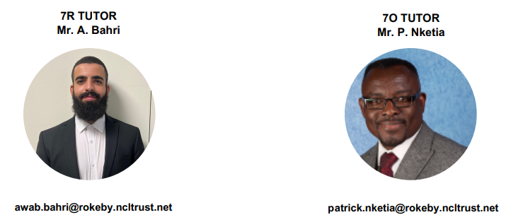
Names You Need to Know
If you have any concerns about your son at Rokeby, please contact, in the first instance, his form tutor.

Slide 3
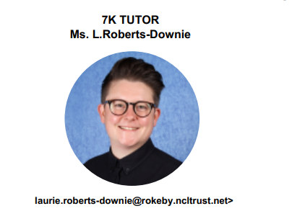
Names You Need to Know
If you have any concerns about your son at Rokeby, please contact, in the first instance, his form tutor.

Slide 4
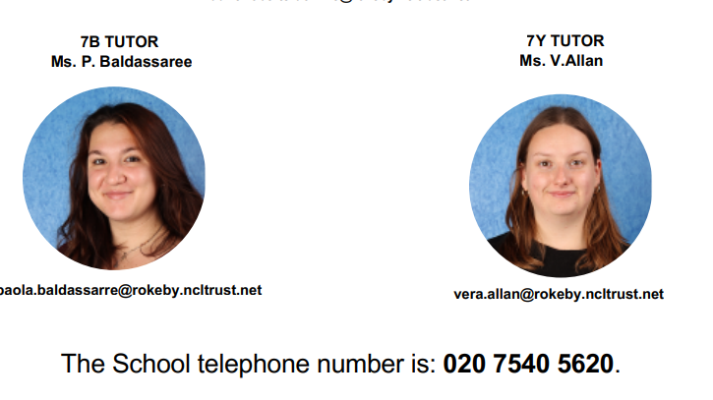
Names You Need to Know
If you have any concerns about your son at Rokeby, please contact, in the first instance, his form tutor.

Slide 5
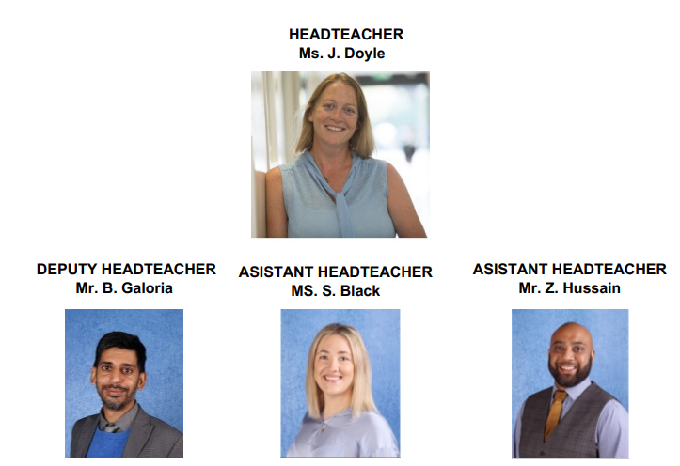
Names You Need to Know
If you have any concerns about your son at Rokeby, please contact, in the first instance, his form tutor.

Slide 6
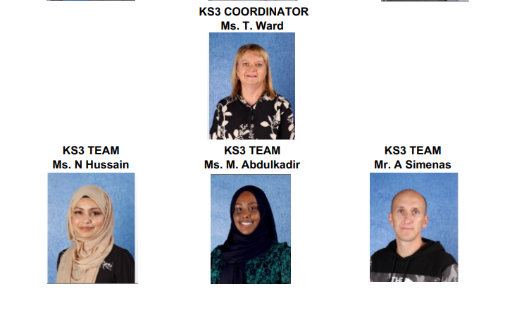
Names You Need to Know
If you have any concerns about your son at Rokeby, please contact, in the first instance, his form tutor.

Slide 7
School Uniform
We expect every pupil to wear our school uniform and bring their PE kit with them when they have PE. Full uniform must be worn not only on the school site, but also whilst students are travelling to and from school and when they attend school trips and visits.
Our school uniform consists of:
Black blazer with school logo
Black trousers
Tailored plain white shirt with collar and school tie
Plain black shoes that can be polished
Plain black or navy-blue overcoat
Black V-necked jumper with school logo (optional)
School bag to hold an A4 book without being folded
We recommend labelling all items with the students name in case any items get lost.

Slide 8
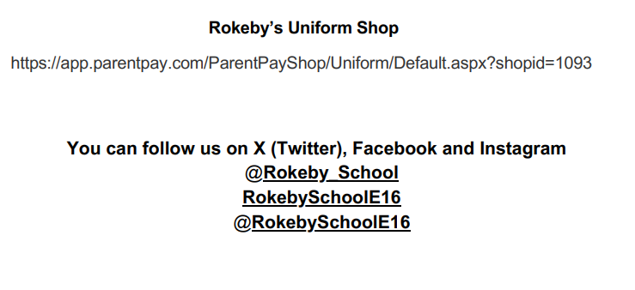

Slide 9
Important Dates for Year 7
Autumn Term

Slide 10
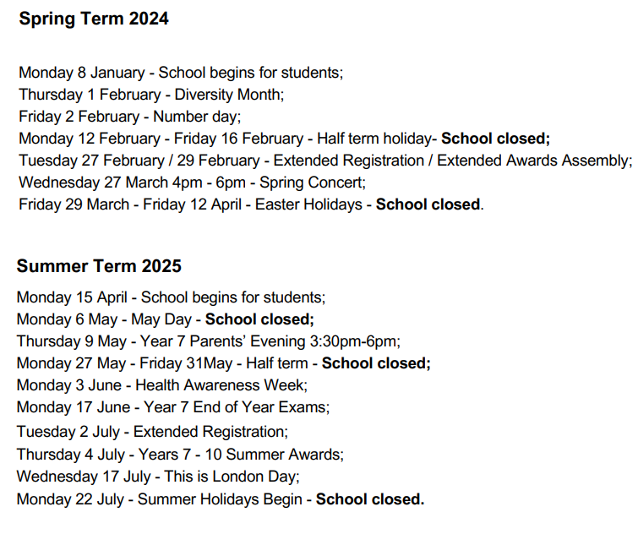
Important Dates for Year 7

Slide 11
Homework
Homework provides our students with the opportunities to develop valuable independent learning skills. The type of homework set will be varied and include:
Questions to check understanding and consolidate learning.
Research-based activities.
Individual/group projects.
Students will receive no more than one homework in each subject.
Homework is set on Class Charts.
If you need a parent login, please email the form tutor.

Slide 13
Equipment
We encourage our students to be as independent as possible. For this reason, we allow them to take full responsibility of their equipment and belongings. Students are expected to have:
A school bag to hold an A4 book without being folded
A pencil case At least two black pens
Two pencils
Pencil sharpener
Rubber/eraser
A ruler
A complete Maths set with protractor and compass
A calculator

Slide 14
Equipment
We encourage our students to be as independent as possible. For this reason, we allow them to take full responsibility of their equipment and belongings. Students are expected to have:
A school bag to hold an A4 book without being folded
A pencil case At least two black pens
Two pencils
Pencil sharpener
Rubber/eraser
A ruler
A complete Maths set with protractor and compass
A calculator

Slide 15
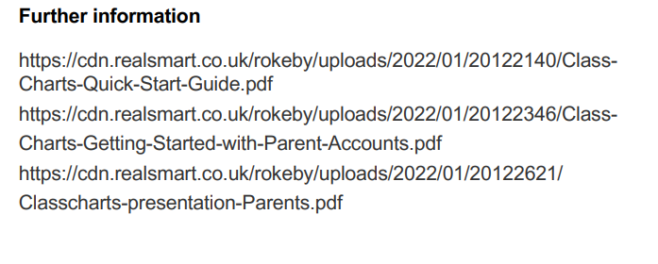

Slide 17
Good Attendance and Punctuality = SUCCESS

Slide 18
Good Attendance and Punctuality = SUCCESS

Slide 19
What do I do if my son is not going to be in school?
Please ring Ms Patel (Attendance Officer) on 020 7540 5620 before 10am. This line is available at all times.
You will be able to leave a message regarding your son’s absence.
A text message from Rokeby School will be sent at 10.30am if your son is absent and Rokeby School has not been notified.
Please respond to this text message with the reason for your son’s absence.
Please fill in the absence note in your son’s planner. If your son has had more than 5 days absent in an academic year, we will require medical evidence to explain his absence.
If your son has a doctor or dentist appointment that is not urgent, please arrange an out of school hour’s appointment.

Slide 20
What do I do if my son is not going to be in school?
Please ring Ms Patel (Attendance Officer) on 020 7540 5620 before 10am. This line is available at all times.
You will be able to leave a message regarding your son’s absence.
A text message from Rokeby School will be sent at 10.30am if your son is absent and Rokeby School has not been notified.
Please respond to this text message with the reason for your son’s absence.
Please fill in the absence note in your son’s planner. If your son has had more than 5 days absent in an academic year, we will require medical evidence to explain his absence.
If your son has a doctor or dentist appointment that is not urgent, please arrange an out of school hour’s appointment.

Slide 21
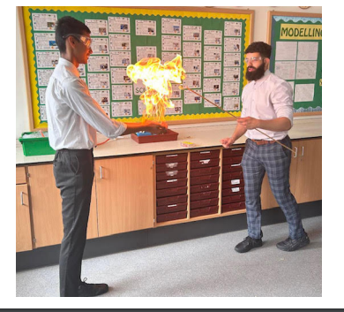

Slide 23
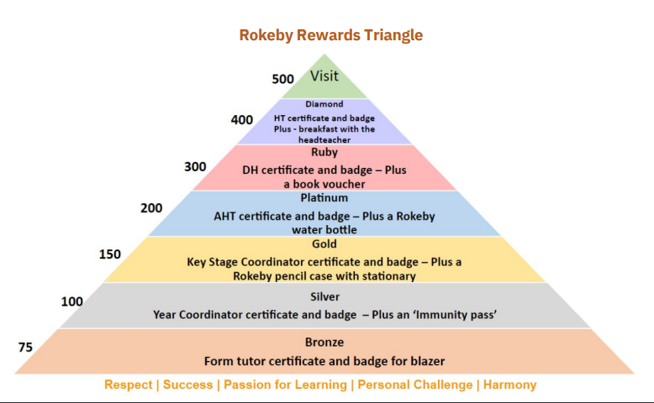

Slide 26
Questions

