Slide 1
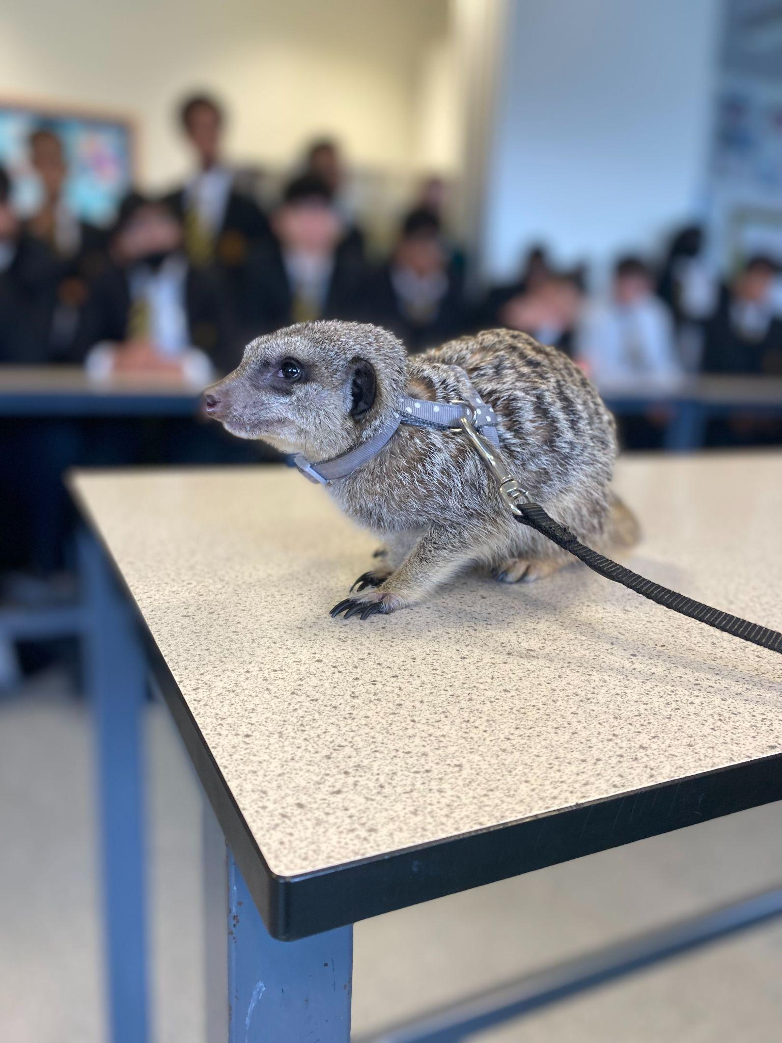
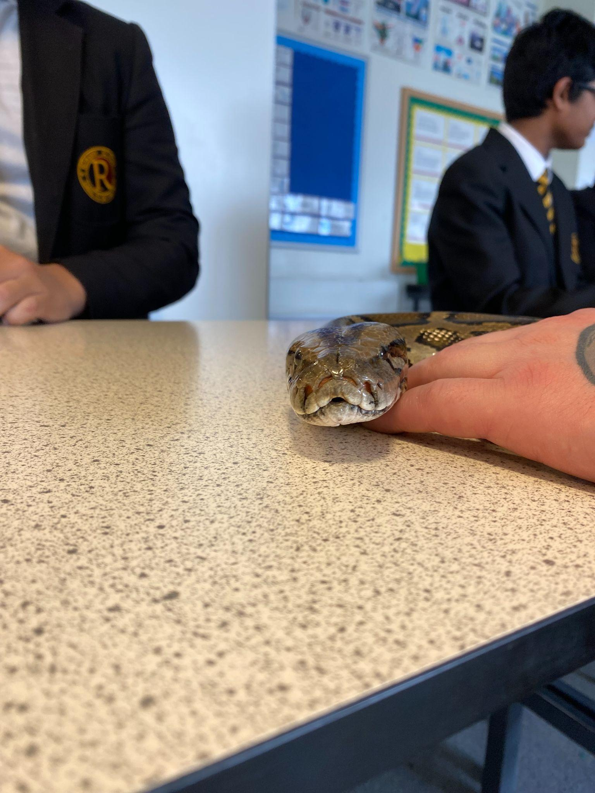
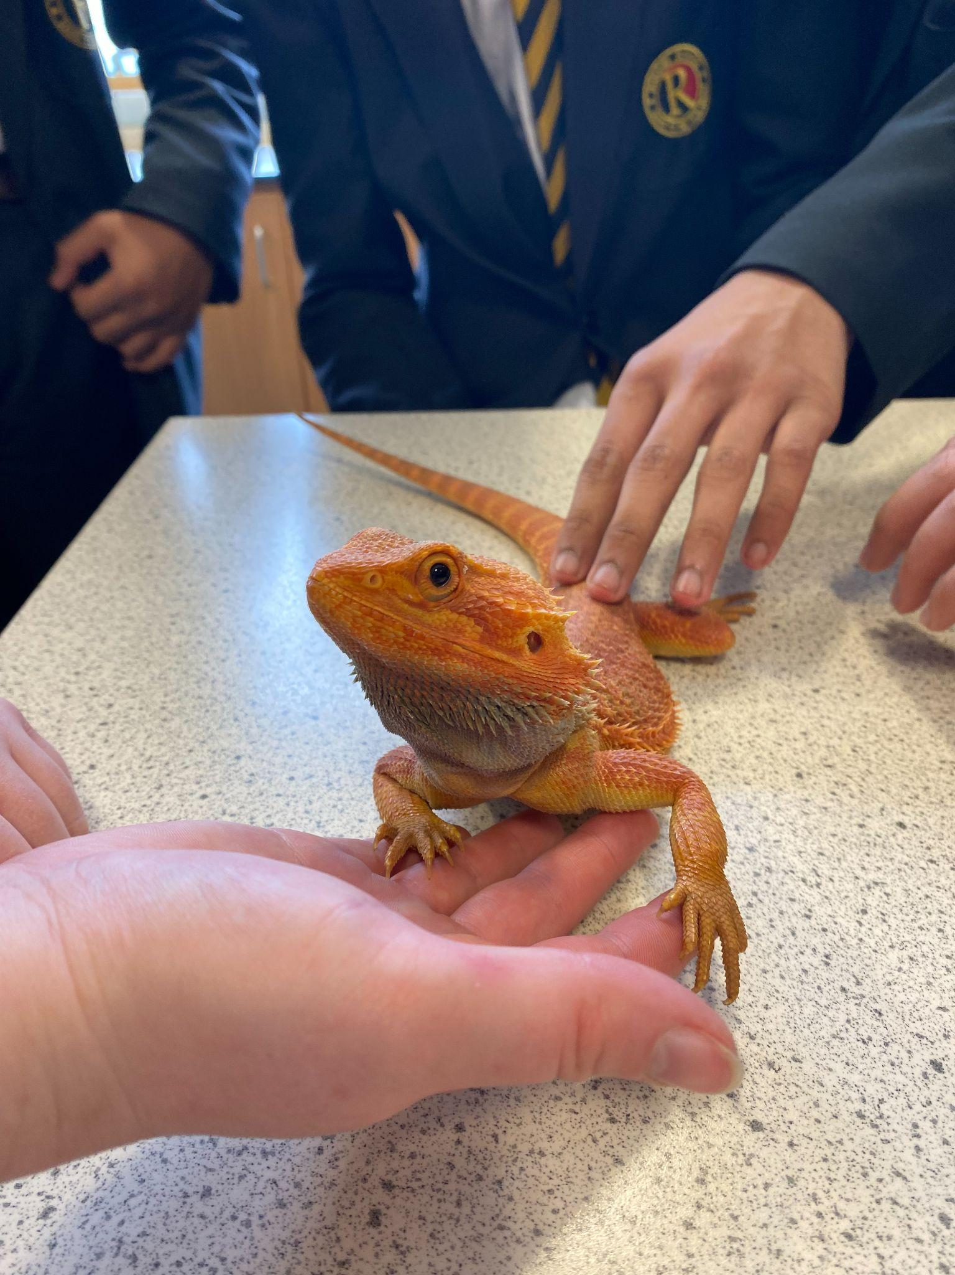
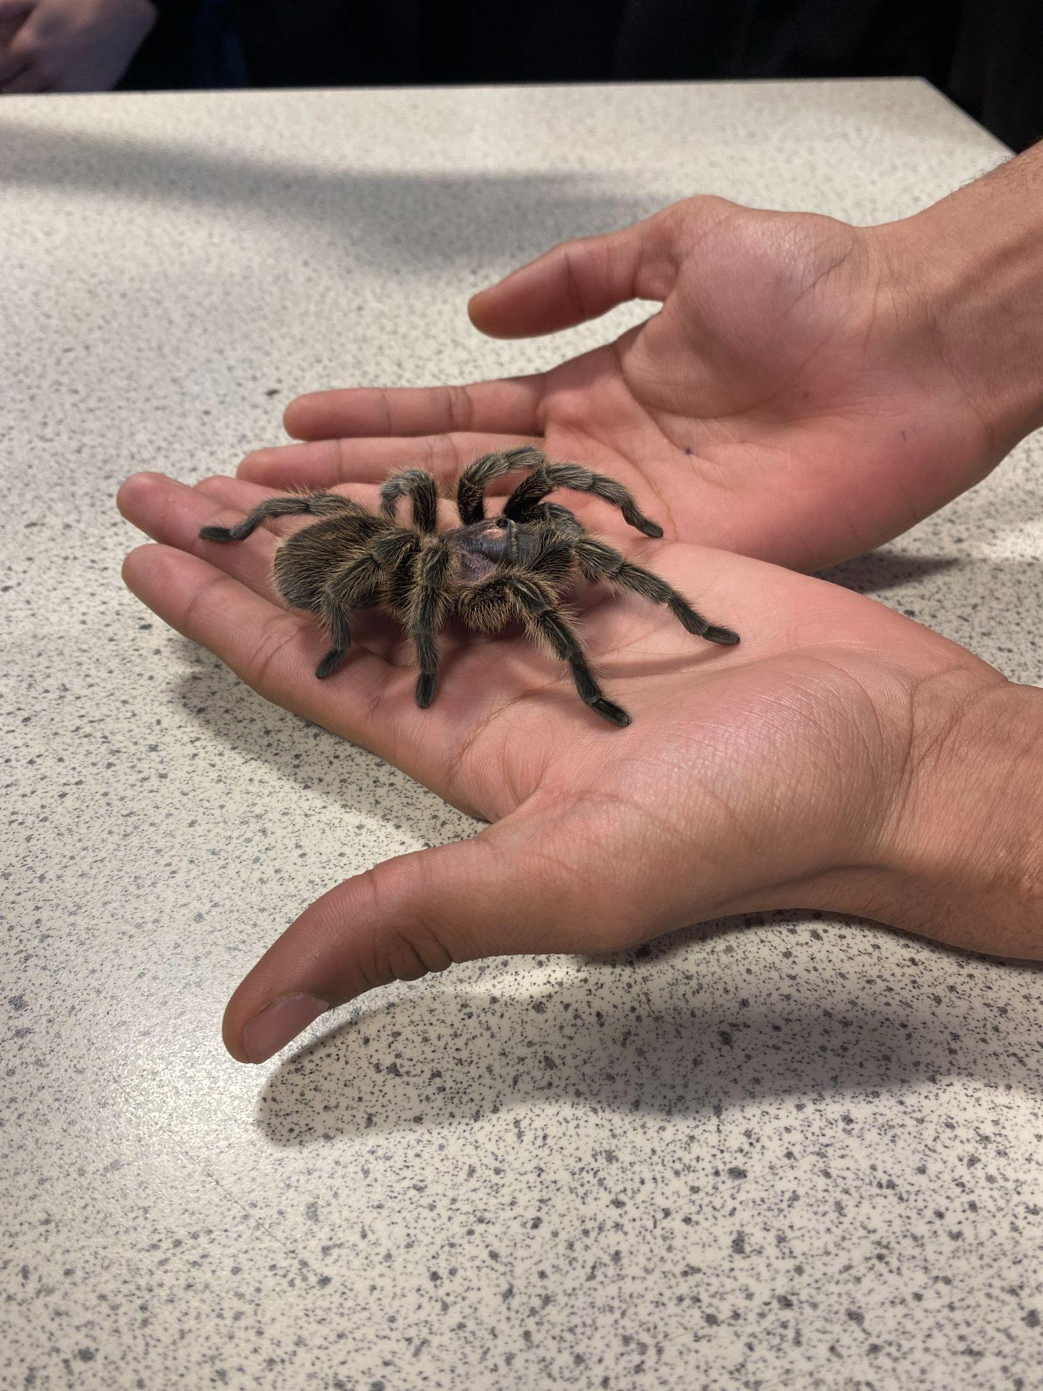
Science @Rokeby

Slide 2
Our curriculum
Disciplinary knowledge -
Refers to how scientific knowledge is generated and grow.
NC - working scientifically.
We focus on the four content areas:
Knowledge of method used to answer scientific questions
Knowledge of apparatus, techniques and measurement
Knowledge of data analysis
Using evidence to develop explanations
Ofsted Research Review - 29th April 2021

Slide 3
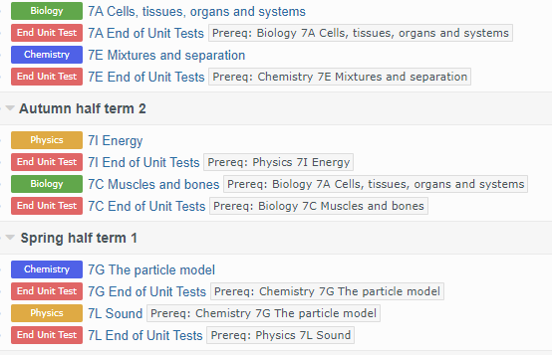

Slide 4
Curriculum progression
What it means to get better in science?
Curriculum is sequenced to build pupils’ knowledge and understanding of substantive and disciplinary knowledge. [DDP & MER]
Disciplinary knowledge consists of knowledge and procedures.
Curriculum outlines how disciplinary knowledge builds over time.
Pupils are taught about the similarities and differences between the two knowledge.
Scientific processes are always taught with reference to substantive knowledge.
Ofsted Research Review - 29th April 2021

Slide 5
Teaching the curriculum and assessment
Pedagogy
Content match the requirements of NC
Teachers are aware of the capacity of the working memory
Systematic teaching techniques. [principles of instructions]
Assessment
Both teachers and pupils are aware of the different types of assessments.
Assessments are not a burden on a teacher’s time. [marking policy and review]
Regular moderations.
Ofsted Research Review - 29th April 2021

Slide 6
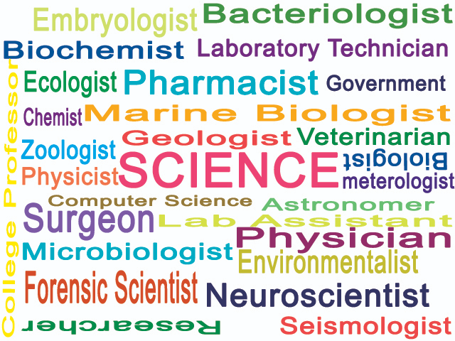
Science for all
Extra curricular activities
Science club
Interventions
Careers
Online workshops. [medic mentor]
Educational visits
Online resources.
Learning resources.

Slide 7
Our Results
Triple science -
Combined science -
Academic year | % 9-7 (B, C, P) | % 9-5 (B, C, P)
2019 | 34.5, 44.8, 55.2 | 93, 93, 96
2023 | 64.5, 74.2, 61.3 | 96.8, 96.8, 96.8
Academic year | % 9-7 | % 9-5
2019 | 8.8 | 25
2023 | 5.4 | 40.7

Slide 8
FAQs
What is my son learning in science?
Where can I get the learning resources for my son?
How can I help my son with his science learning?
How is homework set the monitored?
How do I monitor the progress of my son?
What are the career opportunities for the students of science?

