Slide 1


E-Safety
Parent/Carer Information Morning
September 2023
Respect | Success | Passion for Learning | Personal Challenge | Harmony

Slide 2


Different usage
PARENTS
Mostly email & web for research
YOUNG PEOPLE
Interactive chat and social media, music, games, blogging
Know IT All
28% of parents who use the internet describe themselves as beginners compared with only 7% of children
Notes:
‹#›

Slide 3
Supervision
IN SCHOOL
Supervised, filtered & monitored
OUT OF SCHOOL
Often no supervision, filtering or monitoring
Know IT All
30% of students report having received no lessons at all on using the internet.
79% of young people use the internet privately without their parent’s supervision
Notes:
‹#›

Slide 4

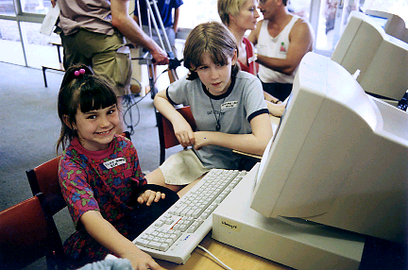
Knowledge vs. Wisdom
KNOWLEDGE
Many children pick up technology quicker!
WISDOM
Understanding how to behave in a virtual world
Know IT All
69% of young people say they mind their parents restricting or monitoring their internet usage!
Notes:
‹#›

Slide 5

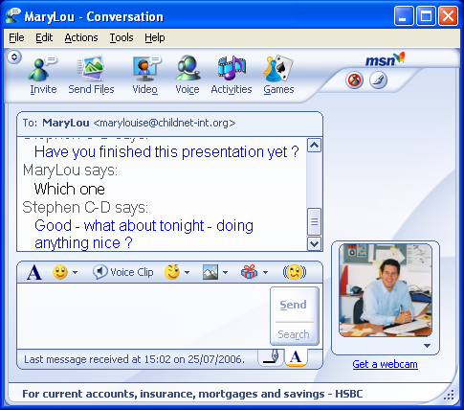

World Wide Web
Discover
Connect
Create
Search engines
Homework
Projects
Personal interest
Amazing facts
The biggest library in the world
Email/chat
VoIP - Skype
Instant Messenger
Multi-user games
Social networks
Brings people together
Blogs (web log)
Vlogs (video log)
Web sites
Text & pictures
Music/photo/video
Anyone can become a publisher
Notes:
‹#›

Slide 6
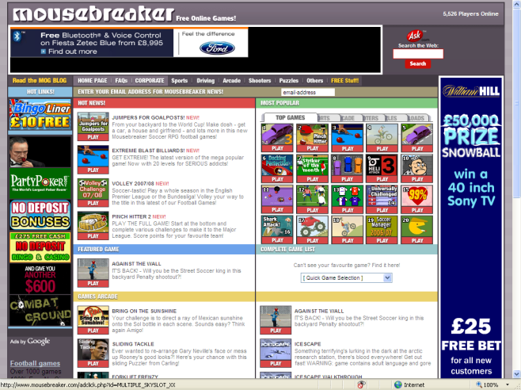


Potential risks
Commerce
Content
Contact
Privacy
Advertising & information
Invasive software
Inaccurate and harmful
Adult content
Illegal content
Inappropriate contact
Cyberbullying
Sex offenders
73% of online adverts are not clearly labelled making it difficult for children and adults to recognise them
57% of 9-19 yr olds have come into contact with online pornography accidentally.
4 in 10 pupils aged 9-19 trust most of the information on the internet.
1/3 of young people have received unwanted sexual or nasty comments online. Only 7% of parents think their child has received such comments.
Notes:
‹#›

Slide 7

Commercial risks
Blur between content & advertising
Subtle requests for marketing information- “Tell a friend”
Invasive programmes - adware/popups
Notes:
‹#›

Slide 8
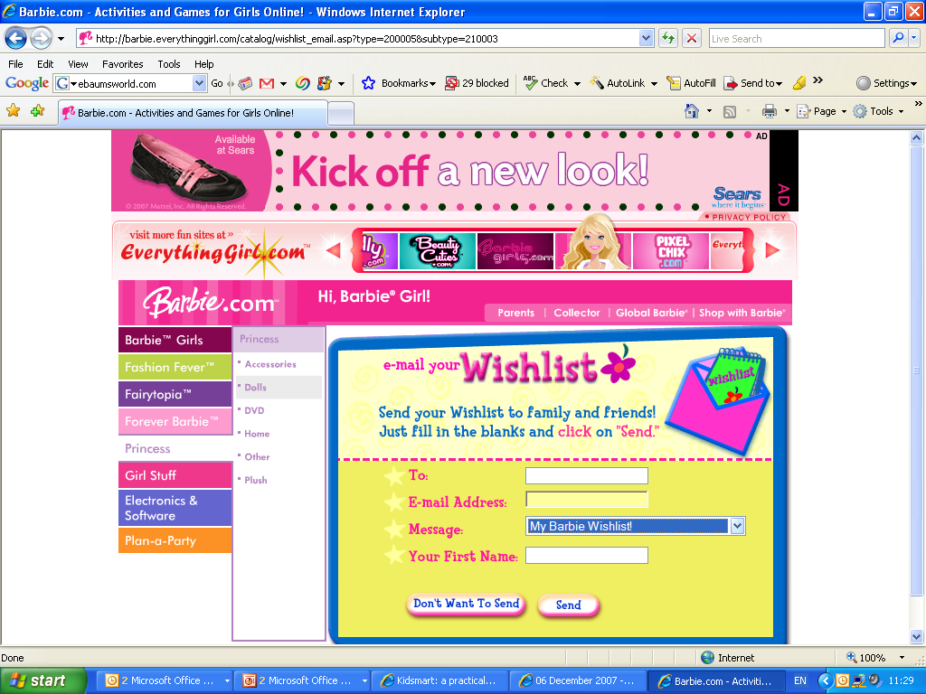

Commercial risks
Know IT All
20% of children claim they mustn’t fill in online forms, compared with 57% of parents who do not allow it.
Notes:
‹#›

Slide 9

Content viewed
Inaccurate content
Extreme material
Pornography
Know IT All
4 in 10 pupils aged 9-19 trust most of the information on the internet
57% of 9-19 yr olds have come into contact with online pornography. Only 16% of parents think that their child has seen pornography on the internet.
Notes:
‹#›

Slide 10
Contact risks
Social networking sites
Instant messaging
File sharing
Multi-user online games
Chat rooms
Know IT All
49% of kids say that they have given out personal information
5% of parents think their child has given out such information
Notes:
‹#›

Slide 11

What is Cyberbullying?
Threats
Manipulation
Hacking
Exclusion
Prejudice
Public postings
Stalking
Notes:
‹#›

Slide 12
Cyberbullying
Threats and intimidation
Threats sent to people by mobile phone, email, or online.
Harassment or stalking
Repeated, prolonged, unwanted contact or monitoring of another person.
Vilification / defamation / prejudice-based bullying
These may be general insults or racist, homophobic or sexist bullying.
Ostracising / peer rejection / exclusion
Set up of a closed group refusing to acknowledge one user on purpose.
Identity theft, unauthorised access and impersonation
‘Hacking’ by finding out or guessing a username and password.
Publicly posting, sending or forwarding information or images
Disclosing information on a website.
Manipulation
May involve getting people to act or talk in a provocative way.
Notes:
‹#›

Slide 13


Differences
24/7 contact
No escape at home
Impact
Massive potential audience reached rapidly. Potentially stay online forever
Perception of anonymity
More likely to say things online
Profile of target/bully
Physical intimidation changed
Some cases are unintentional
Bystander effect
Evidence
Inherent reporting proof
Notes:
‹#›

Slide 14

Advice for parents
Be careful about denying access to the technology
Understand the tools
Discuss cyberbullying with your children
- always respect others
- treat your passwords with care
- block/delete contacts & save conversations
- don’t reply/retaliate
- save evidence
- make sure you tell
Report the cyberbullying
- school
- service provider
- police
Notes:
‹#›

Slide 15
What you can do…
Commerce
Install software to protect your computer’s security
Be careful which sites the rest of the family visit
Use a family email address for shopping and online forms
Use the free technology: pop-up blockers & SPAM filters; and your good judgement: don’t reply to SPAM!
Check sites for extra security (padlock/https)
Notes:
‹#›

Slide 16
What you can do…
Content
Talk to your children about what to do if they do come across something unpleasant and teach them to be critical
Use child-friendly search engines or set a search filter
☺ Encourage them to use browser tools – Bookmarks & History
Install filtering but don’t rely on it
Find appropriate sites to visit and try not to overreact – lots of inappropriate content viewed accidentally
Notes:
‹#›

Slide 17





What you can do…
Contact
Get involved with your children online and encourage balanced use – set time limits
Make sure they know who to talk to if they feel uncomfortable
Talk about the consequences of giving out personal info or making information public
Keep the computer in a family room
Agree rules as a family – meeting up
Notes:
‹#›

Slide 18
SMART rules
SAFE – Keep safe by being careful not to give out personal information – including full name and email address - to people who you don’t trust online.
MEETING – Meeting up with someone you have only been in touch with online can be dangerous. Only do so with your parent’s/carer’s permission and even then only when they can be present.
ACCEPTING – Accepting e-mails, IM messages or opening files from people you don’t know can be dangerous – they may contain viruses or nasty messages!
RELIABLE – Someone online may be lying about who they are, and information you find on the internet may not be true. Check information and advice on other websites, in books or ask someone who may know.
TELL – Tell your parent/carer or teacher if someone or something makes you feel uncomfortable or worried, or you or someone you know is being cyberbullied.
Notes:
‹#›

Slide 19

School response
Academic curriculum
Pastoral curriculum
Web filtering
Monitoring usage

