Slide 1
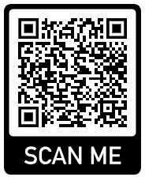
Parent coffee morning
English at Rokeby
An opportunity to discuss the English Curriculum at Rokeby school with Mr Bailey (Head of English)
Monday 5th February 2024
11am at Rokeby School
If you’d like to attend please scan and register

