Slide 1

Special Educational Needs Information Report
How we support children with special education needs and disabilities

Slide 2
This SEN Information report can be looked through page by page or use the ‘quick links’ to find answers to a specific question.

Slide 3
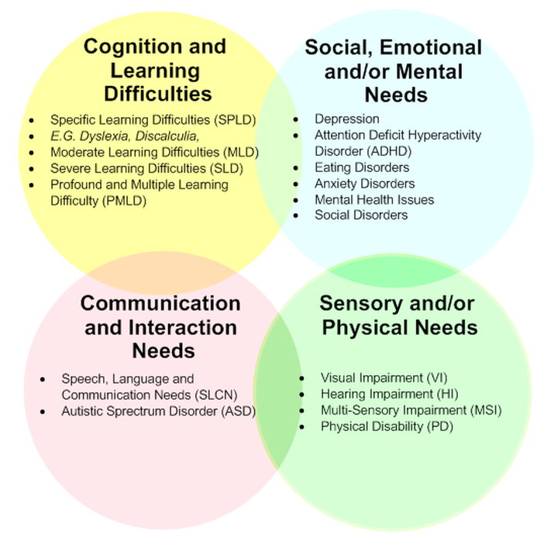
Areas of Special Educational needs
A pupil has SEN if they have a learning difficulty or disability that calls for special educational provision to be
made for them.
They have a learning difficulty or disability if they have:
A significantly greater difficulty in learning than the majority of the others of the same age, or
A disability which prevents or hinders them from making use of facilities of a kind generally provided for others of the same age in mainstream schools
We have students on our register from the four areas of need set out in the SEN (Special Educational Need) Code of Practice, 2014.

Slide 4
Page 1 Quick links:
What should I do if I think my child has Special Educational needs?
How does the school know if a child needs extra help?
How will both school and I know how my child is doing?
How will school help me support my child’s learning?
How will the curriculum be matched to my child’s needs?
How are the school’s resources allocated and matched to chi...
How will the school decide the type of support my child wi...
How does the school judge whether the support has had an ...
How will my child be included in activities outside the c...
What support will there be for my child’s overall well be...

Slide 5
Page 2 Quick links:
What training have the staff supporting SEND had or what ...
How accessible is the school both indoors and outdoors?
How are parents involved in the school? How can I get inv...
How do children contribute their views about their suppor...
What specialist services are available or can be accessed...
How will the school prepare and support my child when tra...
Who can I contact for further information or to complain ...
The Local Offer
School Contact details:
What other support services can help me?

Slide 6
What should I do if I think my child has Special Educational needs?
Return to ‘quick links’
Parents/carers who are concerned about a child’s SEND needs or have question relating to SEND at Ridgeway, please contact the school directly to discuss this further. You can either speak to your child’s form tutor, email the SEND team or use the ‘Talk to us about your child’ button on our website. We will collect information regarding your concern, so we are able to discuss the issues further.
The SEND team contact details are as follow:
SENDCo - Mrs S Trevethick
Assistant SENDCo – Mrs M McNamee
Email address: send@rss.shiresmat.org.uk
Telephone number: 01527 892867
We have rigorous monitoring in place that tracks the progress our learners make in all areas of the curriculum and identifies clearly the next steps. Our staff are vigilant at supporting at raising any concerns. We use data with other forms of assessments/observations to identify additional needs and celebrate achievement. Parents/carers are encouraged to speak to the subject teacher/tutor about any concerns they have.

Slide 7
How does the school know if a child needs extra help?
Return to ‘quick links’
Ridgeway works closely with primary schools to transfer key educational information. The SENCO and Pastoral Lead work closely to collate information from a range of sources to prepare students for life at secondary school. For example, via staff meetings, parental meetings, monitoring visits to the primary schools.
Our teaching staff closely monitor the progress and attainment of all students, including those who have, or may have, SEND. The continuous monitoring of students during their time at our school will further identify students with a special educational need. Identification may come from staff members, parent/carer, outside agencies, parents/carers, or the students themselves.
We follow a staged and graduated approach to identifying and assessing needs (‘Assess, Plan, Do, Review’ model). The triggers for intervention could be staff concerns, underpinned by evidence, about a students who, despite receiving adaptive learning opportunities, does not make expected progress.
For specific issues, we may choose to draw upon the advice of key consultants to further explore the SEND needs of students. Exam access arrangements are explored and determined before GCSE's which identifies any further support that can be offered during exam time such as additional time, readers, or scribes, for which a Specialist Teacher is employed.

Slide 8
How will both school and I know how my child is doing?
Return to ‘quick links’
Feedback regarding student progress is shared regularly with their families via qualitative and quantitative means. Further information regarding the dates of reports and parents' evenings can be found on our website. Following feedback from families, we have adapted our reporting style to ensure it is meaningful to parents and reflects the language used to discuss progress with students in school. We value feedback from families and welcome questions or feedback regarding students learning.
In addition to the reporting and parents’ evenings, students with as Education, Health and Care Plan (EHCP), will have additional reviews throughout the year to discuss student progress. Each year, students with an EHCP will also have review meeting to discuss student’s progress towards the outcomes identified in their plan. Furthermore, the SEND team urge families to make contact if they have any questions or concerns about progress.

Slide 9
How will school help me support my child’s learning?
Return to ‘quick links’
Supporting parents on the SEND journey

Slide 10
How will the curriculum be matched to my child’s needs?
Return to ‘quick links’
We continue to review and adapt our curriculum as part of a rolling programme within school to ensure adaptive teaching is embedded throughout. All our teachers are clear on the expectations of high-quality universal provision, and this was monitored regularly by the leadership team through our quality assurance cycle.
Our approach to the curriculum is context driven and we ensure the subjects offered suit the needs of each cohort. This is evident in the Key Stage 4 offer which changes from year to year to reflect the needs of the students. We also offer a more bespoke curriculum for some students with severe and complex needs. Staff work closely with students and families to regularly review students' progress and adapt plans to ensure the needs of students are met in the best way possible.

Slide 11
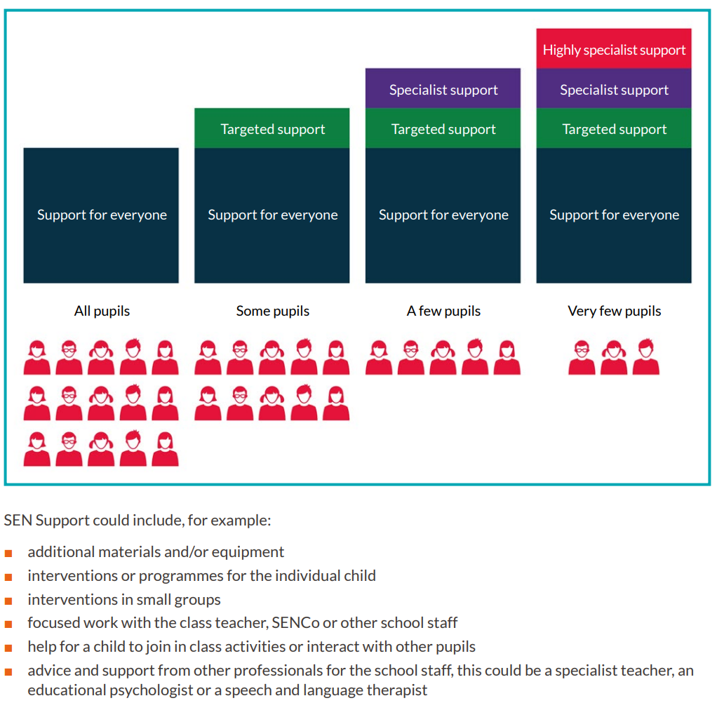
How are the schools resources allocated and matched to children’s special educational needs?
Return to ‘quick links’

Slide 12

How will the school decide the type of support my child will receive?
Return to ‘quick links’

Slide 13
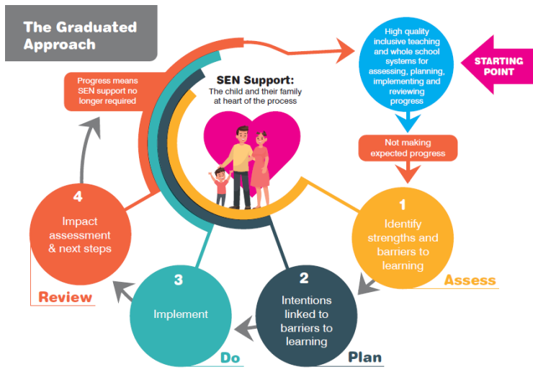
How does the school judge whether the support has had an impact?
Return to ‘quick links’

Slide 14
How will my child be included in activities outside the classroom including school trips?
Return to ‘quick links’
Our extracurricular offer includes:
- After school clubs run by school staff and alternative providers
- A co-ordinated trips offer known as the Ridgeway Promise
- House Events
- Fundraising and charity events
- Leadership opportunities
- Guest speakers
- Duke of Edinburgh Award Schemes
- Camps International
- Work Experience
- Careers Support and Guidance

Slide 15
What support will there be for my child’s overall well-being?
Return to ‘quick links’
The pastoral and SEND team work incredibly closely to ensure that our SEND learners are never left behind or misunderstood. The safeguarding team has a dedicated member of staff for SEND learners who is experienced and understanding the nuances of supporting those with additional needs. We have extensive support available in school as well as strong links with external agencies.
In addition to pastoral support, staff are regularly trained to meet the medical needs of students within school and liaise with families to ensure students can access school safely.

Slide 16
What training have the staff supporting SEND had or what are they having?
Return to ‘quick links’
Staff have been trained in the following:
- Dyslexia
- ADHD
- Autism Education Trust Level 1 and 2
- Exam Access Arrangements
- Mental Health
- Pathological Demand Avoidance
- Autism in Girls
Adaptive Teaching
Tourette's Syndrome
Our SENCo has completed the mandatory National SENCo Award and is a qualified teacher. We regularly invest time and money in training our staff to improve delivery of universal provision and targeted interventions and to develop enhanced skills and knowledge. Staff meetings regularly update on matters pertaining to special education needs and disability.

Slide 17
How accessible is the school both indoors and outdoors?
Return to ‘quick links’
The school is adapted to suit all needs. SEND learners are at the heart of all decisions the school makes. From all buildings being wheelchair friendly to carpeted floors and distraction free classrooms to benefit learners that struggle with cognitive and sensory difficulties. We are vigilant about making reasonable adjustments, where possible.
Our behaviour is exemplary and allows disruption free learning as well as corridor conduct.

Slide 18
How are parents involved in the school? How can I get involved?
Return to ‘quick links’
Parents are involved in the following ways:
- Open tours
- Half termly parent voice
- SENDCo Appointments
- Pupil Passport Reviews
- Parent Governor opportunities where appropriate
- Parents Evening
Social Media Engagement
Parent Carer Forum

Slide 19
How do children contribute their views about their support and who can help them?
Return to ‘quick links’
Students are involved in the following ways:
- Leadership roles
- Regular check ins
- Half termly student voice
- SEND Team Meetings
- Pupil Passport Reviews
- Assessment feedback
- Form tutor checks

Slide 20
What specialist services are available or can be accessed by the school?
Return to ‘quick links’
External Services:
- Dedicated Educational Psychologist
- Autism Team CCN Team
- Learning Support Team
- Physical Disability Team
- SEMH Team
- Careers Guidance
- Dyspraxia Support
- Occupational Therapy
- Alternative Provision
- CAMHS and EMHP Support

Slide 21
Who can I contact for further information or to complain about SEN issues?
Return to ‘quick links’
Our complaints procedure is on the school website. This enables parents of all registered pupils at the school to raise concerns about the school. Please note that appeals and complaints about decisions taken by the local authority should be made to that body. The school’s complaints procedure cannot be accessed to resolve such complaints.
For parents who require additional independent advice and support, there is a service available within Worcestershire area. The SENDIASS service can be contacted by phone on 01905 768153 or by email sendiass@worcestershire.gov.uk.

Slide 22
The Local Offer
Return to ‘quick links’
Details of that support are set out in the local authority’s local offer which can be found at:
SEND Local Offer | Worcestershire County Council

Slide 23
School Contact details:
Return to ‘quick links’
Our SENDCo is Mrs S Trevethick who can be contacted at the school by calling 01527 892867 or emailing SEND@rss.shiresmat.org.uk
Our Safeguarding lead is Mr J Worton who can be contacted at the school by calling 01527 892867 or emailing jworton@rss.shiresmat.org.uk
Our LAC leads are Miss J Powell and Mrs McNamee who can also be contacted at jpowell@rss.shiresmat.org.uk and mmcnamee@rss.shiresmat.org.uk
Our Assistant SENDCo is Mrs M McNamee who can be contacted at the school by calling 01527 892867 or emailing SEND@rss.shiresmat.org.uk

Slide 24
What other support services can help me?
Return to ‘quick links’
Early Help | Ridgeway Secondary

