Slide 1
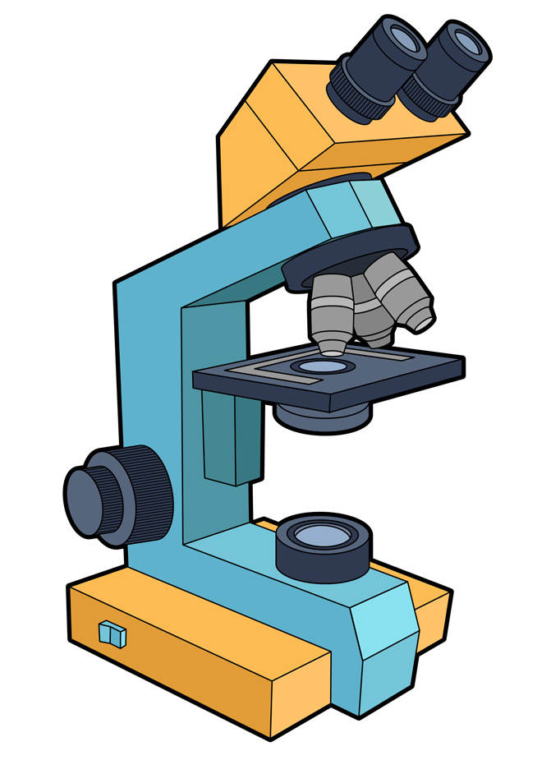
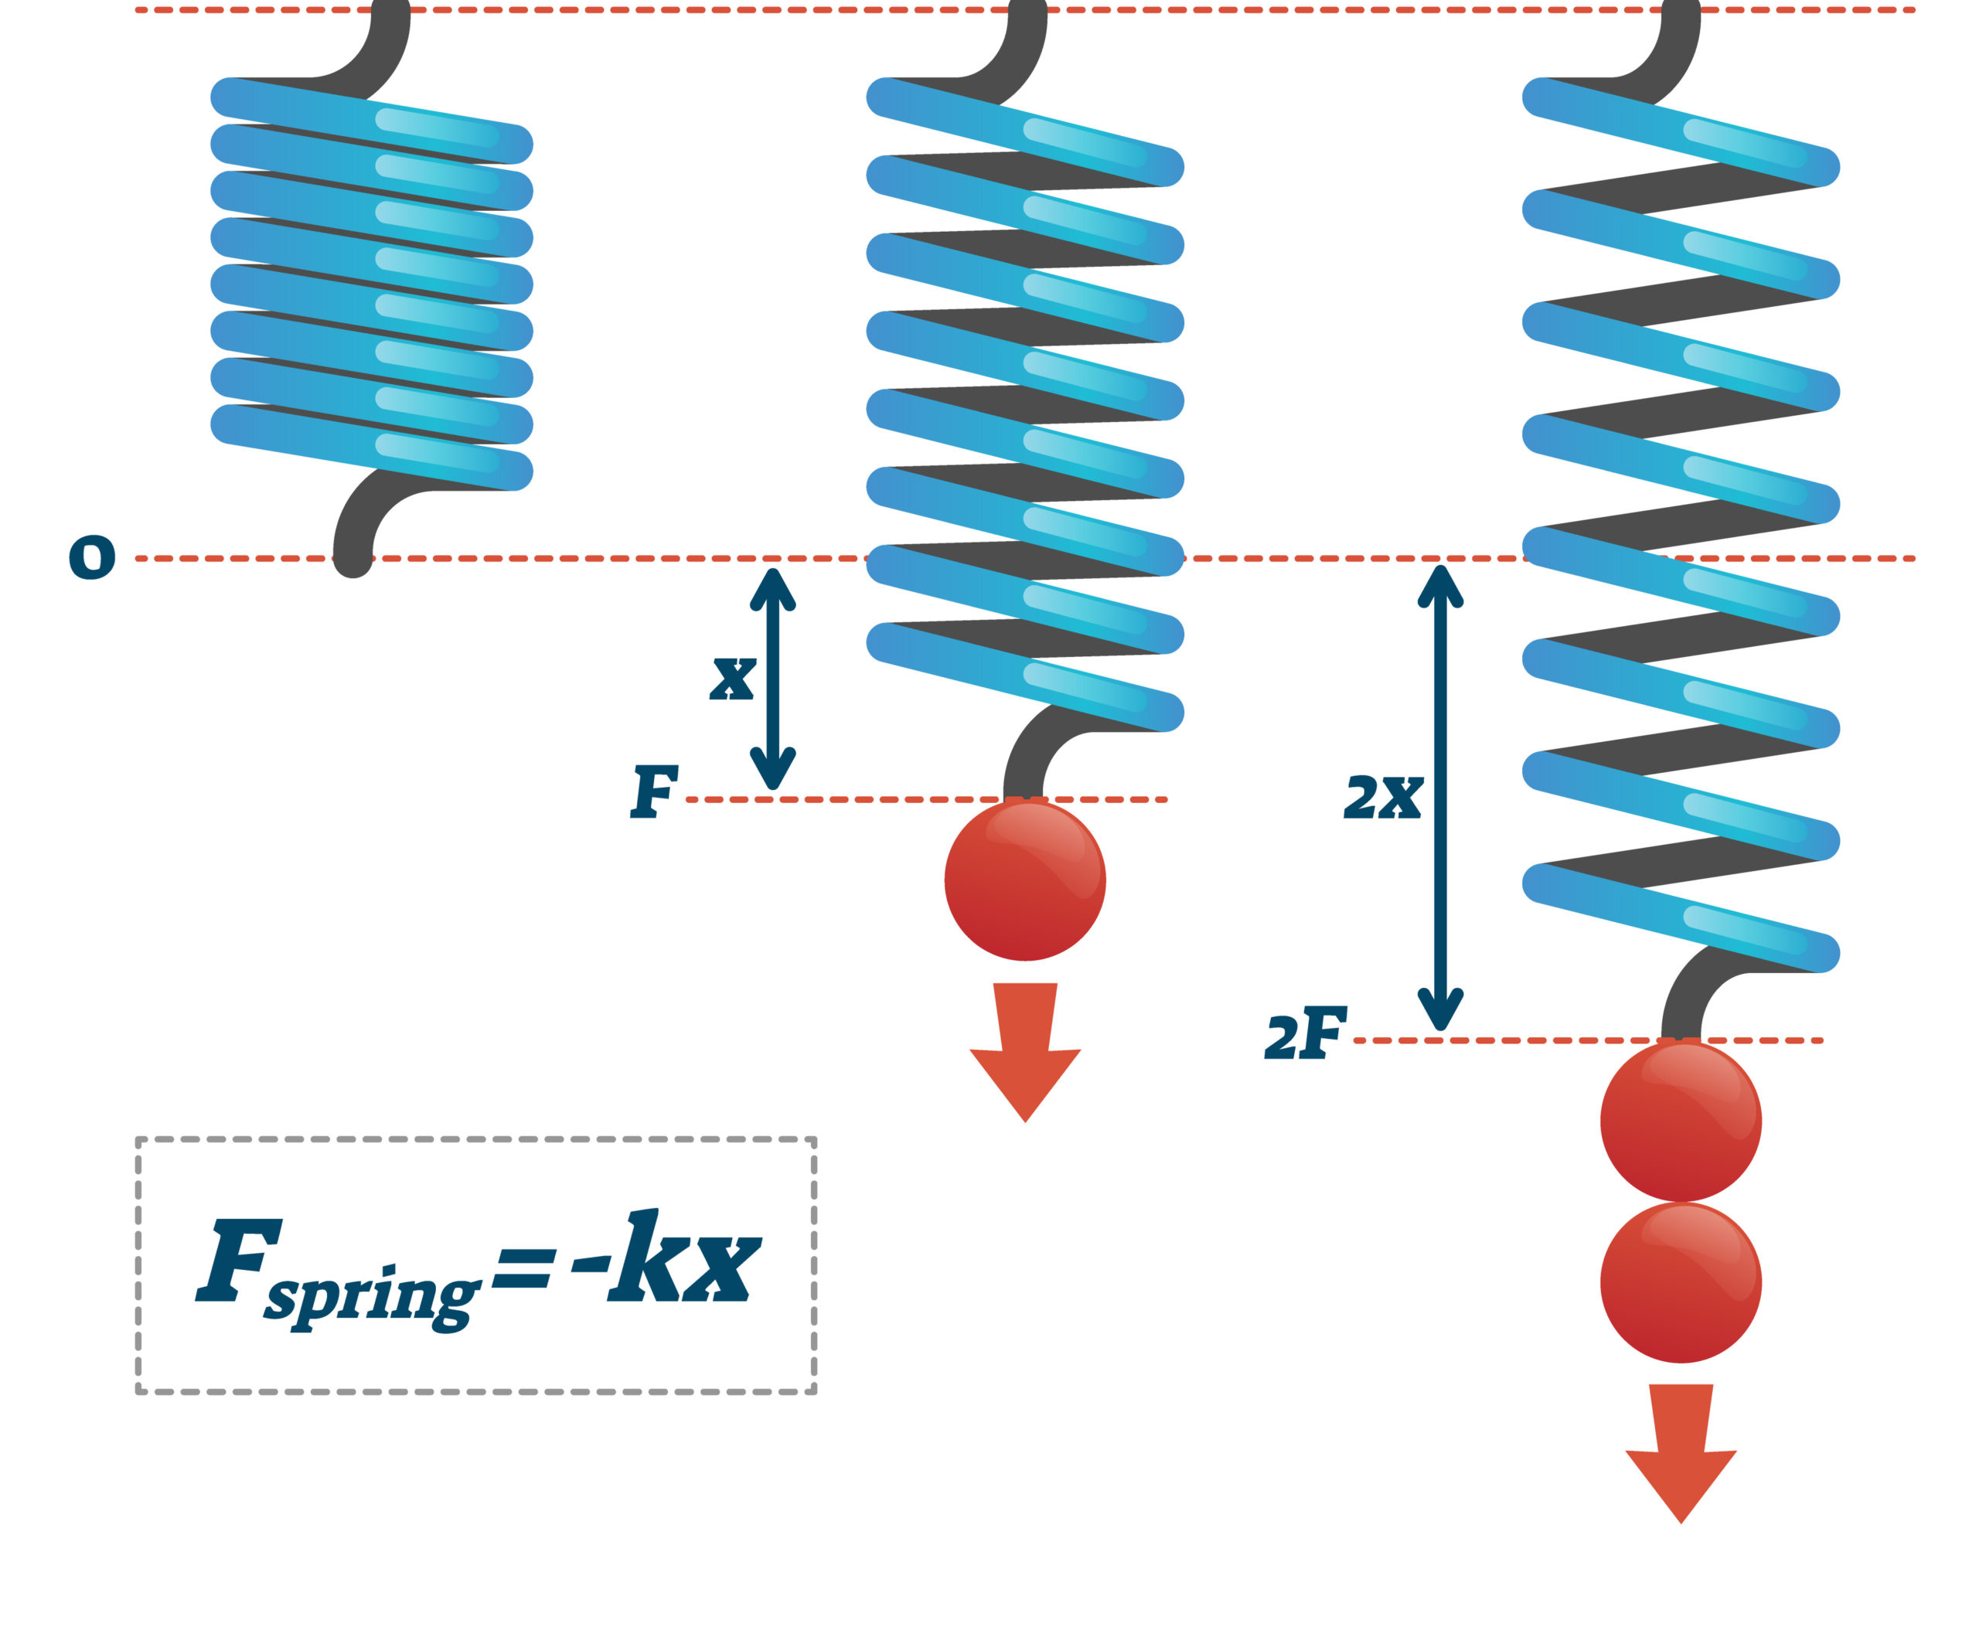
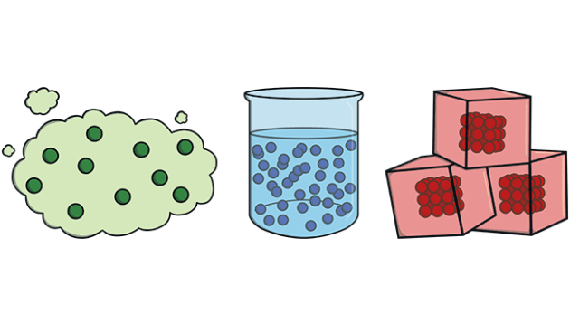
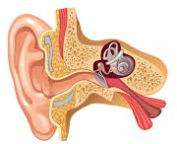
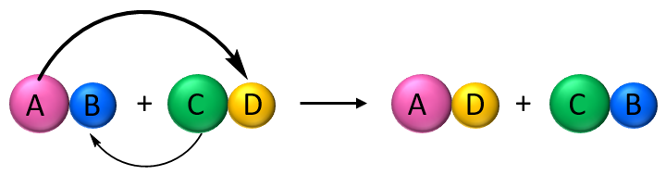
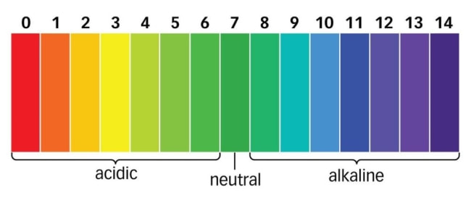
Science - Learning Journey - Year 7
2. Forces – Contact and non-contact forces, Hooke’s Law and pressure.
1. Cells - A study of the different types of cells in multicellular and unicellular organisms.
Year 7
3. Particles – States of matter, diffusion and energy changes.
5. Waves – an exploration of longitudinal and transverse waves, the ear and the uses of ultrasound.
4. Organisation – A topic that explores organ systems, gas exchange and the skeletal and muscular system.
6. Elements – An investigation into atoms, elements and compounds used in displacement reactions.
9. Chemical Reactions – an exploration of the different types of reactions that take place such as neutralisation reactions and the various metals undertake.
7. Reproduction – an exploration of adolescence, reproduction and the menstrual cycle.
Year 8
8. Light – an introduction into reflection, refraction and how we see colour.
10. Space – A study of planets and stars, gravity and the different seasons we experience.

Slide 2
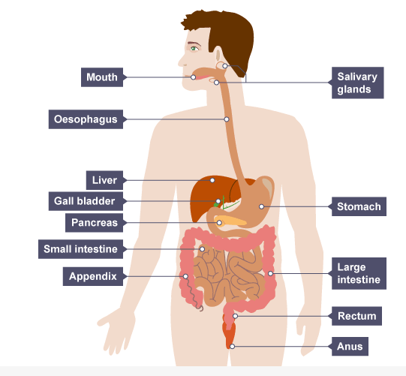
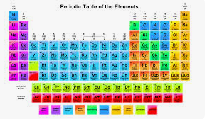
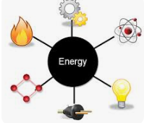
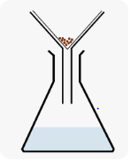
Science - Learning Journey - Year 8
2. Electricity - Students will learn about electric charge, what batteries do, circuit components and resistance.
3. Periodic Table – An exploration of how to classify elements, finding out about patterns in chemical and physical properties.
1. Digestion and Organisation - A study of how food is used in the body and the benefits of a healthy lifestyle.
Year 8
5. Energy – Sudents will learn abou the differen store of energy, how energy can be transferred and doing work.
6. Separating mixtures – A study of the differences beyween pure and imopure substnces and how to separate mixtures of substances.
4. Ecology – Students will find out about how we get energy from food, how micro-organisms use respiration and learn how plants produce food.
7. Inheritance and evolution – Students will find out how the organisms living today have evolved, how to preserve biodiversity and how organisms inherit characteristics from their parents.
8. Forces – a study of forces; how they arise and how they change the motion of an object.
Year 9
10. Climate and the Earth’s resources – An exploration of how The Earth formed and how crucial substances are recycled through our atmosphere.
9. Metals and Non-metals – A study of the properties of metals and non-metals, the reactions of metals and the trends in reactivity.

Slide 3
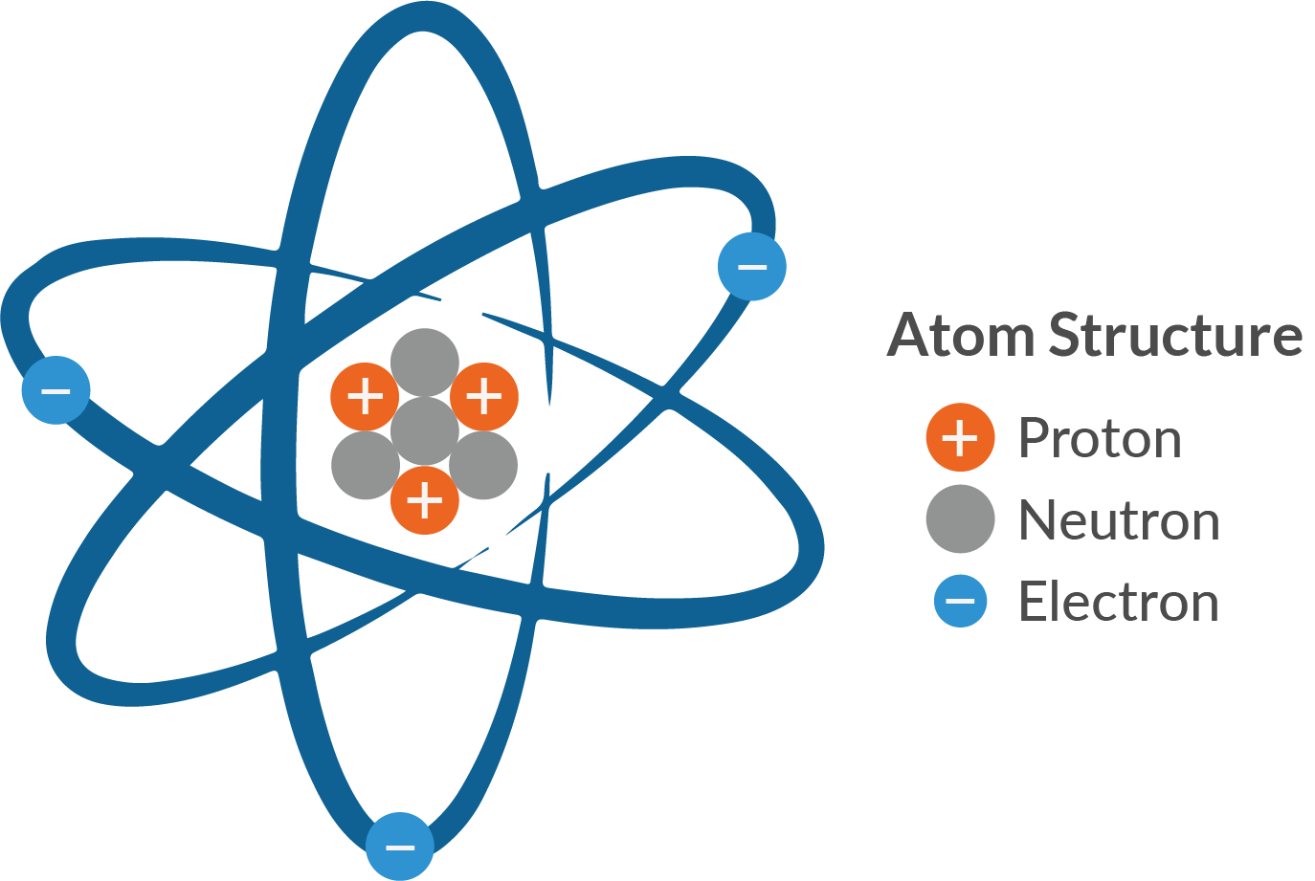
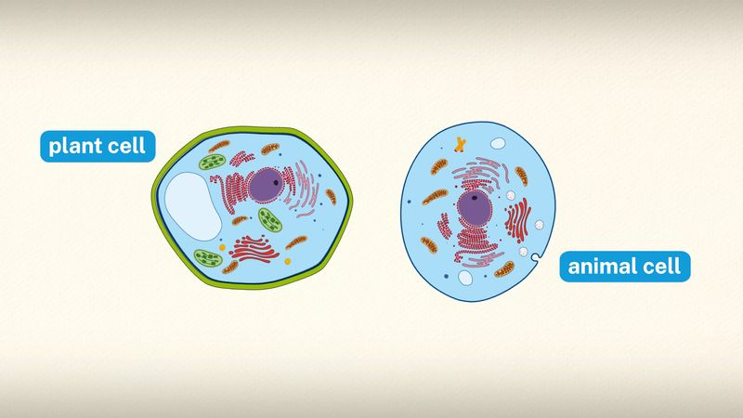
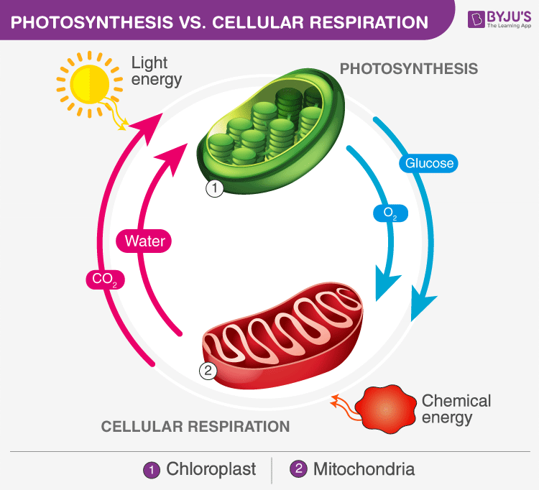
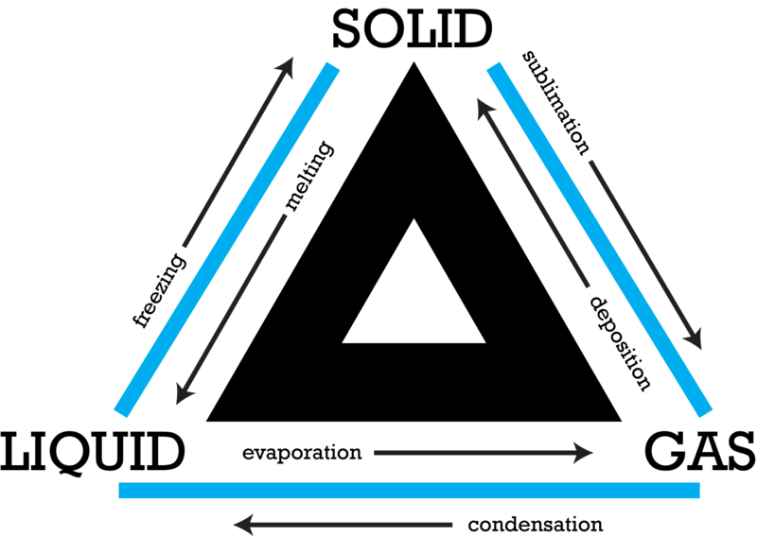
Science - Learning Journey - Year 9
2. New Technology in Chemistry – A study of the use of nanoparticles in medicine and ways of reducing emissions through investment into hybrid cars.
1. Turning Points in Biology - A study of revlolutionary discoveries such as, DNA, vaccines, antibiotics and extinctions.
Year 9
3. Turning Points in Physics – A study of how the Big Bang has moulded current theories of the Big Bang and our existence.
5. Atoms, Element and Compounds. A study of atoms, elements, compounds and mixtures and separation techniques.
4. Cells – A study of prokaryotic and eukaryotic cells.
6. Particle Model– A study of how subtsances change state due to the amount of energy energy supplied.
7. Cell Transport and Division – a study of how substances enter and leave cells and how cells divide.
Year 10
8. Structure of the atom – a study of how models of atoms have change dover time up until the current model of the atom.
9. Photosynthesis and Respiration – a study of the chemical reactions within the cells of living things

Slide 4
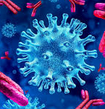
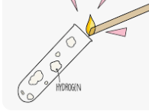
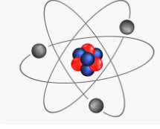
Science - Learning Journey - Year 10
1. Organisation – A study of how cells are organised into tissues, organs, systems and organisms. Looking at the digestive system and circulatory system
2. Infection and Response – A study of how pathogens can cause infectious disease, human defence against disease and development of drugs.
Year 10
3. Quantitative Chemistry Use of quantitative analysis to determine the formulae of compounds and the equations for reactions.
4. Energy – A study of energy stores and transfers, using and rearragning mathematical equations.
5. Homeostasis and Response - An exploration of how the nervous and endocrine systems maintain a constant internal environment .
6. Atomic Structure – Explore past and current models of the atom, describe different types of radiation and their effects and uses.
7. Chemical Changes Exploring chemical reactions and changes to understand complex reactions that take place in living organisms
8. Inheritance, Variation and Evolution – A study of the variation between living organisms, the genetic cause of these and a study of how living things have gradually changed over time.
Year 11
9. Forces – Develop understanding of Newton’s Laws
11. Bioenergetics – an exploration of the processes photosynthesis and respiration and their intrinsic link.
10. Rate of Reaction – Explore how changing factors can alter the rate of a chemical reaction.

Slide 5
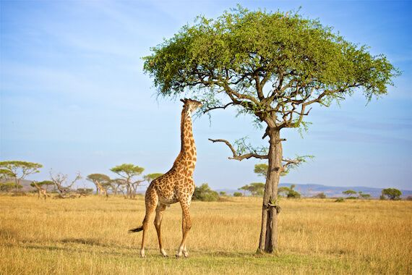
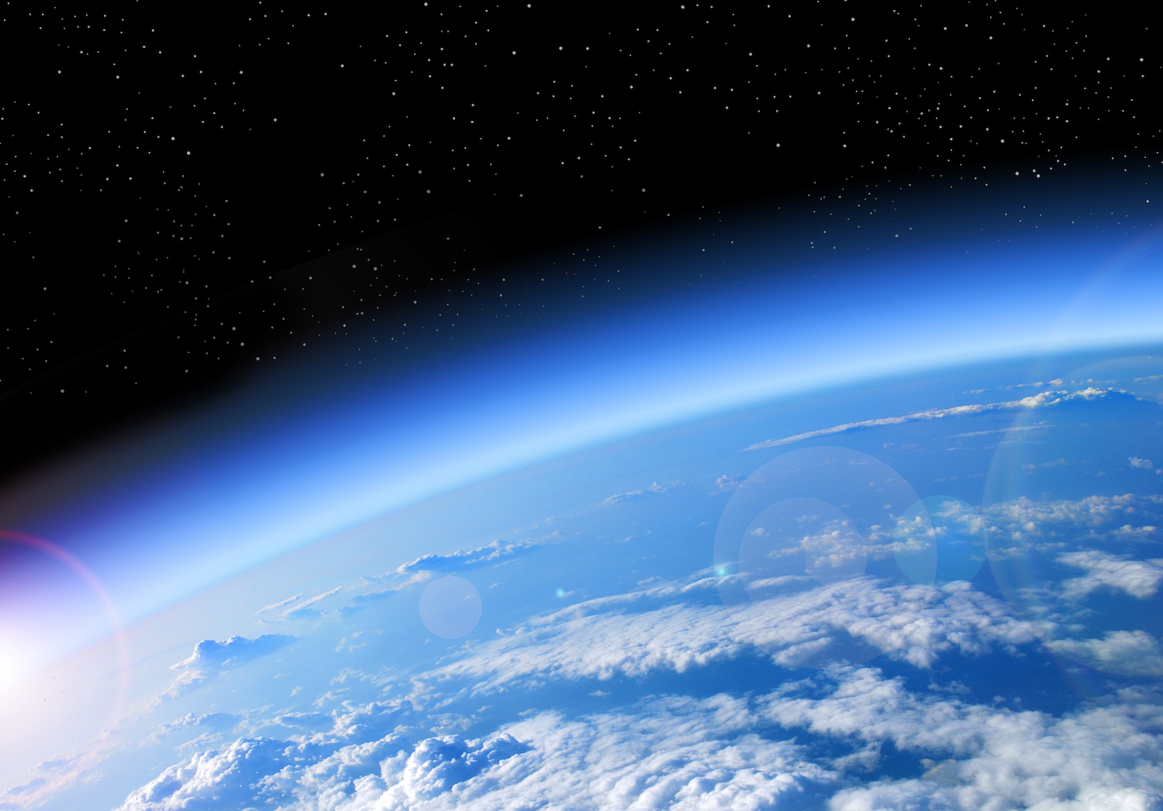
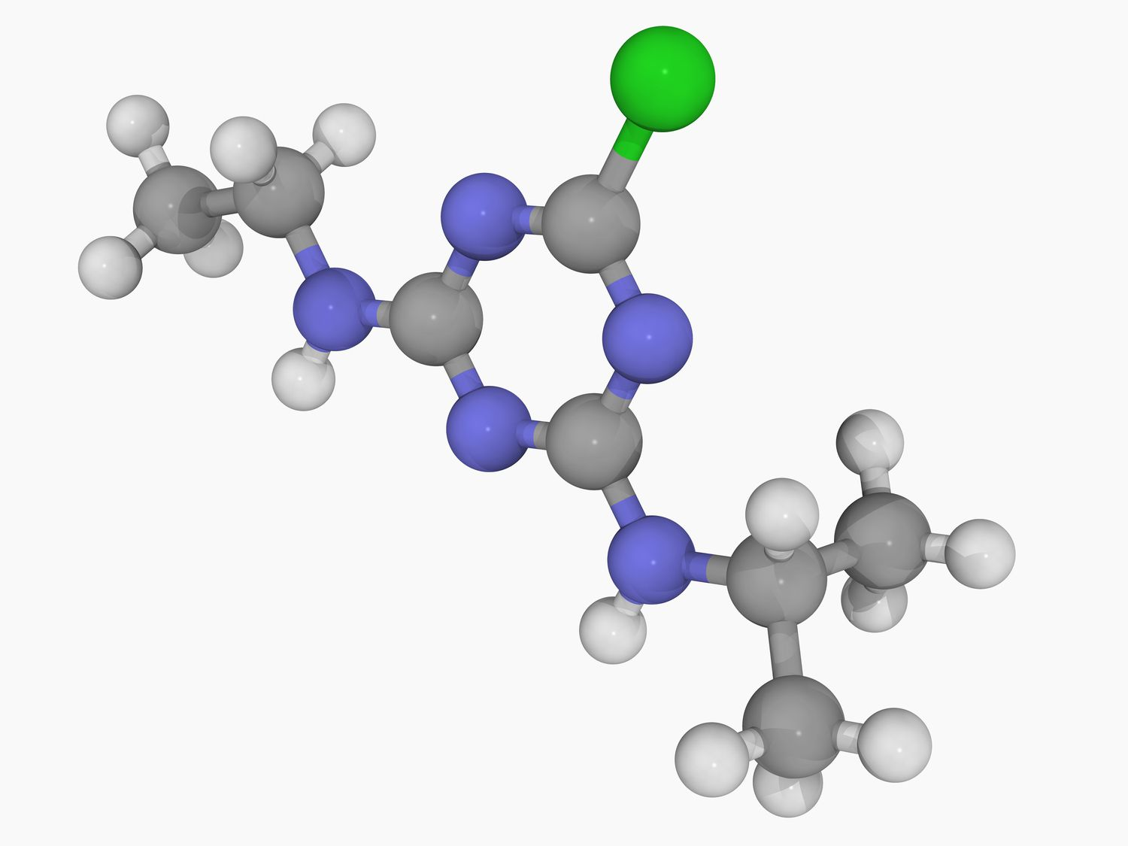
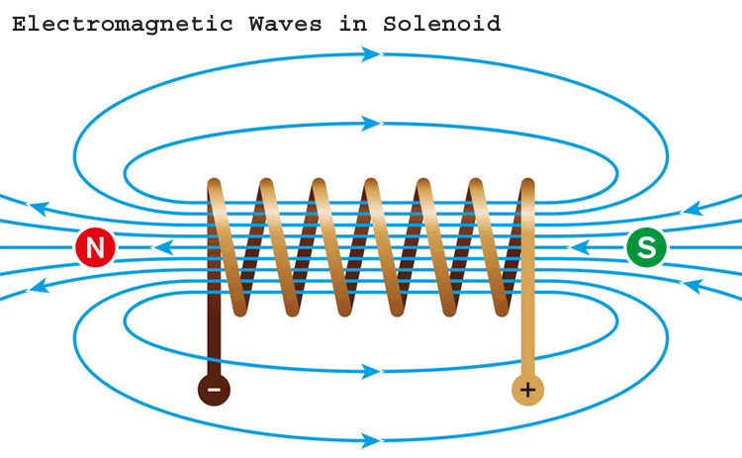
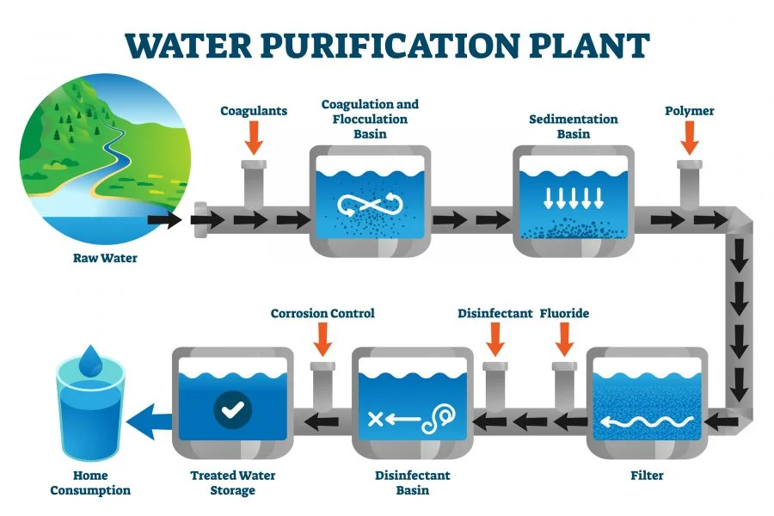
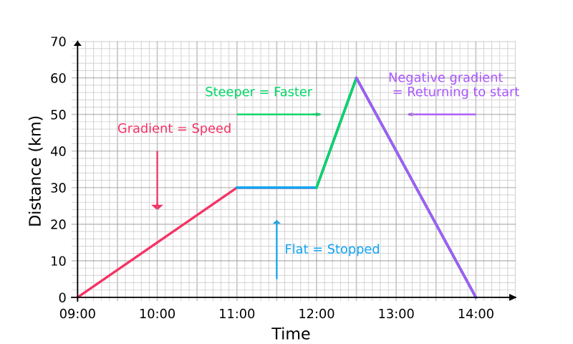
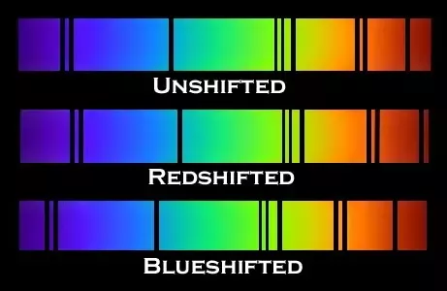
Science - Learning Journey - Year 11
1. Ecology - A study of the living world around us, exploring biodiversity, adaptations and the carbon and water cycle.
2. Chemistry of the Atmosphere – An investigation into the composition and evolution of the Earth’s atmosphere.
Year 11
4. Magnetism and Electromagnetism – A study of how magnets and electricity can work together to induce magnetic fields to prove the motor effect.
3. Organic Chemistry – A study of carbon-based compounds and the reactions they undergo such as addition and condensation reactions.
5. Using Resources – A study of how safe to drink water is obtained, metals are extracted and the impact on the Earth’s environment.
7. Forces Part 2 – A study of elasticity, moments, levers and gears along with a study of D-T and V-T graphs.
Exams
6. Waves – An exploration into Longitudinal and Transverse waves, the wavespeed equation and an analysis of the electromagnetic spectrum.
8. Space (triple) – A study of the solar systems, satellites, red-shift and the life cycle of a star.

