Slide 1
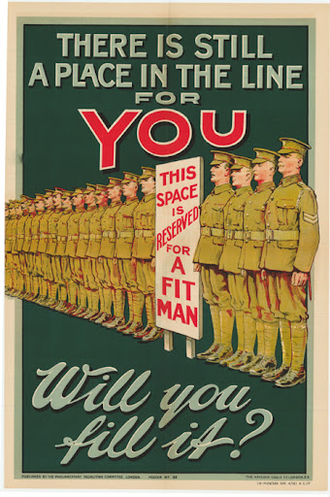
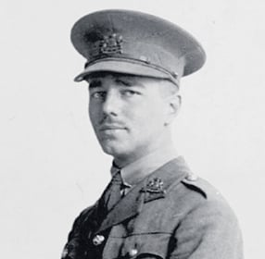
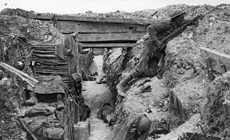
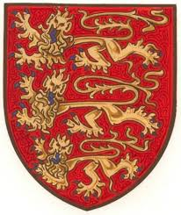
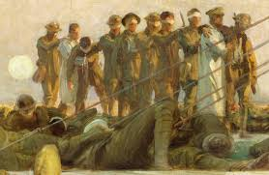
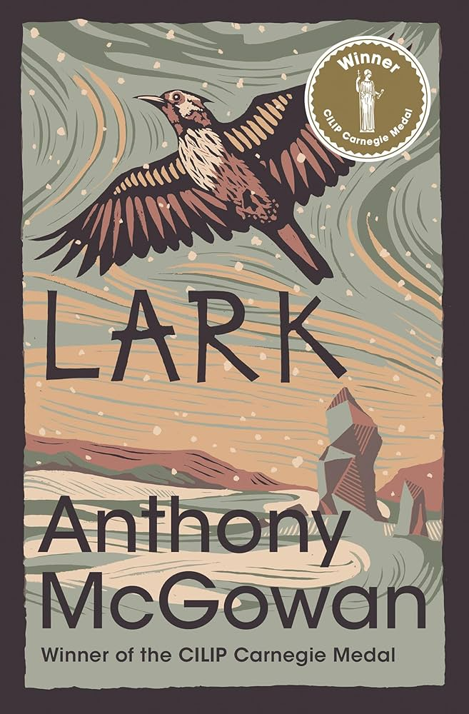
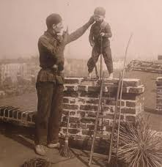
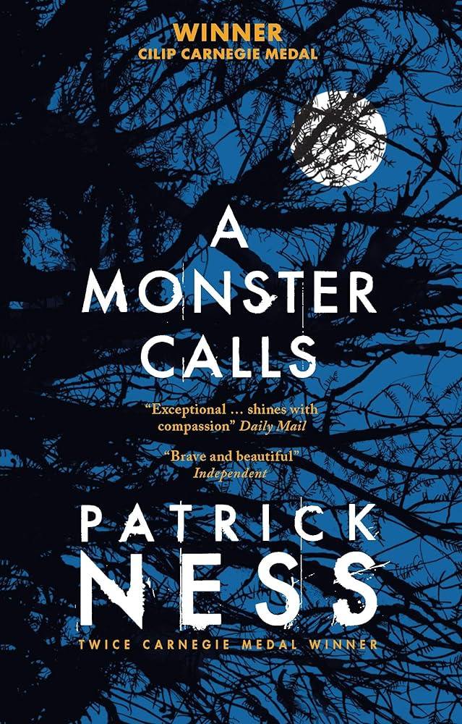
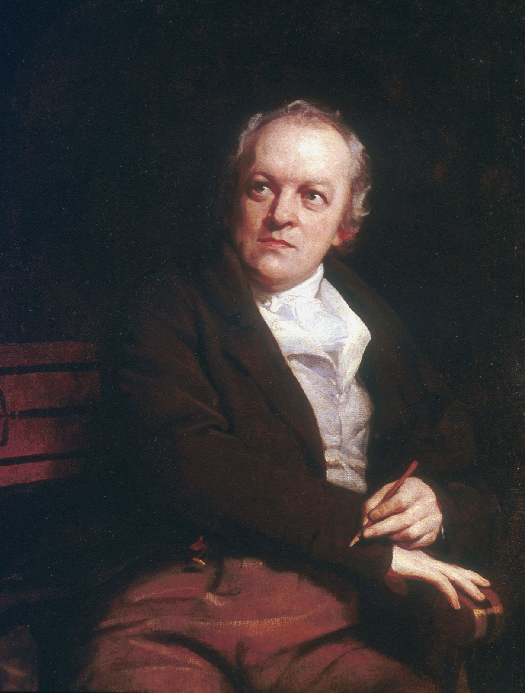
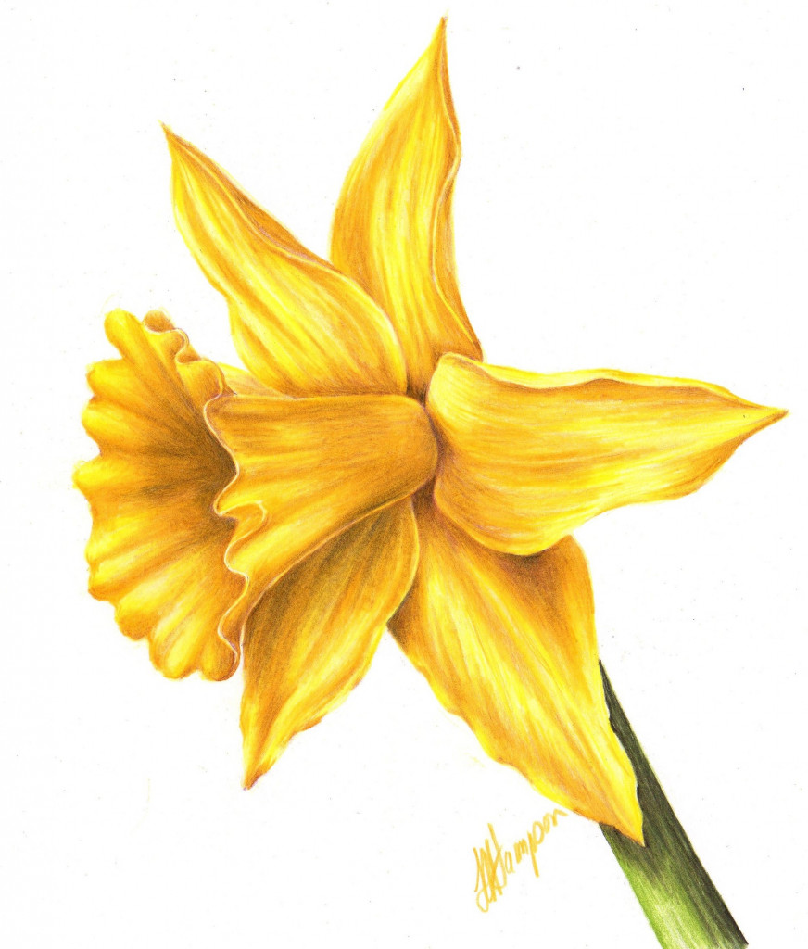
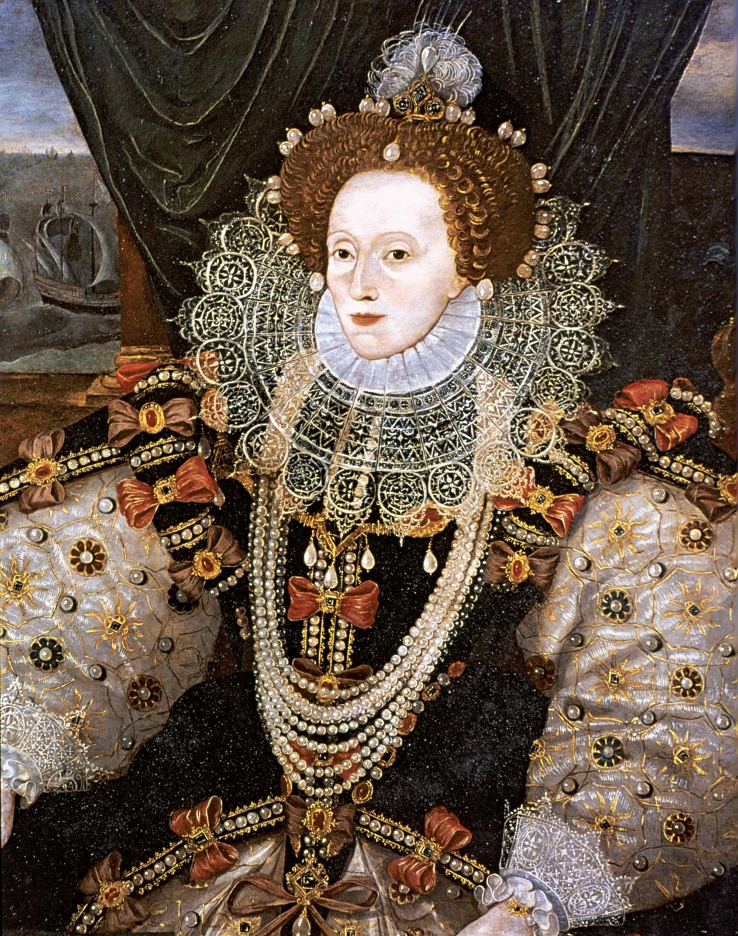
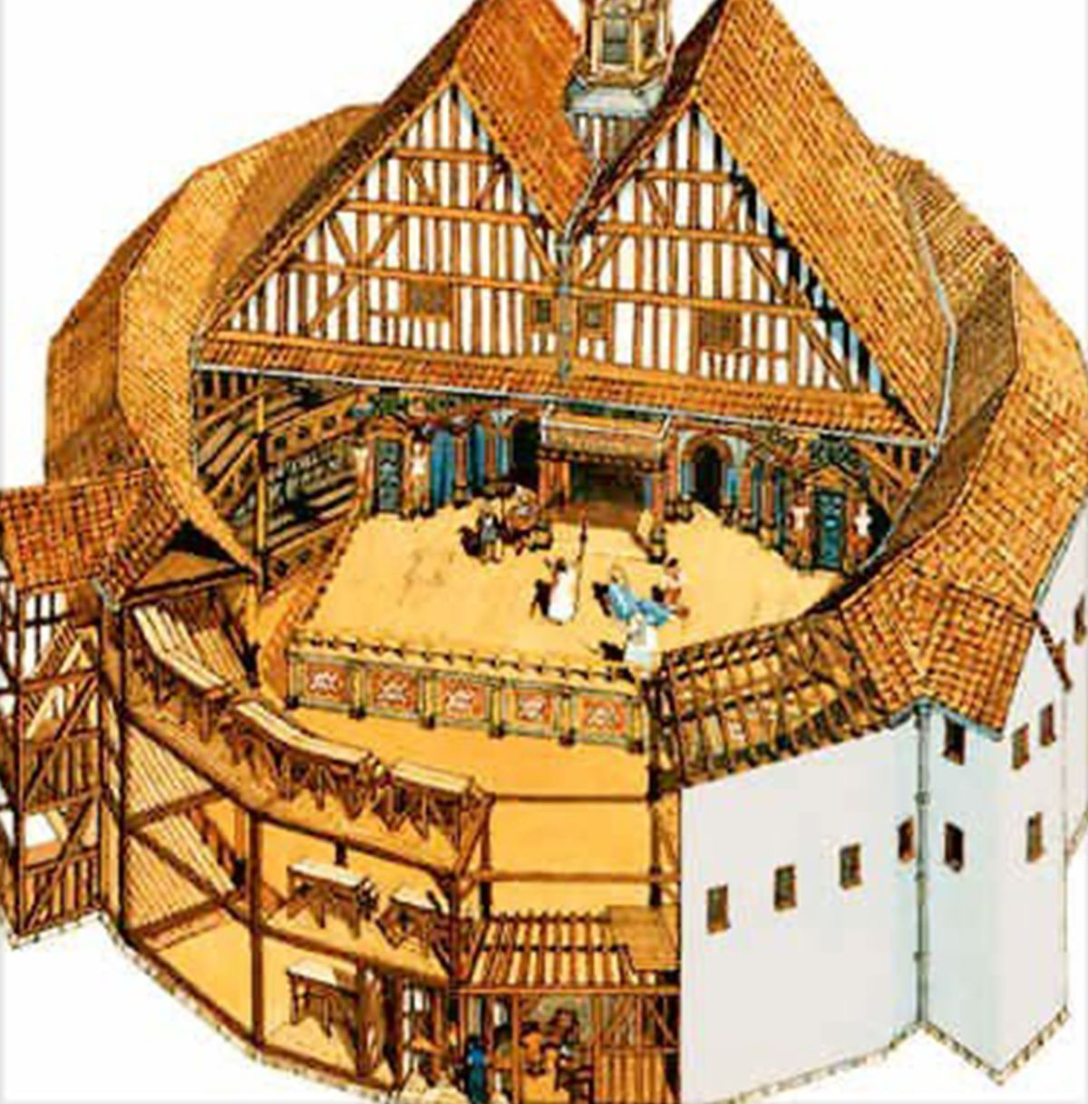
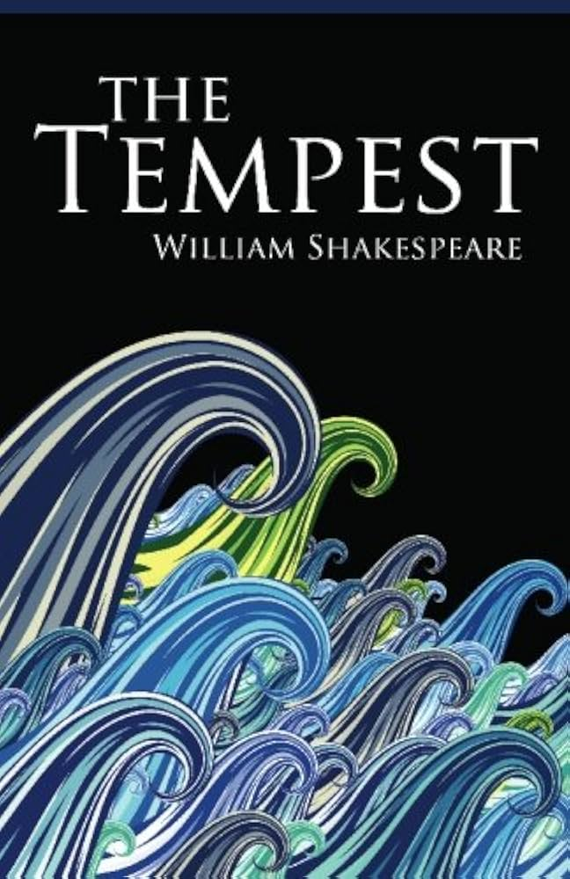
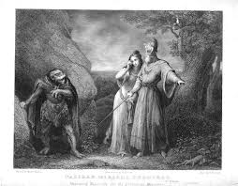
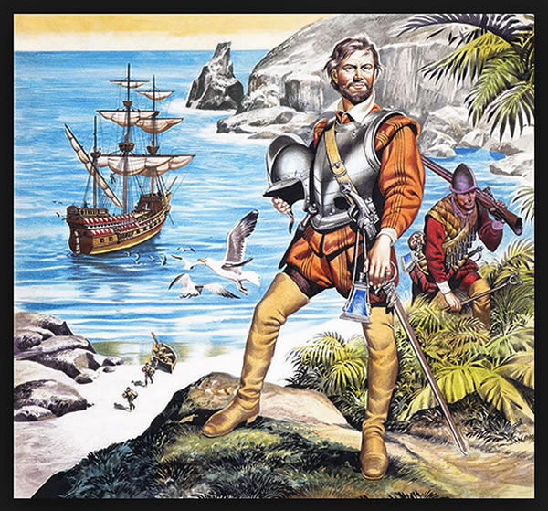
English - Learning Journey – Year 7
Assessment Point One
R :How does the writer use language to present the reality of war?
W :A persuasive speech arguing why war and revenge must be avoided at all costs.
Year 7
The Journey Starts!
You will explore how literature presents different attitudes to war. From a sense of patriotic duty and excitement to the reality once in the midst of battle. In examining key texts, you will question the idea if war can ever be justified and understand why remembrance is more powerful than retribution.
Spring Term
The Power of Nature : Hubris and Humility
Autumn Term
The World at War : From Propaganda to Peace
From Romanticism to modern writing, you will explore how writers present the beauty and power of nature. Throughout your reading, you will also examine nature's relationship with man, and how conflict is created and resolved, with lessons being taught by nature.
Assessment Point Two
R :How does the writer use language to present nature as a healing and helpful force?
W :A descriptive writing task
focusing on the power and beauty
of nature.
Assessment Point Three
R: How does the writer use language to present the character of Caliban as an outsider?
W: A non-chronological report to inform and advise on Elizabethan society.
Year 8
Your introduction to Shakespeare will explore the playwright's life and the Elizabethan world, with a focus on explore conflict between society and being misunderstood.
Summer Term
Shakespeare Study I :
Misunderstood and Misconceptions

Slide 2
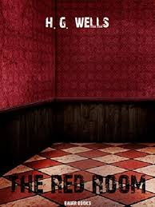
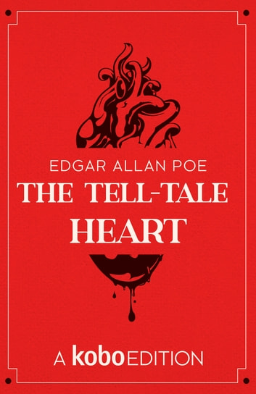
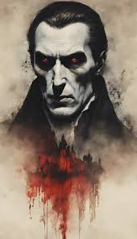
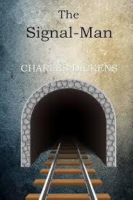
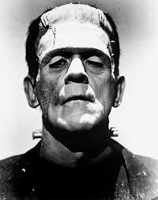
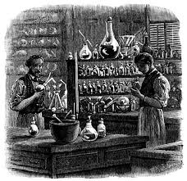
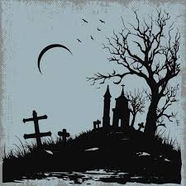
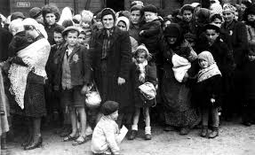
English - Learning Journey – Year 8
Assessment Point One
R :How does the writer use language to tension and fear?
W : A descriptive writing task in response to the meeting of a gothic image.
Year 8
The Journey Starts!
You will explore the Gothic genre by examining extracts and poems to secure your understanding of the key components and expectation of the genre. You will consider how a writer use language and techniques to build appropriate characters, settings and reactions.
Spring Term
Crime and Punishment : Victims and Villainy
Autumn Term
The Gothic : Unseen, Unheard and Unknown
After studying the unknown and mystery of the Gothic genre, your attention will turn from superstition to suspects and Sherlock Holmes! You will examine how detective fiction was developed and the quest for justice.
Assessment Point Two
R : How does the writer use language to present the character as a villain?
W : To create your own opening or extract for a Penny Dreadful
Assessment Point Three
R : How far do you agree with the following statement : Alem Kelo and refugees are vulnerable and need protection from society?
W : A persuasive letter to an MP arguing why more still needs to be done to combat discrimination and defend the rights of refugees.
Following on from the summer unit of Year 7, this unit will examine the experiences of those who are marginalized and left powerless within society. It will centre on how aspects of identity cause conflict.
Year 9
Summer Term
Different Perspectives : Stereotypes, Separation and Silence

Slide 3
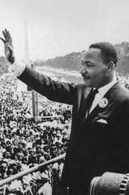
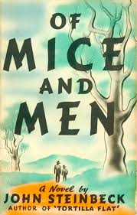
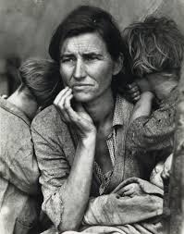
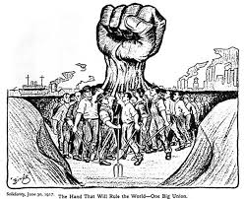
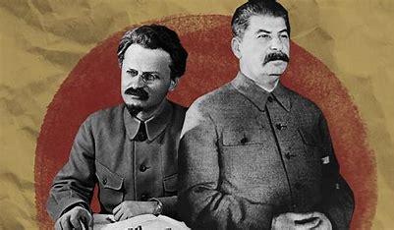
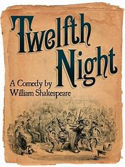
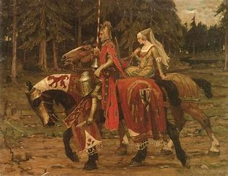
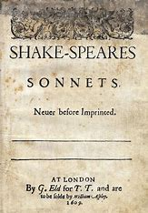
English - Learning Journey – Year 9
Assessment Point One
R : How does the writer use language to present the themes of friendship, honour and justice?
W : Write a non-chronological report on 1930s American society and the loss of the American Dream.
Year 9
The Journey Starts!
You will study the theme of social justice by examining different representations and how society exploits the vulnerable and creates conflict. Texts studied will act as a mirror emphasizing the importance of challenging injustice.
Spring Term
Protests : Rebellion and Revolution
Autumn Term (Seminal World Literature)
Social Justice: Challenging Stereotypes and Discrimination
You begin a political exploration of key ideologies and systems and how power can be abused leading to dystopic worlds and the fight back for freedom , democracy and humanity.
Assessment Point Two
R : How does the writer present the character of Napoleon?
W:A persuasive speech to argue why democracy and a person’s right to vote must be protected.
Assessment Point Three
R:How does the writer use language to present the power of love?
W:A narrative writing task in response to the title ‘Heartbroken’.
You will continue to develop your understanding of the Elizabethan world by examining different types of love and the consequences of its power and the development of romantic relationships.
Year 10
Summer Term
Shakespeare Study II
Love and Relationships : Can love conquer all?

Slide 4
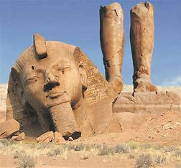
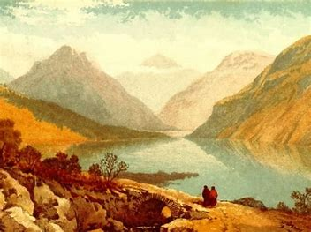
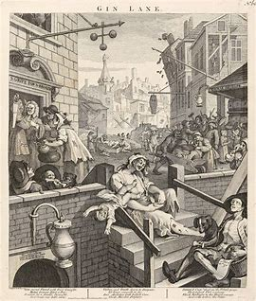
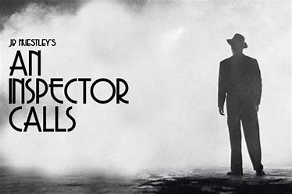
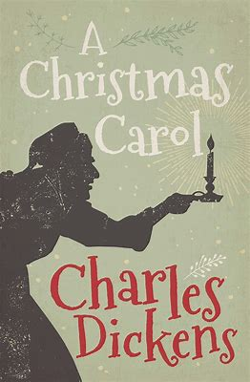
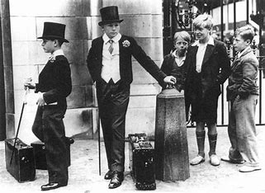
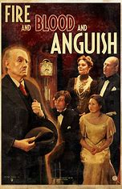
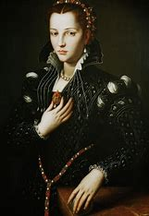
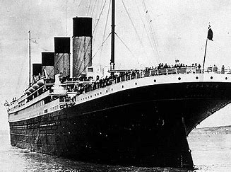
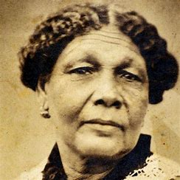
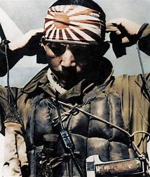
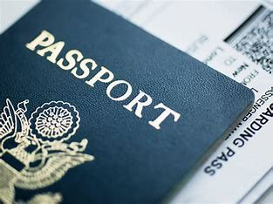
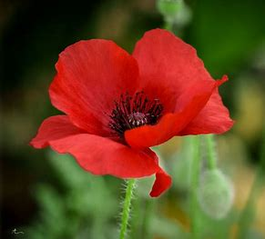
English - Learning Journey – Year 10
Assessment Point One
R : Response to an extract-based exam question
W : Descriptive writing task
Year 10
The Journey Starts!
Throughout Year 10 you will study key literature components and key reading and creative writing skills you will need for Language Paper One.
or
Spring Term
20th century text and a selection of poetry from the cluster
Autumn Term
19th century novel and a selection of poetry from Power and Conflict cluster
Assessment Point Two
R : Response to an exam question
W: Narrative writing task
Assessment Point Three
End of year mock exams
English Language Paper One
English Literature exam
Year 11
Summer Term
Selection of poetry from Power and Conflict cluster centred on theme of identity

Slide 5
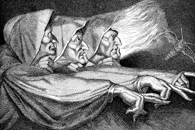
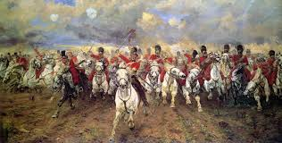
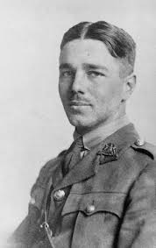
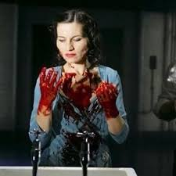
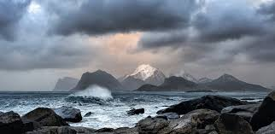
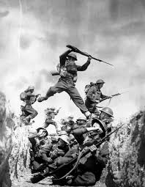
English - Learning Journey – Year 11
Assessment Point One
English Literature Paper One (A Christmas Carol or The Strange Case of Dr Jekyll and Mr. Hyde ONLY)
English Literature Paper Two
Year 11
The Journey Starts!
English Language Paper One
In Year 11 you will conclude your study of literature with Shakespeare's Macbeth and the final poems which focus on war. You will begin revision and exam preparation.
Spring Term
Revision and exam preparation begins
Autumn Term
Shakespeare text and a selection of poetry from Power and Conflict cluster
Assessment Point Two
March Mock Exams
Assessment Point Three
English Literature Paper One
English Literature Paper Two
Summer Term
Final revision and exam preparation
GCSE Exams completed!
English Language Paper One
English Language Paper Two
End

