Slide 1
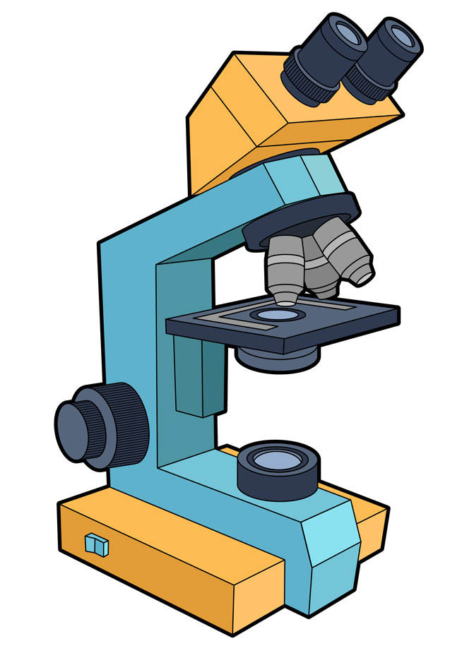
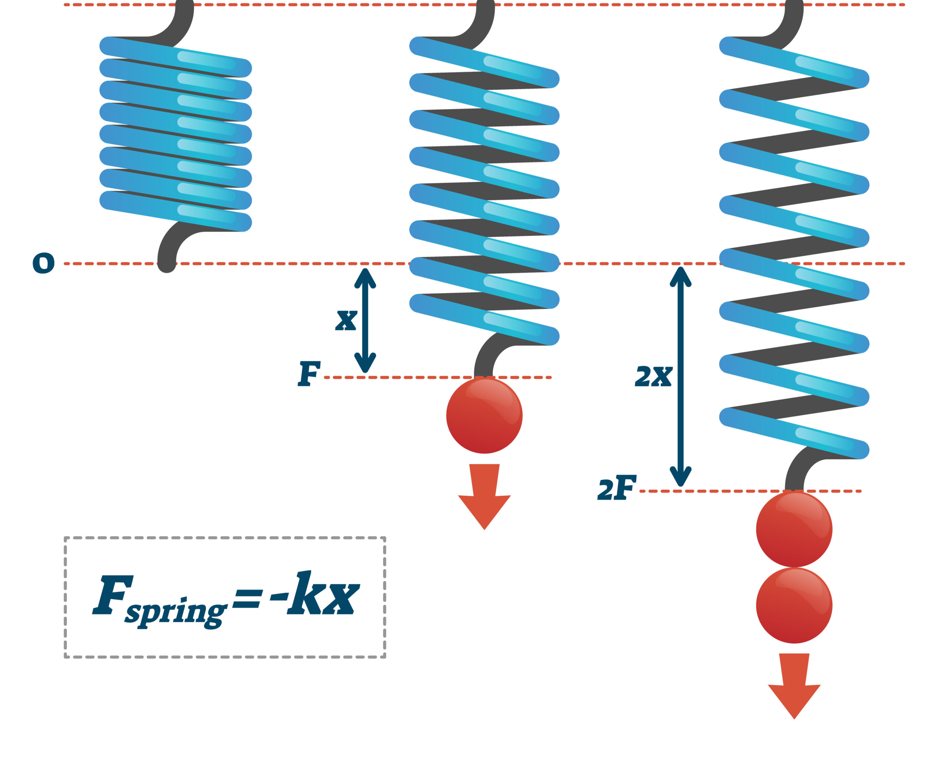

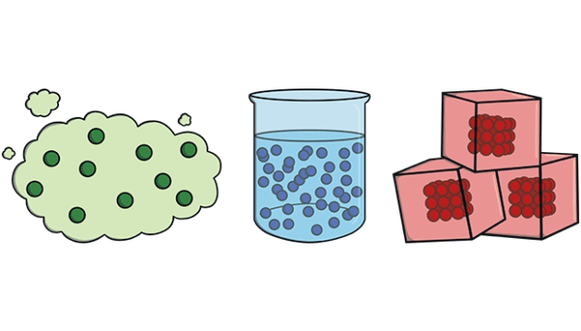
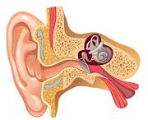
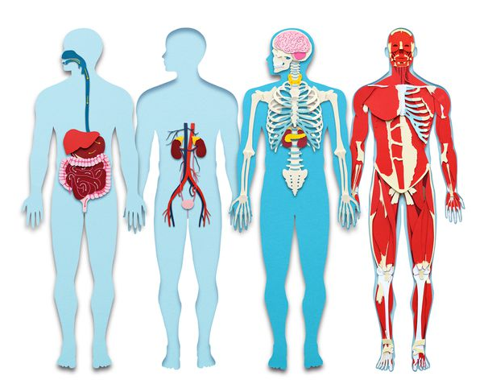
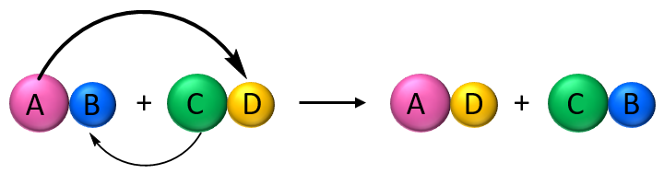
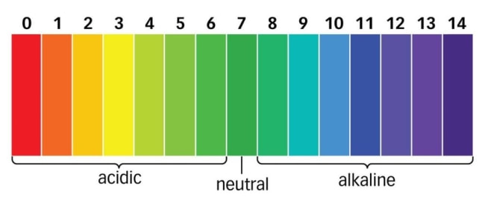

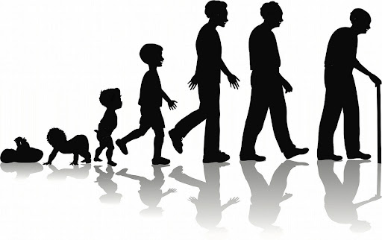
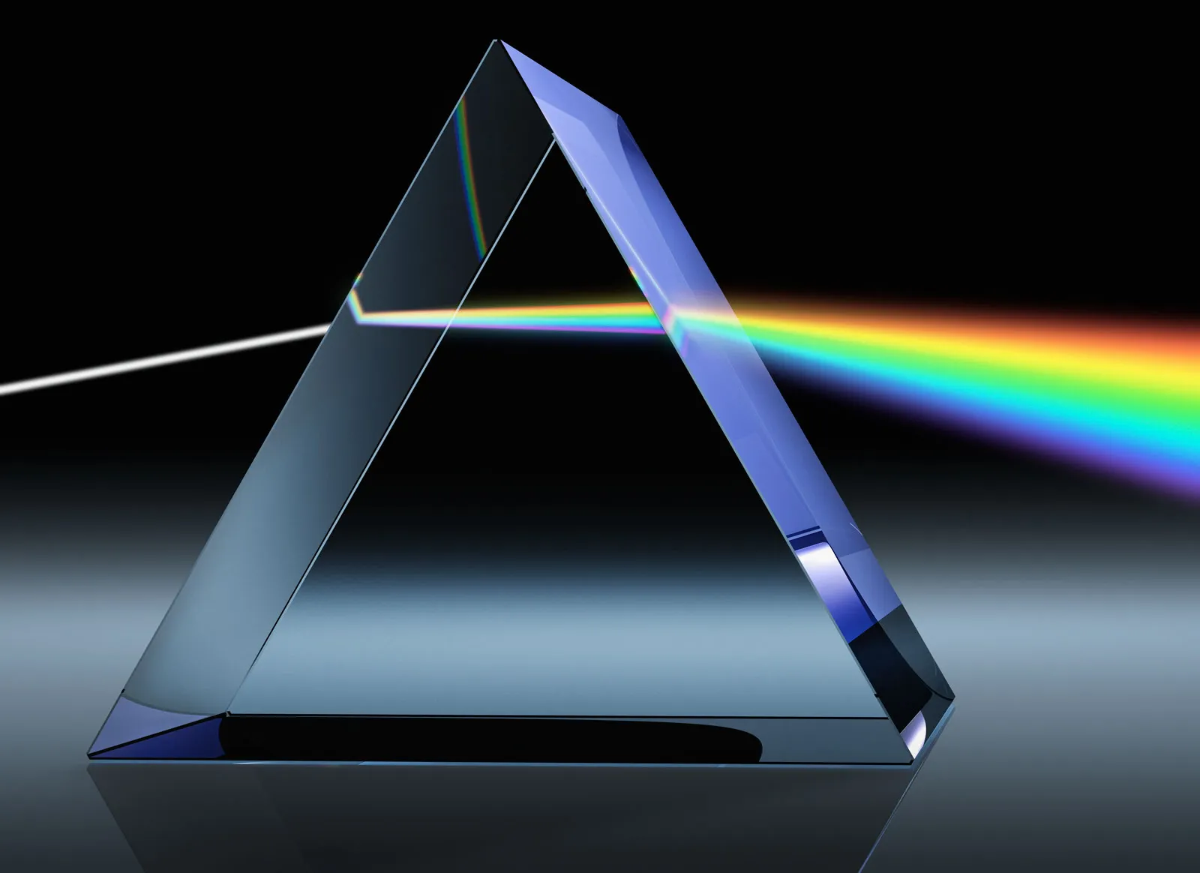
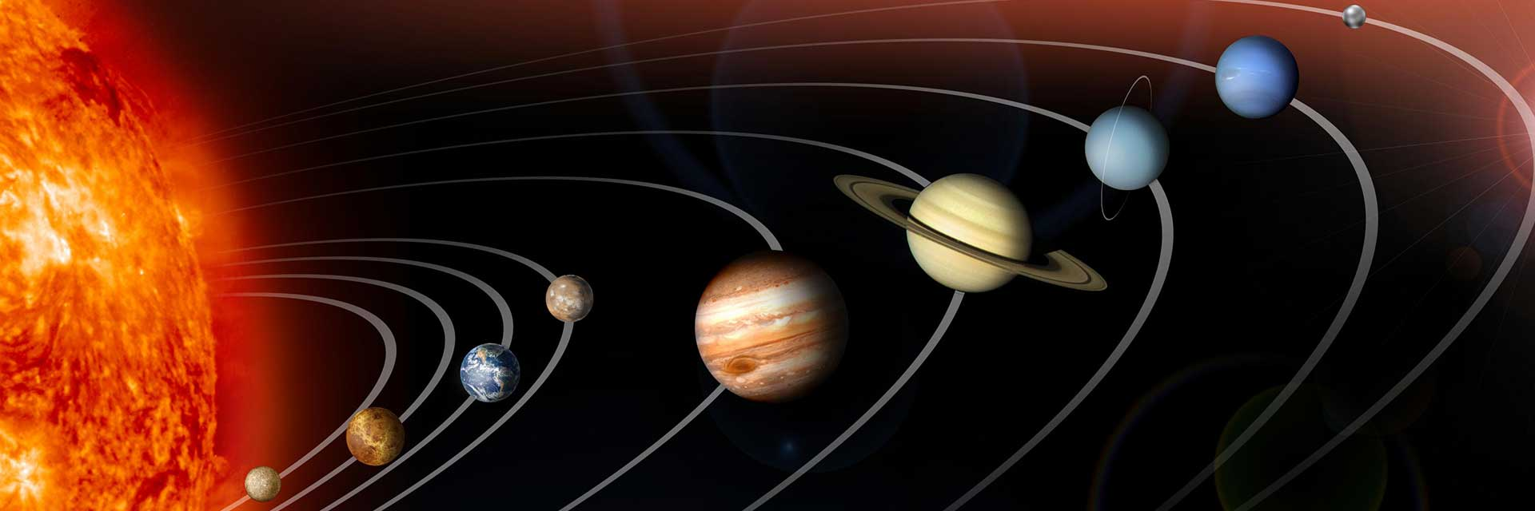
Science - Learning Journey - Year 7
2. Forces – Contact and non-contact forces, Hooke’s Law and pressure.
1. Cells - A study of the different types of cells in multicellular and unicellular organisms.
Year 7
3. Particles – States of matter, diffusion and energy changes.
5. Waves – an exploration of longitudinal and transverse waves, the ear and the uses of ultrasound.
4. Organisation – A topic that explores organ systems, gas exchange and the skeletal and muscular system.
6. Elements – An investigation into atoms, elements and compounds used in displacement reactions.
9. Chemical Reactions – an exploration of the different types of reactions that take place such as neutralisation reactions and the various metals undertake.
7. Reproduction – an exploration of adolescence, reproduction and the menstrual cycle.
Year 8
8. Light – an introduction into reflection, refraction and how we see colour.
10. Space – A study of planets and stars, gravity and the different seasons we experience.

Slide 2
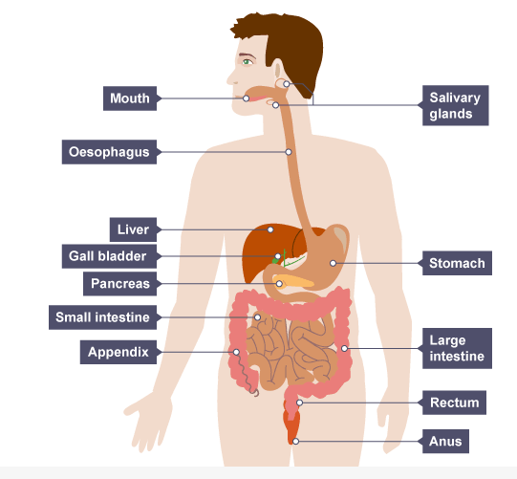

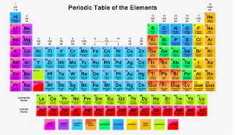
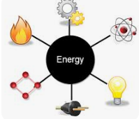
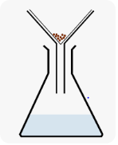




Science - Learning Journey - Year 8
2. Electricity - Students will learn about electric charge, what batteries do, circuit components and resistance.
3. Periodic Table – An exploration of how to classify elements, finding out about patterns in chemical and physical properties.
1. Digestion and Organisation - A study of how food is used in the body and the benefits of a healthy lifestyle.
Year 8
5. Energy – Sudents will learn abou the differen store of energy, how energy can be transferred and doing work.
6. Separating mixtures – A study of the differences beyween pure and imopure substnces and how to separate mixtures of substances.
4. Ecology – Students will find out about how we get energy from food, how micro-organisms use respiration and learn how plants produce food.
7. Inheritance and evolution – Students will find out how the organisms living today have evolved, how to preserve biodiversity and how organisms inherit characteristics from their parents.
8. Forces – a study of forces; how they arise and how they change the motion of an object.
Year 9
10. Climate and the Earth’s resources – An exploration of how The Earth formed and how crucial substances are recycled through our atmosphere.
9. Metals and Non-metals – A study of the properties of metals and non-metals, the reactions of metals and the trends in reactivity.

Slide 3
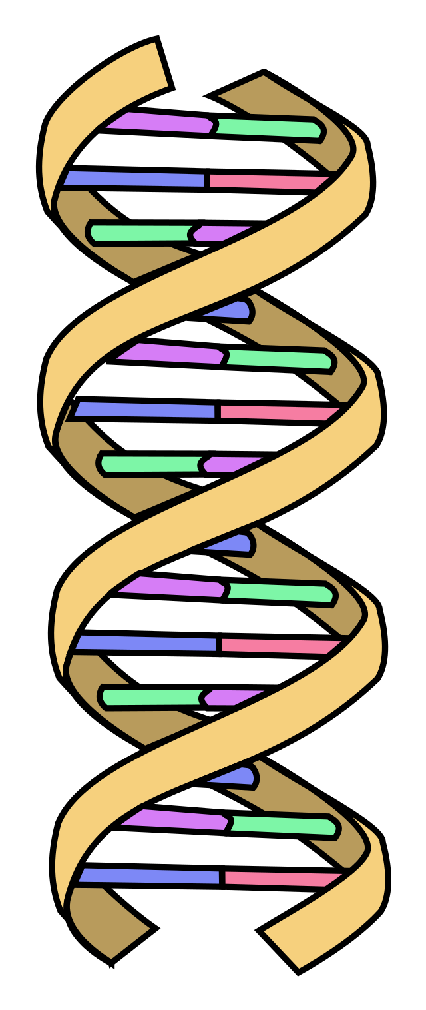
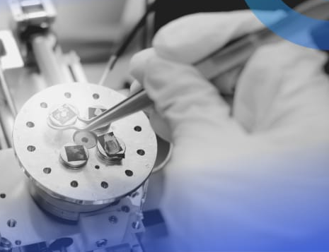
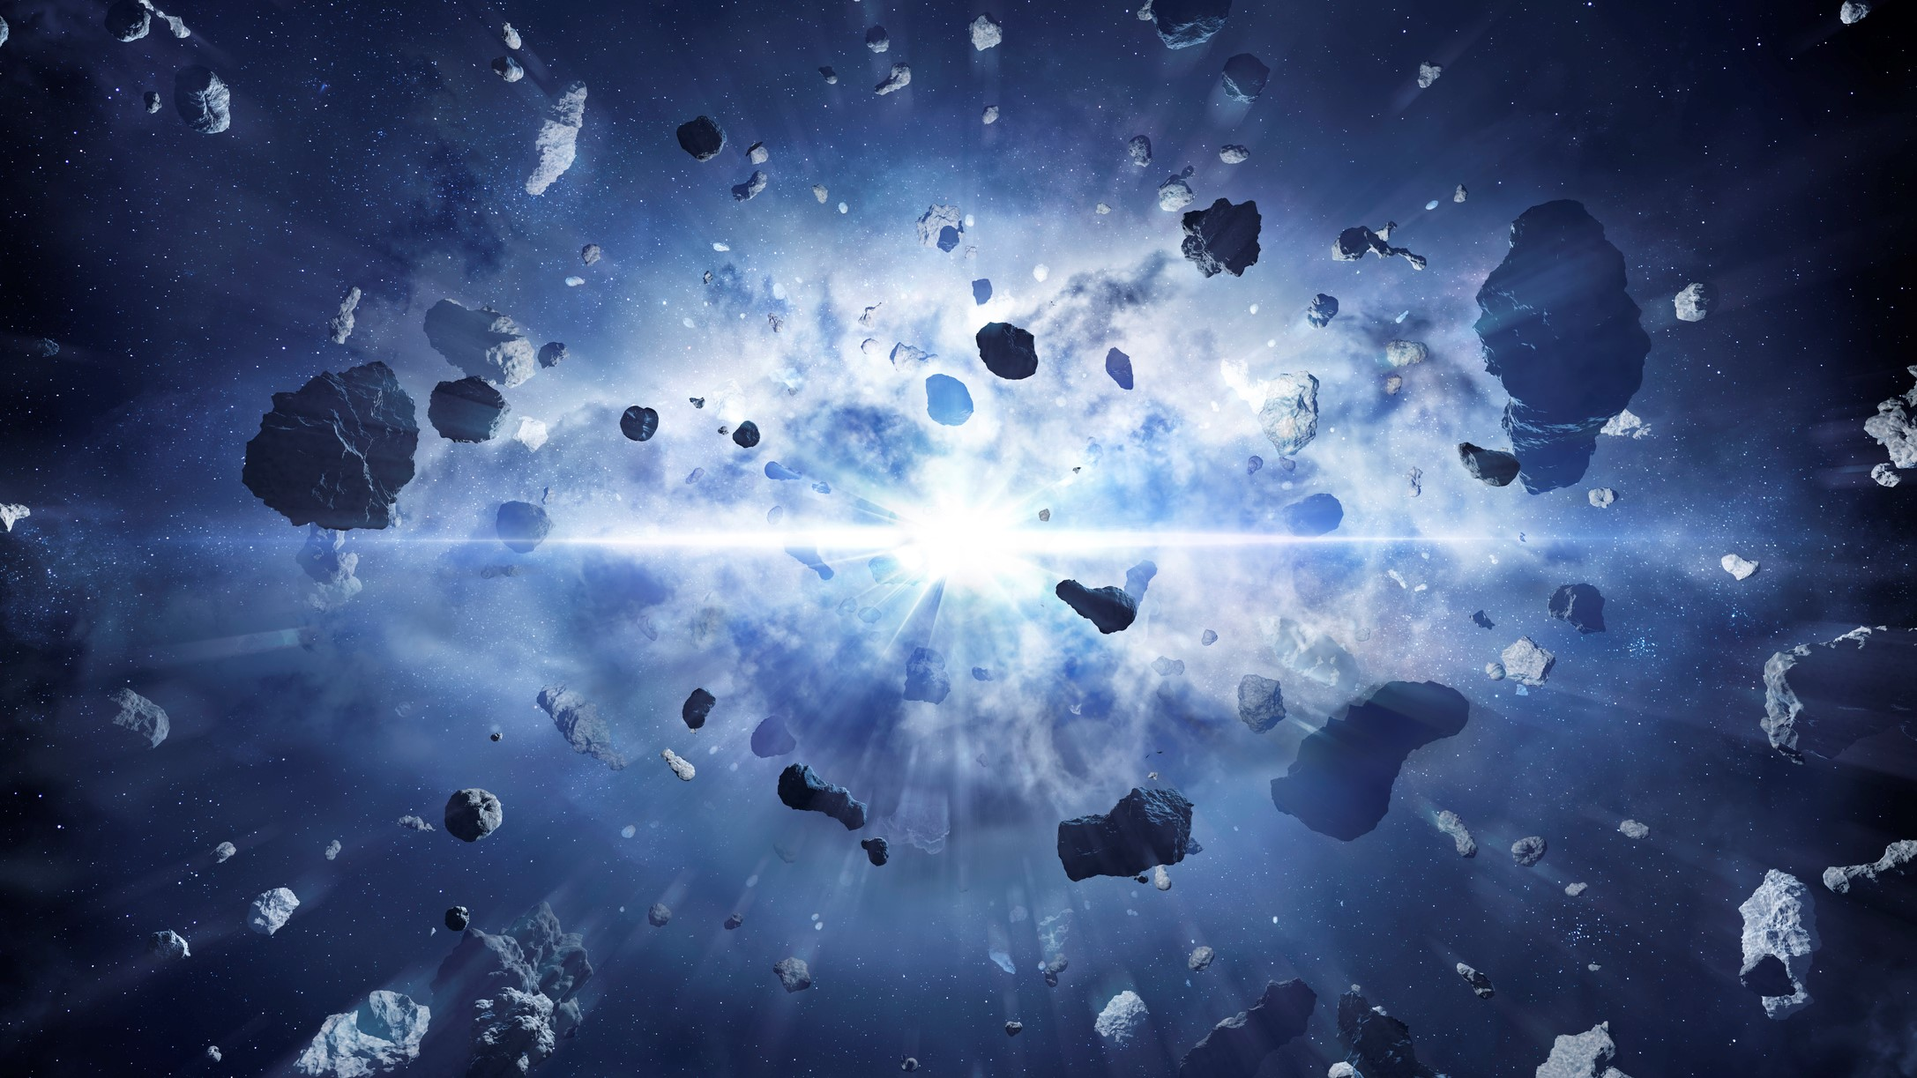
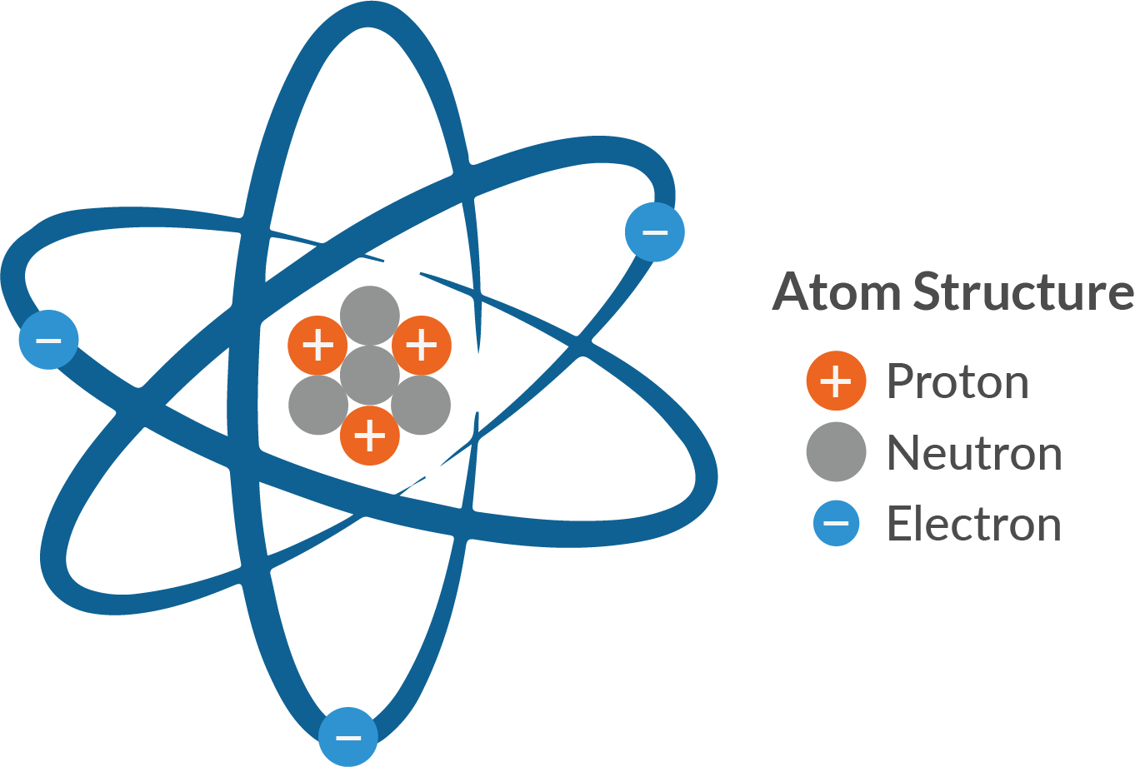
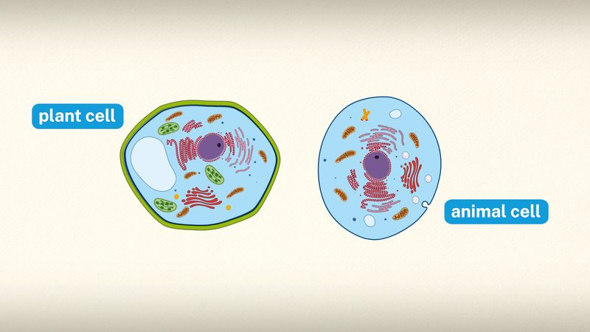
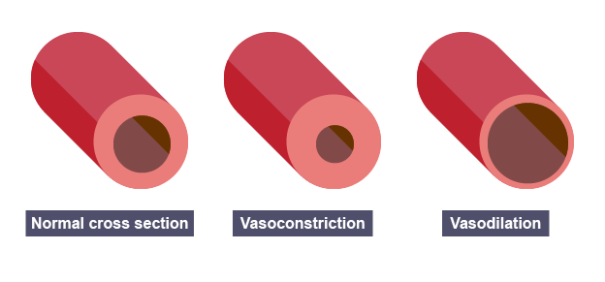

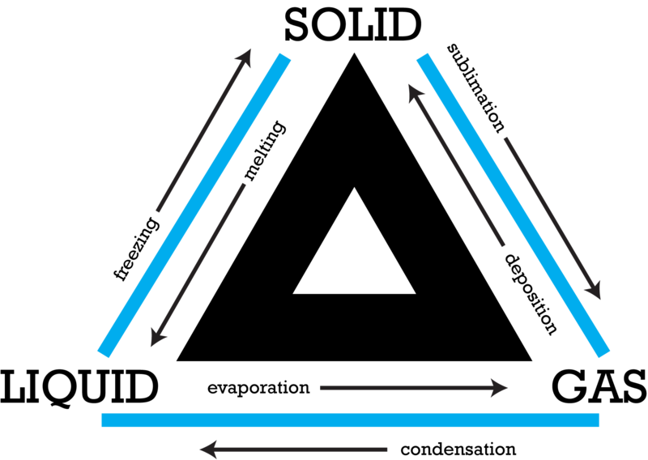
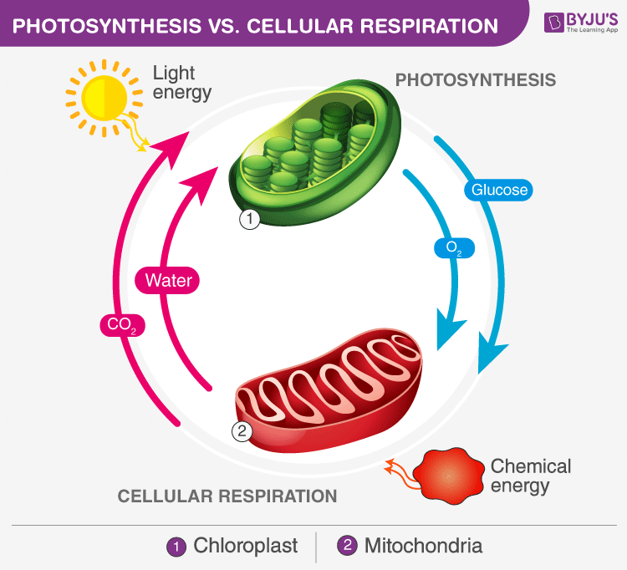
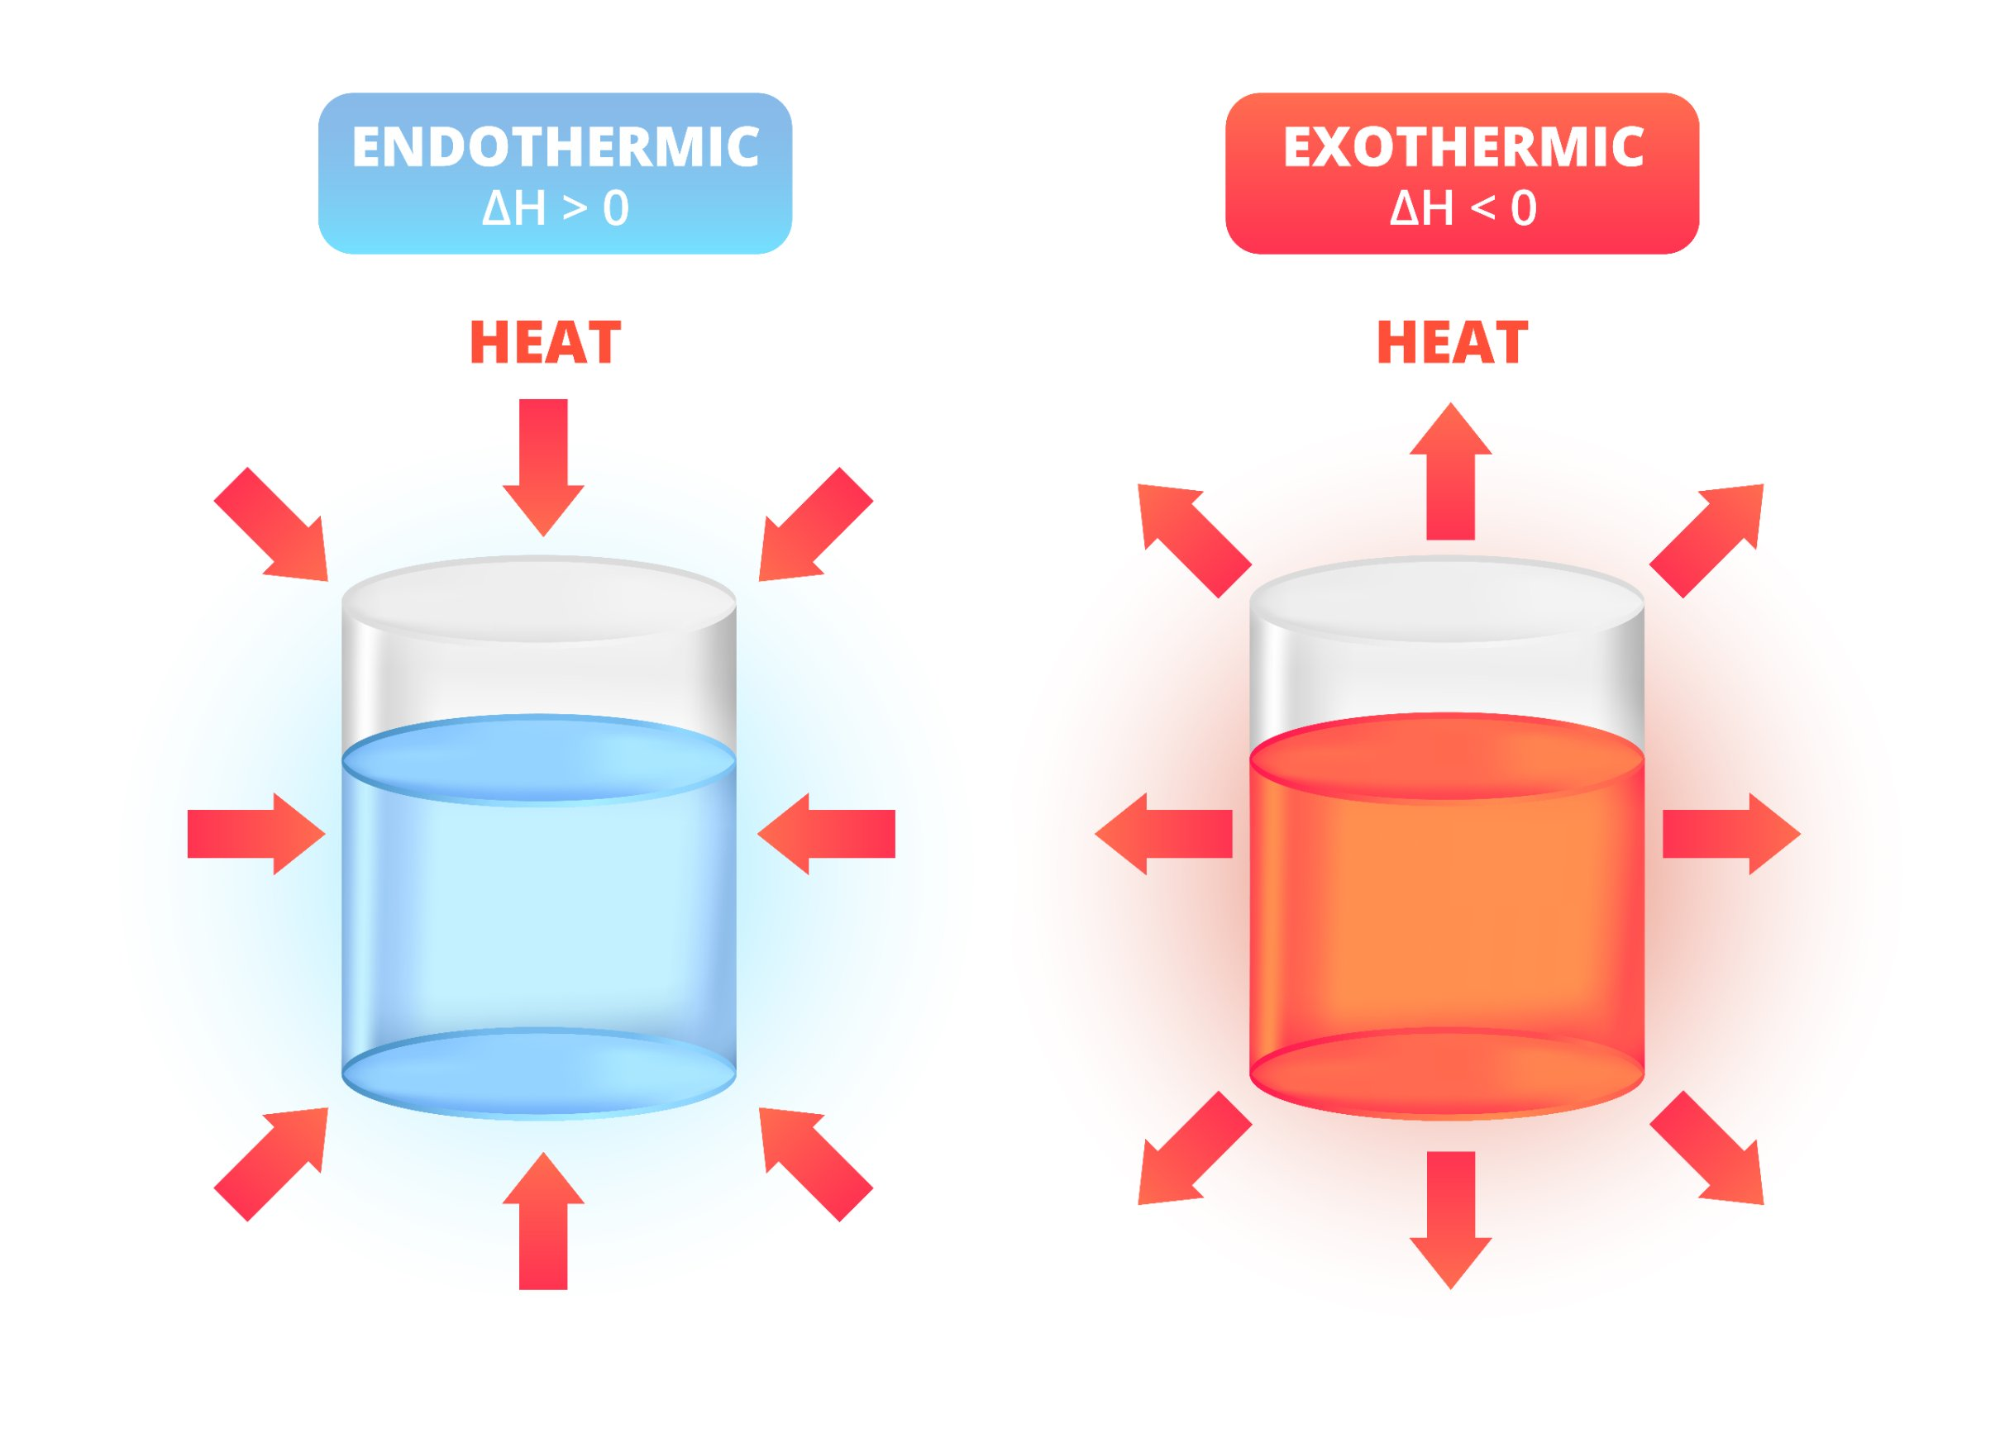
Science - Learning Journey - Year 9
2. New Technology in Chemistry – A study of the use of nanoparticles in medicine and ways of reducing emissions through investment into hybrid cars.
1. Turning Points in Biology - A study of revlolutionary discoveries such as, DNA, vaccines, antibiotics and extinctions.
Year 9
3. Turning Points in Physics – A study of how the Big Bang has moulded current theories of the Big Bang and our existence.
5. Atomic Structure and Periodic Table – An exploration of how atoms are structured and hwo Mendeleev contributed to the modern Periodic Table.
6. Organisation – An investigation into the systems involved in both animals and plants.
4. Cells – A study of prokaryotic and eukaryotic cells as well as the way substances transport between cells.
7. Particle Model of Matter – A study of how subtsances change state due to the amount of energy energy supplied.
9. Bonding and Structure – an investigation into the different types of bonding present in different compounds.
11. Energy – A study of energy stores and transfers, using and rearragning mathematical equations.
Year 10
8. Bioenergetics – an exploration of the processes photosynthesis and respiration and their intrinsic link.
10. Energy Changes – A study of exothermic and endothermic reactions.

Slide 4
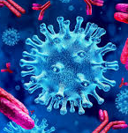
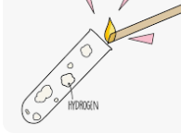
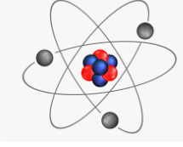
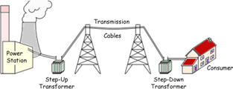

Science - Learning Journey - Year 10
1. Infection and Response – A study of how pathogens can cause infectious disease, human defence against disease and development of drugs.
2. Chemical Analysis – Students will a explore range of qualitative tests to detect specific chemicals.
Year 10
3. Quantitative Chemistry Part 1 - Use of quantitative analysis to determine the formulae of compounds and the equations for reactions.
6. Atomic Structure – Explore past and current models of the atom, describe different types of radiation and their effects and uses.
5. Homeostasis and Response - An exploration of how the nervous and endocrine systems maintain a constant internal environment .
7. Chemical Changes Exploring chemical reactions and changes to understand complex reactions that take place in living organisms
4. Electricity – An exploration of basic circuits, mains electricity and the national grid
8. Inheritance, Variation and Evolution – A study of the variation between living organisms, the genetic cause of these and a study of how living things have gradually changed over time.
Year 11
9. Quantitaive chemistry Part 2 – Use mathematical skills to calculate concentration of solutions, build on pevious knowledge determining formulae of compounds.
11. Forces Part 1 – Develop understanding of Newton’s Laws
10. Rate of Reaction – Explore how changing factors can alter the rate of a chemical reaction.

Slide 5
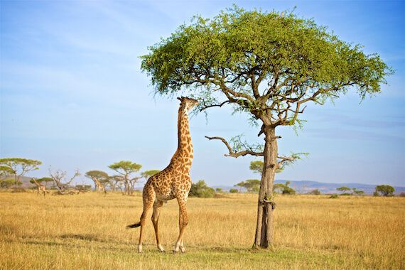
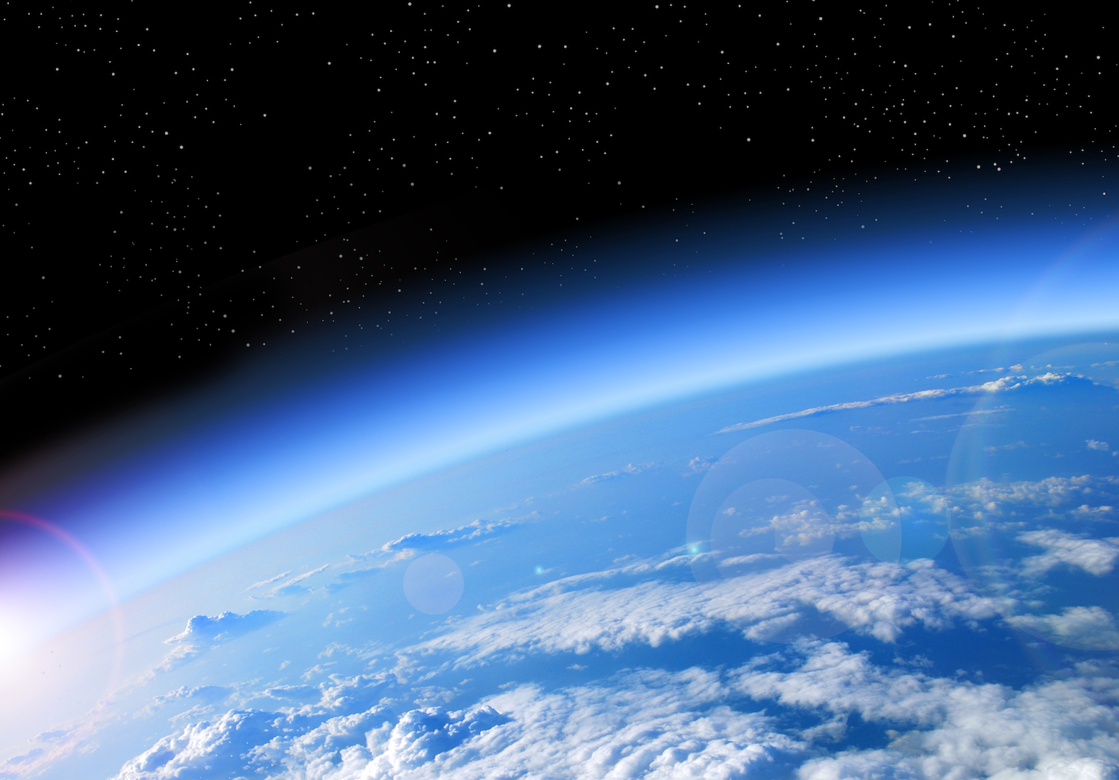
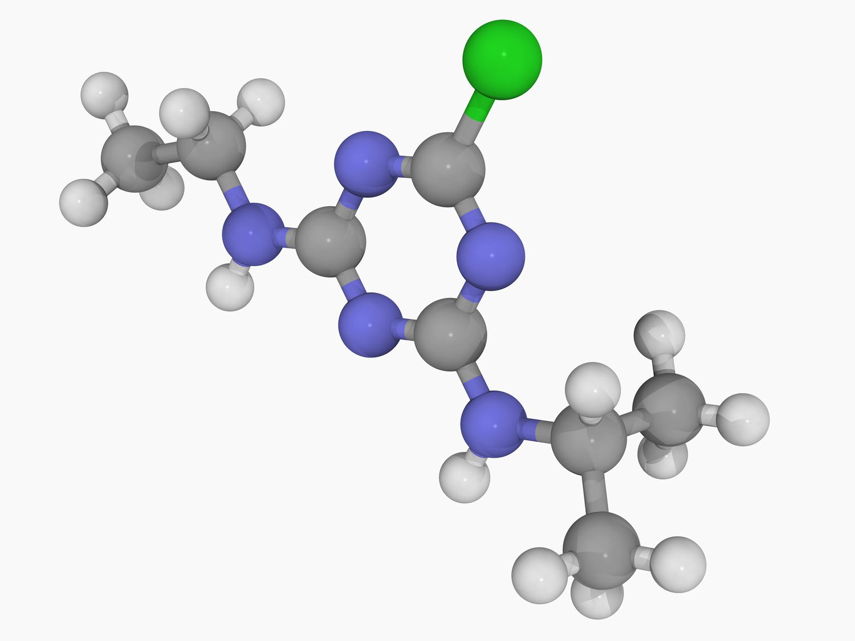
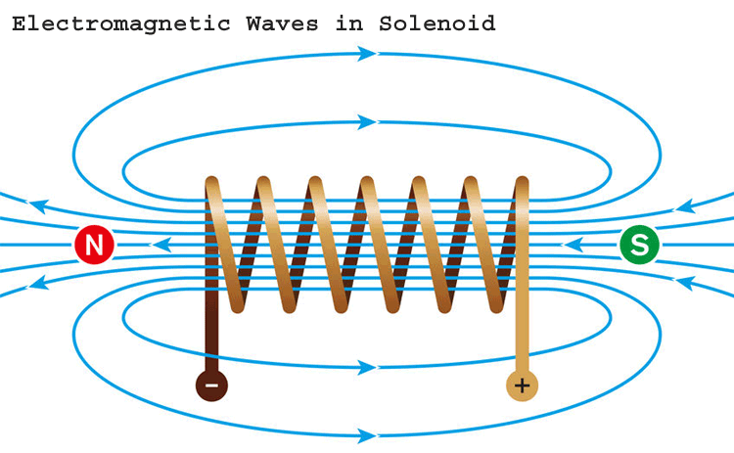
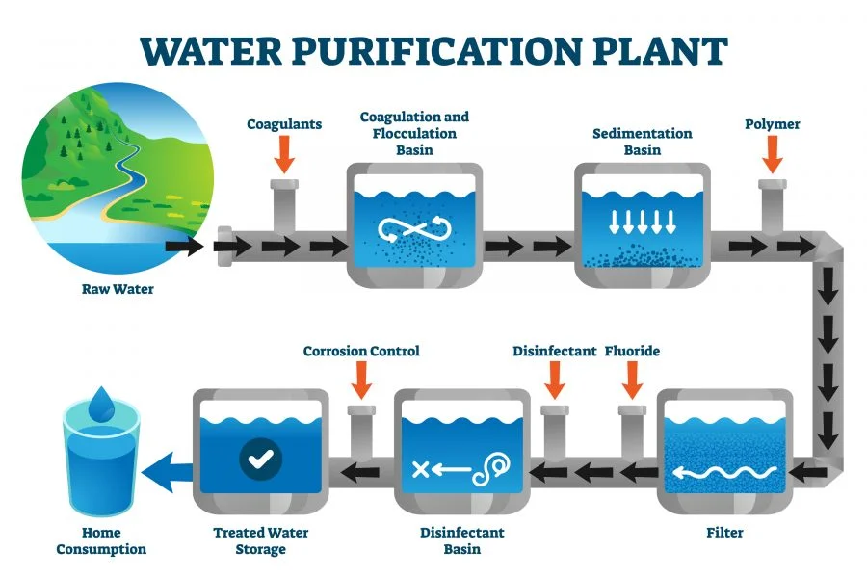
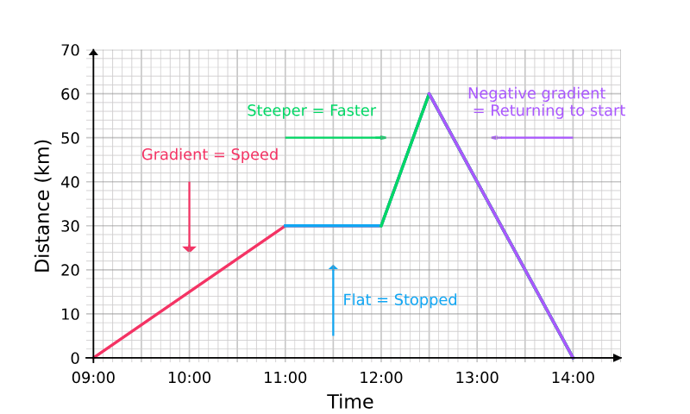
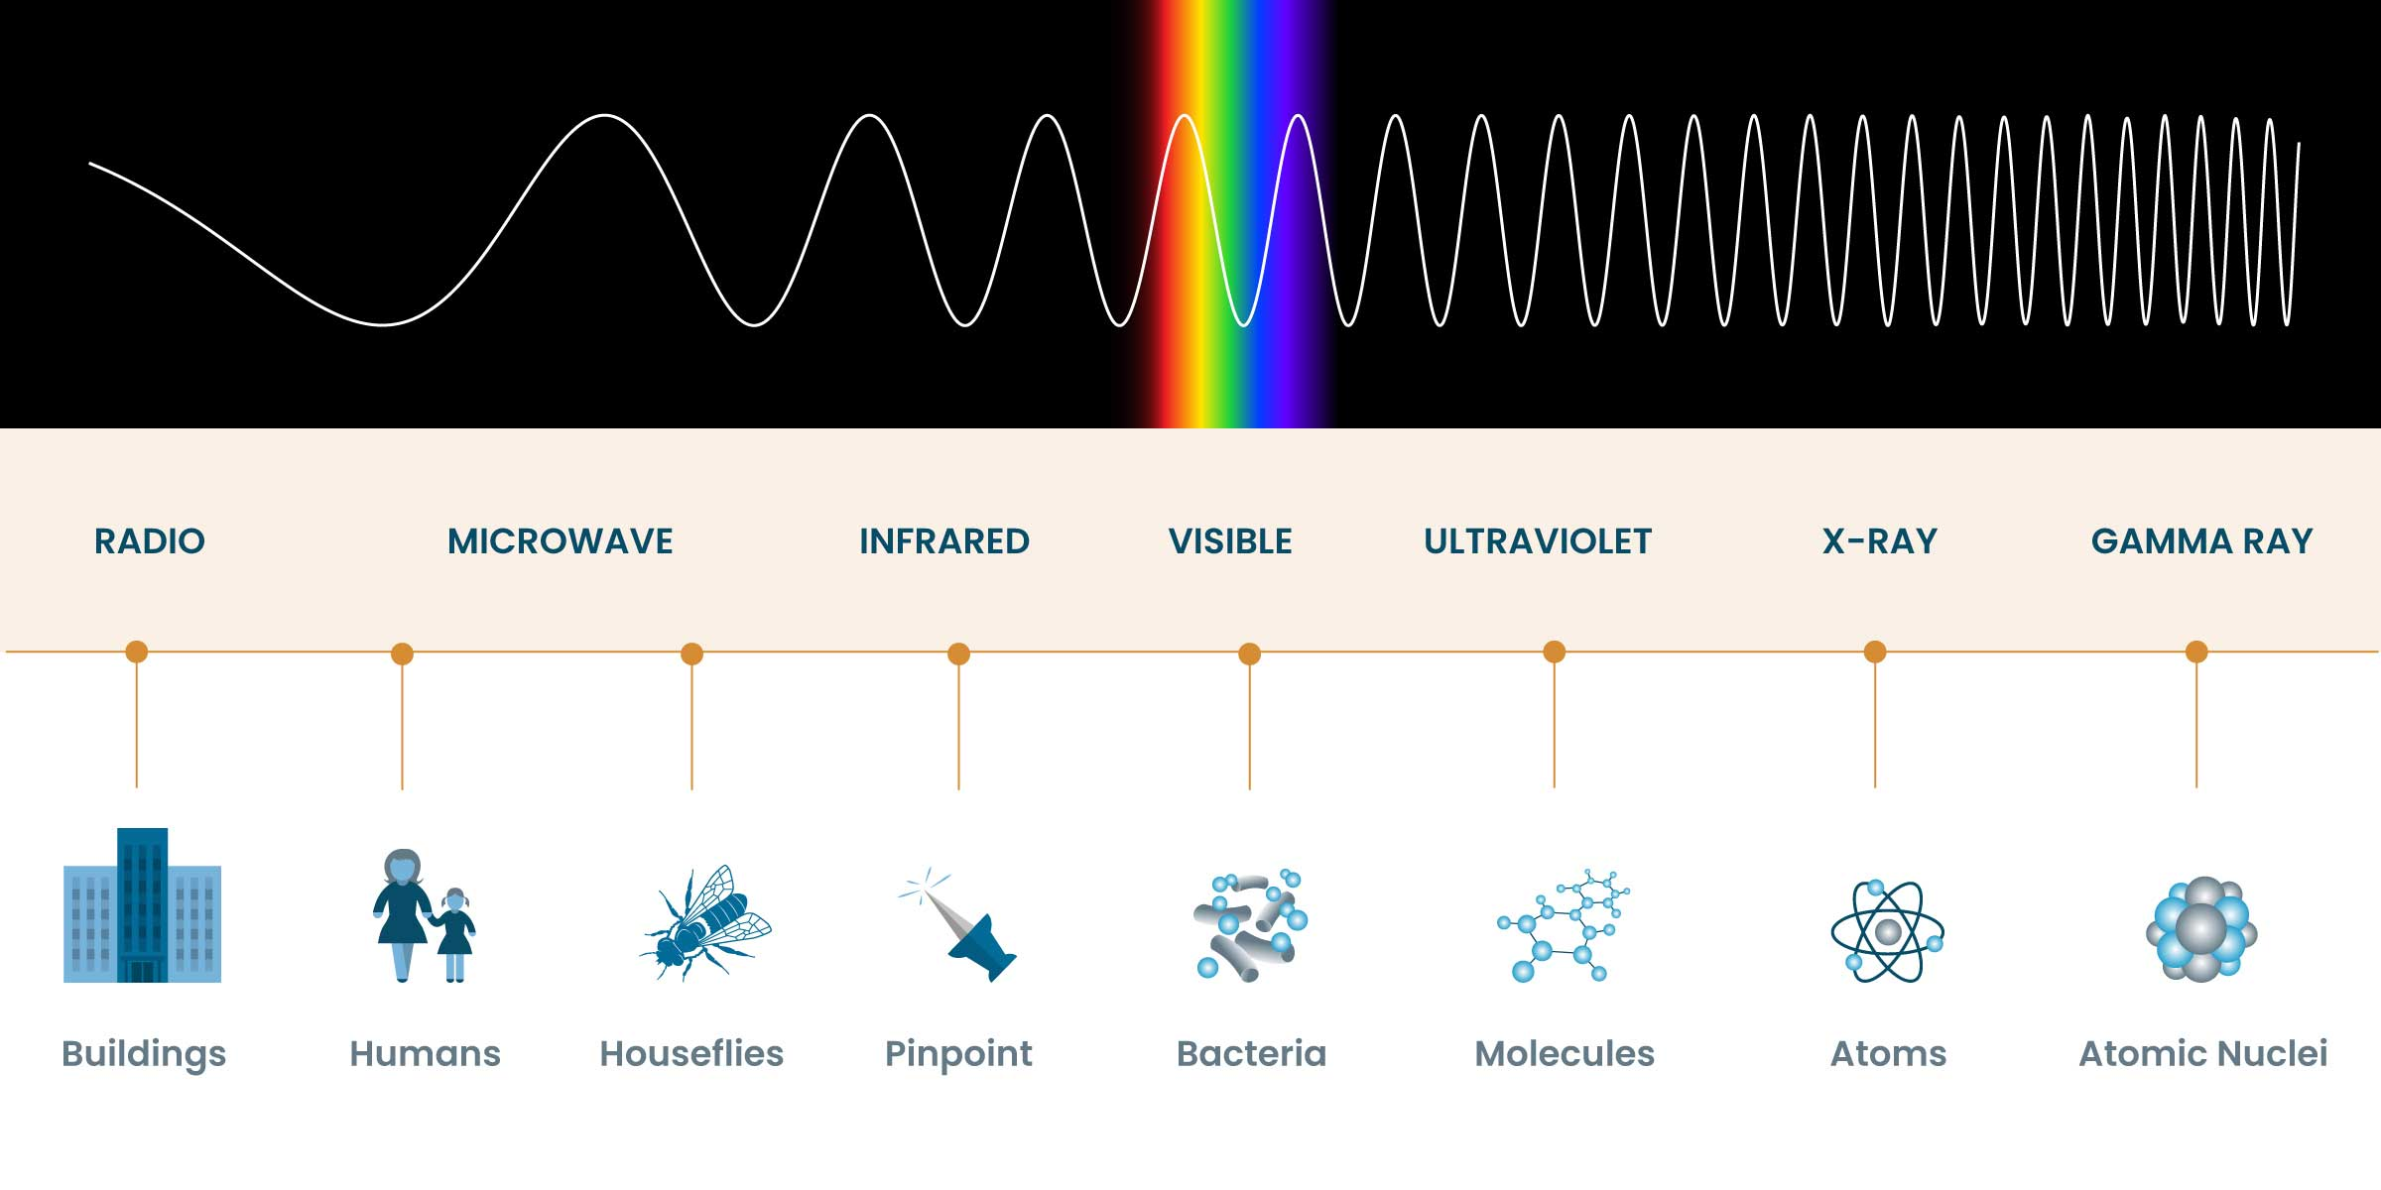
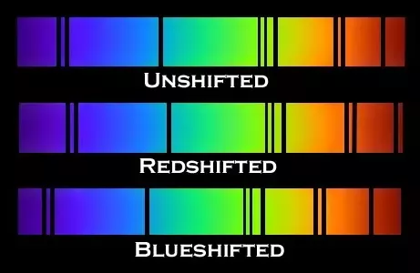
Science - Learning Journey - Year 11
1. Ecology - A study of the living world around us, exploring biodiversity, adaptations and the carbon and water cycle.
2. Chemistry of the Atmosphere – An investigation into the composition and evolution of the Earth’s atmosphere.
Year 11
4. Magnetism and Electromagnetism – A study of how magnets and electricity can work together to induce magnetic fields to prove the motor effect.
3. Organic Chemistry – A study of carbon-based compounds and the reactions they undergo such as addition and condensation reactions.
5. Using Resources – A study of how safe to drink water is obtained, metals are extracted and the impact on the Earth’s environment.
7. Forces Part 2 – A study of elasticity, moments, levers and gears along with a study of D-T and V-T graphs.
Exams
6. Waves – An exploration into Longitudinal and Transverse waves, the wavespeed equation and an analysis of the electromagnetic spectrum.
8. Space (triple) – A study of the solar systems, satellites, red-shift and the life cycle of a star.

