Slide 1
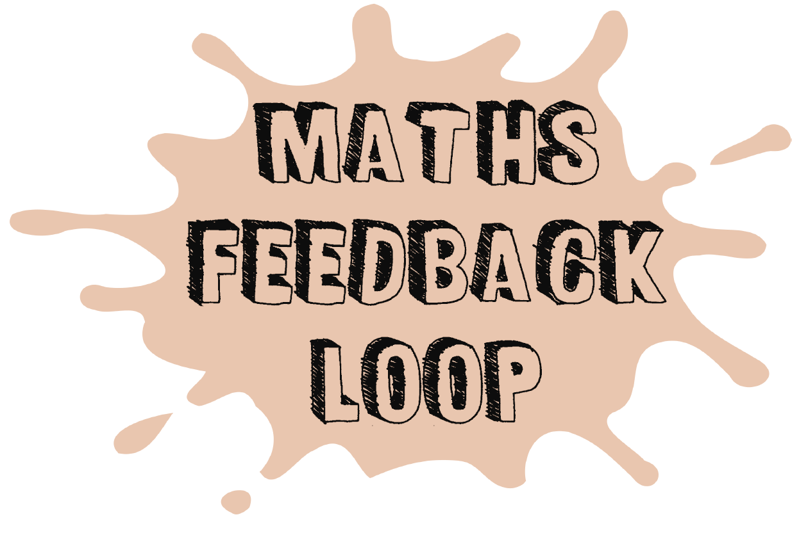
Maths - Learning Journey – Year 7
1. Analysing and displaying data
Lots of averages and visual representations!
2. Number skills (written and mental)
Addition,subtraction, multiplication & division
Year 7
3 Expressions, functions
and formulae
Lots of algebra!
6 Probability
The ‘chance’ of things happening
5 Fractions and
Percentages – exactly what it says on the tin!
4 Decimals and measures
Moving away a little from just whole numbers!
7 Ratio and proportion
We know percentages and
fractions, now time for ratio
8 Lines and angles
Constructing and measuring
10 Transformations
Enlargements, Reflections, Rotations, Translations
9 Sequences and graphs
Number patterns and coordinates
Year 8

Slide 2
Maths - Learning Journey – Year 8
1 Number
Written & metal methods also powers and roots
2 Area and volume
Learning lots about 2D and 3D shapes
Year 8
3 Statistics, graphs and
Charts
Comparing and
contrasting data
6 Decimals and ratio
In depth look at place value
5 Real-life graphs
Looking at data in real life situations.
How graphs really help us
4 Expressions and equations
Lots of algebra – factorising and solving
7 Lines and angles
Angles in more unusual situations
8 Calculating with fractions
Easily forgot, but seeing it all here again helps it stick!
9 Straight-line graphs
Looking at gradients
10 Percentages, decimals and fractions
Linking these with proportion
Year 9

Slide 3
Maths - Learning Journey – Year 9
1 Indices and standard form
Dealing with small and large numbers
2 Expressions and formulae
Solving and Expanding
Year 9
3 Dealing with data
Collecting, displaying
and comparing
4 Multiplicative
Reasoning
Lots here from similarity to compound measures
6 Sequences, inequalities, equations
and proportion
Non linear and linear sequences with more solving too!
5 Constructions
Compasses, rulers and pencil at the ready!
7 Circles, Pythagoras and prisms
Shape, shape and more shape!
8 Graphs
All types of graphs including looking
at simultaneous equations
9 Probability
More visual representations
10 Comparing shapes
Hello Trigonometry
Year 10

Slide 4
Maths - Learning Journey – Year 10 Foundation
UNIT 1: Number, powers, decimals, HCF and LCM, roots and rounding
UNIT 2: Expressions, substituting into simple formulae, expanding and factorising
Year
10
UNIT 3: Drawing and interpreting graphs, tables and charts
UNIT 4: Fractions and percentages
UNIT 6: Angles, polygons and
parallel lines
UNIT 5: Equations, inequalities
and sequences
UNIT 7: Statistics,
sampling and
the averages
UNIT 8: Perimeter, area and volume
UNIT 9: Real-life and algebraic
linear graphs
UNIT 10: Transformations
(All 4)
Year 11

Slide 5
Maths - Learning Journey – Year 10 Higher
UNIT 1: Powers, decimals, HCF LCM, roots, rounding, reciprocals, standard form, indices and surds
UNIT 2: Expressions, substituting into simple formulae, expanding and factorising, equations, sequences and inequalities, simple proof
Year
10
UNIT 3: Averages and range, collecting data, representing data
UNIT 4: Fractions, percentages, ratio and proportion
UNIT 6: Real-life and linear graphs, quadratic/cubic graphs, equation of a circle, rates of change and area under graphs
UNIT 7: Perimeter, area and volume; Accuracy and bounds
UNIT 5: Angles, polygons, parallel lines; Right-angled triangles: Pythagoras and trigonometry
UNIT 8: Transformations; Constructions: triangles, nets, plan and elevation, loci, scale drawings and bearings
UNIT 9: Algebra: Solving quadratic equations and inequalities, solving simultaneous equations algebraically
UNIT 11: Direct and inverse proportion, compound measures, repeated proportional change
UNIT 10: Probability
Year 11
UNIT 12: Similarity and congruence in 2D and 3D

Slide 6
Maths - Learning Journey – Year 11 Foundation
UNIT 11: Ratio and Proportion
UNIT 12: Right-angled triangles: Pythagoras and trigonometry
UNIT 13: Probability
Year
11
UNIT 14: Multiplicative reasoning: more percentages, rates of change, compound measures
UNIT 17: Perimeter, area and volume: circles, cylinders, cones and spheres
UNIT 16: Algebra: quadratic equations and graphs
UNIT 15: Constructions: triangles, nets, plan and elevation, loci, scale drawings and bearings
UNIT 18: More fractions, reciprocals, standard form, zero and negative indices
UNIT 19: Congruence, similarity and vectors
UNIT 20: Rearranging equations, graphs of cubic and reciprocal functions and simultaneous equations
Revisit key areas as necessary
Year 12

Slide 7
Maths - Learning Journey – Year 11 Higher
UNIT 13: Sine and cosine rules, 0.5ab sin C, trigonometry and Pythagoras’ Theorem in 3D, trigonometric graphs, and accuracy and bounds
UNIT 14: Statistics and sampling, cumulative frequency and histograms
Year
11
UNIT 15: Quadratics, expanding more than two brackets, sketching graphs, graphs of circles, cubes and quadratics
UNIT 17: Changing the subject of formulae, algebraic fractions, rationalising surds, proof
UNIT 16: Circle theorems and circle geometry
UNIT 18: Vectors and
geometric proof
UNIT 19: Direct and indirect proportion, reciprocal and exponential graphs, rates of change in graphs, functions, transformations of graphs
Revisit key areas as necessary
Year 12

