Slide 1
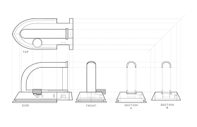
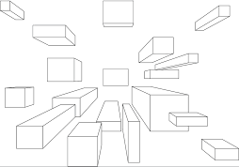
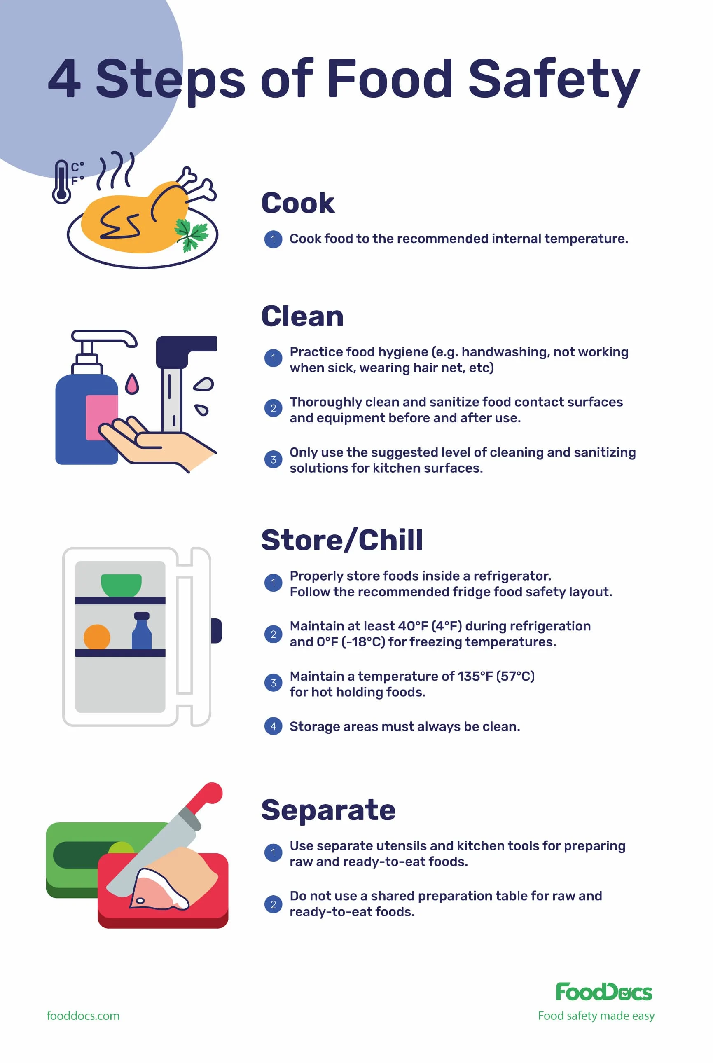
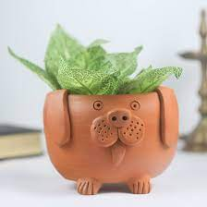
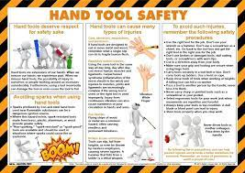
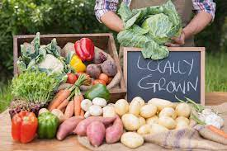
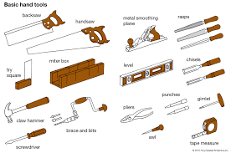
Technology - Learning Journey – Year 7
Introduction to Graphics :
Development of orthographic views, use of shading & tones, introduction to isometric, one-point & two-point perspective drawings, and 3D CAD design package
Health and Safety: Development of understanding the how to keep themselves safe in a Food and Nutrition lesson. Development of knowledge of health and safety and hygiene, demonstrated in correct knife skills.
DT
FOOD
Year 7
Lifestyle Specific Meals: Development of understanding of specific nutritional values – protein, starchy carbohydrates, dairy and alternatives, how the diet can be healthy through Eatwell Guide and portion sizes. Practical skills – knife skills, weighing / measuring, grating, slicing and spreading.
DT
Introduction to Ceramics :
Styles of pots and their uses, development of techniques used to make them, and tools used for pottery
FOOD
Introduction to Wood Working Skills :
Safety rules for workroom, safe use of hand tools, aesthetics of design, limitations of materials, further development of orthographic & perspective drawing skills
DT
Seasonal Fresh Produce and Provenance: Factors affecting food choice, what is seasonal produce, specific cooking methods affecting nutritional value of fruit and vegetables. Food provenance – grown, reared and caught. Further development of knife skills and electrical equipment.
FOOD
Year 8

Slide 2
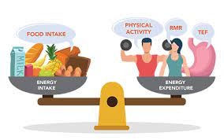
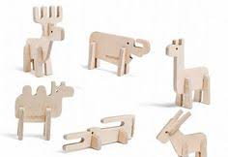
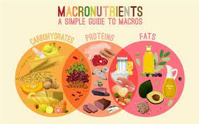
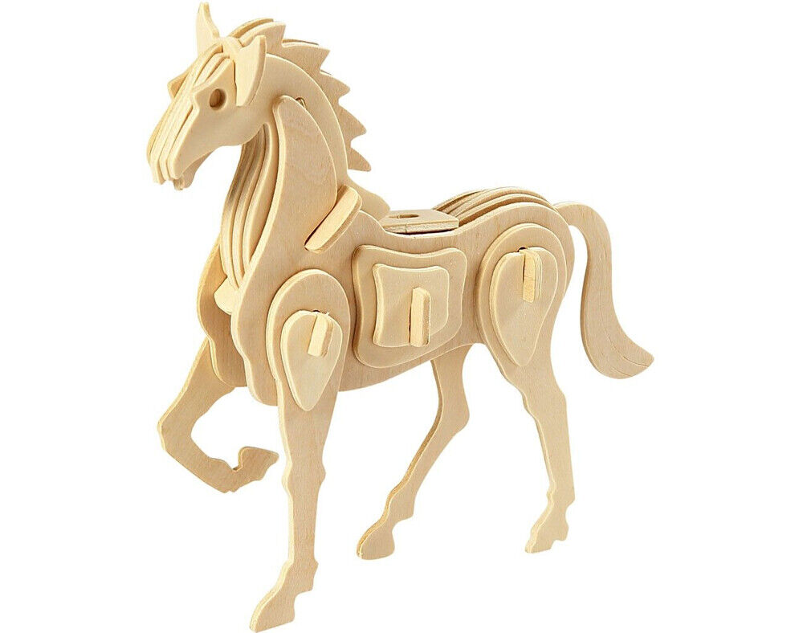
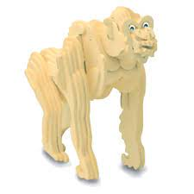
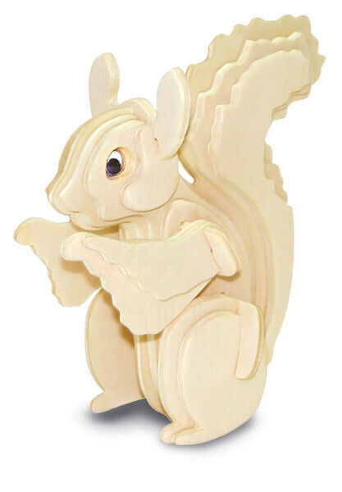
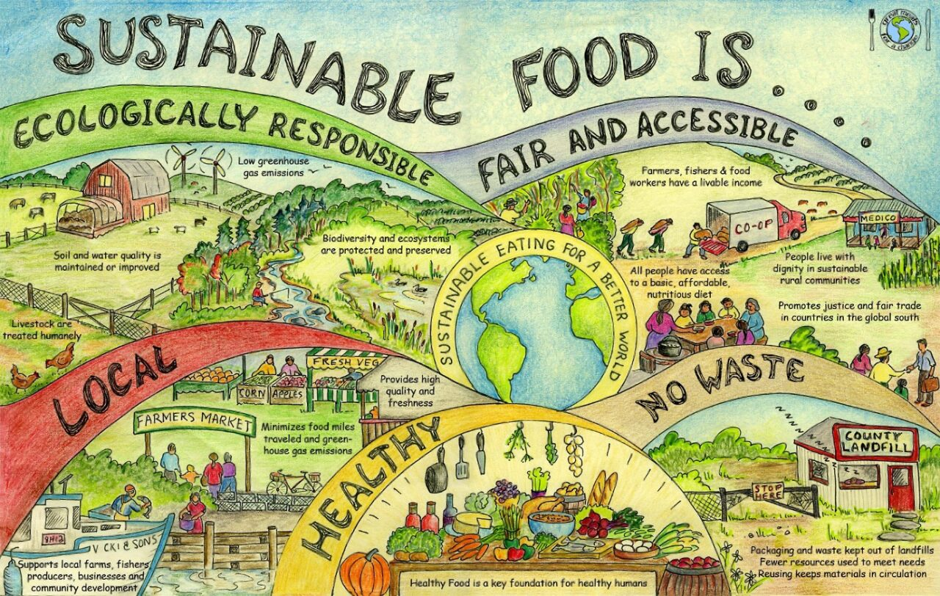
Technology - Learning Journey – Year 8
FOOD
Balloon Powered Vehicles : Introduction to movement through designs of vehicles, and exploration of simple mechanics of motion. This project also builds upon prior wood-working skills previously taught as well as orthographic drawings
Food Safety and Food Science: How does energy requirements change throughout life stages and how the diet needs to be balanced. Functions of ingredients and the science behind them, i.e. aeration. Practical skills working with raw ingredients and health and safety and hygiene.
DT
Year 8
Paper Straw Modelling : Students will be researching the designs of chairs and modelling a scaled-down design.
It includes investigating the ergonomics and anthropometrics of chair designs
DT
Food and Nutrition: Main nutrients in the diet provided by a healthy diet, protein and their types, sources and functions on the body, key understanding of macronutrients and why are they needed. Modified recipes for life stages.
DT
Slot Together Animals : Development of understanding of key features of plywood and its uses, how animal features can be depicted & outlined in design. It enables students to develop their use of hand and power tools.
FOOD
Textile Squares : Students develop an understanding of stitches and embroidery design. It includes threading, hemming, cross stitch, zig-zag stitch, straight stitch and knotting off.
DT
Food Provenance and Choice: Reducing food waste and seasonality, difference between organic farming and local produce, how can nutritional values be maintained using alternatives, sustainability and the importance of it when selecting ingredients. Cooking with alternative ingredients to maintain nutritional value.
FOOD
Year 9

Slide 3
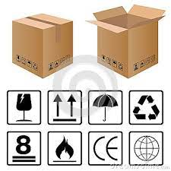
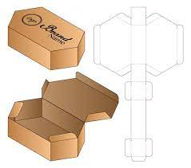
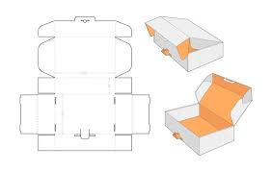
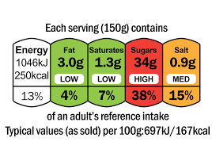
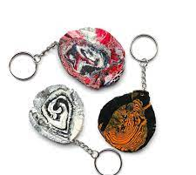
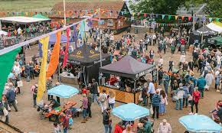
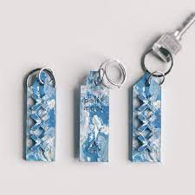
Technology - Learning Journey – Year 9
Logos & Packaging : A look into the world of packaging focusing
on design shape & size, font used on the package, developing into
logos and emblem designs. Including perspective & isometric drawing and progresses through to CAD 3D designs. Screening printing & heat transfers.
Food, Diet & Health: Develop an understanding of how important the Eatwell Guide is to specific ages groups, specific functions of macronutrients, how the body functions with regards to the specific nutritional values, calculation of the cost of a dish versus ready made. Practical skills – frying, boiling and simmering.
DT
FOOD
Year 9
Jigsaw Designs: Create jigsaws for a given client group (pre-school, educational, physical disability, elderly) using CAD and CAM (laser cutter). Research use of colour, shape, size and material to create most appropriate jigsaw.
DT
Food Provenance & Consumer Information: Guidance to the consumer regarding availability, traceability, food assurance scheme & animal welfare. Production of recipe cards and the practical application of skills used, science behind pastry whilst considering shortening and coagulation.
FOOD
Recycled plastics & Polymers : this project focuses n recycling plastics, looking into companies that specialise in it when making their products. Produce own recycled polymer based key ring, in addition to looking into resins & polymorphs.
DT
Food Hygiene & Safety in a Range of Situations: Factors food vendors need to consider when planning & preparing food to be sold and eaten at festivals, food hygiene and legislations for selling food at festivals, designing a menu to be sold at a venue. Understanding food allergies and intolerances.
FOOD
Year 10

Slide 4
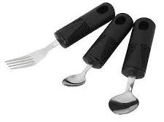
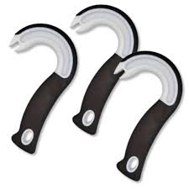
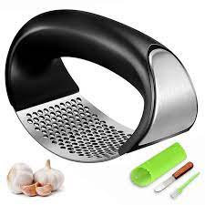
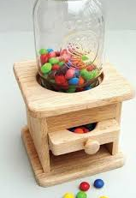
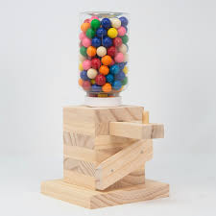
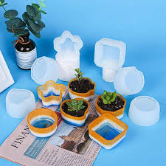
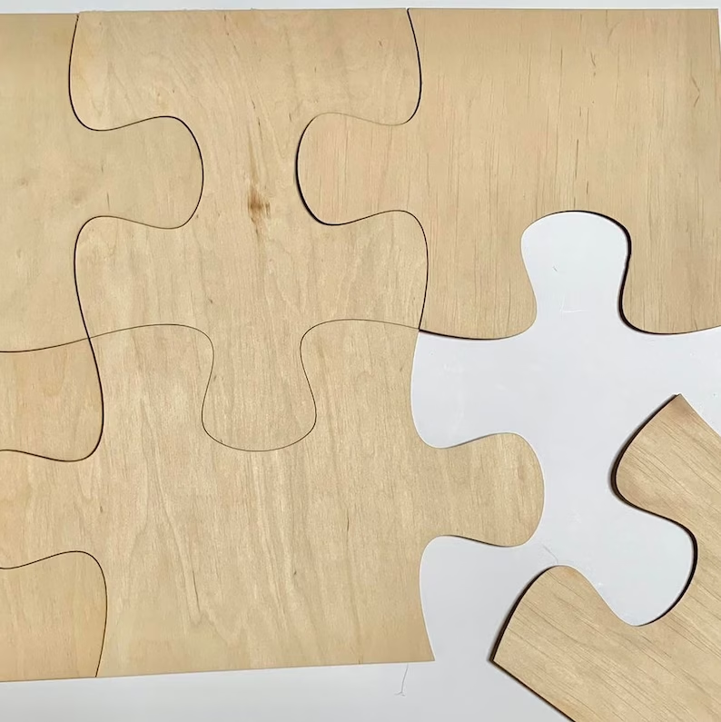
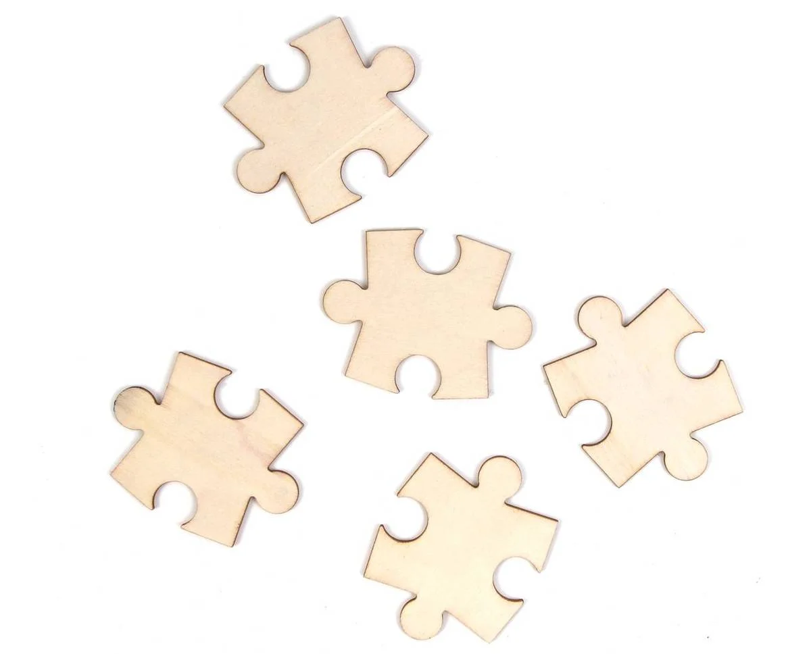
Design Technology - Learning Journey – Year 10
Paper, Card & Board : introduction to process of making paper, its finishing & sizing, and a look into its environmental impact. Investigation into paper types and uses, differences in textures & weights.
Kitchen Utensil Designs : students have to research disabilities and
overcome their impact on using kitchen utensils. This introduces students
to the Iterative Design Process and encourages them to create mood boards, design briefs, participate in research a& reviews, as well as making prototypes.
DT
DT
Year 10
Sweet Dispensers : looking at current designs of dispensers, reviewing styles/sizes/mechanics. Following iterative design process to plan, design, assess and review models. This project allows students to further develop their practical skills using wood, plastics and upcycling.
DT
Polymers & Resins : understand where and how
plastics are produced from source and its impact on environment. The use of polymers within other materials and an awareness of technology fabrics.
Polymer & Resin Thermo-forming :
to develop further student knowledge of polymorphing and resins by creating coasters & pots. This project allows students to develop their graphics skills to accompany their designs.
DT
DT
Metals & Alloys : focusing on Smart &
Emerging technologies. Being able to identify and compare metals, non-metals & alloys and explain their different uses and manufacture. Looking into industrial and commercial uses.
DT
DT
Wood / Timber : Develop students understanding of different types of wood (hard & soft), differences in their appearance characteristics and the properties affecting their uses.
Laser cutting / Jigsaw Making : introduce to 2D planning for laser cutter. Investigate aesthetics, purpose, anthropometrics & materials of jigsaw designs.
DT
Year 11

Slide 5
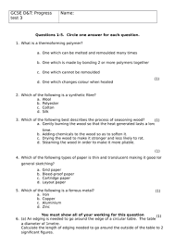
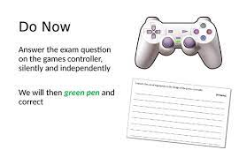
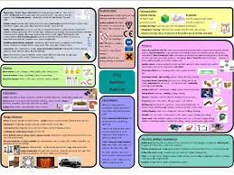
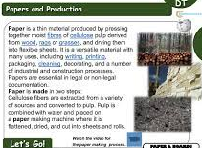
DesignTechnology - Learning Journey – Year 11
Non-Examination Assessment Coursework : students are given the exam board criteria and have to complete coursework with discussion with their client, comparing existing designs, analysing their strengths & weaknesses, designing & redesigning their models, reviewing & evaluating each step and design, before making their final prototype.
This coursework takes 30 hours and is produced as a 25-page A3 project.
DT
Year 11
DT
Exam Question Revision : the focus is put upon previous exam questions and the structure of response for questions requiring extended written answers. Following PEEL approach.
Revision : the whole course is reviewed, and areas of previous omission or confusion are focused upon.
DT
DT

Slide 6
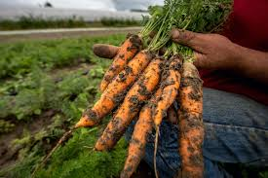
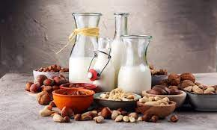
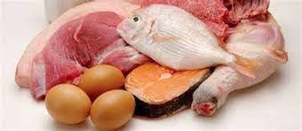
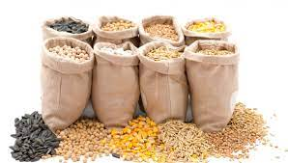
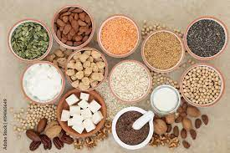
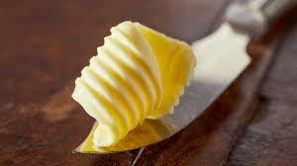
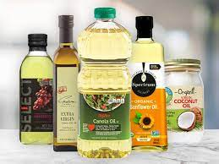
Food- Learning Journey – Year 10
Fruit and Vegetables: How and where fruit & vegetables are grown and differences. Difference between organic and non-organic & how pesticides and herbicides affect health. Preservation of fruit and vegetables, differences between two dietary fibers. Introduction of principles of NEA.
Milk, Yoghurt & Cheese: How provenance is affected by climate, soil conditions and processes. Consider food miles and local produce. Consumer choice and how provenance impacts this. How does the rearing of animals effect the quality of the commodity and the process. What alternatives there are and the impact upon the diet. Consider macronutrients and micronutrients.
Year 10
Cereals: How provenance is affected by climate, soil conditions and processes. What are the classifications of flour and the secondary processes of the commodity. Investigating how the consumer can choose the healthier option compared to another. How the cereal can be stored whilst taking into consideration food safety & hygiene. What other cereals are grown across the world, Chemical and physical structure of the cereal grains and their food science – gluten formation, gelatinization etc. Continue developing understanding of NEAs.
Meat, Fish, Poultry and Eggs: How does geographical areas where meat, fish, poultry and eggs are produced / reared compare (when referring to fishing. Differences between imported and local eggs. How does the farming / rearing and slaughtering of the animal impact upon the quality of the meat / poultry. Difference in egg production and the secondary processes. Classification of animals, cuts of meat, categories of fish and types of eggs. Food science associated to the topic and ways of cooking them.
Butter, Oils, Margarine, Sugar and Syrup: How does local verses imported butter and the cost. Provenance of sugar cane and sugar beet. How does organic, non-organic and GMF compare? Nutritional values of butter, oils, margarine, sugar and syrup. Classifications of butter, oils, margarine, sugar and syrup and how does the storage affect the classifications. Chemical and physical structure of the butter, oils, margarine, sugar and syrup. Continue developing understanding of NEAs.
Soya, Tofu, Beans, Nuts and Seeds: How does the provenance, climate and soil affect the process, cost and food mileage. Develop an understanding of the how Soya and Tofu are cultivated and how beans (pulses / legumes), nuts and seeds are grown. What are the secondary processes applied to beans (legumes), nuts and seeds. Classification of soya products and Quorn and their nutritional values. Dietary considerations of Soya and Quorn products. Continue developing understanding of NEAs.
Year 11

Slide 7
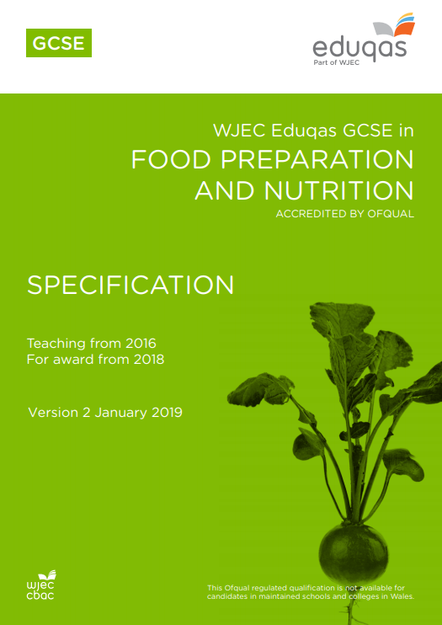
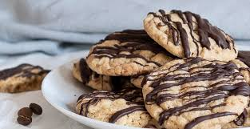
Food- Learning Journey – Year 11
NEA Assessment 1: Recap over the process of NEA and the expectations of the assessment. Application of knowledge when researching the scientific properties of the given commodity as per the Eduqas brief. Students to analyse task analysis, conduct research and create hypothesis.
NEA Assessment 1: Students to conduct 2 hour practical relating to the task brief. Write up all pieces of information under specific headings (as given in booklet) and the answer brief and hypothesis.
Year 11
NEA Assessment 2: Decision on either task A or B. Students to analyse the task and what they are required to do. Consider different recipes and reasons for decision and to conduct trials of an element of the dish or of an accompaniment. Students to carry out visits to restaurants / cafes, research menu’s, conduct survey’s / questionnaires.
NEA Assessment 2: Conduct further food trials in preparation of three hour practical exam, whilst meeting the brief. Students to write up time plan prior to practical exam. Practical exam conducted. Finally, students to write up all research, analysing results from research, sensory analysis and evaluating the three dishes and the accompaniments.

