Slide 1
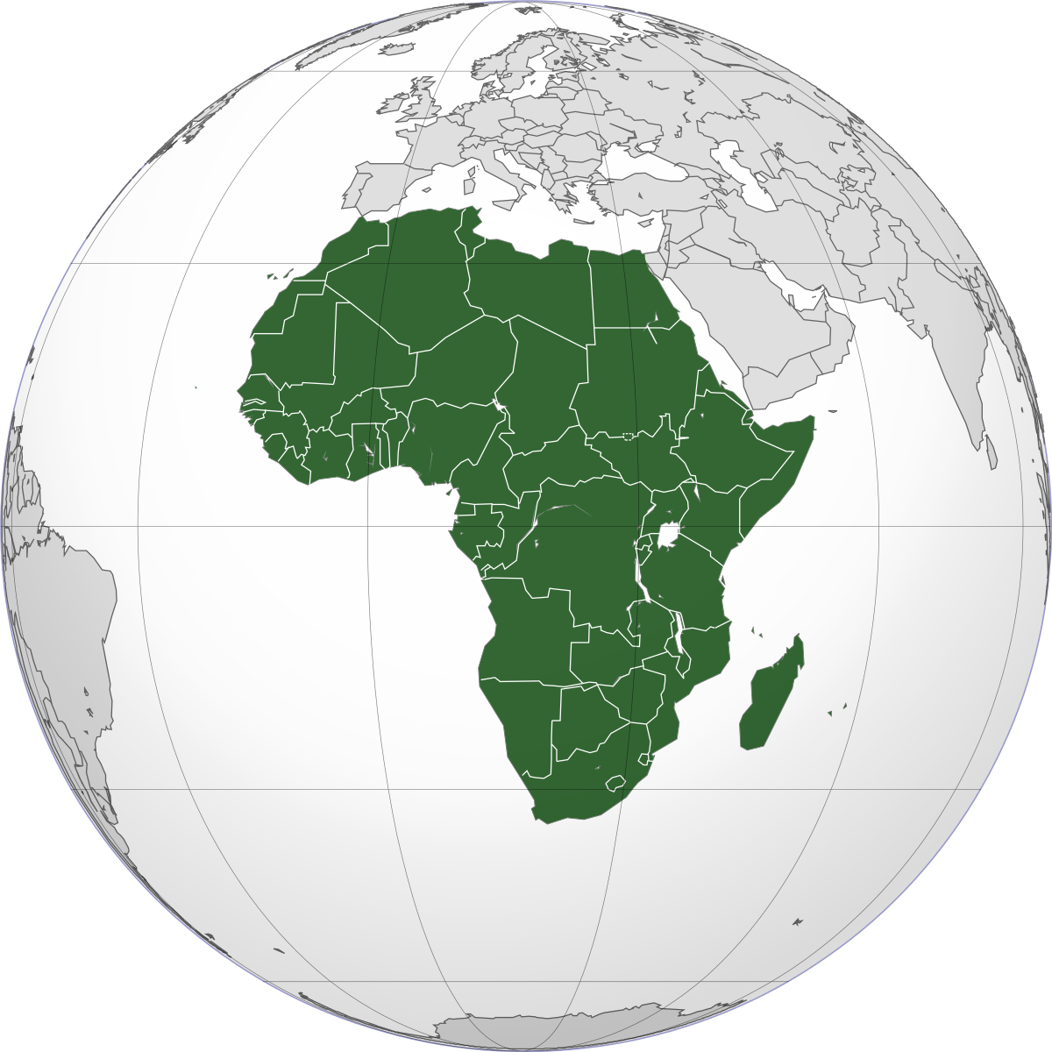
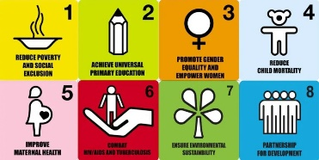
Key Stage 3 Geography
Learning Journey
Identifying and understanding customer needs
Controlling populations
GCSE skills and questions
What will year 10 Geography look like?
Where do we live?
Topic 5 USA
The human geography of the USA
Topic 6 GCSE Ecosystems
Topic 4 Population
Comparing HIC and LICs
Population change
The physical geography of the USA
The USA’s role in the modern world
Ecosystems at GCSE
Measuring development
Climate Change
Topic 2 Energy and Resources
What is Africa’s history?
What is the physical geography of Africa
Topic 3 Development Gap
Topic 1 Africa
A sustainable future?
Renewable and Non-renewable resources
What is the human geography of Africa
YEAR
9
The global Fashion Industry
Working in a Sweatshop
Sustainable Fashion
Topic 6 Fragile Environments
Topic 4 Fashion
Topic 5 Russia
Global examples of Tourism
How can we help?
Sustainable Tourism
Landforms of Erosion and Deposition (3 courses of a River)
Russia’s physical geography
Russia’s human geography
Exploitation and Conservation
The positives and negatives of Tourism
Russia in the modern world
Topic 3 Tourism
Physical geography of Extreme Environments
Topic 2 Extreme Environments
Landforms at the coast
Topic 1 Coasts
YEAR
Weathering, Erosion and Deposition
YEAR
8
Examples of Extreme Environments
Living in Extreme Environments
Managing the coast
8
Where we live and why
Local Settlement Fieldwork in Astwood Bank
Crime and statistics
Topic 4 Settlement
Topic 5 China
China’s human geography
Topic 6 Crime
Measuring Weather and Climate
Mapping crime
Explaining weather and Climate
Developing Settlements
China in the modern world
Chinese industry and ethics
Different types of crime
Topic 3 weather
China’s physical geography
What are the challenges in these environments?
Topic 2 Rainforests and Deserts
Cartographic Skills
Topic 1 What is Geography
YEAR
7
Explaining Rainforest and Desert environments
Good descriptions and explanations
The different types of Geography

