Slide 3
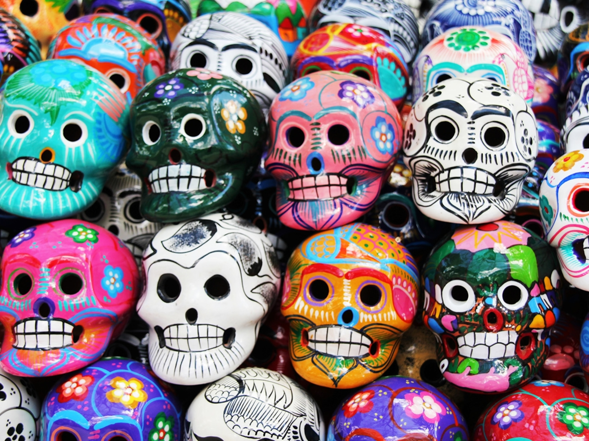
Day of the Dead research and work in the style.

