Slide 1
'Learning Journeys' - improving students understanding of what they are studying, when and why.
This academic year, all subjects have introduced 'learning journeys' to ensure that students are supported with understanding their curriculum development across the year and 'where their learning is going'. See below for some examples!

Slide 2
History Learning Journey - Year 8
Focus for the year:
'Rights and Riots'
Autumn Term (A)
How 'great' was the Great British Empire?
Why was the British Empire considered 'great'? How was the Empire built? What benefits did the Empire bring? Who are the Empires 'heroes'? At what expense did the Empire come?
The Journey Starts!
Autumn Assessments
Evaluating the impact of the British Empire essay, end of topic tests. Causes of revolutions written piece.
Year 8
Spring Term (A)​
The abolition of slavery
How 'uncivilised' were the people of Africa in the 15th and 16th centuries? Where and why were people enslaved? What were the experiences of enslaved peoples? How did people fight for abolition?
Autumn Term (B)
How 'enlightened' was the Age of Enlightenment?
What was the Age of Enlightenment? What impact did it have on different countries? Why 'were the colonies' mad? An exploration of key revolutions – America, France and Haiti. Did the revolutions change anything?
Summer Term (A)
How much did the Industrial Revolution change England?
Why did Britain change in the 1700s and 1800s? What key changes took place? What did different groups experience at this time? What benefits and drawbacks did industrialisation bring?
Spring Assessments
Essay – how did people fight for change? Key knowledge and terms test (Civil Rights focus)
Spring Term (B)
Black Power
Did abolition change anything for the experiences of black Americans? What was life like for black Americans in the 1920s and 1930s? Who, and how, did people fight for change? What is the Black Lives Matter Movement? Has racism been 'solved' today?
Summer Assessments
Impact of change during the Industrial Revolution (essay)
End of year assessment
Thinking about Year 9!
Summer Term (B)
Fight for your rights!
How did British people protest? What was the 'state' of English politics by 1800? What political reforms took place at this time and what impact did they have? How effectively did people protest at this time?

Slide 3
Girls PE Learning Journey - Year 8
Competition
Children will be introduced to competition – Intra / Inter Sportsday / School Games
2. Badminton
3. OAA
The Journey Starts
Shuttle Control
Individual Shots
Send/Receiving
Problem Solving
Navigation
Defining Boundaries
5. Dance
Year 8
Musicality
Aesthetics
Cheorography
1. Netball
4. Football
Shooting
Outwitting
Defending
Shooting
Attcking
Defending
6. HBPE
Habitual
Motivated
Informed
Community Clubs
Children will be encouraged to join local clubs – Exit Routes / Sign-posting
8. OAA
7. Enrichment
9. Handball
Problem Solving
Navigation
Defining Boundaries
Developing key skills and knowledge in a variety of alternative activities
Shooting
Attacking
Defending
Year 9
10. Rounders
Fielding
Batting
Bowling
12. Athletics
11. Cricket
Fielding
Batting
Bowling
Throws
Jumos
Pacing/Sprint
Children will develop a love of PE, physical activity & sport. At Ridgeway Secondary School they will engage in opportunities, clubs, teams and become active, healthy learners

Slide 4
Boys PE Learning Journey - Year 8
Competition
Children will be introduced to competition – Intra / Inter Sportsday / School Games
1. Football
3. OAA
Shooting
Attacking
Defending
Problem Solving
Navigation
Define Boundaries
The Journey Starts
5. Handball
Year 8
Shooting
Attacking
Defending
2 .Rugby
Rule Detail
Attacking
Defending
4. Badminton
Community Clubs
Shuttle Control
Individual Shots
Sending/Receiving
6. HBPE
Children will be encouraged to join local clubs – Exit Routes / Sign-posting
Habitual
Motivated
Informed
9. Basketball
Shooting
Attacking
Defending
7. Enrichment
8. OAA
Developing key skills and knowledge in a variety of alternative activities
Problem Solving
Navigation
Define Boundaries
10. Table Tennis
Service Actions
Individual Shots
Sending/Receiving
Year 9
11. Cricket
Catching
Fielding
Batting
Bowling
12. Rounders
13. Athletics
Children will develop a love of PE, physical activity & sport. At Ridgeway Secondary School they will engage in opportunities, clubs, teams and become active, healthy learners
Fielding
Batting
Bowling
Throws
Jumps
Pacing/Sprint

Slide 5
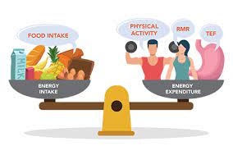
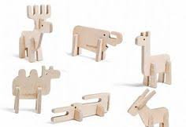
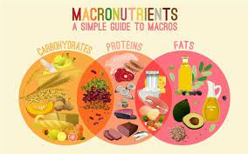
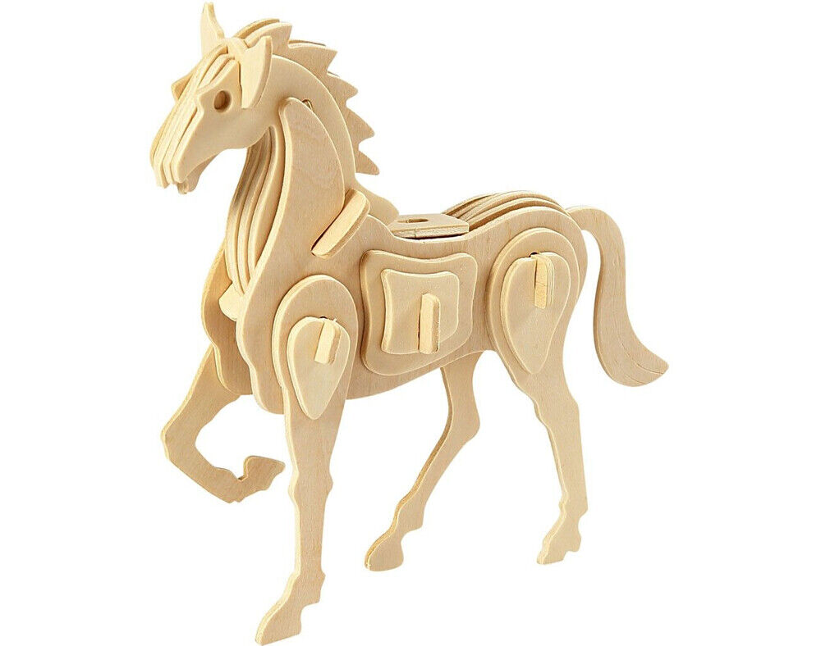
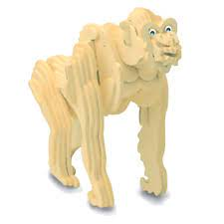
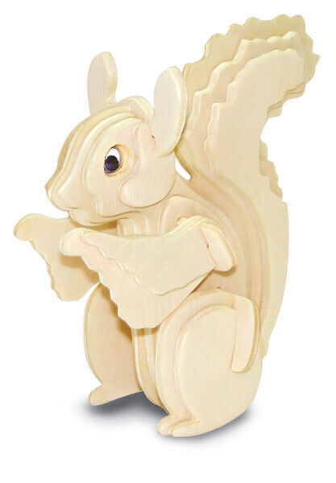
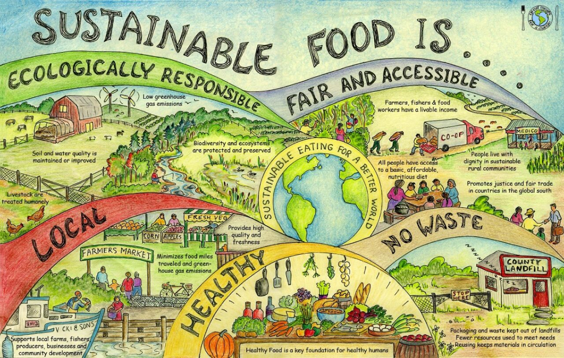
Technology - Learning Journey – Year 8
FOOD
Balloon Powered Vehicles : Introduction to movement through designs of vehicles, and exploration of simple mechanics of motion. This project also builds upon prior wood-working skills previously taught as well as orthographic drawings
Food Safety and Food Science: How does energy requirements change throughout life stages and how the diet needs to be balanced. Functions of ingredients and the science behind them, i.e. aeration. Practical skills working with raw ingredients and health and safety and hygiene.
DT
Year 8
Paper Straw Modelling : Students will be researching the designs of chairs and modelling a scaled-down design.
It includes investigating the ergonomics and anthropometrics of chair designs
DT
Food and Nutrition: Main nutrients in the diet provided by a healthy diet, protein and their types, sources and functions on the body, key understanding of macronutrients and why are they needed. Modified recipes for life stages.
DT
Slot Together Animals : Development of understanding of key features of plywood and its uses, how animal features can be depicted & outlined in design. It enables students to develop their use of hand and power tools.
FOOD
Textile Squares : Students develop an understanding of stitches and embroidery design. It includes threading, hemming, cross stitch, zig-zag stitch, straight stitch and knotting off.
DT
Food Provenance and Choice: Reducing food waste and seasonality, difference between organic farming and local produce, how can nutritional values be maintained using alternatives, sustainability and the importance of it when selecting ingredients. Cooking with alternative ingredients to maintain nutritional value.
FOOD
Year 9

