Slide 1
'Learning Journeys' - improving students understanding of what they are studying, when and why.
This academic year, all subjects have introduced 'learning journeys' to ensure that students are supported with understanding their curriculum development across the year and 'where their learning is going'. See below for some examples!

Slide 2
History Learning Journey - Year 7
Focus for the year:
'Forging Foundations'
Autumn Term (A)
Who are the 'British'?
Why did early settlers come to Britain? What impact did Roman invasion have? What changed with the arrival of the Anglo-Saxons? Why have other groups moved to, & away from, Britain? What does 'being British' even mean?
Autumn Assessments
End of topic knowledge test & interpretation on impact of immigration.
Essay – how did William keep control?
The Journey Starts!
Spring Term (A)​
How did medieval kings keep control?
What was life like in the Middle Ages? What role did religion play at this time? How effective a king was King John? How did medieval kings cause problems in the Middle Ages? How important was the Magna Carta?
Year 7
Autumn Term (B)
Castles & the Conquered
Why was their a succession crisis in 1065? Why did William invade England? How did he win at the Battle of Hastings in 1066? How did the Normans change life in England?
Spring Assessments
Essay – could medieval kings do whatever they wanted?
End of topic knowledge tests and 'significance' assessment.
Summer Term (A)
The Terrible Tudors?!
Why is Henry VIII so infamous? What impact did his religious changes have on England? What changes did his children make? Why did Lady Jane Grey only rule for 9 days? Who was 'Bloody Mary'?Is Elizabeth I the 'greatest monarch' of all time?
Spring Term (B)
'Her-Story'
An exploration of remarkable women throughout history – the context in which they lived, the challenges they faced, the significance of their actions.
Summer Assessments
'Religious rollercoaster' essay, end of topic tests, Cromwell interpretation assessment.
Thinking about Year 8!
Summer Term (B)
A country torn in two
Why did relationships between Charles I and Parliament break down? Why was to blame? Who won the English Civil War? How did the English Civil War change England? Why did Cromwell ban Christmas? Was Charles II the 'King of Bling'?

Slide 3
Girls PE Learning Journey - Year 7
Competition
Children will be introduced to competition – Intra / Inter Sportsday / School Games
2. Badminton
3. OAA
Footwork/Stance
Grips
Forehand /Backhand
Symbols
Map Orientation
Thumb the Map
The Journey Starts
5. Dance
Year 7
Timing
Levels
Travel
1. Netball
4. Football
Passing
Receiving
Footwork
Passing
Receiving
Dribbling
6. HBPE
Habitual
Motivated
Informed
Community Clubs
Children will be encouraged to join local clubs – Exit Routes / Sign-posting
8. OAA
7. Enrichment
9. Hand/Basketball
Symbols
Map Orientation
Thumb the Map
Developing key skills and knowledge in a variety of alternative activities
Passing
Receiving
Dribbling
Year 8
10. Rounders
1
12. Athletics
Catching
Throwing
Batting
Bowling
11. Cricket
Catching
Throwing
Batting
Bowling
Throws
Jumos
Pacing/Sprint
Children will develop a love of PE, physical activity & sport. At Ridgeway Secondary School they will engage in opportunities, clubs, teams and become active, healthy learners

Slide 4
Boys PE Learning Journey - Year 7
Competition
Children will be introduced to competition – Intra / Inter Sportsday / School Games
1. Football
3. OAA
Passing
Receiving
Dribbling
Symbols
Map Orientation
Thumb the Map
5. Handball
The Journey Starts
Passing
Receiving
Dribbling
Year 7
2 .Rugby
4. Badminton
Community Clubs
Passing
Receiving
Movment
Footwork/Stance
Grips
Forehand /Backhand
Children will be encouraged to join local clubs – Exit Routes / Sign-posting
6. HBPE
Habitual
Motivated
Informed
9. Basketball
Passing
Receiving
Dribbling
8. OAA
7. Enrichment
Symbols
Map Orientation
Thumb the Map
Developing key skills and knowledge in a variety of alternative activities
10. Table Tennis
Footwork/Stance
Grips
Foprehand/Backhand
Year 8
11. Cricket
13. Athletics
Catching
Throwing
Batting
Bowling
12. Rounders
Throws
Jumps
Pacing/Sprint
Catching
Throwing
Batting
Bowling
Children will develop a love of PE, physical activity & sport. At Ridgeway Secondary School they will engage in opportunities, clubs, teams and become active, healthy learners

Slide 6
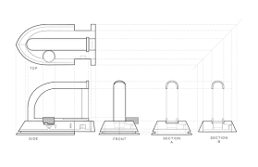
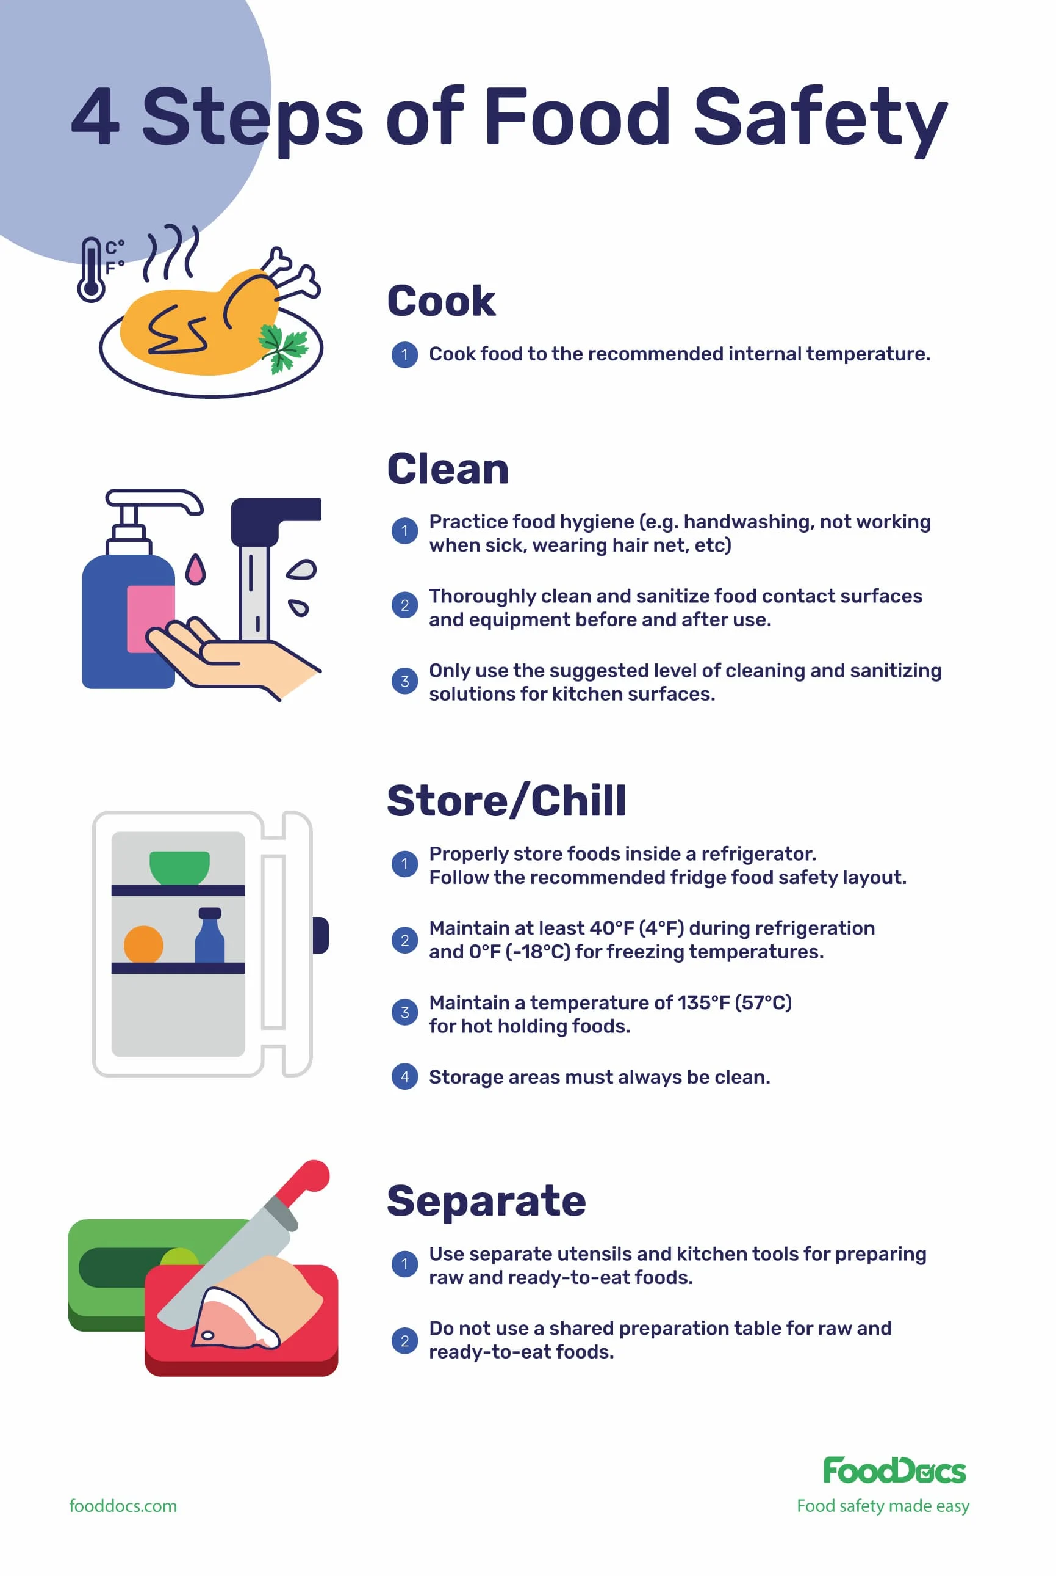
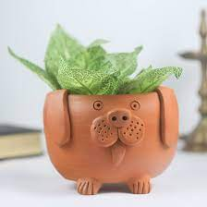
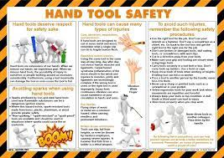
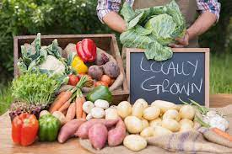
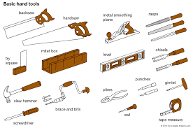
Technology - Learning Journey – Year 7
Introduction to Graphics :
Development of orthographic views, use of shading & tones, introduction to isometric, one-point & two-point perspective drawings, and 3D CAD design package
Health and Safety: Development of understanding the how to keep themselves safe in a Food and Nutrition lesson. Development of knowledge of health and safety and hygiene, demonstrated in correct knife skills.
DT
FOOD
Year 7
Lifestyle Specific Meals: Development of understanding of specific nutritional values – protein, starchy carbohydrates, dairy and alternatives, how the diet can be healthy through Eatwell Guide and portion sizes. Practical skills – knife skills, weighing / measuring, grating, slicing and spreading.
DT
Introduction to Ceramics :
Styles of pots and their uses, development of techniques used to make them, and tools used for pottery
FOOD
Introduction to Wood Working Skills :
Safety rules for workroom, safe use of hand tools, aesthetics of design, limitations of materials, further development of orthographic & perspective drawing skills
DT
Seasonal Fresh Produce and Provenance: Factors affecting food choice, what is seasonal produce, specific cooking methods affecting nutritional value of fruit and vegetables. Food provenance – grown, reared and caught. Further development of knife skills and electrical equipment.
FOOD
Year 8

