Slide 1
'Learning Journeys' - improving students understanding of what they are studying, when and why.
This academic year, all subjects have introduced 'learning journeys' to ensure that students are supported with understanding their curriculum development across the year and 'where their learning is going'. See below for some examples!

Slide 2
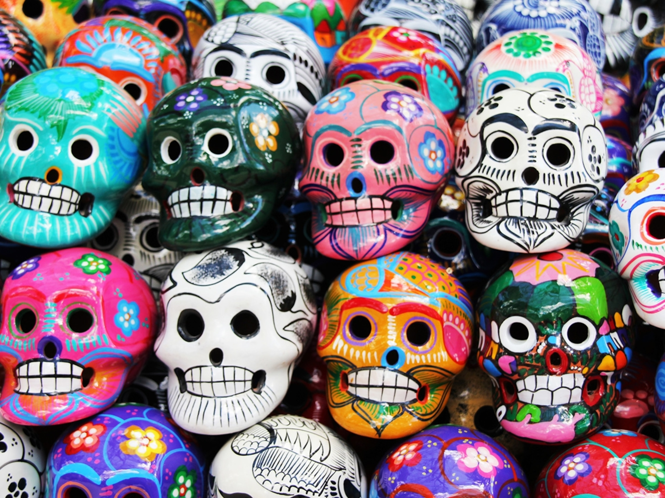
Day of the Dead research and work in the style.

Slide 3
History Learning Journey - Year 9
Focus for the year:
'Conflict & cooperation'
Autumn Term (A)
The War to end all Wars?
What were the main causes of WW1? What was life like for the soldiers in the trenches? What technological changes took place at this time? How did the experiences of WW1 impact on medicine?
The Journey Starts!
Autumn Assessments
Key term knowledge test, impact of war essay.
Dictator comparison written piece.
Year 9
Spring Term (A)​
How should the Holocaust be remembered?
What was the Jewish experience in Germany before the rise of the Nazi Party? How did the lives of Jewish people change under Hitler's rule? What was the 'Final Solution'? Why should the Holocaust be remembered? Why did other genocides still happen post WW2?
Autumn Term (B)
The rise of the 'deadly' dictators.
How did WW1 impact on Europe politically and economically? Why did people turn to extreme leaders? What was life like in a dictatorship?
Summer Term (A)
WW2 - a different type of warfare?
An exploration of the main battles of WW2 – invasion of Poland, Dunkirk, Battle of Britain, Battle of the Atlantic, the war in the Pacific.
Was the dropping of the Atomic bomb justifiable?
Spring Assessments
Reflection piece on the Holocaust, key term test.
Propaganda assessment (Home Front)
Spring Term (B)
WW2 - How did the lives of British people change during WW2?
What was the 'Home Front'? How did Britain prepare for WW2? What did different groups experience?
Summer Assessments
Cold War source work, end of Year assessment (all topics).
Summer Term (B)
What made the Cold War so terrifying?
Who were the 'Big Three'? Why did alliances break down? What actions did Stalin take and how did the West retaliate? Key events of the 1960s and 1970s? What impact did the collapse of the Berlin Wall have? How did the Cold War 'thaw'?
Thinking about Year 10!

Slide 4
Girls PE Learning Journey - Year 9
Competition
3. OAA
Children will be introduced to competition – Intra / Inter Sportsday / School Games
2. Badminton
Doubles
Shot Selection
Space
Compass
Negotiation
Leadership
The Journey Starts
5. Dance
Year 9
Musicality
Aesthetics
Cheorography
1. Netball
4. Football
Individual and Team Principles of Attack and Defence
6. HBPE
Individual and Team Principles of Attack and Defence
Habitual
Motivated
Imformed
Community Clubs
Children will be encouraged to join local clubs – Exit Routes / Sign-posting
8. OAA
7. Enrichment
9. Handball
Compass
Negotiation
Leadership
Developing key skills and knowledge in a variety of alternative activities
Individual and Team Principles of Attack and Defence
KS4
10. Rounders
Positioning
Tactics
11. Cricket
12. Athletics
Positioning
Tactics
Phases of Sprint
Tactics
Throws/Jumps
Children will develop a love of PE, physical activity & sport. At Ridgeway Secondary School they will engage in opportunities, clubs, teams and become active, healthy learners

Slide 5
Boys PE Learning Journey - Year 9
Competition
Children will be introduced to competition – Intra / Inter Sportsday / School Games
1. Football
3. OAA
Individual and Team Principles of Attack and Defence
Compass
Negotiation
Leadership
The Journey Starts
5. Handball
Year 9
Individual and Team Principles of Attack and Defence
2 .Rugby
4. Badminton
Community Clubs
Passing
Receiving
Movment
Doubles
Shot Selection
Space
6. HBPE
Children will be encouraged to join local clubs – Exit Routes / Sign-posting
Habitual
Motivated
Informed
9. Basketball
Individual and Team Principles of Attack and Defence
8. OAA
7. Enrichment
Compass
Negotiation
Leadership
Developing key skills and knowledge in a variety of alternative activities
10. Table Tennis
Service Actions
Individual Shots
Sending/Receiving
KS 4
13. Athletics
11. Cricket
Phases of the Sprint
Tactics
Throws/Jumps
Positioning
Tactics
10. Rounders
Children will develop a love of PE, physical activity & sport. At Ridgeway Secondary School they will engage in opportunities, clubs, teams and become active, healthy learners
Positioning
Tactics

Slide 6
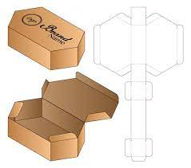
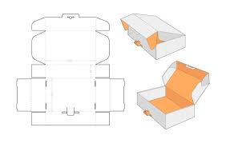
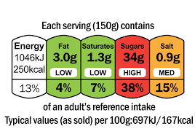
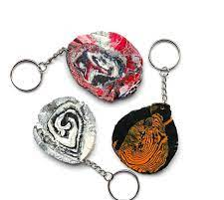
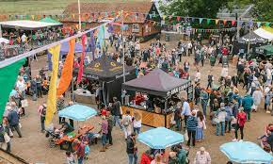
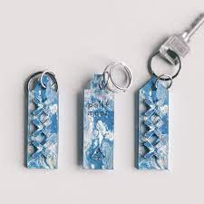
Technology - Learning Journey – Year 9
Logos & Packaging : A look into the world of packaging focusing
on design shape & size, font used on the package, developing into
logos and emblem designs. Including perspective & isometric drawing and progresses through to CAD 3D designs. Screening printing & heat transfers.
Food, Diet & Health: Develop an understanding of how important the Eatwell Guide is to specific ages groups, specific functions of macronutrients, how the body functions with regards to the specific nutritional values, calculation of the cost of a dish versus ready made. Practical skills – frying, boiling and simmering.
DT
FOOD
Year 9
Jigsaw Designs: Create jigsaws for a given client group (pre-school, educational, physical disability, elderly) using CAD and CAM (laser cutter). Research use of colour, shape, size and material to create most appropriate jigsaw.
DT
Food Provenance & Consumer Information: Guidance to the consumer regarding availability, traceability, food assurance scheme & animal welfare. Production of recipe cards and the practical application of skills used, science behind pastry whilst considering shortening and coagulation.
FOOD
Recycled plastics & Polymers : this project focuses n recycling plastics, looking into companies that specialise in it when making their products. Produce own recycled polymer based key ring, in addition to looking into resins & polymorphs.
DT
Food Hygiene & Safety in a Range of Situations: Factors food vendors need to consider when planning & preparing food to be sold and eaten at festivals, food hygiene and legislations for selling food at festivals, designing a menu to be sold at a venue. Understanding food allergies and intolerances.
FOOD
Year 10

