Slide 2
Website to track your child’s learning both at school and at home
Both staff at Prudhoe Castle and yourselves at home can add observations of your child using photos, videos and written notes.
You can login securely on your phone, tablet or computer and view your child’s progress.
What Is Tapestry?

Slide 3
It creates a two way communication between us (the EYFS team), and you (the parents and carers).
Unlike a physical, hard copy book, it’s easy to share with groups of relatives, such as extended families, separated parents and relatives living overseas.
We will use Tapestry to track your child’s progress and help with next steps in their development.
You can view how your child’s progress links to the Early Years curriculum with statements under the observations
Why Are We Using Tapestry?

Slide 4
Photos, videos and observations are uploaded to Tapestry.
It is accessed via the Android/iOS app or the Tapestry website.
It enables you to comment on observations or add your own, so you can show us what your child is doing outside the school day – weekend trips, exciting learning opportunities, trip to the shops etc.
Email notifications can be sent to inform parents of new observations and comments.
How Does It Work?

Slide 5
A password is required to access Tapestry, and parents can only view observations of their own children.
Hosted on secure cloud servers within the EU.
Tapestry uses the same encryption as online banking.
Data is stored separately for each school.
Tapestry’s developers and support personnel require our permission to access our Tapestry account.
How Is The Data Protected?

Slide 6
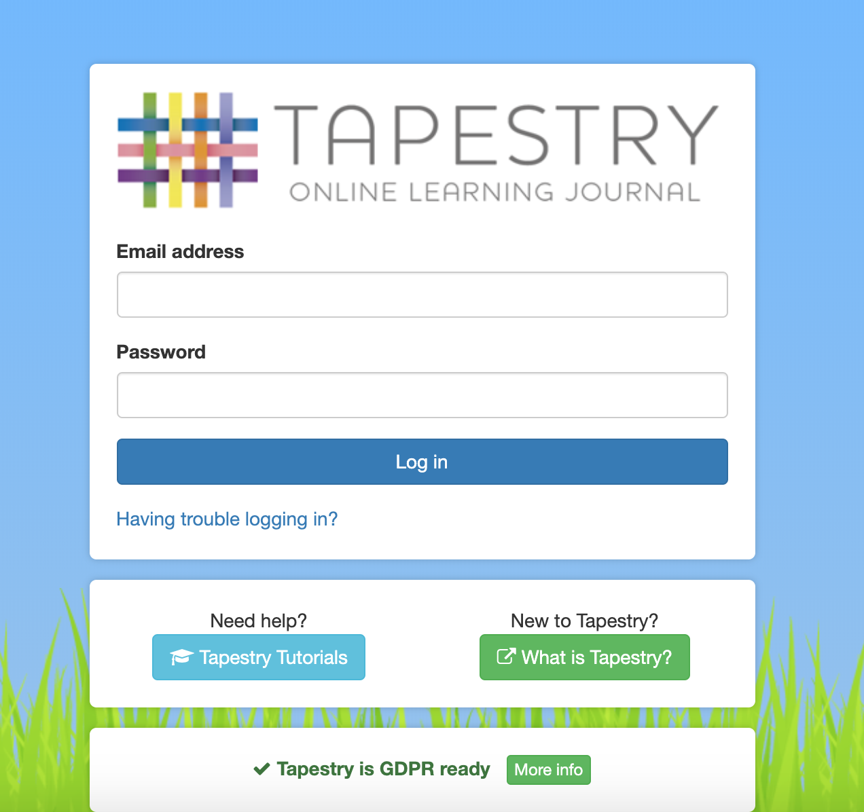
What Does It Look Like?

Slide 7
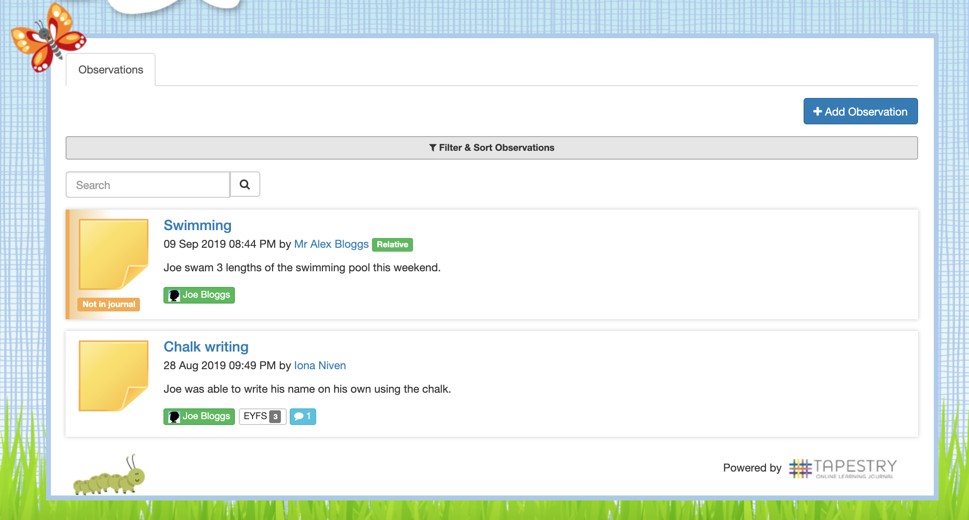

Slide 8
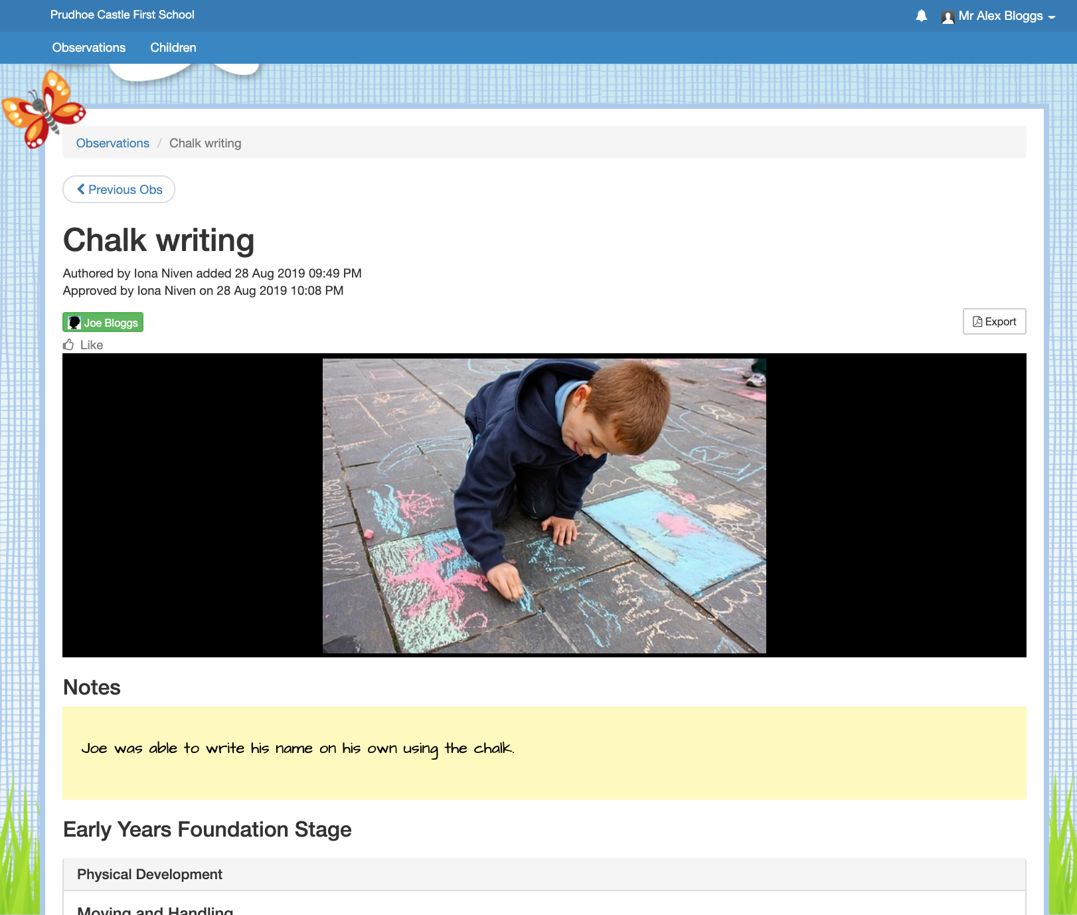

Slide 9
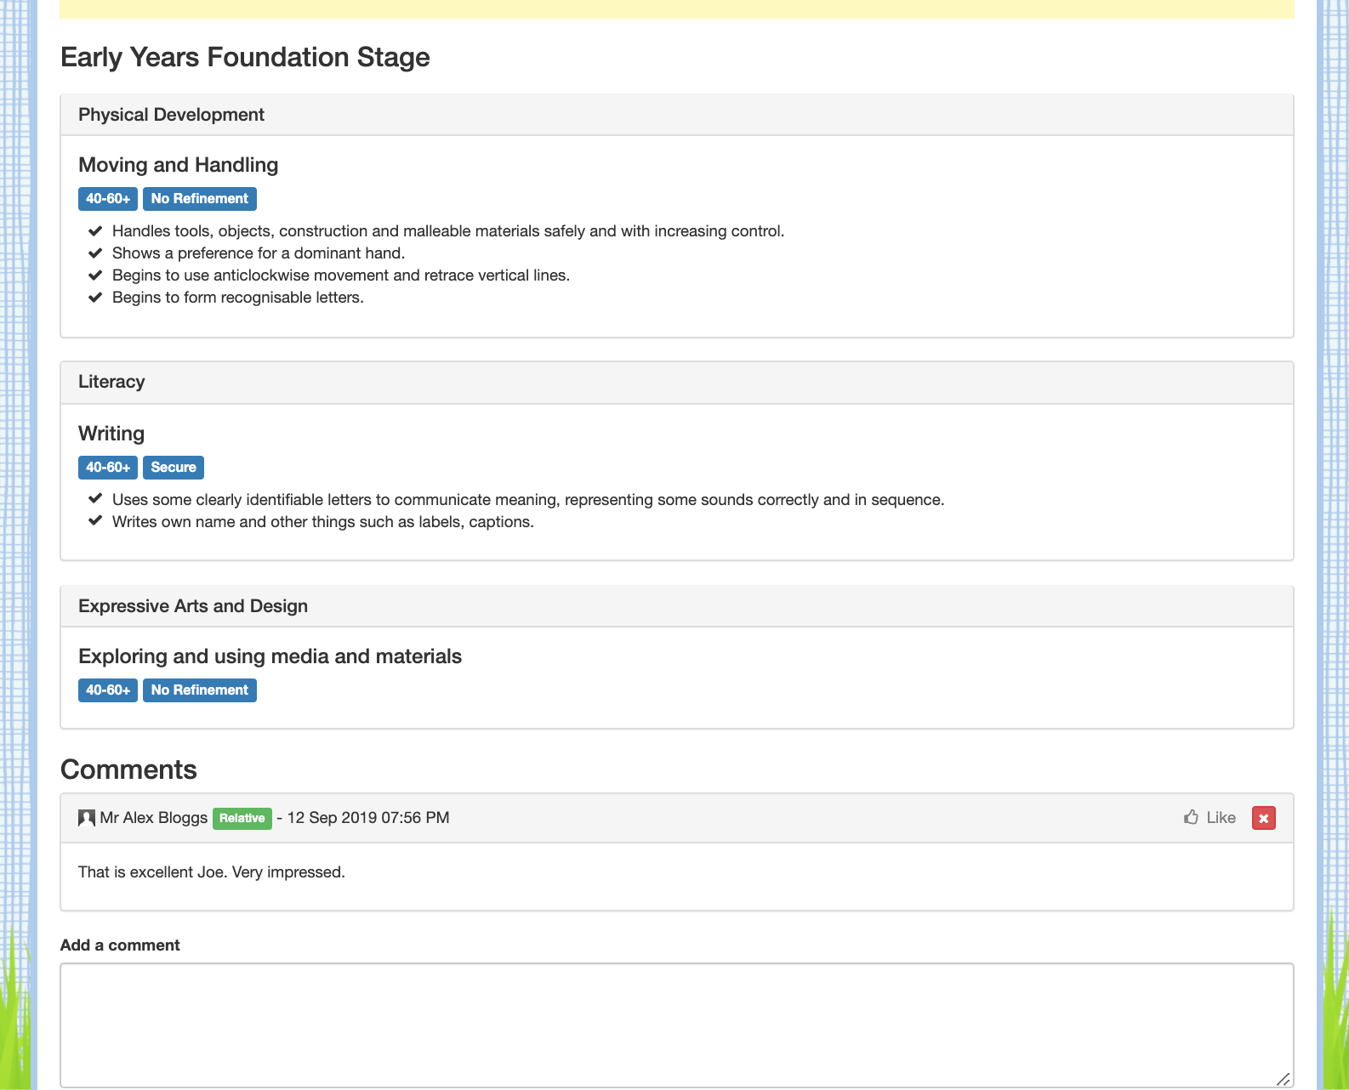

Slide 10
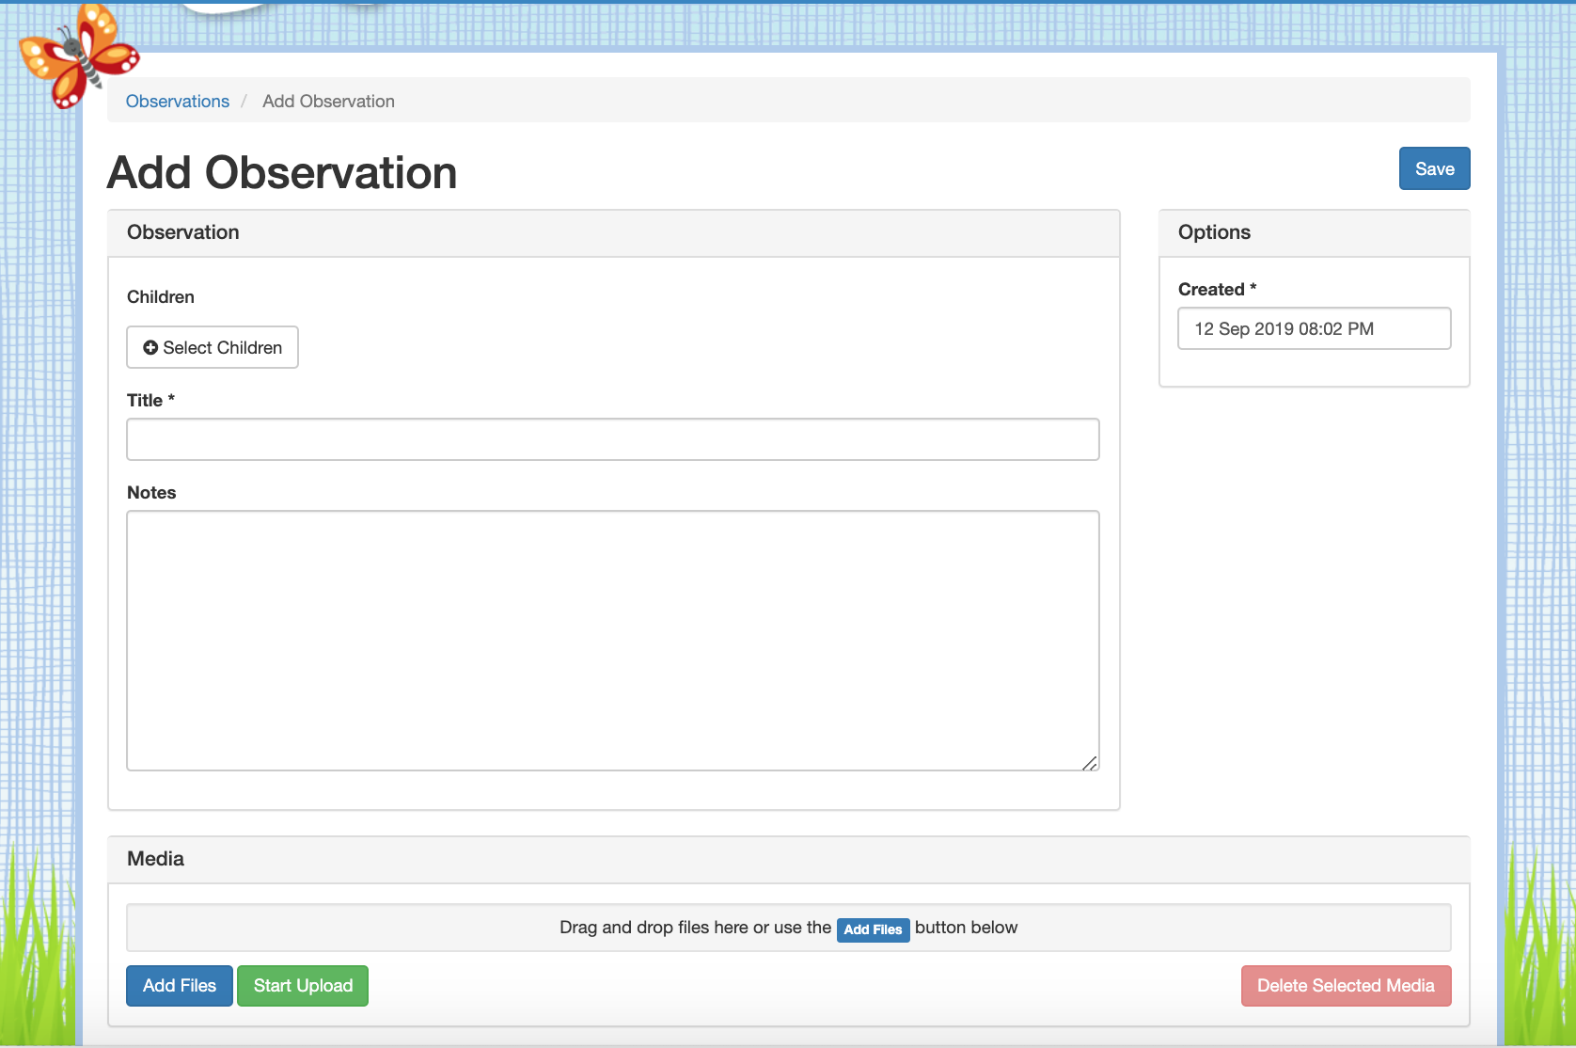

Slide 11
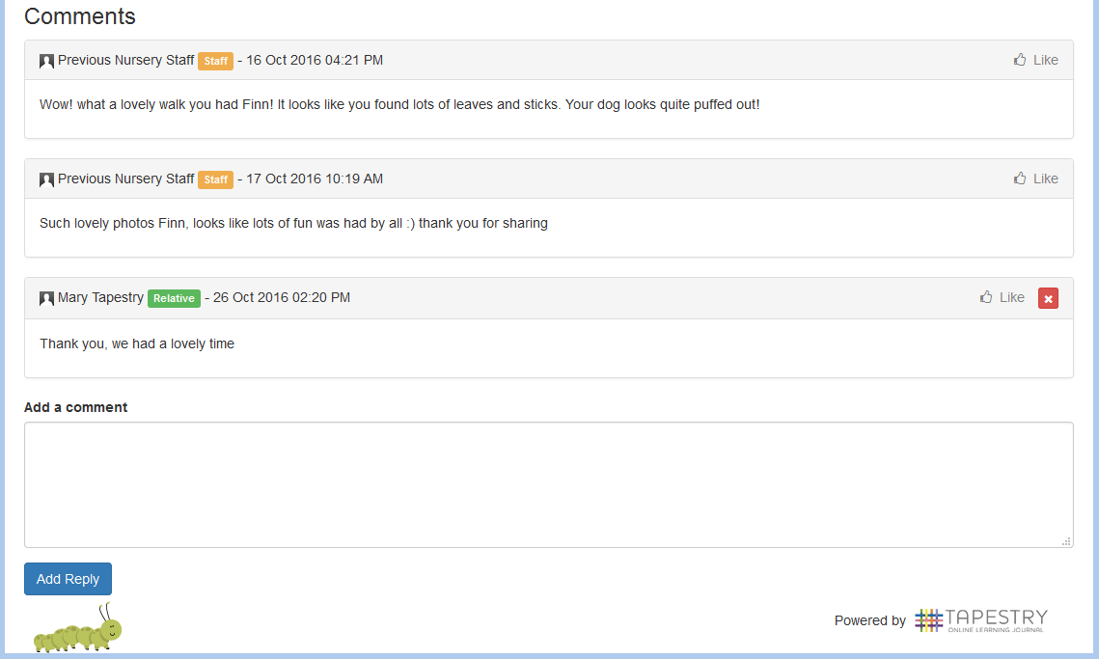
What Does It Look Like?

Slide 12
We will shortly hand out introductory letters so you can grant your permission and provide an email address
We should have your account created by the end of next week, and you will receive a link via email to set a password for yourself
When Will We Get Started?

Slide 13
If you have any questions, please ask
as you collect your form.

