Slide 1
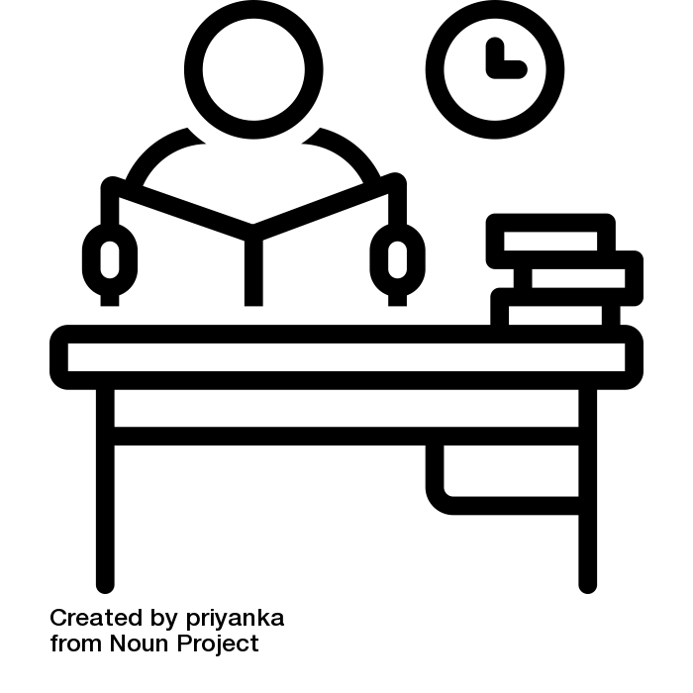
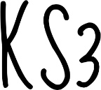
ENGLISH 2024-5
Do I understand the content and can I apply the skills required?
How can I improve my grade using what I have learnt from my mocks?
Do I understand the content and can I apply the skills required?
How can I revise effectively to feel confident in my mock and final exams?
Revision of Literature and Language
Lit & Lang
MOCK
Revision of Literature and Language
Lang&Lit
MOCK
Revision of Literature and Language
Year 11
FINAL
GCSE
EXAMS
GCSE
How do writers create immersive and believable characters and situations? How can we do the same?
♕
How do I prepare for exams and feel confident in my skills?
How can I revise effectively to feel confident in my mocks and final exams?
How do poets create meaning and raise ideas/ questions for us in poetry?
Why did Dickens write A Christmas Carol and what does he want us to learn from it?
Why Did Shakespeare write this play and what are the ideas inside it?
Spoken language Endorsement
Language paper 1 skills
Macbeth
MOCK
Lg P1 Mock and revision skills
Revision of Literature & Language
Power and Conflict Poetry
A Christmas Carol
How can I develop the life skill of effective public speaking?
YEAR 10
How do poets convey experiences of war and how can we do the same?
☎
How do writers’ use different methods to show experiences by informing, entertaining and engaging ?
GCSE
Why has Priestley written this play and what does he want us to learn from it?
War
Poetry
Science Fiction and Non-Fiction
An Inspector
Calls
My Name is Leon
Reading and creative writing
How does Shakespeare present ideas about the world through characters and situations?
♕
How can we learn to write creatively from mythology?How do classical stories link with modern ideas and texts?
How are our experiences different depending on who we are and how is this shown in Literature?
How can we learn from non-fiction writing to create engaging non-fiction articles?
Romeo and Juliet
Classical Stories: myths, legends, fables
➸
The Disappearance
Non-Fiction
YEAR
9
How do writers use different methods to present their ideas?
How is gothic writing created and what are the codes and conventions?
Grow a Poem
Class Novel
Gothic Writing
How do poets present ideas and experiences of identity?
How does Dickens use different methods to create engaging characters?
How does Shakespeare present ideas about love?
How can we use methods studied in classic crime stories to develop our own writing?
Much Ado About Nothing
YEAR
Dickens
Crime
8
Creative Writing Quest
writing
Autobiographical
YEAR
How can a range of writers’ methods be built on and developed to form a well structured creative narrative?
Class Novel
7
How can different writers’ methods be used to create engaging and technically accurate writing?
How do writers use different methods to present their ideas?
How can I use language to engage my reader?

