Slide 1
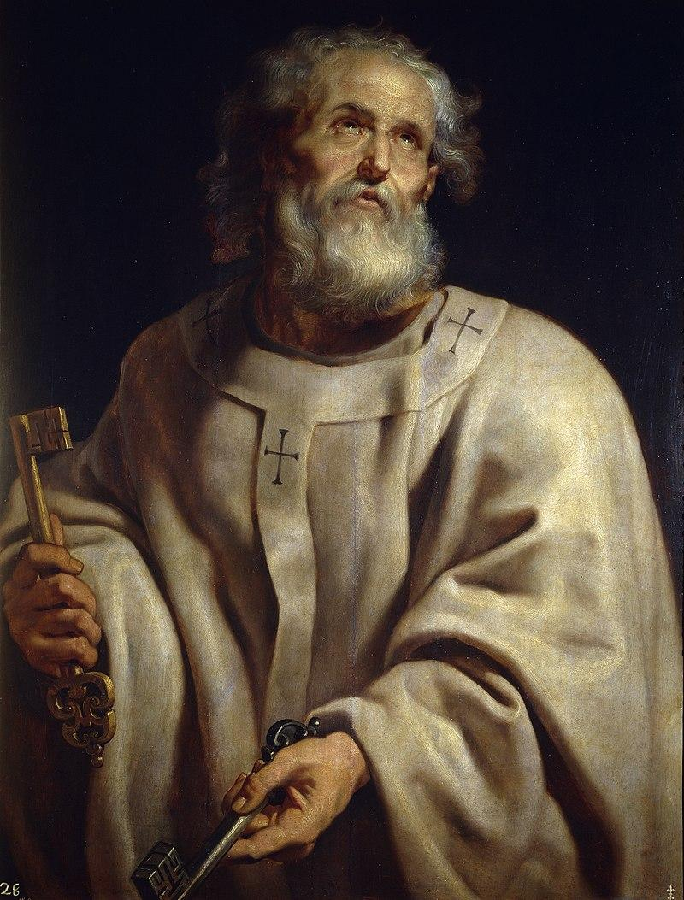
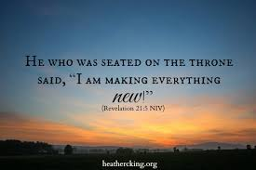
Welcome Class of 2026

Slide 2
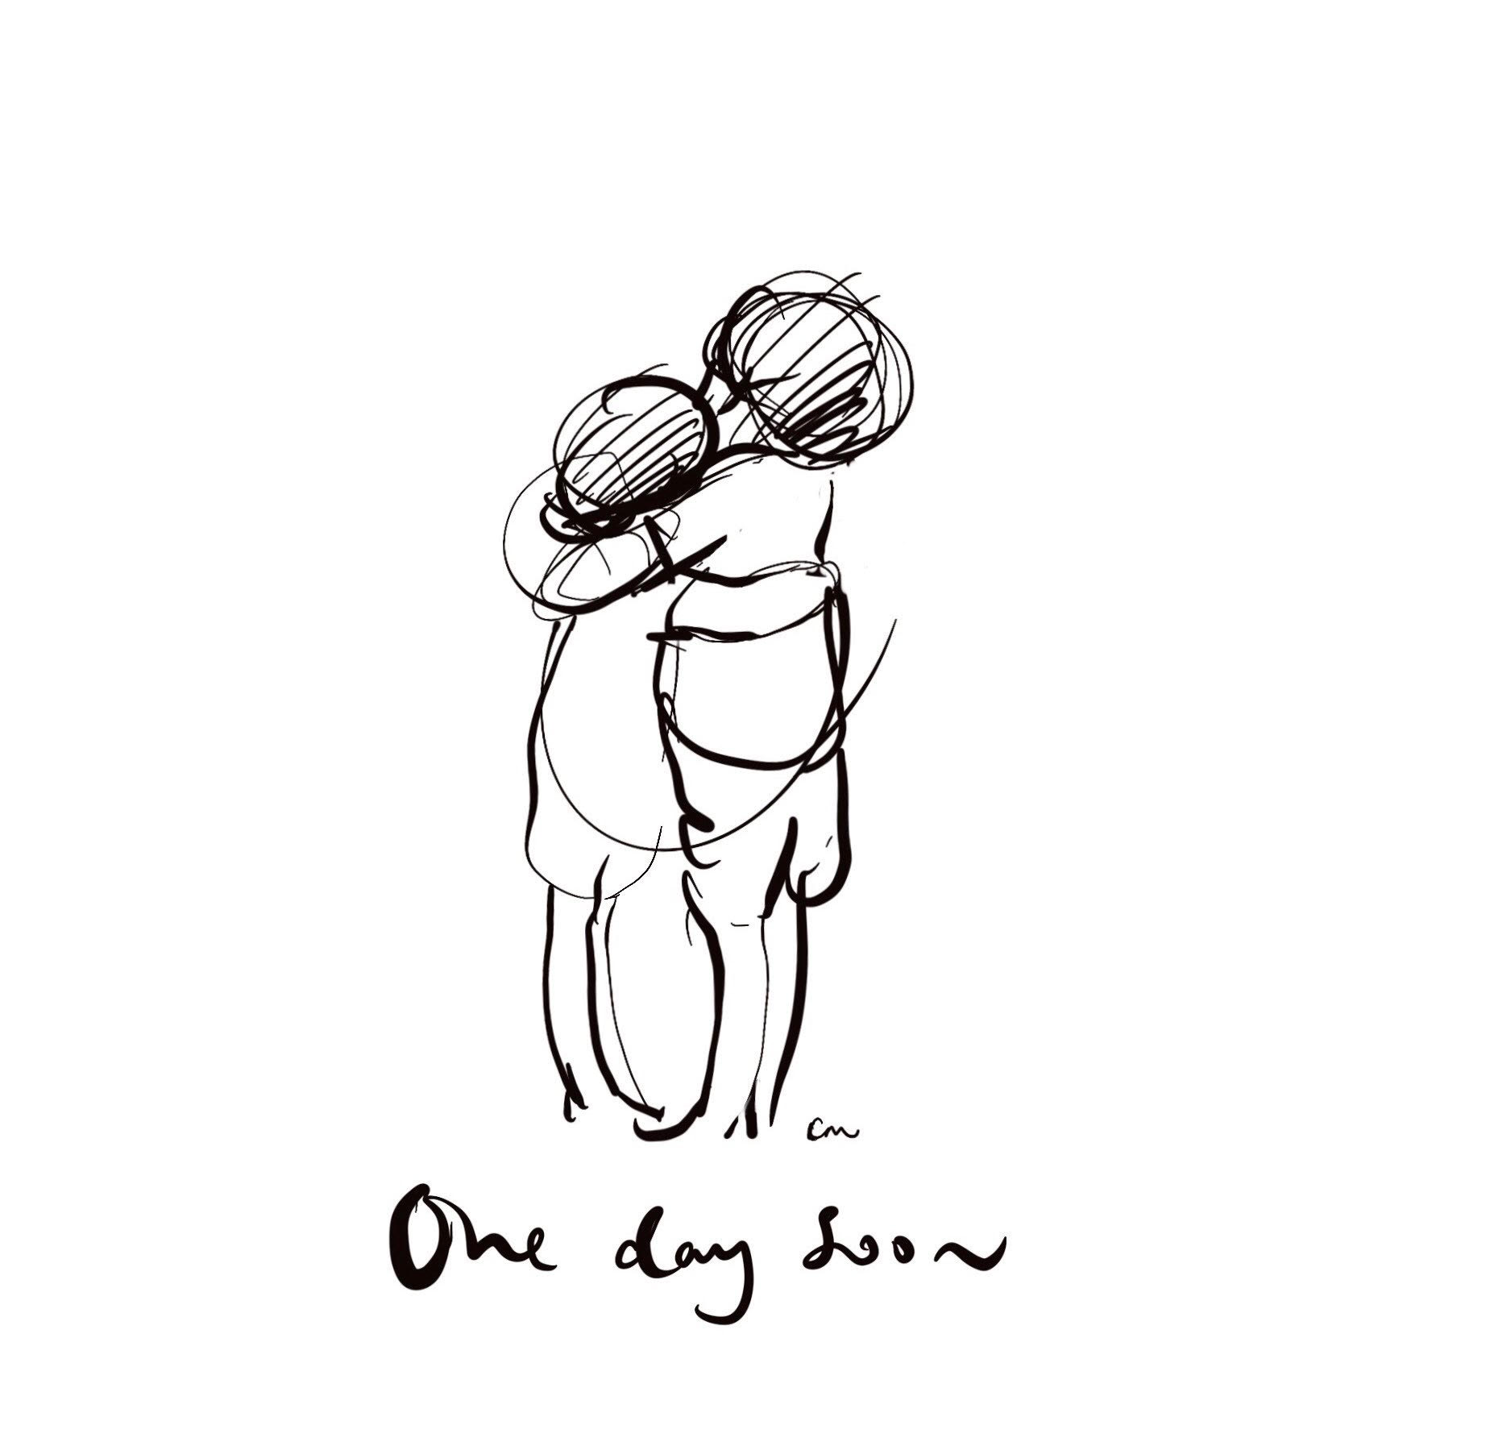

Slide 3
Start date: Thursday 2nd September – Drop pupils off at reception at 8.30, Mrs Hardy will be there to meet you
Timetables: Pupils will be given a timetable to follow
Lunch: All pupils will have their fingerprint taken on the first day, you have been sent a log in for parentpay, please activate, even if you are on FSM or bring a packed lunch as this is used for other things. (if you haven’t already please inform us of any allergies)
Toilets: There are toilets available to use before school, at break and lunch and after school. Pupils will not be able to use the toilets at any other time, unless they have medical evidence and a toilet pass
Sanitiser pump in each classroom - You must sanitise your hands on entry and exit

Slide 4
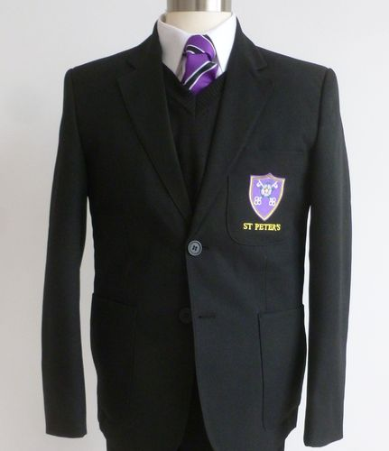
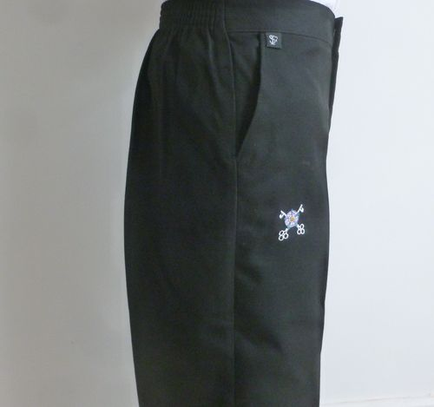
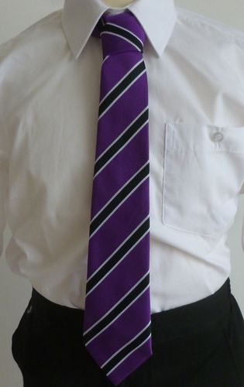
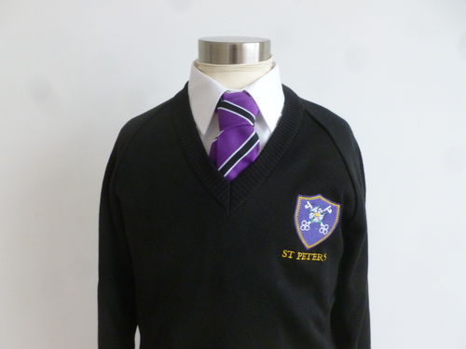
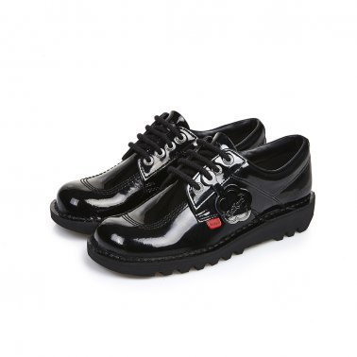
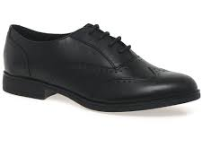
Uniform
Blazers, Ties, Trousers and Skirts are all available from Ross’s in Middlesbrough White shirts can be bought from anywhere School shoes must be plain black, no trainers, no heels or bows bag (big enough to fit an A4 Folder in) to carry your equipment.

Slide 5
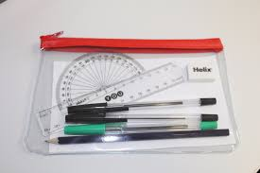
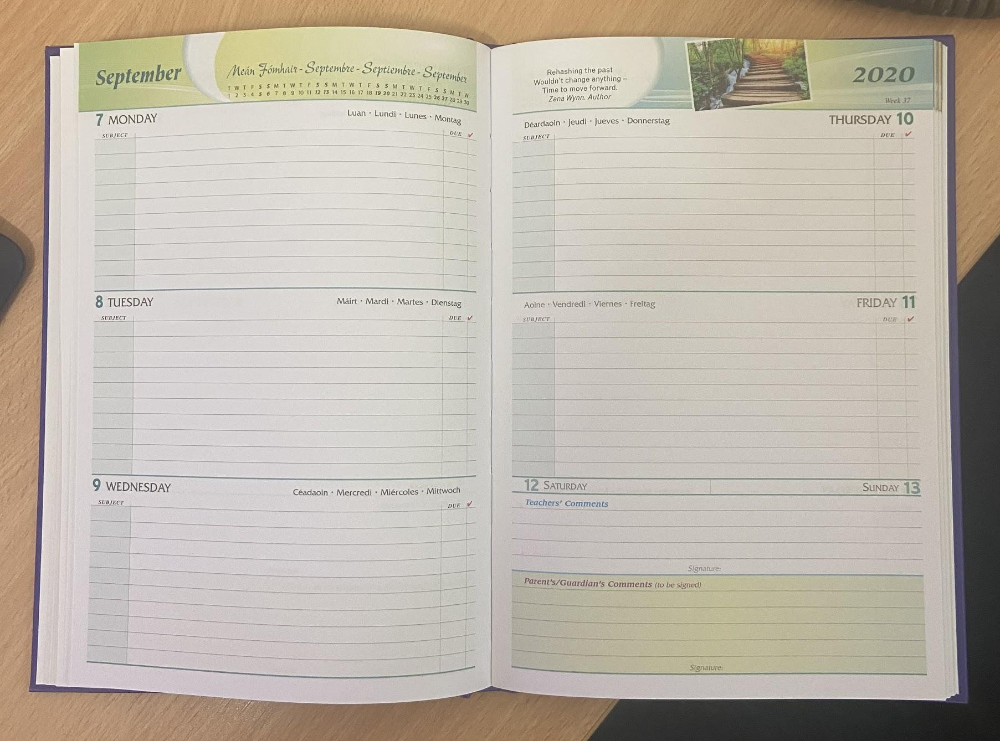
Planners/Equipment
All pupils will be gifted a planner and a pencil case with a pen, pencil, ruler, purple pen and board pen. If you have lost your equipment then you must replace the items - we are not in a position to be supplying you with equipment every day - take responsibility.

Slide 6
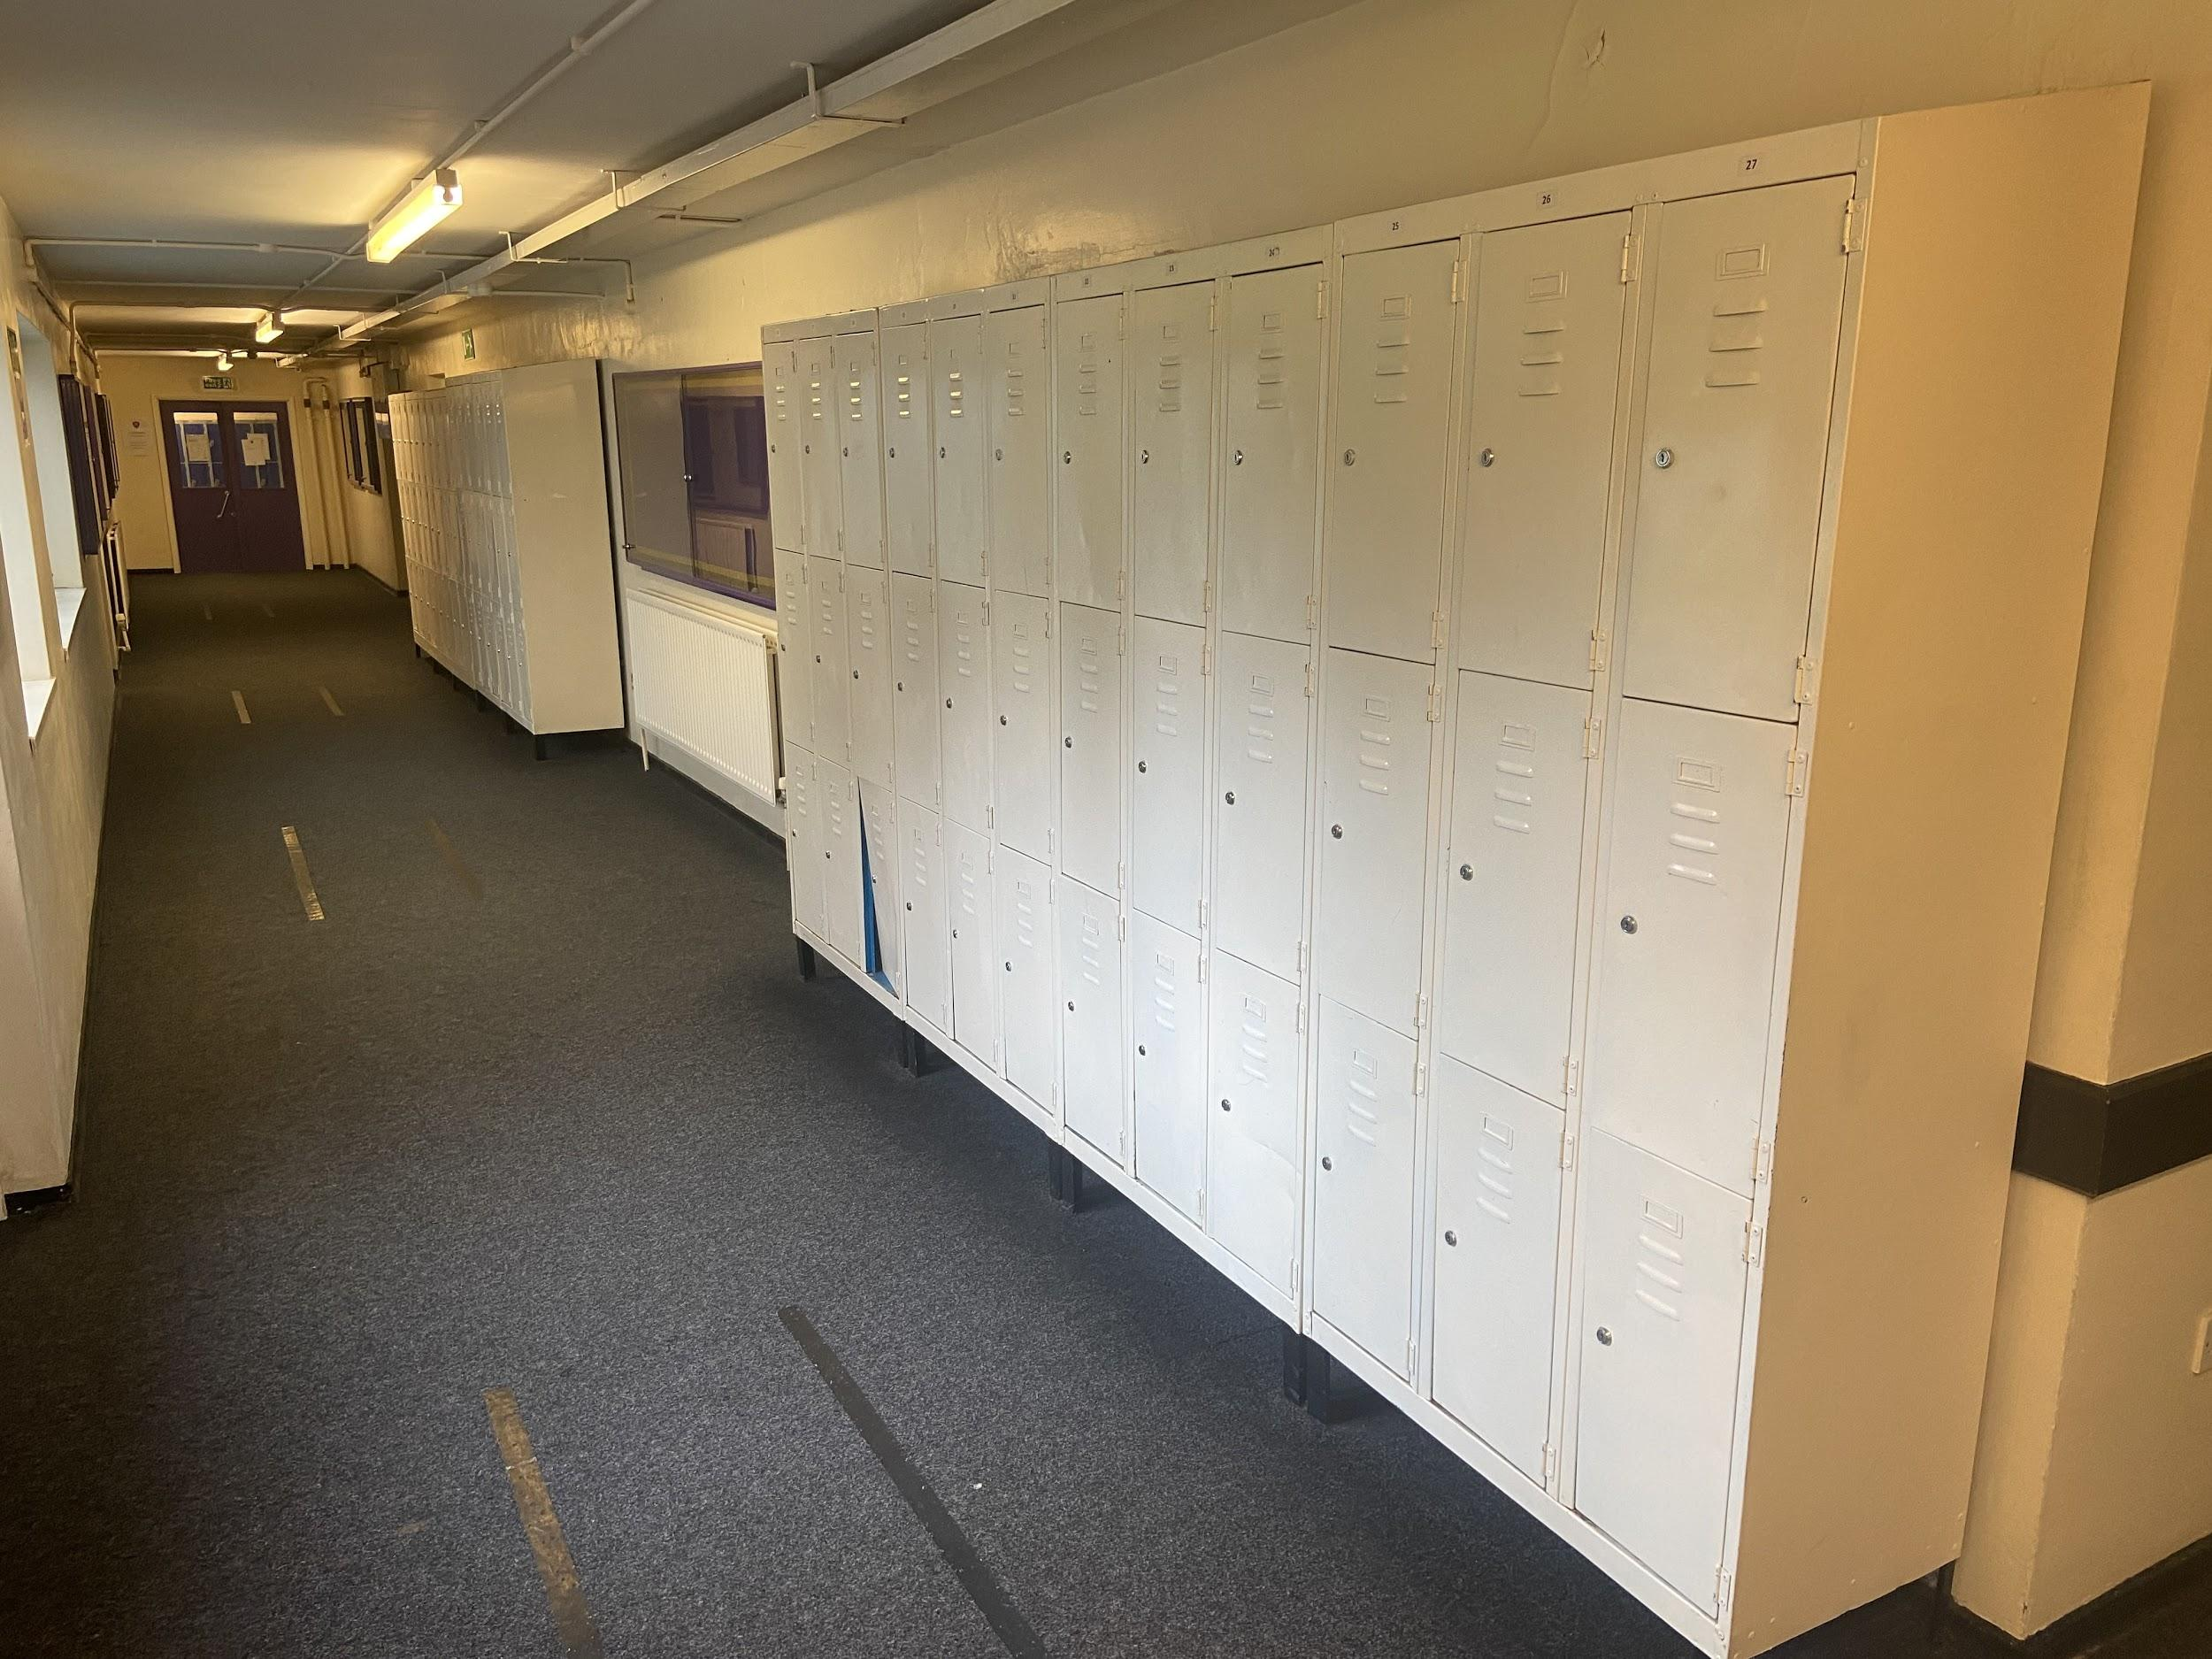
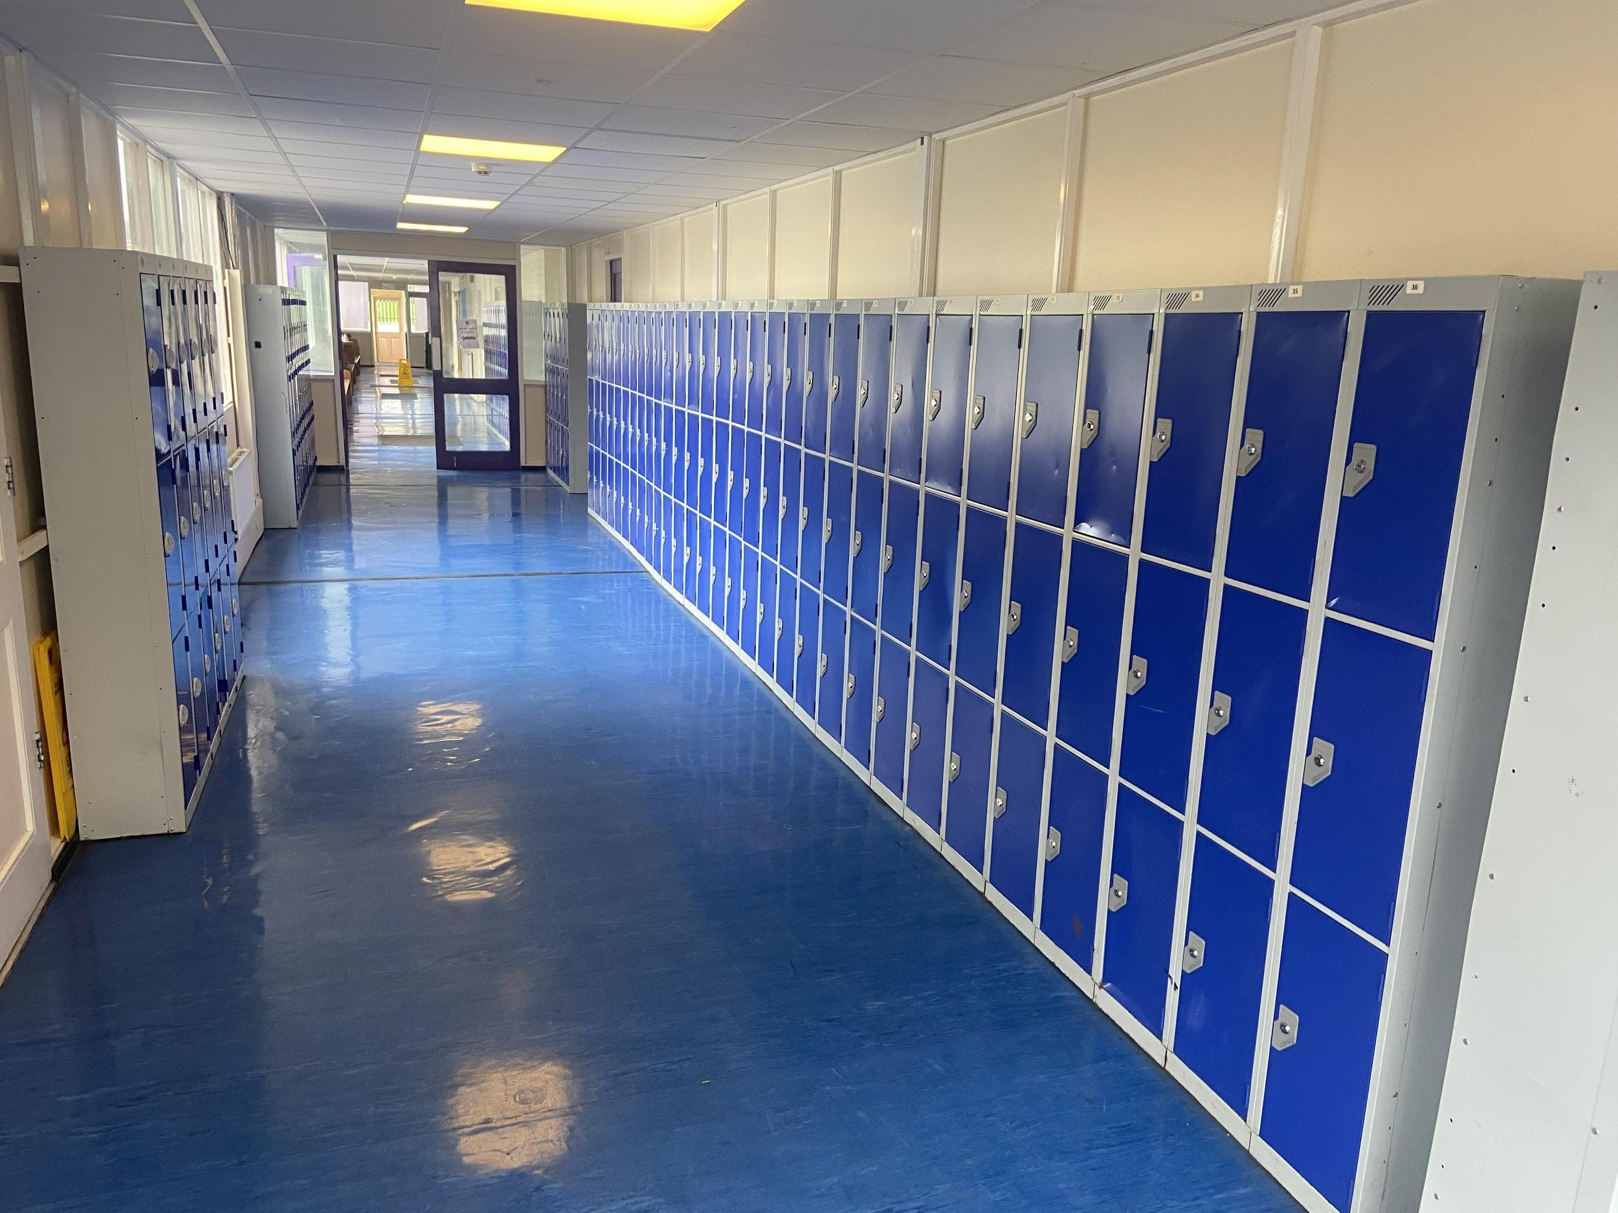
Corridors
At all times, we must keep to the left, a huge amount of effort has resulted in you being back into school and in lessons, we need to ensure that outside of classrooms we wear masks and walk sensibly to our classrooms.

Slide 7
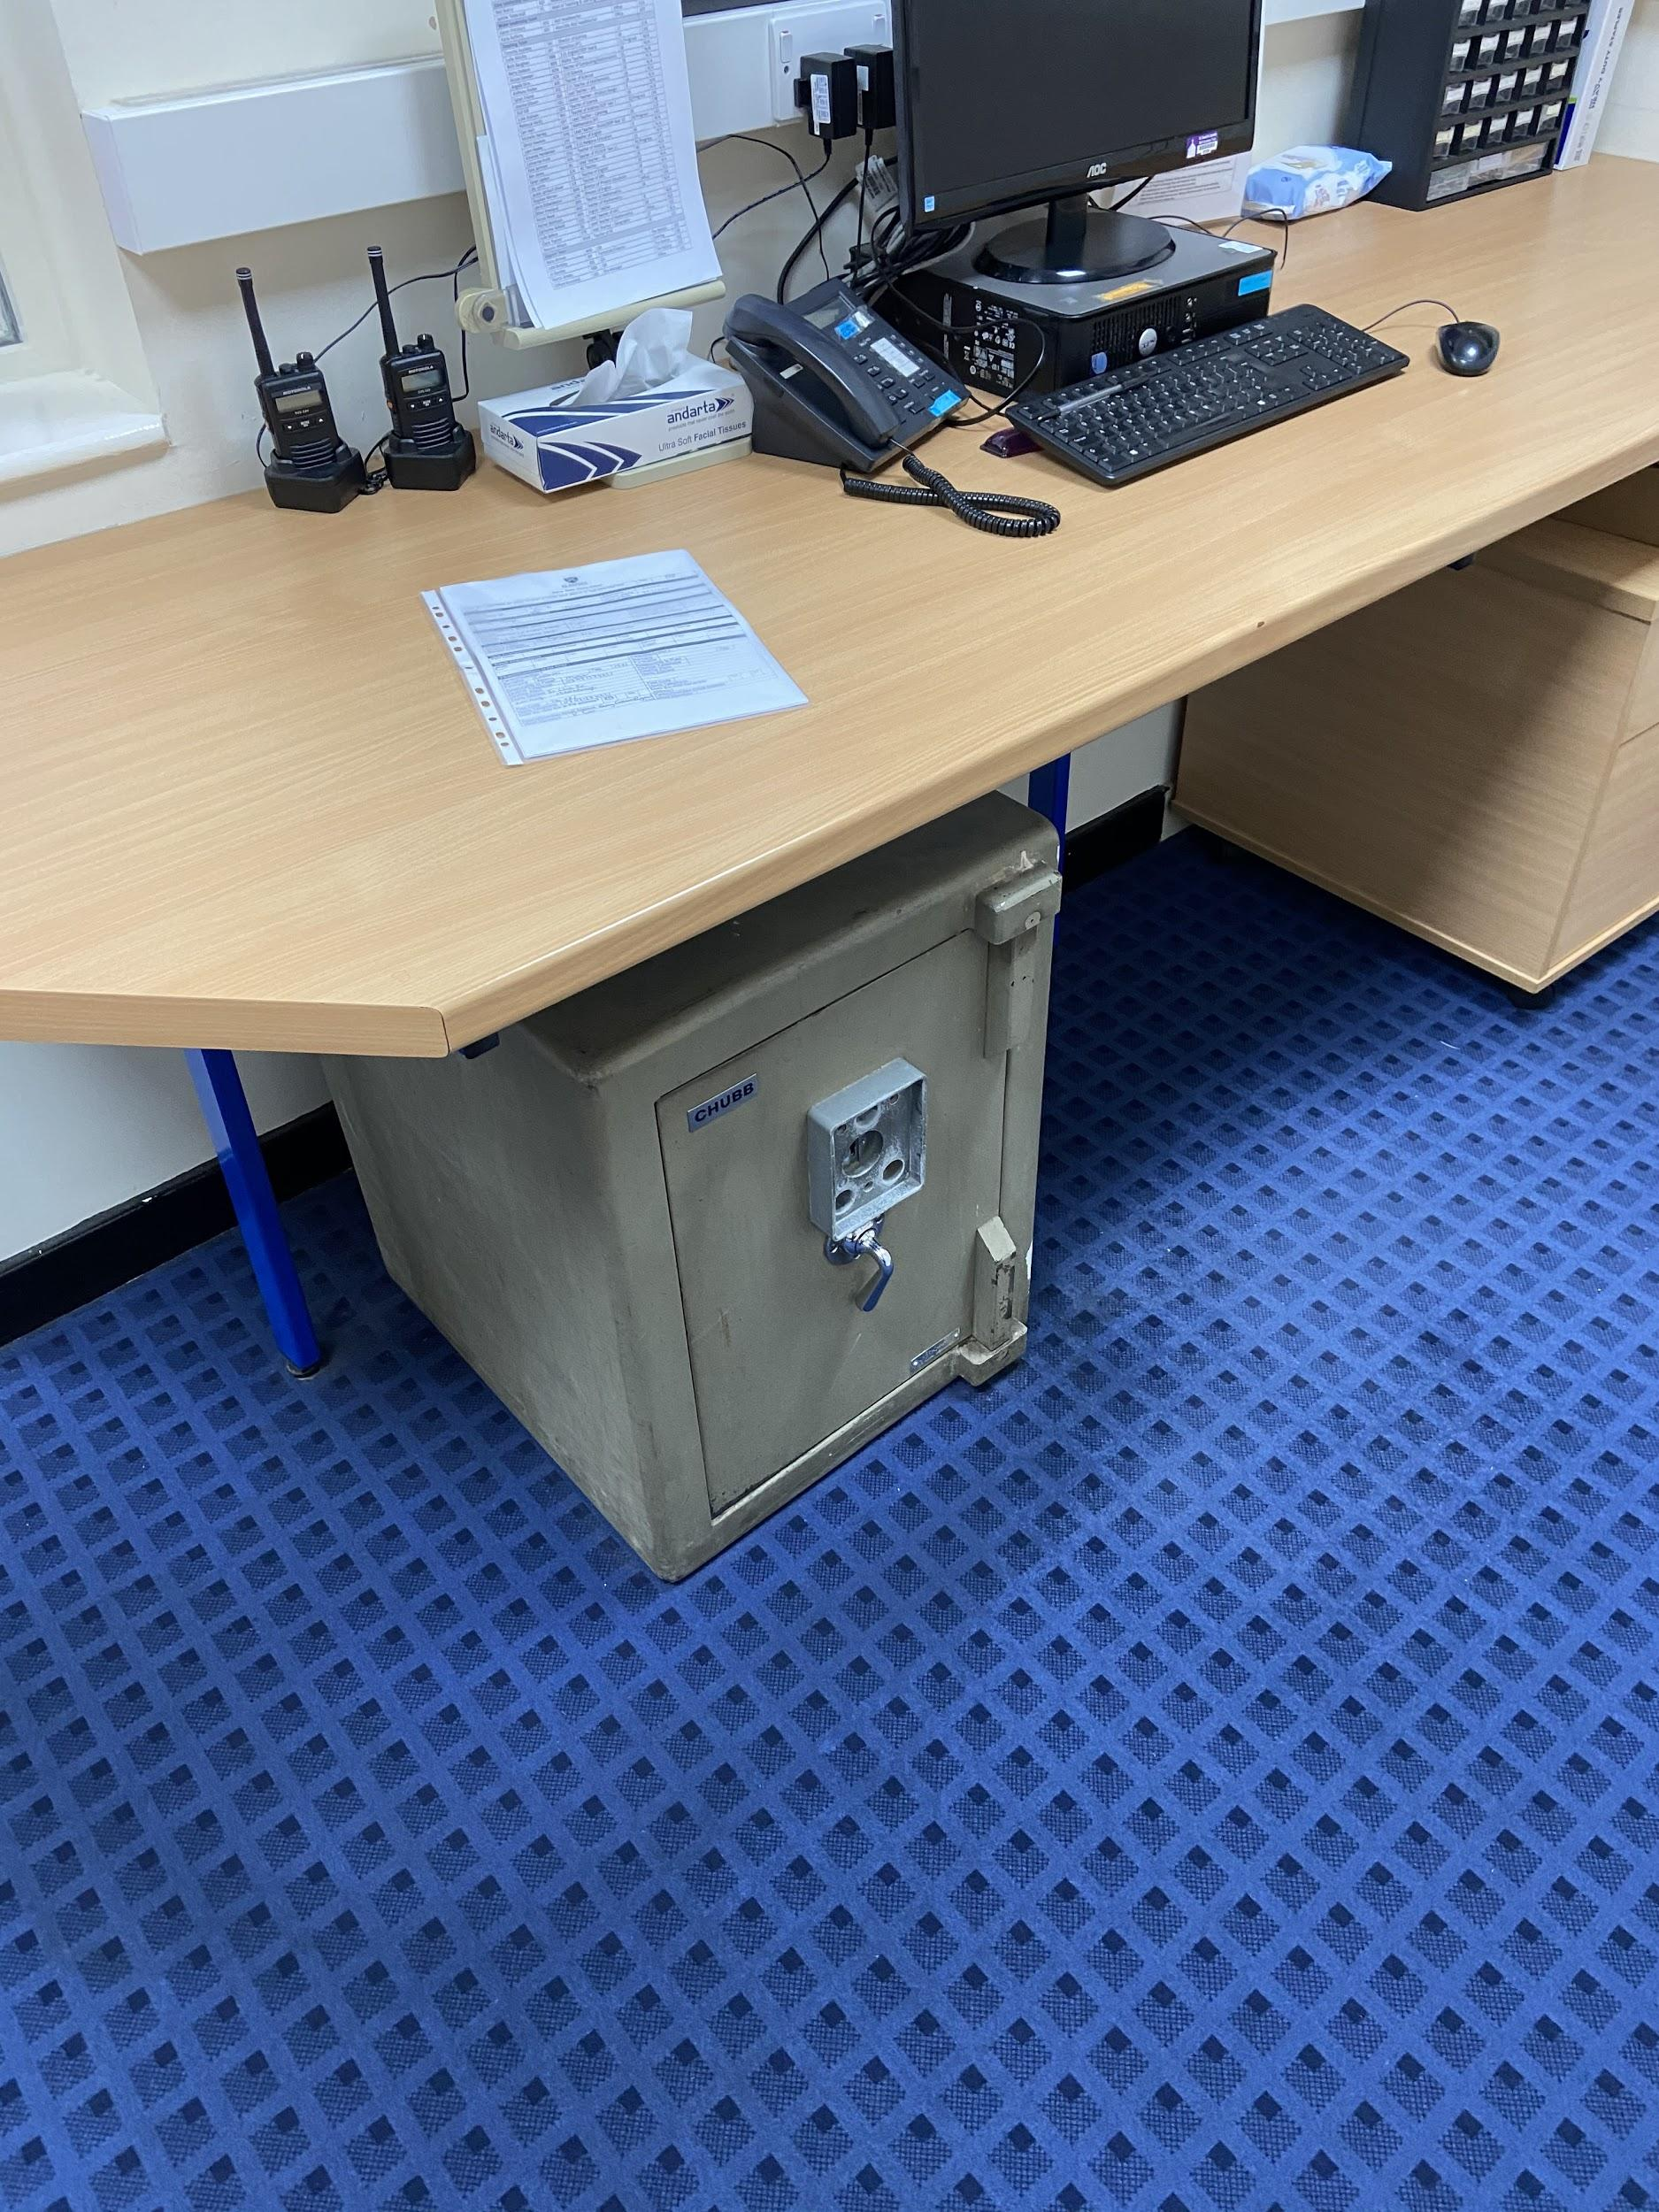
Mobile Phones
Mobile phones must be switched off and in your bag.
If a pupil has a mobile phone out in lessons/corridors/yard then it will be removed by the member of staff, handed into the office, and kept in the safe.
Parents will have to collect the phone personally from school – it will not be given back at the end of the day to the pupil

Slide 8
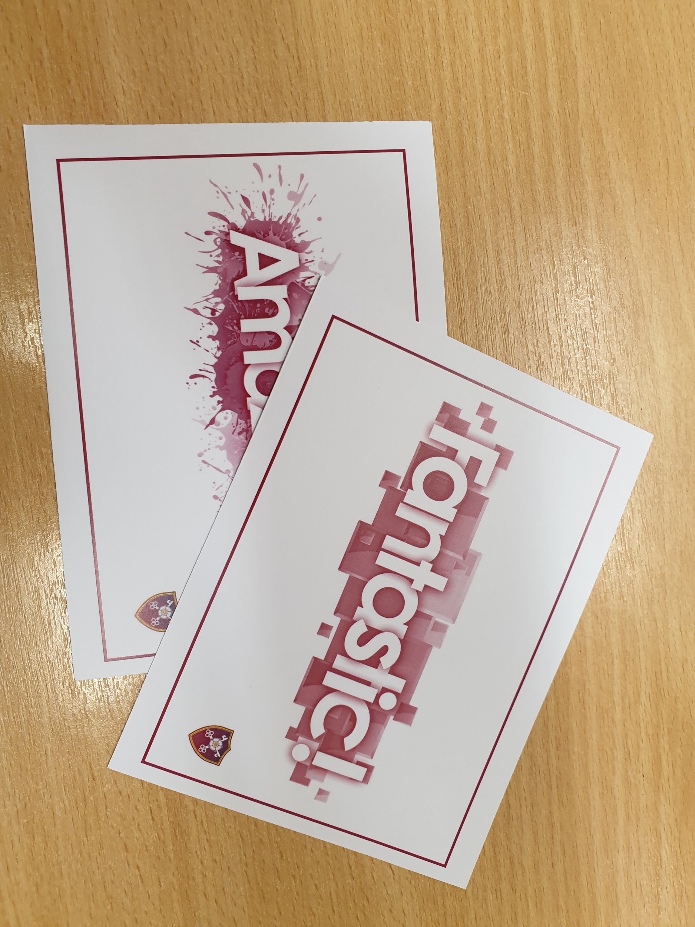
Rewards
All pupils effort, achievement and contributions to school life will be rewarded in a number of ways, such as:
Praise postcards
Head of School honours
Twitter shout outs
Head of year star awards
(collective worship)
Celebration events
How do you want to be remembered this term?

Slide 9
Every day, every lesson, Make the most of it!

Slide 10
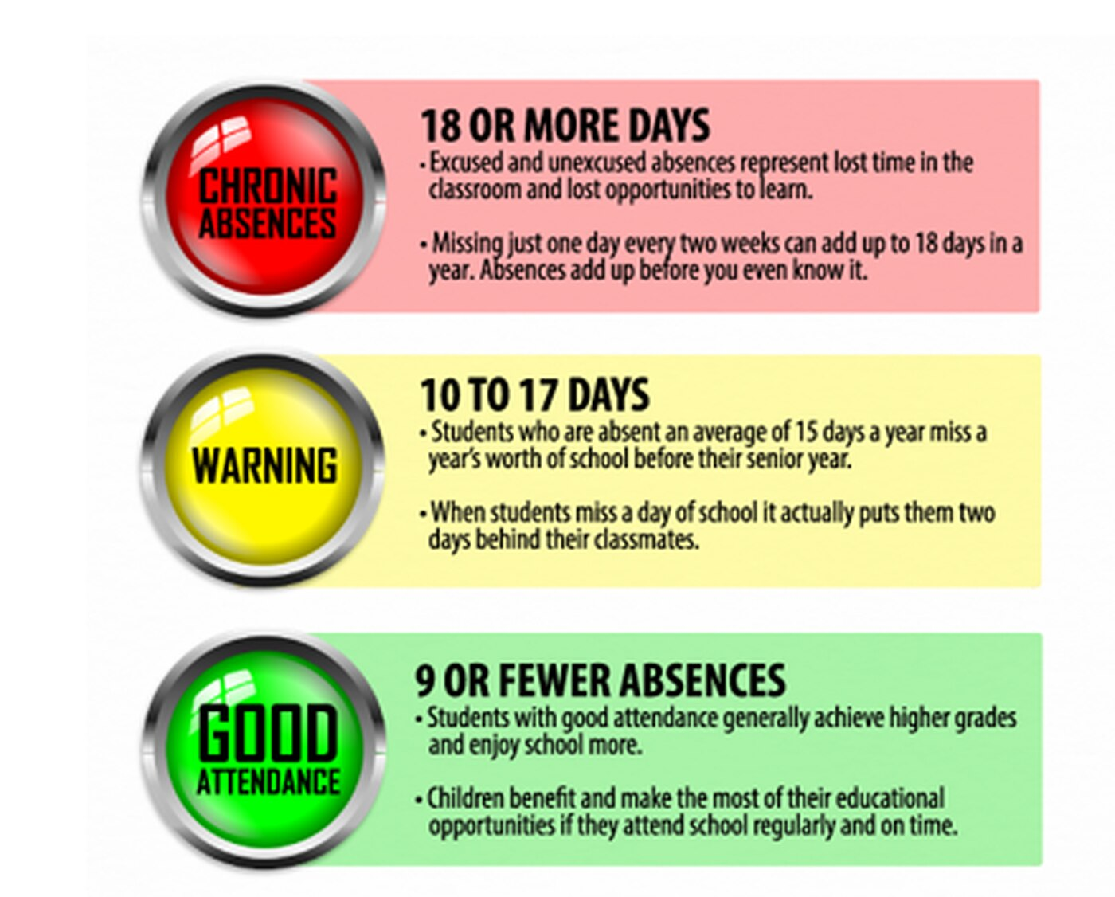
Attendance Rewards
We have a number of attendance rewards, including weekly icepops, half term reward afternoons and trips out of school at the end of term.
To be able to attend, your attendance and progress need to be excellent.
More details will be shared with you in September.

Slide 11
House Challenge

Slide 12
Shine Friday
We are really committed to being the best we can be at St Peter’s and every week we celebrate the best work from all subjects.
You need to come to the dining hall and share your work with Mrs Garthwaite or a member of SLT every Friday.

Slide 13
Enrichment Clubs
We have a number of Enrichment clubs
We encourage all pupils to attend at least one after-school club per week
A register will be recorded for each club
All clubs will be promoted during lessons and if you are interested then please come along
A timetable of what is clubs are running for Week A and Week B will be issued in September

Slide 14
In the name of the Father,
and of the Son, and of the Holy Spirit.
Amen.

