Slide 1
Holland 2019
Sunday 23rd June – Saturday 29th June.

Slide 2
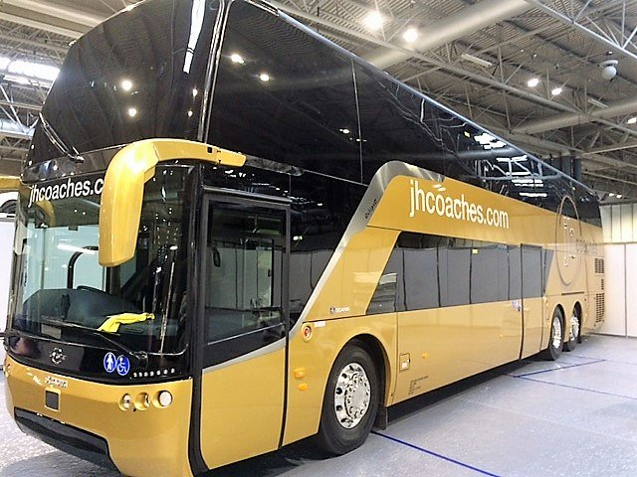
Coach
- Departing St Patrick’s on Sunday 23rd June (Approximately 11pm).
- Arriving in Noordwijk Monday 24th June.
Returning journey will depart Holland on Friday 28th.
Arriving back to St Patrick’s on Saturday 29th (Approximately 7am).

Slide 3
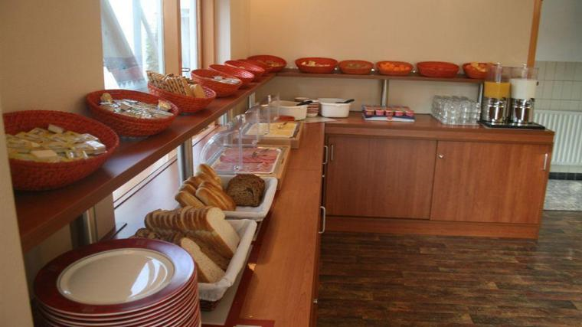
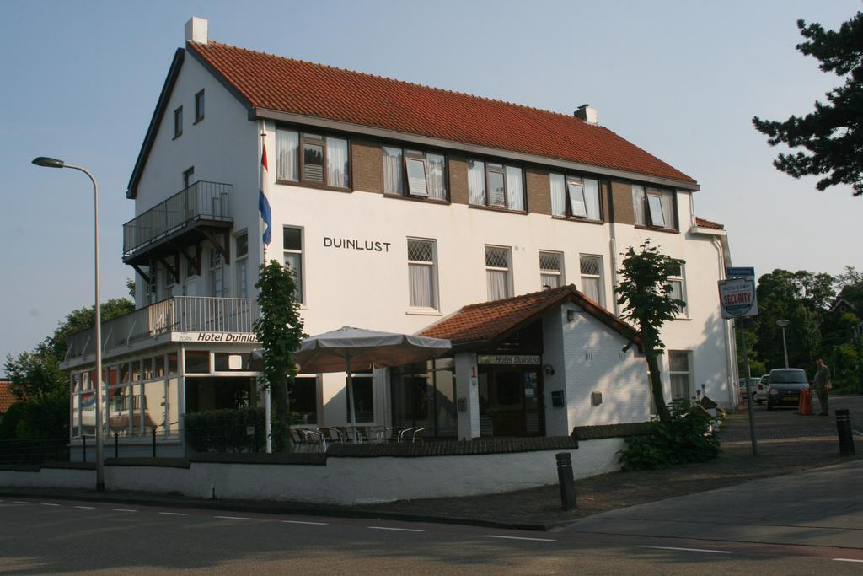
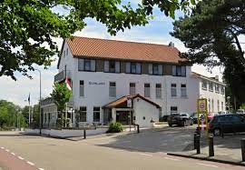
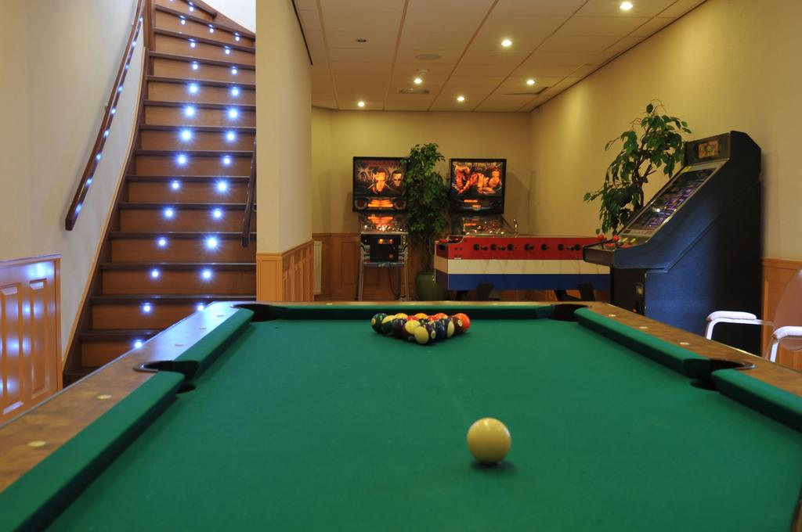
Hotel Zorn - Noordwijk

Slide 4

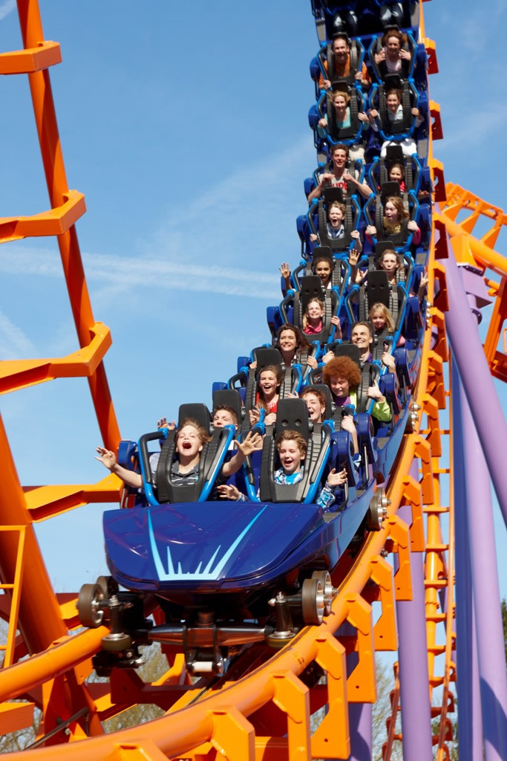
Day one
Walibi Theme Park

Slide 5


Day Two
Blijdorp Zoo (Rotterdam)

Slide 6

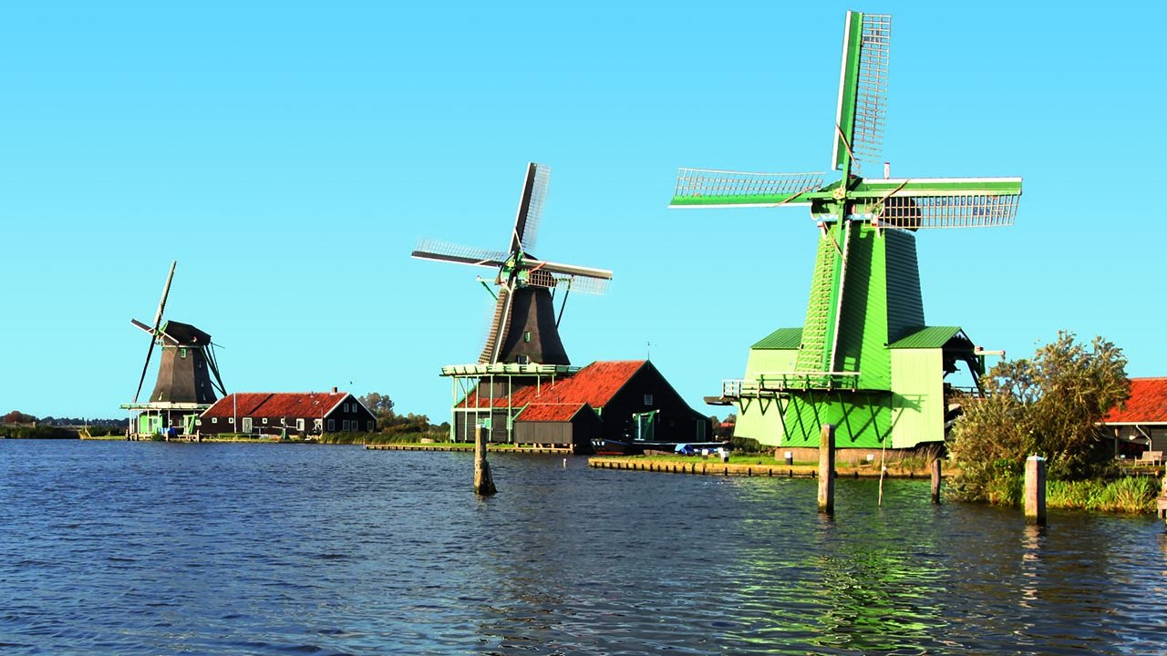
Day Three
Volendam

Slide 7


Day Four
Duinrell

Slide 8
Costings
£330 per child
All children wishing to go need to pay a £120 non-returnable deposit by Tuesday 2nd October. This deposit will secure your child’s travel.
This includes excursions. These usually cost £50 per child.
Next instalment of £60 to be in for Friday 1st February, 2019.

Slide 9

Collective passport and medical forms

