Slide 1
Long Term Planning Document
For
PSHE

Slide 2
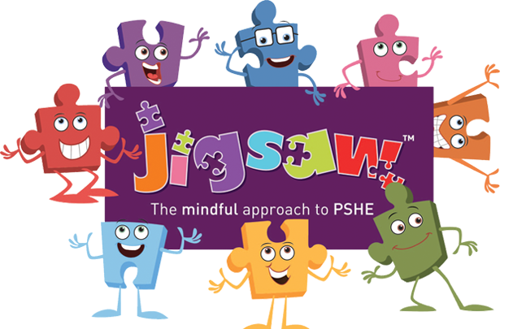

Slide 3
Jigsaw is our Primary PSHE Programme. We give the children at St Clare’s relevant learning experiences to help them navigate their world and to develop positive relationships with themselves and others.
With strong emphasis on emotional literacy, building resilience and nurturing mental and physical health, Jigsaw 3-11 properly equips St Clare’s staff to deliver engaging and relevant PSHE within a whole-school approach. Jigsaw lessons also include mindfulness allowing children to advance their emotional awareness, concentration and focus.

