Slide 1
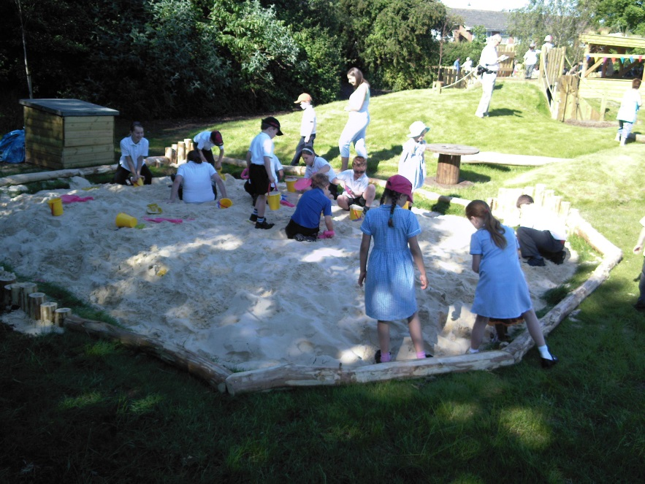
Welcome to OPAL

Slide 2
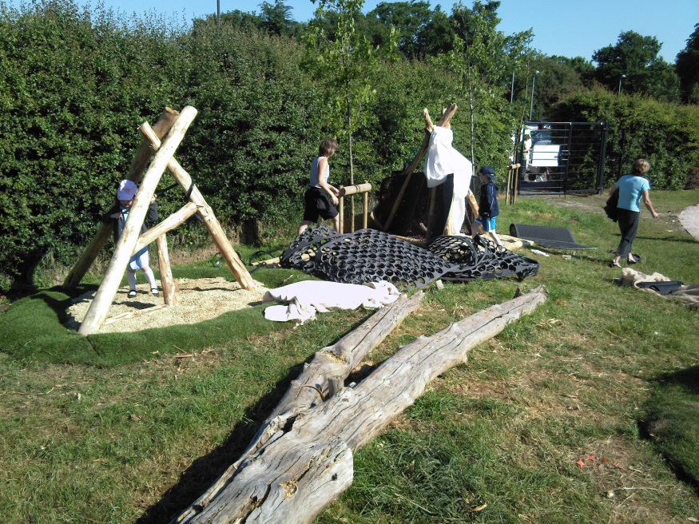
What is OPAL?
‘A strategic school improvement programme for primary schools. It provides 8 meetings spread over 18 months to enable a school to transform its entire culture around play and ensure that every child has an amazing playtime every single day’

Slide 3
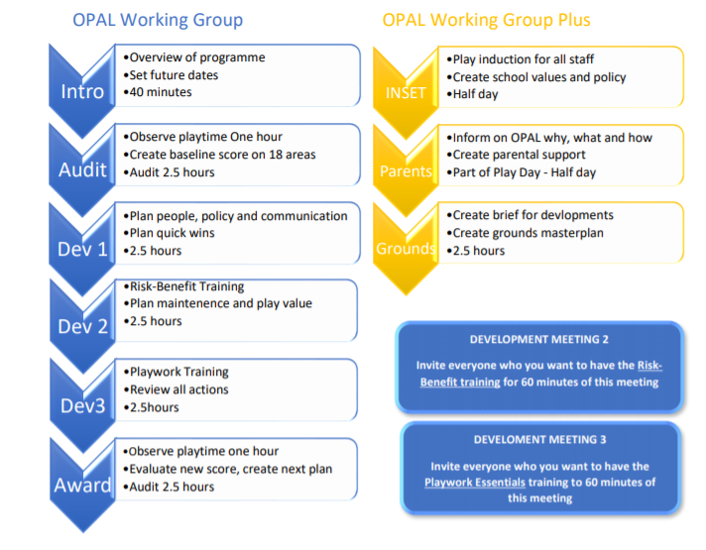
Our Process
Meetings in the OPAL Primary Play Programme
18 Point Audit
Action planning
Communication Strategy
INSET Training
Grounds Development
RISK Benefit Training
Playwork Training
Parent Presentation
Assessment and Award
OPAL Plus

Slide 4
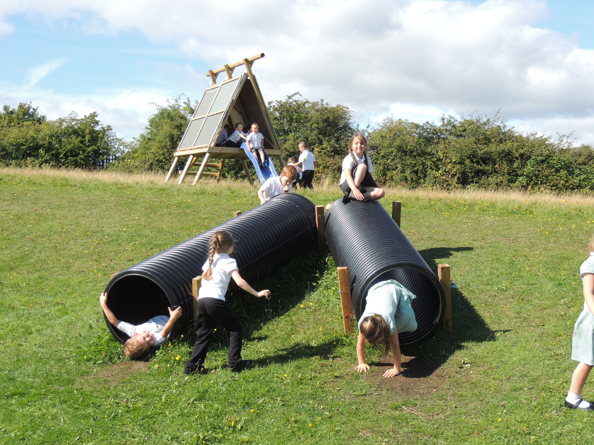
Time
200 children – 20k play hours
Space
Your most valuable asset
Resources
Budget needed and
Cost effective solutions
Leadership
2 clear Leadership Roles
Permission
Culture change, RBA, play to be valued and celebrated
Key considerations

Slide 5
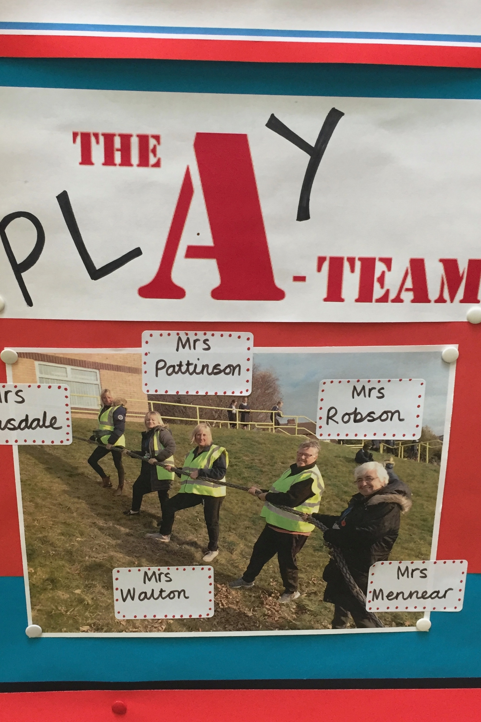
Key Roles to support Play in your school?
The Curricular Lead for Play
Leads on all strategic, planning and evaluation aspects of play
The Play Coordinator
Leads on all operational, resource, playwork and communication
The Play Team
Delivers playwork practice and supports children every day at playtime

Slide 6
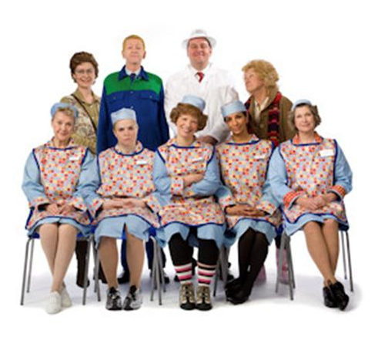

The importance of the
Lunch Time Supervisor
Lunch Time Supervisor
OPAL Team
Management
Parents
Children
Teachers
Whole school approach
Lunch Time Supervisors play a key role in supporting Play and OPAL

Slide 7



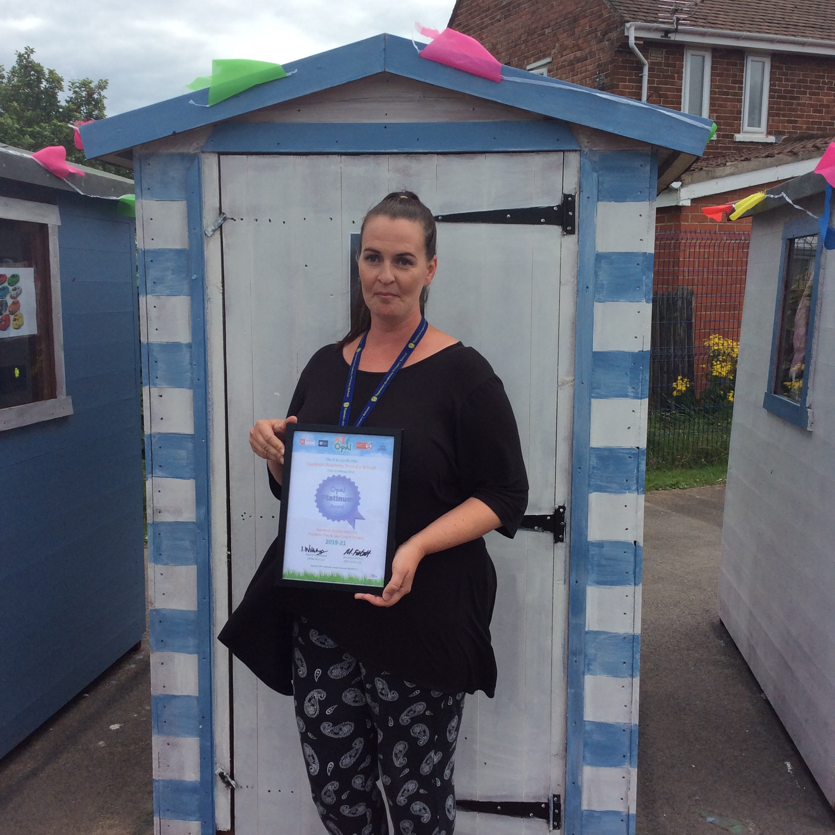
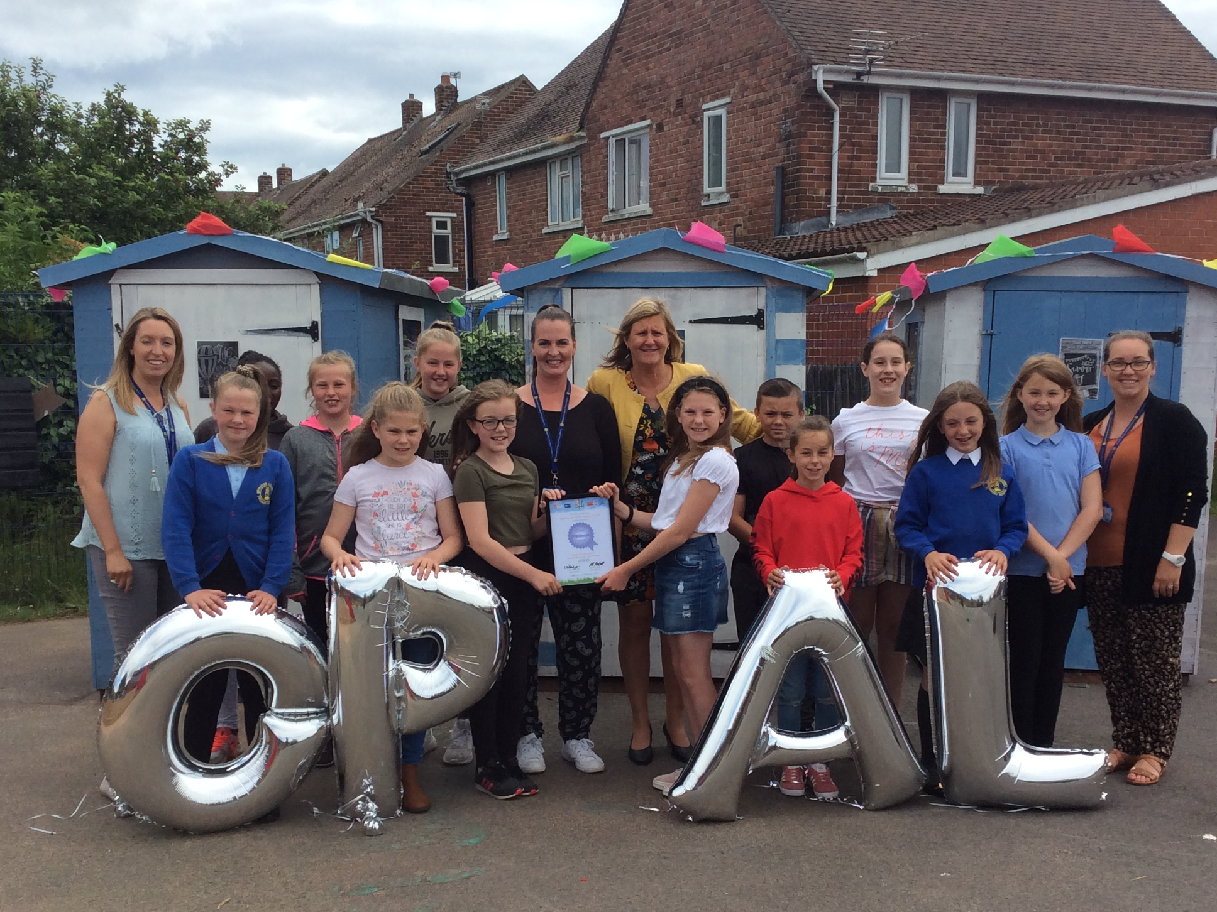
OPAL Award
Silver 65-74%
Gold 75%-84%
Platinum 85%-100%

Slide 8

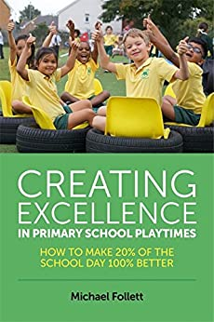

OPAL Resources
Guidance documents and templates
Data collection and surveys
Job and role descriptors
Risk benefit assessment and good practice guide
Grounds Development
Parent’s info
Playwork Essentials
Further Reading

Slide 9

OPAL is a UK and world leader in supporting schools improve the quality of children’s play
Welcome to the OPAL Est 2006
Our mission is for every primary school child to have an amazing playtime, every day … no exceptions!
Our delivery
12 Mentors provide advice and support across England
Over 500 UK schools and over quarter of a million children have benefited
Projects in Canada, New Zealand, Australia, France and Poland
Expansion to many more schools funded by a quarter of a million pound grant from Sport England and the National Lottery
Citations
National Children’s Bureau
Public Health England
All Party Parliamentary Group on Childhood
Cambridge University (Play Education Development and Learning)

Slide 10


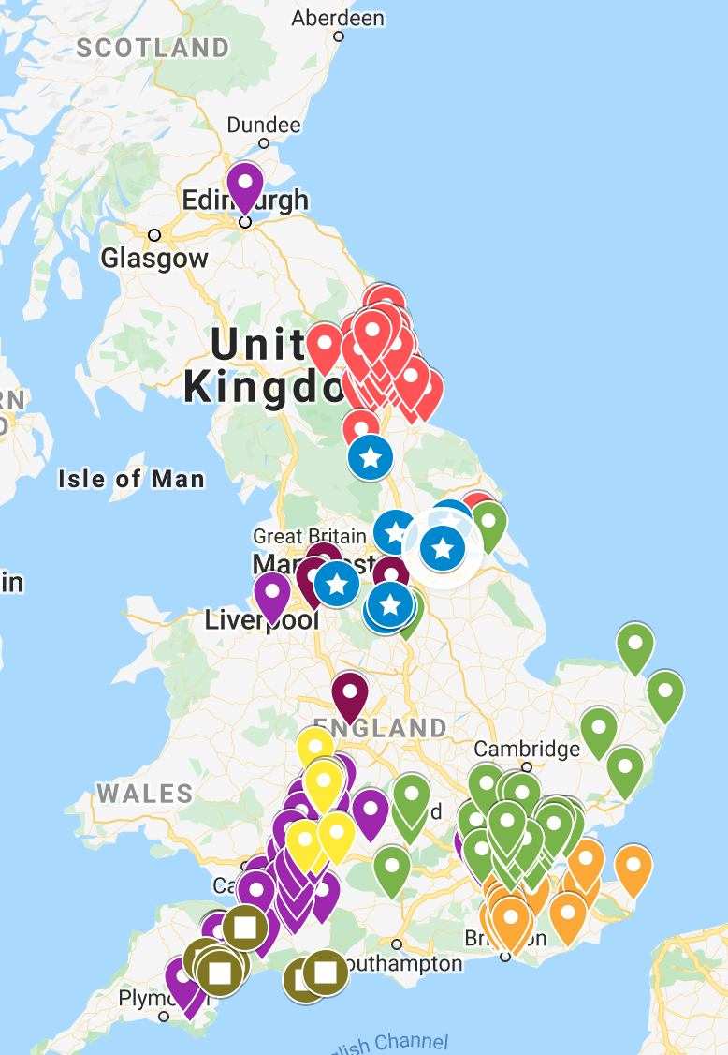
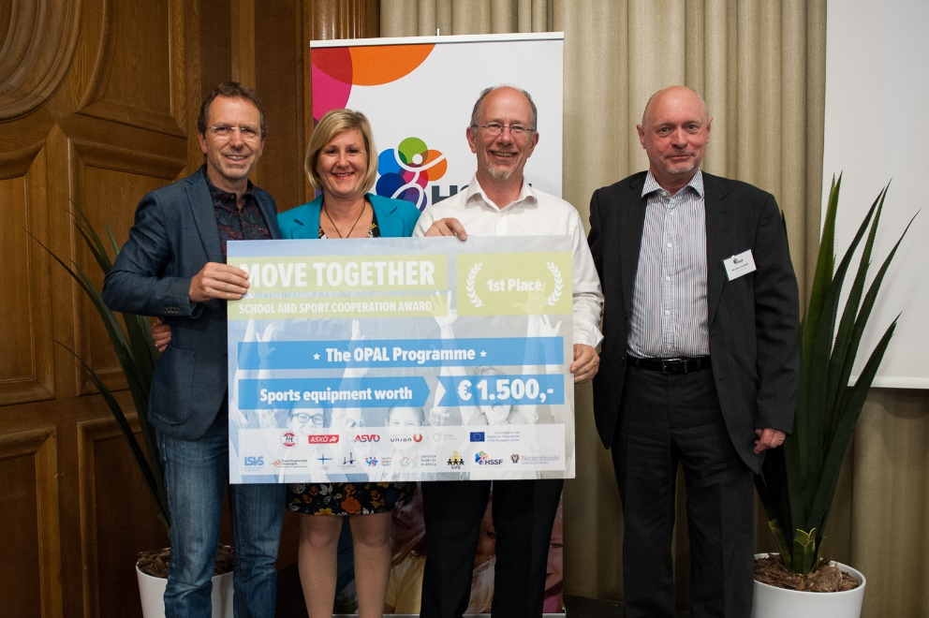
2020 Awarded £250k from Sport England
to double capacity and develop new materials to support all schools in the UK
2018 European Winners
Active School Programme Awards

Slide 11
OFSTED and OPAL
How do you develop a child’s resilience, perseverance, determination and grit?
How do you prepare a child with skills for life?
How do you provide character building skills and opportunities?
Notes:
2019 Update The new inspection framework expects schools to take a much broader approach to the development of characteristics in the areas of ‘personal development’ and ‘behaviour and attitudes‘ which OPAL is especially effective at delivering. Even the inspection area of ‘Leadership and Management‘ can benefit from the structured, hierarchical approach taken by the OPAL Programme. This is because Intent (what and why),Implementation (how and when) and Impact (evaluation, reflection, success criteria) have been at the very core of the OPAL Programme ever since its inception back in 2005!
Ofsted looks for behaviour which supports children in becoming resilient, well adjusted and competent citizens who are equipped to cope in the world beyond school. They are interested in how schools support development of the core skills that are best accrued by children through high quality play, including co-operation, context-rich language use, problem solving, negotiation, creativity and mental and physical well-being.
OPAL enables schools to clearly evidence both a base-line and also a monitorable improvement strategy for active learning, well being and physical activity.

Slide 12
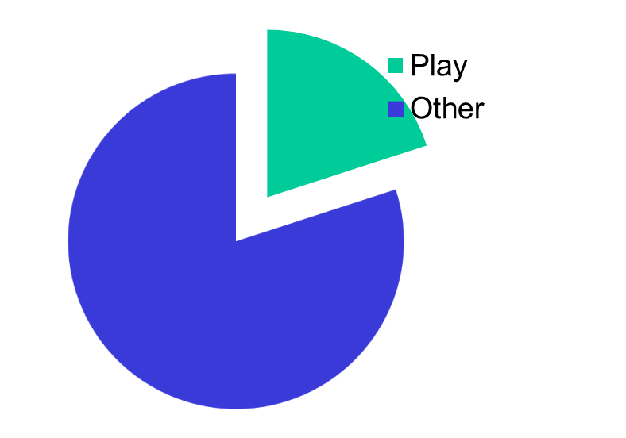
Leadership and Responsibility for Play
Playtime makes up 20% of school life
Per year - 231 hours, 37 days, 7.4 weeks…or 1.4 years overall
You are going to make 20% of that time into amazing playtimes every single day for all of your children.
Notes:
Great play will:
Make your children happier
Equip your children with the skills they need for life
Make your children more effective learners
Make it anecdotal “you know the way our kids like to do X…?”
School/teachers are doing a great job but they can only be responsibility for teaching during lesson times and the remaining 20% is a rich opportunity for the necessary learning outside the curriculum that all children need (core skills etc)

Slide 13
The Benefits of OPAL to Adults
Increased learning time – children more settled and ready to learn - 10 mins more teacher time, per teacher per day
Cost saving – SLT and Teachers time
Access to grounds and nature regardless of the weather
Increase staff happiness in their jobs

Slide 14
The Benefits of OPAL to children
More physically active, Up to 100% of girls and SEN more active.
Increase in happiness and well-being
Significant increase in core skills
Children are playing more creatively
Developing life skills – resilience, competence,
perseverance and determination
Risk Management Skills - improved decision making
Social skills, team building, negotiation
Improved mental health and well-being
Improved behaviour
Less accidents, incidents and winging – addressing
cotton wool culture
More inclusive – no child bored, feeling left out,
unhappy, withdrawn,
New friendship groups developed and wider social
networks
Increased learning time – more settled and ready
to learn
Access to grounds and nature regardless of the weather
New skills and interests nurtured
Therapeutic, opportunity to revisit developmental stages

Slide 15
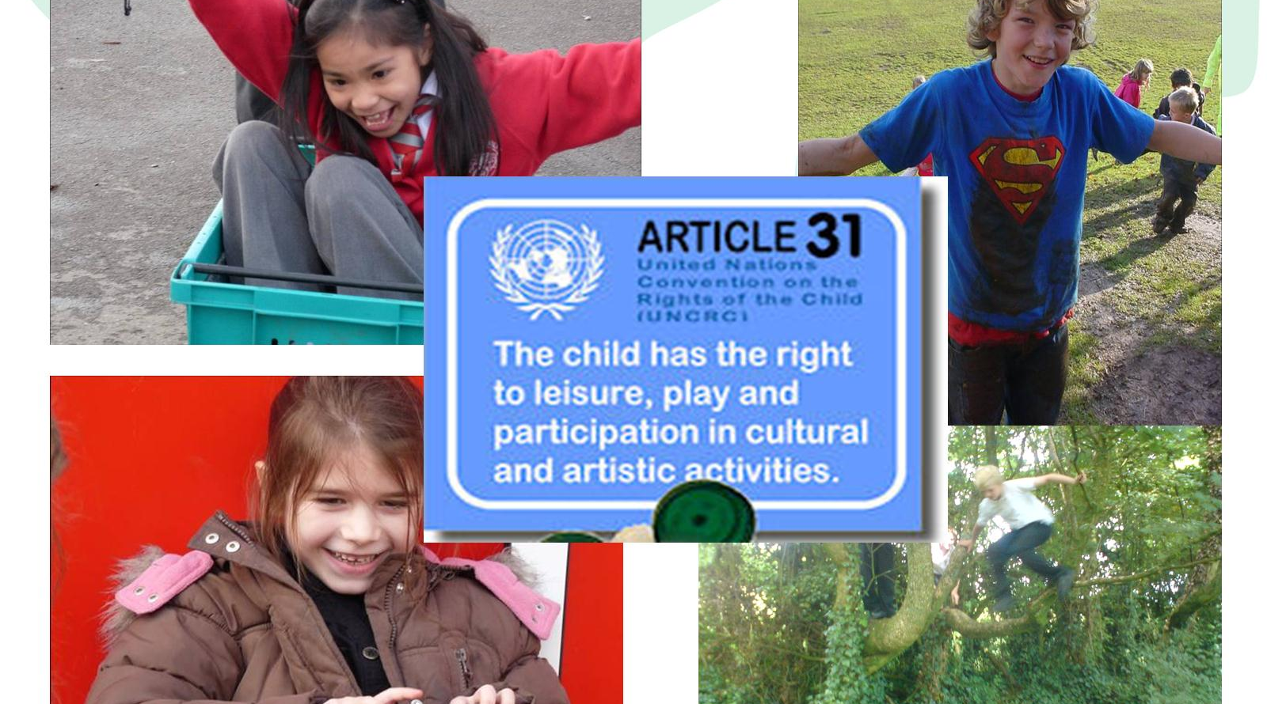
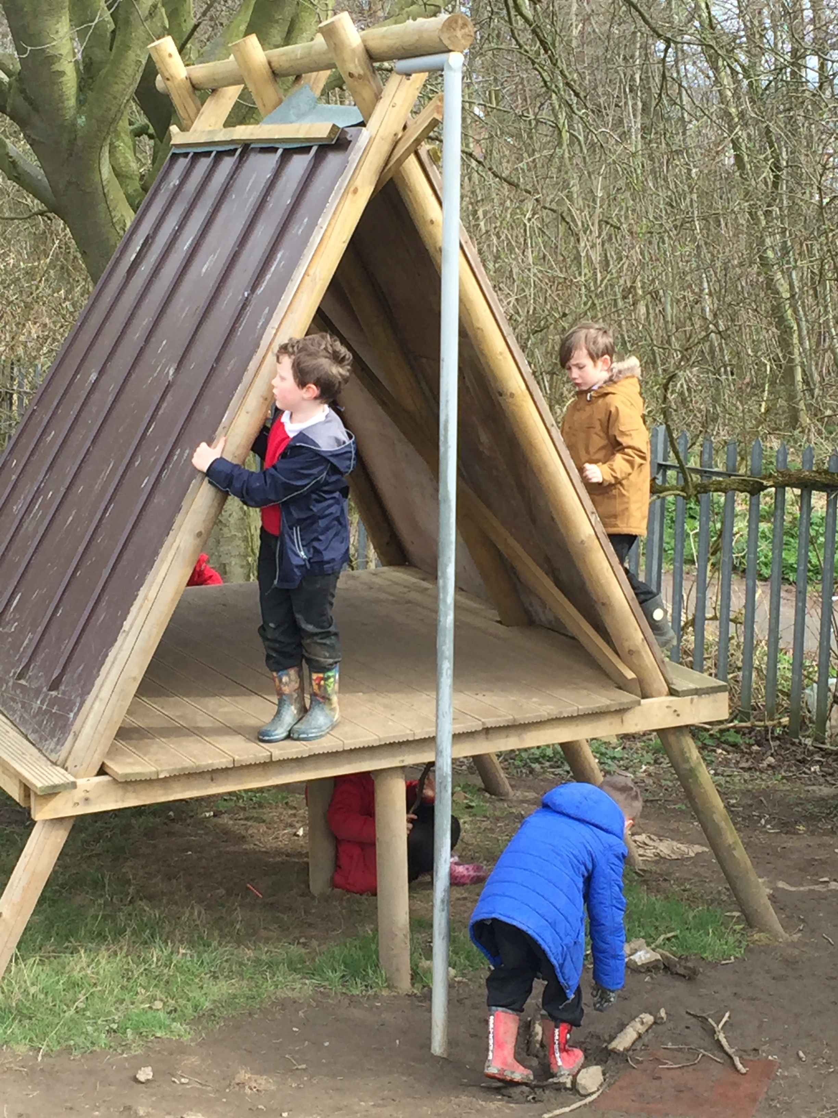
Article 31 UNRC and
General Comment 17

Slide 16
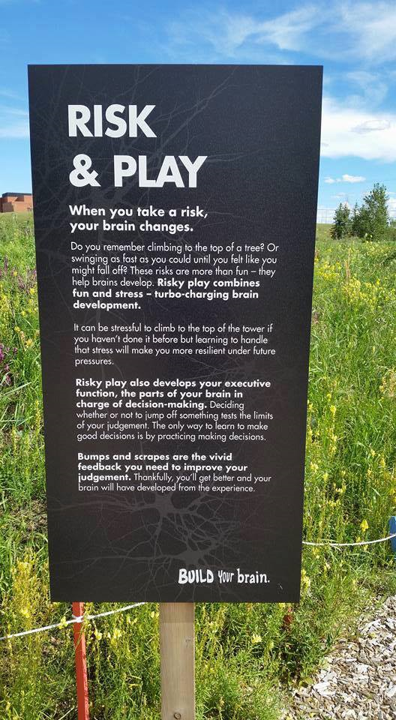
Risky play combines
fun and stress ............
turbo charging
brain development
Risky play also develops your executive function, the parts of the brain in charge of decision- making...the only way to learn to make good decisions is by practising making decisions.
Who can ride a bike?
What’s the first thing that happens when you start to learn this skill?
Safe-guarding and personal risk assessment
Ref; Playgroundology

Slide 17
OPAL supports schools to manage risk in children’s play
Strict 5 point approach to risk
Advised by Zurich Insurance and LA H@S
Adoption of HSE ‘Promoting a balanced approach”
Employed Microbiologist
Play Safety Forum and ROSPA Inspector
Accidents and Incidents reduce
Gradual introduction
Provides support, reassurance and confidence
Invaluable benefits to children

Slide 18

CHILDREN’S PLAY AND LEISURE – PROMOTING A BALANCED APPROACH
SEPTEMBER 2012
Key message: ‘Play is great for children’s well-being and development. When planning and
providing play opportunities, the goal is not to eliminate risk, but to weigh up the risks and
benefits. No child will learn about risk if they are wrapped in cotton wool’.
STRIKING THE RIGHT BALANCE MEANS
• Weighing up risks and benefits when designing and providing play opportunities and activities
• Focussing on and controlling the most serious risks, and those that are not beneficial to the play activity or foreseeable by the user
• Recognising that the introduction of risk might form part of play opportunities and activity
• Understanding that the purpose of risk control is not the elimination of all risk, and so accepting that the possibility of even serious or life-threatening injuries cannot be eliminated, though it should be managed
• Ensuring that the benefits of play are experienced to the full

Slide 19
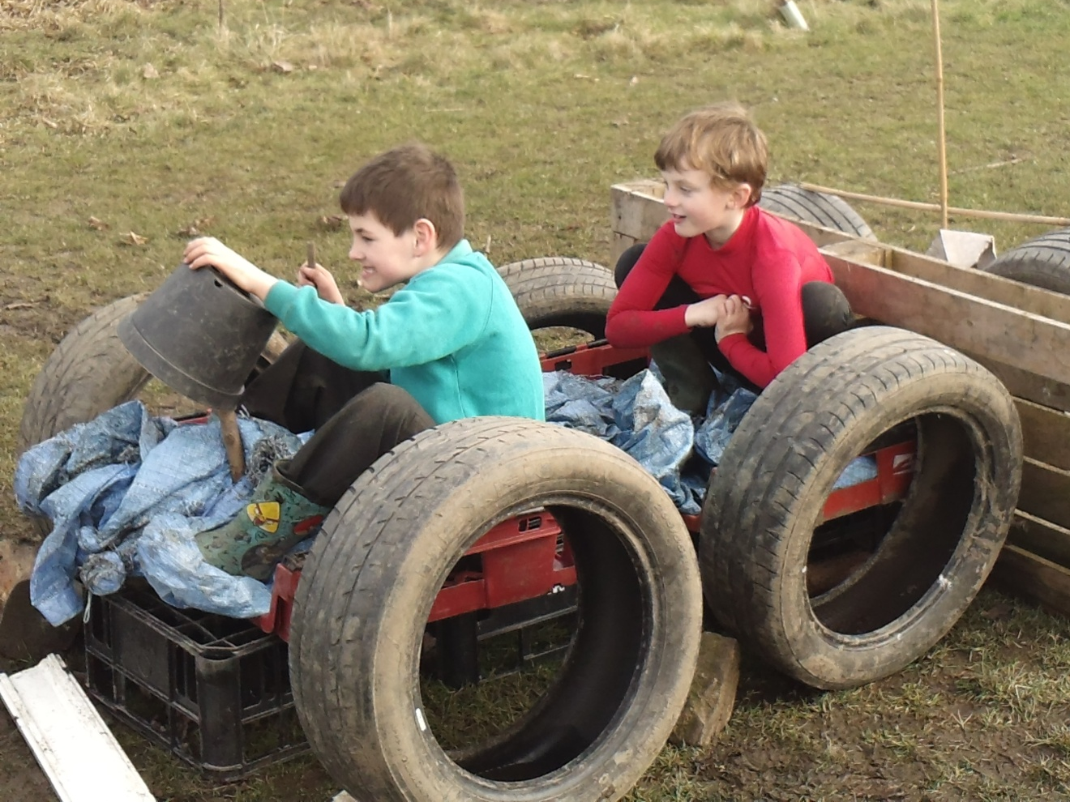
What does an OPAL school look like?

Slide 20
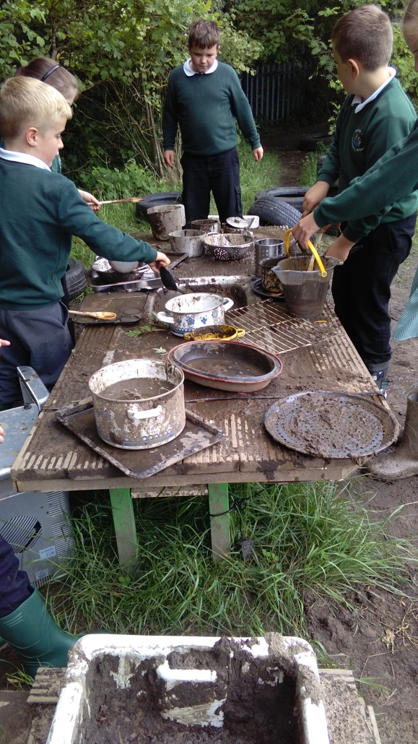
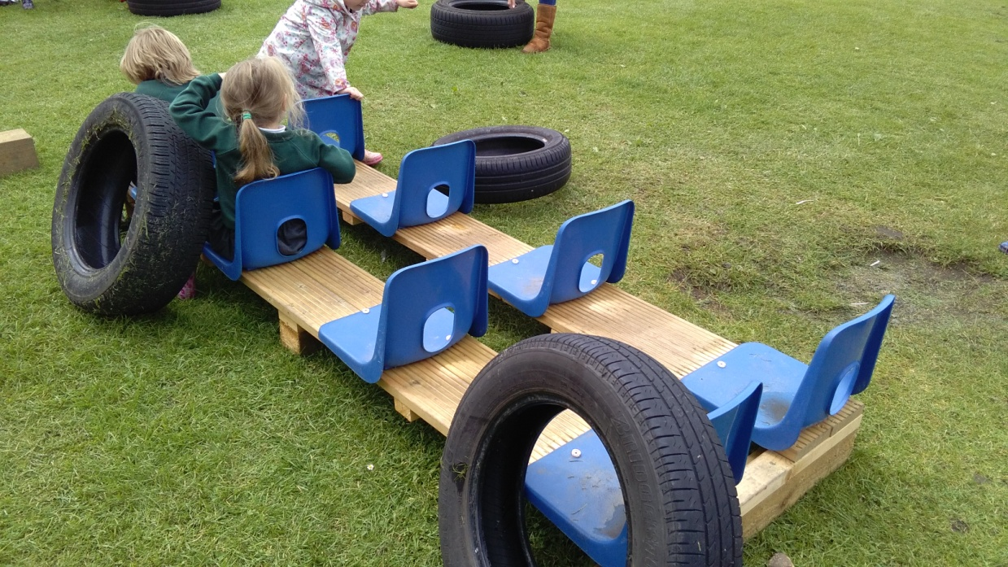
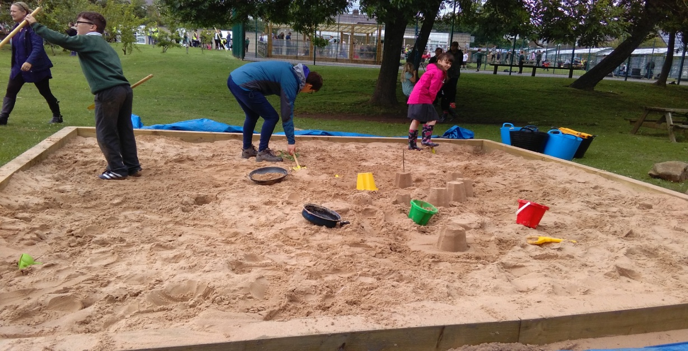
Messy, creative, adventurous, fun, inclusive and much more!

Slide 21
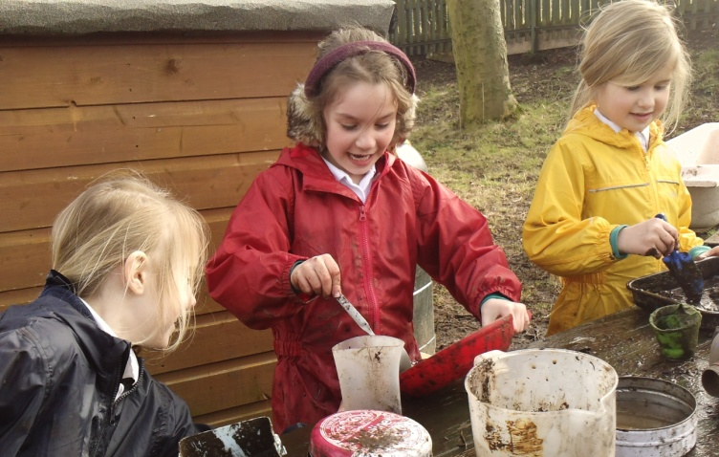
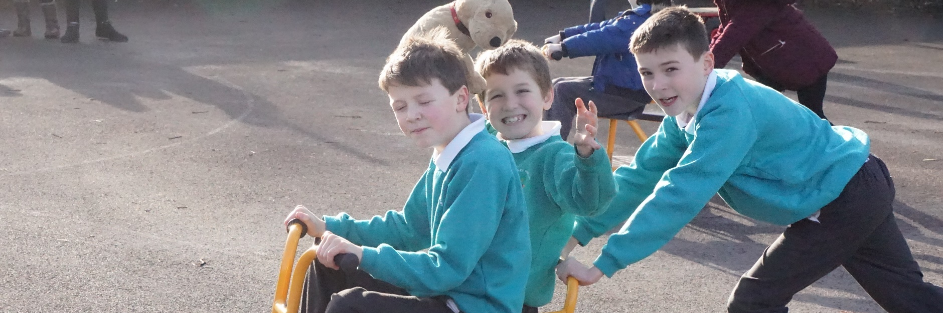
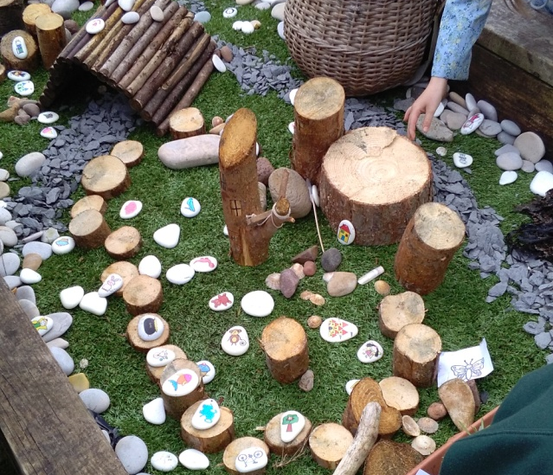
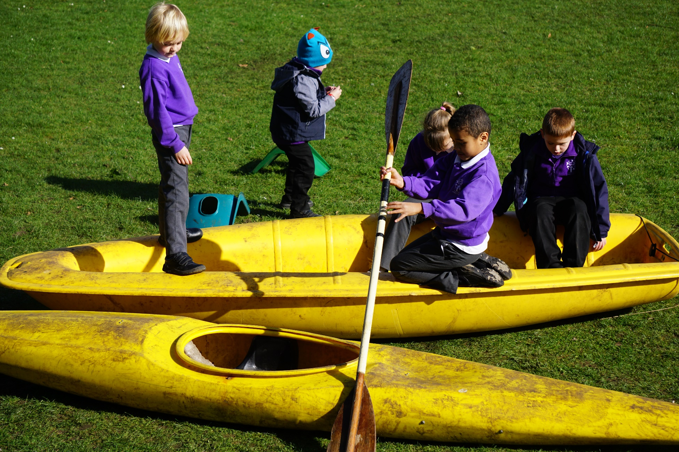

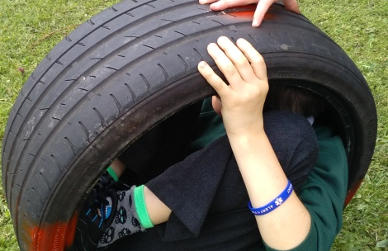
Children’s play is enriched by what is provided and the space in which they play.
When children play anything is possible!

Slide 22
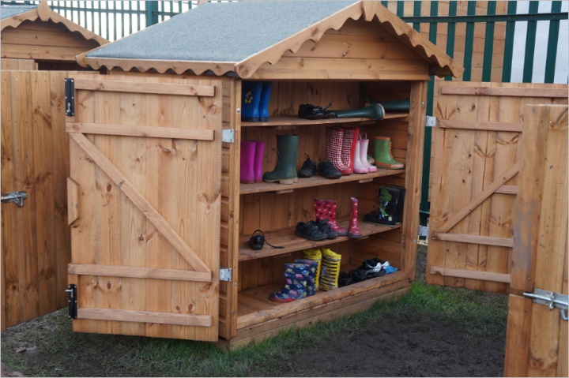
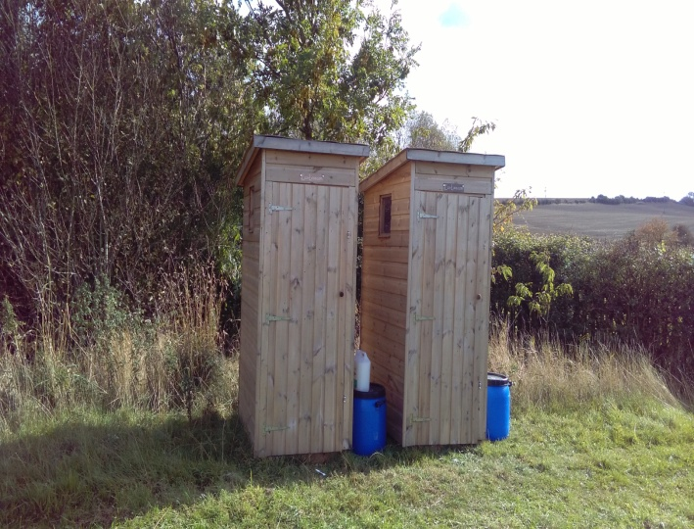
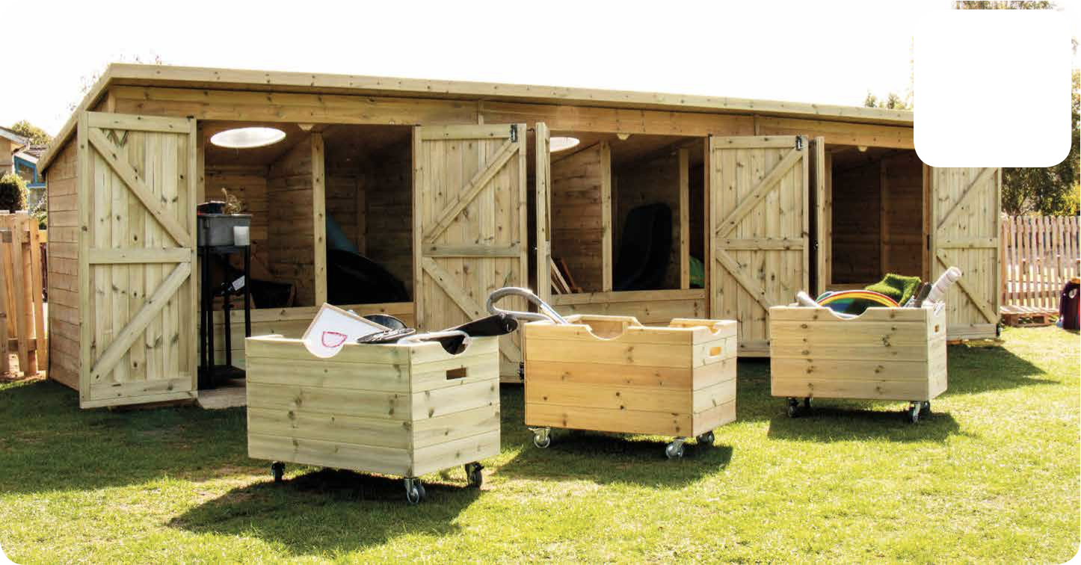
There is no such thing as bad weather, only
inappropriate clothing
OPAL schools overcome challenge and ensure enriched play opportunities can be achieved for all children
Access
Storage
Resources
Provision

Slide 23
One of many Testimonials
‘OPAL has revolutionised our play at lunchtime. From being football dominated we now offer an exciting, creative, physical environment which has something to offer everyone. Children are now highly active and interactive; challenged both physically and mentally. There is high quality role play, greater integration across the school and so much creativity. You can build a den, play in the mud kitchen, chat in the stilt houses, swing on the tyre swings, enjoy a picnic, dig to your heart's content - the possibilities are endless and our children love it.'
Kay Hemmings, Head Teacher, Tanfield Lee, Durham

Slide 24
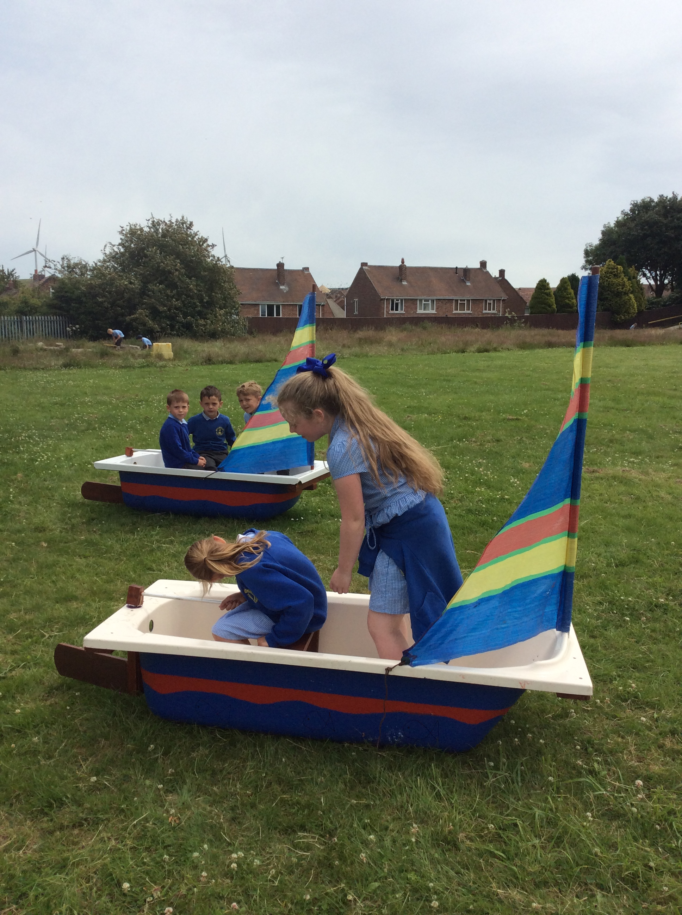
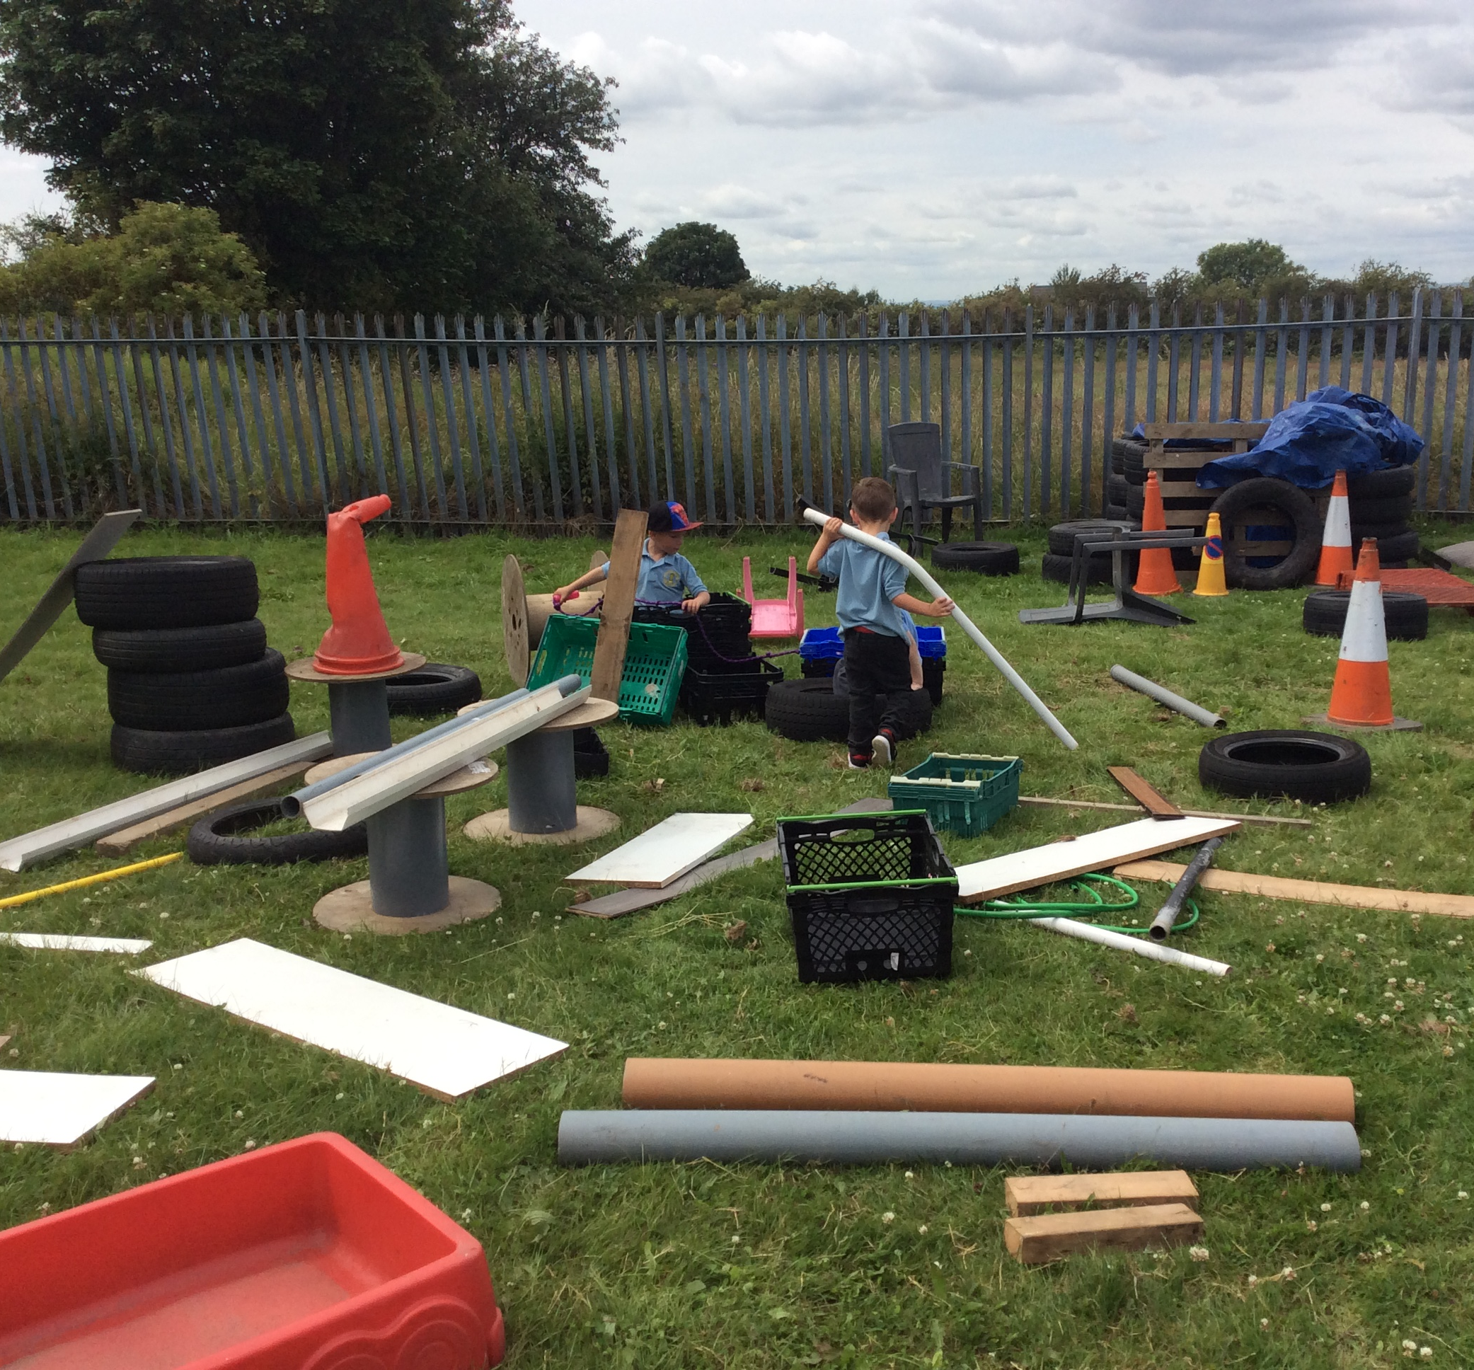
For further information: www.outdoorplayandlearning.org.uk

