Slide 1
Welcome to St Clare’s Reception
Reception Class Teacher: Mrs Sedgwick
Headteacher: Mrs Eddies
School Office Receptionist: Miss Cooper
Parent Information 2021
School Number: 01642 815412
School email: enquiries@stclares.npcat.org.uk

Slide 2
Our Mission Statement At St Clare’s we Walk in the Light
We follow in the footsteps of Christ.
All of St. Clare’s family work together to
Let our light shine
Keep encouraging everyone in all that
Is good.
Night and day care for and
Tolerate each others differences, be kind,
Help each other to do our best and
Encourage each other and
Love one another.
Is what God asked us to do.
Giving us opportunities to
Help make a positive difference.
Teach us to work each day for you.

Slide 3
Our EYFS Aims
St Clare’s we aim to provide a caring and safe environment where children can develop through play and first hand experiences. The child’s total development is important- social, emotional, physical, intellectual and moral development are inter-related.

Slide 4
St Clare’s Golden Rules
I try my best in everything I do.
I am a good listener.
I show respect at all times.
I wear my uniform with pride.
I move around the school quietly and calmly.
I keep my hands and my feet to myself.
I keep myself and others safe.

Slide 5
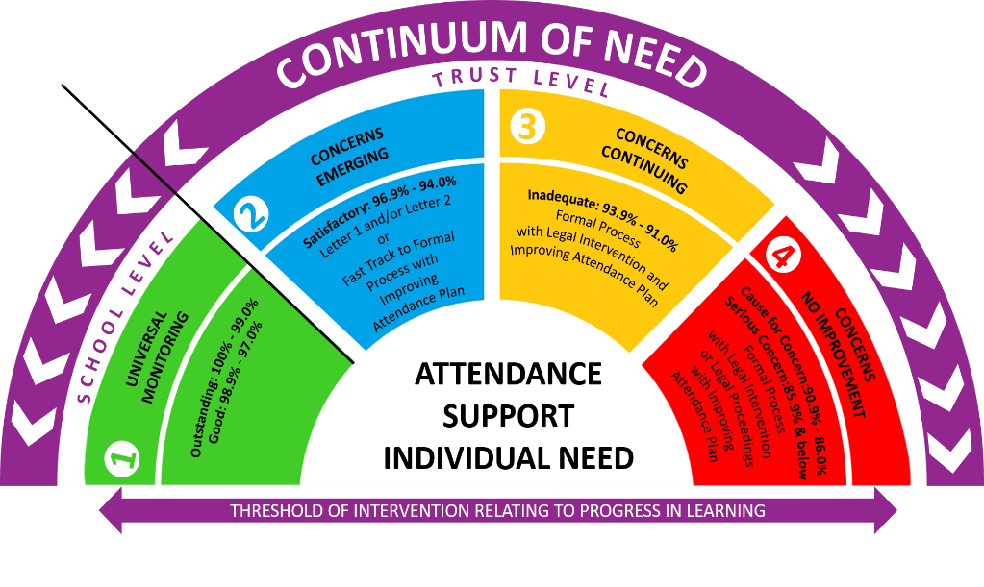
Attendance
At St Clare’s Primary school, we pride ourselves on our high attendance rate and the continuing effort of our school family to continue to increase our percentage rate year on year.
Our school target is 97%.
The model of attendance practice supports a continuum of need applying a step up/step down process. It consists of a four-tiered approach, which is applied consistently across the stages, to ensure the individual needs of a child are being met.
If your child’s attendance falls below 97% then our school and NPCAT’s monitoring processes begin. Letters and visits from our attendance team will be part of the monitoring process. You will also be invited in to meet the head teacher and to set targets for improvement. Please get in touch with the school as soon as possible if there is a valid medical reason why there is significant attendance issue.
Holidays are not allowed in school term time and will be declined by the head teacher following the policy set out by NPCAT. (Available on our website) Fines are issued by the Local Authority.

Slide 6
Your child’s first few weeks
We will find out what the children
already know and can do
and use this information to help us develop a learning programme for each child.
You are always welcome to speak with the class teacher to discuss your child’s progress and/or any concerns you may have.

Slide 7
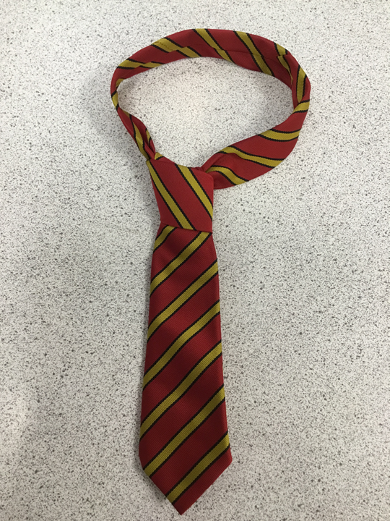
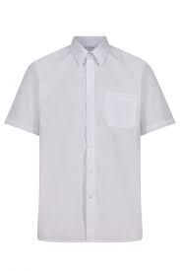
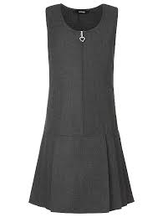
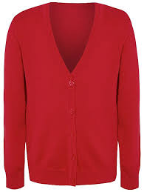
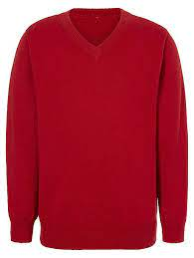
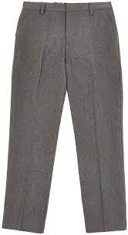
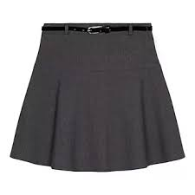
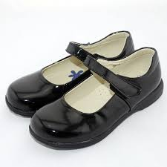
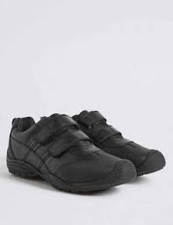
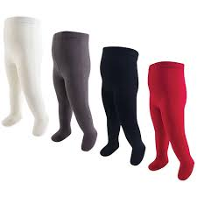
School Uniform
Branded St Clare’s uniform can be bought from Lollipops. Please name all uniform with your child’s name. We have a winter and optional summer uniform. Winter uniform is: shirt with a tie, trousers, skirt/pinafore and v neck jumper or cardigan with school badge. Black school shoes are worn throughout the whole school year.

Slide 8
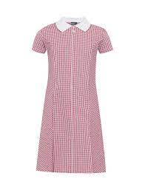
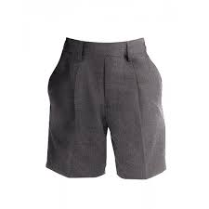
School Uniform
Children can wear Summer uniform from after the Easter break up until October half term. Summer uniform is optional.
The Summer uniform is: polo shirt or shirt and tie, pinafore/skirt, trousers/shorts, summer dress. Children must wear a pair of black school shoes. No trainers please.
When your child starts in September they can choose to be in winter or summer uniform until the October half term when we go into winter uniform.

Slide 9
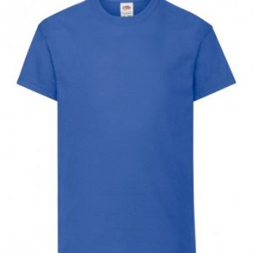
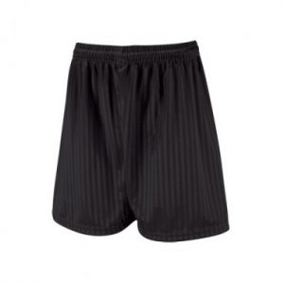
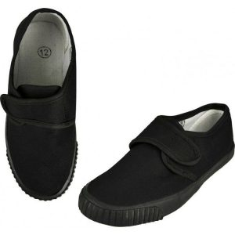
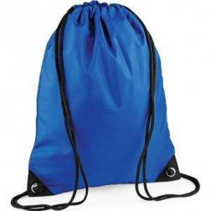
PE Uniform
Your child will be placed into a house group and this will remain the same during their time at St Clare’s. Children wear this house colour as part of their PE kit.
Our PE uniform at St Clare’s is: house top, black shorts, plimsolls (indoor), trainers (outdoor)
St Andrew’s - blue
St David’s - yellow
St George’s - red
St Patrick’s - green
PE t shirts with the school logo can be purchased from lollipops alongside PE bags.
To order uniform please follow the link at the bottom of this slide.
https://lollipops-middlesbrough.co.uk/product-category/st-clares-rc-school/

Slide 10
Daily Organisation
School starts at 8.40am and finishes at 3.00pm. Please be on time. Children can enter school from 8.40 am. Drop off and pick up is at the outside classroom door. There will be a member of staff there to greet your child every day.
Any queries/problems, please see a member of the team before/after school.
Children enter the classroom, put red book bag on their own shelf, hang up their coat and come to the carpet.
Due to safeguarding, the classroom door and gate will be locked promptly. If you are running late, please ring our main reception to let them know. On arrival, please collect/ drop off your child at the main reception to sign the late book. Thank you.

Slide 11
School Lunch
Reception children are all eligible for Universal free school meals under the government's universal free school meal scheme.
We ask that all children have a school lunch. This has worked very well in this year and helped children to develop their independent skills and trying new things. It also helps with behaviour as children learn how to sit and eat correctly at a table. After lunch, children will be taken onto the playground by their dinner lady/Teaching assistant for outdoor play.

Slide 12
School Lunch
My child needs a Special Diet, are you able to feed him/her?
Special diets can be catered for and can be discussed with our SENDCO/medical team, as well as our school cook. .
In order for us to provide a child with special dietary requirements, however, we must have written confirmation from the Paediatric Dietician that the child is under. They can forward us the necessary medical dietary information to enable our cooks to provide your child with the appropriate meals.
Snack time
All children have access to free fruit, milk or water throughout their session. Please do not send your child in with extra fruit.
Water Bottles
Please provide your child with a named water bottle. This will be sent home on a daily basis and returned the next school day.

Slide 13
Before & After School Club
Early Birds and Late Birds
At St Clare’s we offer a before and after school club.
This offers full wraparound childcare in our school setting and is available to all children Nursery-Y6.
Children can attend from 7:30am (£3.50 including breakfast)
After school club
3pm-4pm - £3.50
3pm-5pm - £7.00 including a light tea
3pm-6pm £10.00 including a light tea
Booking via Parent Pay or the School Office
Last minute places available on the day
Childcare vouchers are accepted

Slide 14
Parental Engagement
Marvellous Me App
St Clare’s Twitter feed (@StClaresPrimary)
Stay and Pray
Stay and Play
Parent’s Evening
Headteacher monthly newsletter
Termly class newsletter
Please share your child’s talents and achievements from home with us – we love to hear all about them!

Slide 15
Medical Matters
Any sickness, diarrhoea, must be followed by 48 hrs absence.
Any absence requires a telephone call explaining why to the main school office.
Head lice are common! Please check regularly and treat as recommended.
Any medicines can only be administered by prior arrangement in the main school office and filling in a medical form.

Slide 16
How you can help?
Reading books (stories, information books, newspapers, magazines, comics etc), encouraging your child to join in and talk about books
Singing songs and nursery rhymes
Modelling correct letter formation and pencil grip
Taking time to listen to them talking about things they’ve done and answering their questions (You can ask them questions too!!)
Maths - sing number songs and count different objects. Look at door numbers and numbers you see in the environment. Ask your child to count out different objects.

Slide 17
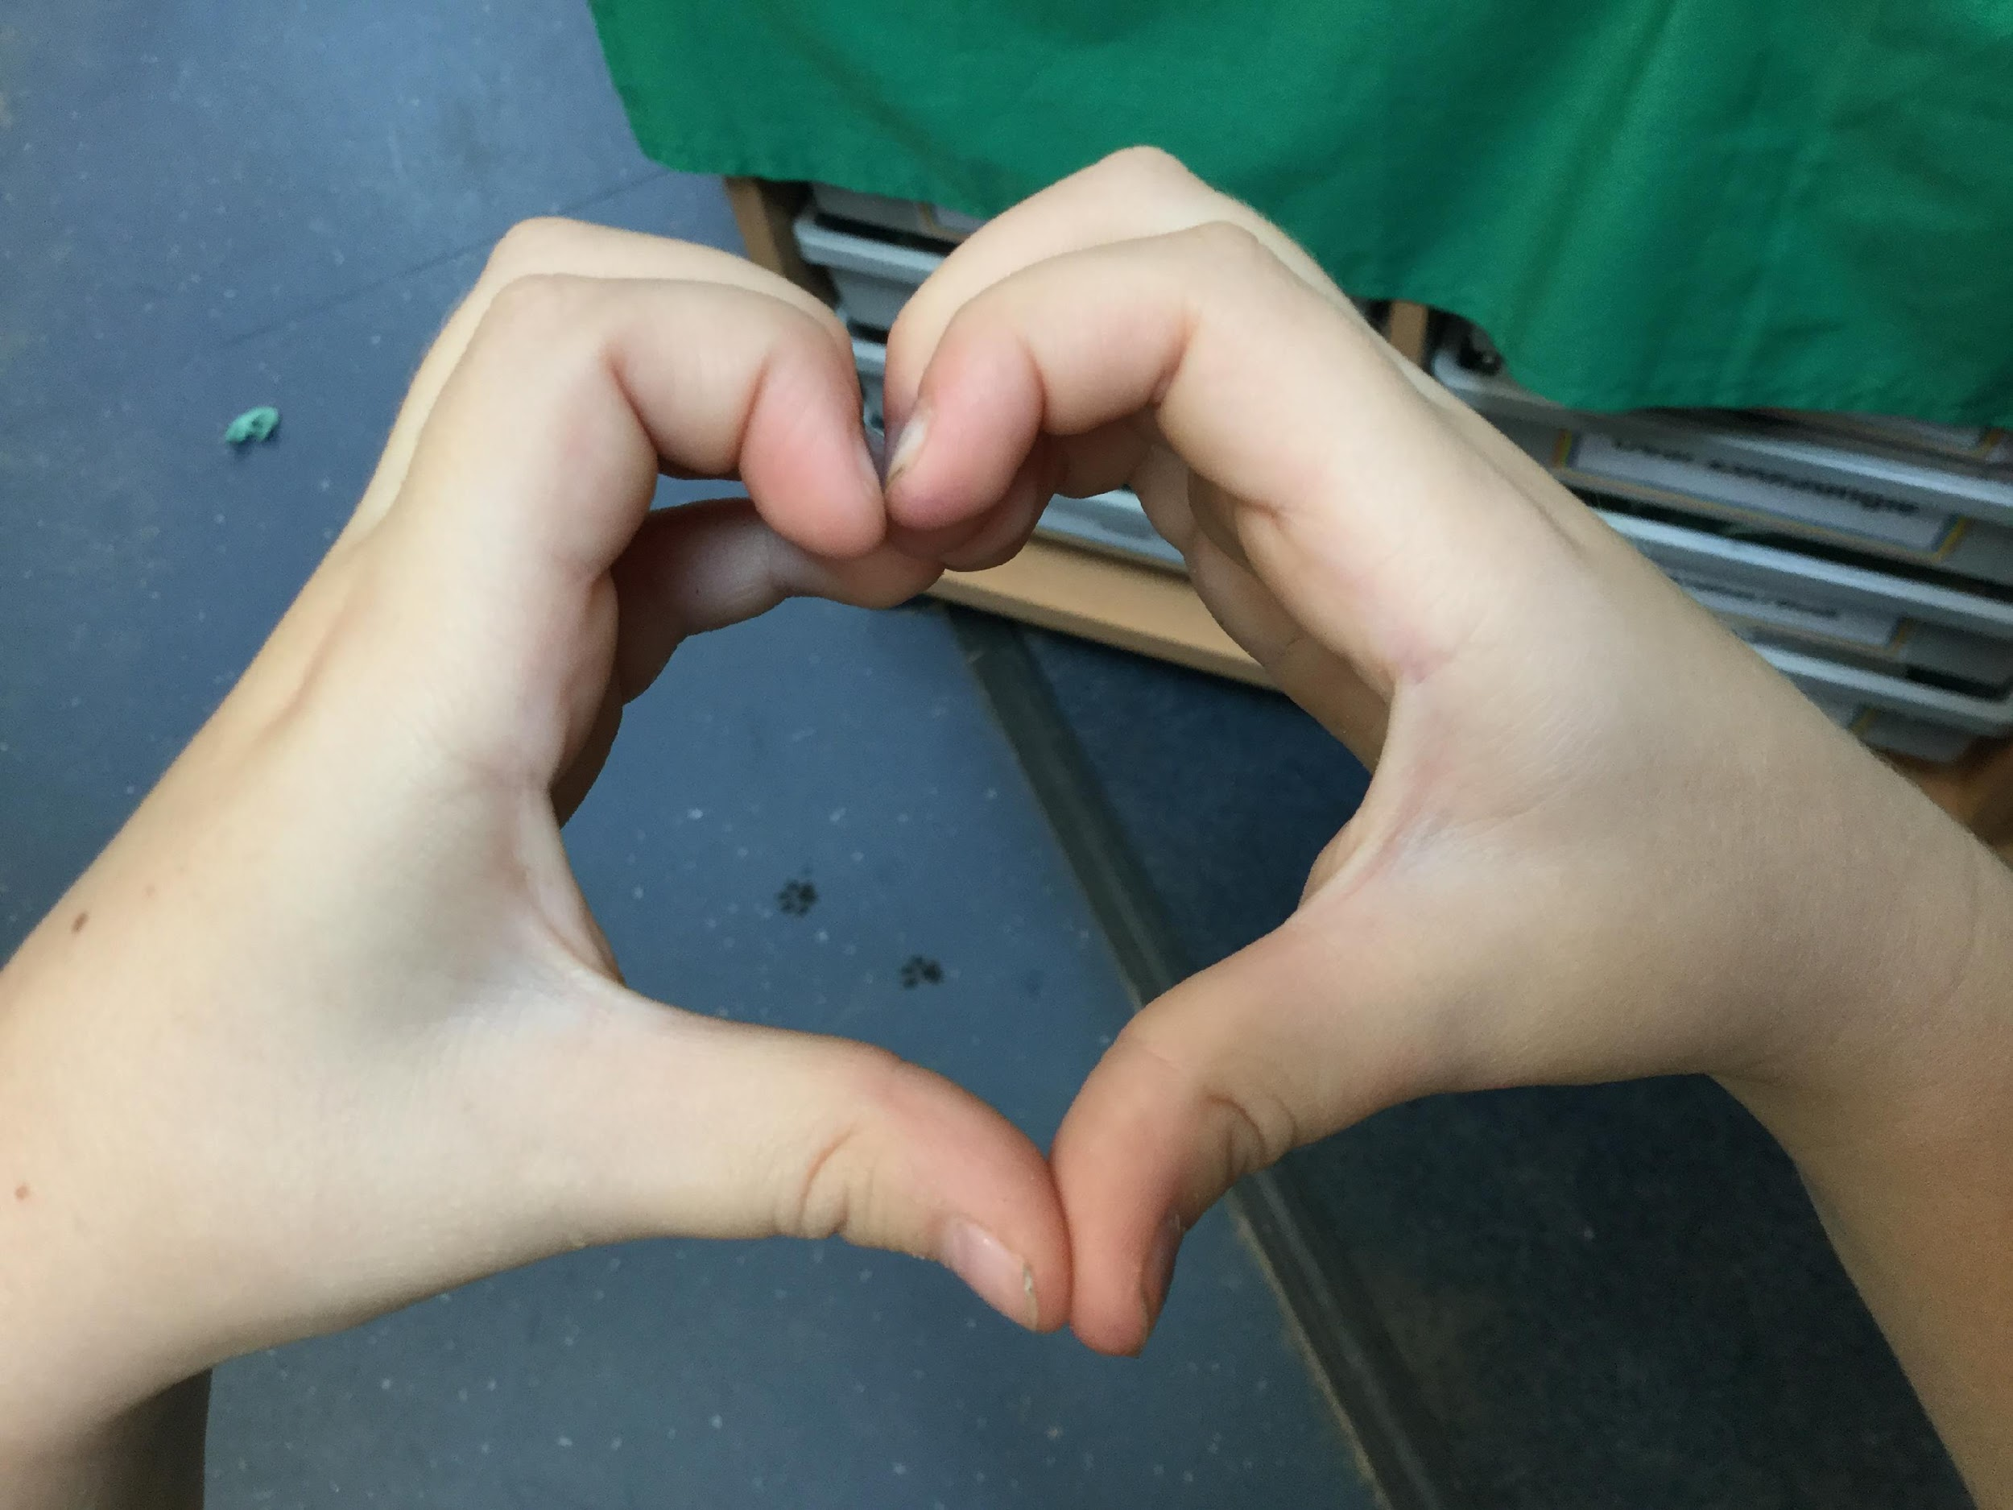
Welcome & thank you for choosing St Clare’s
We operate an open door policy and are always happy to see any parent requiring information or advice.
If you have any questions
please do not hesitate to
contact school:
01642 815412
enquiries@stclares.npcat.org.uk

