Slide 1
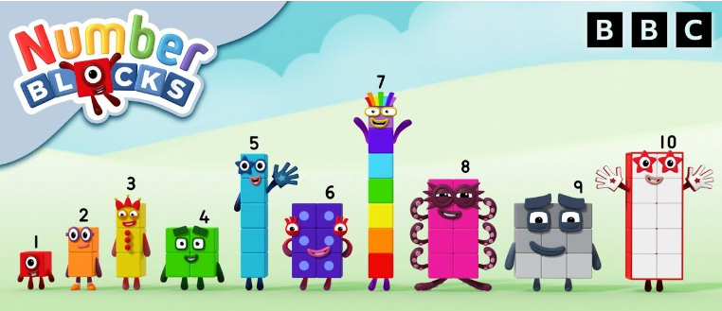
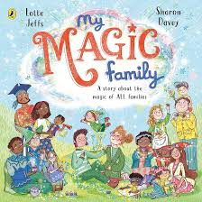
Autumn 1 2024
Welcome to our Reception Newsletter!
We are so proud of how the children have started their journey in Reception and how well they have settled into their new environment. The children have enjoyed seeing old friends, making new friends and exploring inside and outside the classroom. We have lots of exciting things planned for this term and many new things to learn!
Phonics
This term, your child will be taught phonics for 10–15 minutes every day. They will learn to say and read all the single letter sounds (for example, s and m) and some consonant digraphs. A digraph is where two letters make one sound (for example qu and sh). We will work really hard to teach your child to blend sounds together to read words. They will start reading wordless books and, when they can blend sounds into words, will read Phase 2 books. We will provide your child with daily additional practice if they need it.
Talking Through Stories
Each half term we focus on a range of high quality stories to extend and deepen our children’s vocabulary so that they can understand the books they will soon be able to read for themselves.
This half term we will be reading:
Hugless Douglas
Rainbow Fish
I’m in Charge
Room on the Broom
The Owl who was Afraid of the Dark
Stickman
Maths
Pupils will build on previous experiences of number from their home and nursery environments, and further develop their subitising and counting skills. They will explore the composition of numbers within 5. They will begin to compare sets of objects and use the language
of comparison.
Mastering Number
The children will develop their Maths knowledge through the Mastering Number programme. This project aims to secure firm foundations in the development of good number sense for all children. The children will watch the Numberblock episodes as part of this project.
Super Six
To promote a love of reading and provide the children with a bank of stories that they know well before leaving Reception, we focus on six books each Term with a range of themes and morals.
This term our Super Six stories are:

Slide 2
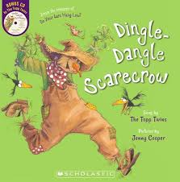
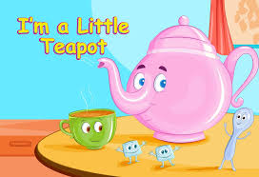
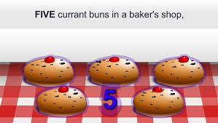
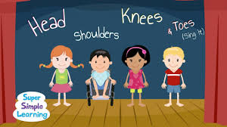
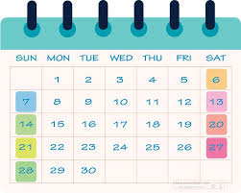
Rhymes and Songs
Nursery Rhymes are extremely valuable to support language and communication skills, build confidence and prepare children for reading and writing as they get older. We also focus on six Rhymes and Songs each Term.
This term we are learning:
Happy and You Know It
Head Shoulders Knees and Toes
Dingle Dangle Scarecrow
5 Currant Buns
I’m a Little Teapot
Two Little Dicky Birds
RE
Domestic Church– Family: Myself
Why am I Precious?
In this topic we will know and understand:
the importance of being part of a family
the importance of their name
that God knows and loves them and each one by name
Baptism/Confirmation – Belonging: Welcome Why is Welcome important?
In this topic we will know and understand:
What it is to welcome and be welcomed.
Know that Baptism is when we are welcomed into God’s family.
Ten Ten
The children will be told the story of creation, engaging with it creatively through sound, movement and discussion. The children will explore the language and understanding of the fundamental principle that we were created by God out of love and for love.
Children will know that:
We are created individually by God as part of His creation plan
We are all God’s children and are special
Our bodies were created by God and are good
We can give thanks to God
EYFS Baseline
Your child will complete the reception baseline assessment (RBA) within the first 6 weeks of starting reception. The purpose of the assessment is to provide the starting point for a progress measure that will help parents understand how well schools support their pupils to progress between reception and year 6.
The RBA is a short, interactive and practical assessment of your child’s early literacy, communication, language and mathematics skills when they begin school, using materials that most children of your child’s age will be familiar with.
If you have any questions, please do not hesitate to speak to your child’s teacher.
Reminders
When your child begins to bring a book home please read with your child regularly, this makes such a difference to their reading journey. Bookbags will be kept on a Thursday night and new books given on a Friday. We will spend lots of time outside and may get a little bit messy, please ensure your child brings a waterproof coat each day. You can bring a spare set of clothes in for your child to change into which can be kept on their peg.
Dates
All reminders of dates/events will be sent separately.
Wed 2nd October - Stay and Play 8:45
Wed 16th October - Rise and Read 8:45

