Slide 1
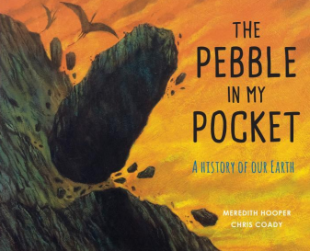
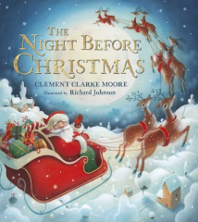
Autumn Term 2022
Welcome to Year 3! Miss Holmes, Mrs Atkinson and Mrs Wissen are both very excited to welcome your children into a new key stage. We have lots of exciting things planned this term for your children to enjoy. We have a Year 3 email account that you can contact us on any time, as well as ringing school or speaking to us at the end of the school day. Our email address is: y3staff@stbenedicts.npcat.org.uk. Please ensure you read your child’s school reading book a minimum of three times per week, writing in their Reading Records each time they have read. We will also send home Maths and Spelling homework each week which is handed out on a Friday to be returned the following Wednesday.
In English this term, we will be studying a range of writing genres that are often linked to the work we are covering in other curriculum areas:
Poetry
Narrative descriptions
Non-chronological reports
Formal letters to complain
Dialogue through narrative
Performance poetry.
During our English lessons, we will teach any punctuation and grammar that is needed for a particular genre , as well as vocabulary the children will need to complete their work to a high standard.
Our reading lessons will be completed daily, focusing on one text for a period of between two to four weeks. The books we will be studying are:
Greta and the Giants by Zoe Tucker
The Pebble in My Pocket by Meredith Hooper
Leon And The Place Between by Angela McAllister
The Night Before Christmas by Clement Clarke Moore
Additionally, we will be reading other texts during our Control the Game sessions, which will include:
James And The Giant Peach by Roald Dahl
Pugs Of The Frozen North by Phillip Reeve
In Maths this term, we will be studying the four main areas of number that the children will then be able to apply to other areas of the curriculum. These will include:
Place Value
Addition
Subtraction
Multiplication
Division
Additionally, the children will be completing a ‘Flashbook Four’ each morning as they come into school, which practices skills they have learned last lesson, last week, last term and last year, ensuring that these key skills are used on a regular basis.
We will complete Times Tables sessions three times per week in school, where we will focus on a particular times table. We ask that you practice times tables with your children at home; ways that you can do this include TT Rockstars, Hit the Button or by making up your own way that your child will enjoy! This term, please practice the 10, 5, 2 and 4 times tables.

Slide 2
We will begin our RE this year with a topic called ‘Homes’, thinking about what makes a home special and what we can do to make the people in our homes feel worthy. We will study pieces of scripture to help us to do this and compare what we do at home and school to make our environments a better place.
We will then be learning about Baptism, what happens during a Baptism, the role of parents and godparents and why we are Baptised.
In the lead up to Christmas, our Advent topic will be focusing on the Christmas story, learning about where Jesus came from, retelling the annunciation Angel Gabriel to Mary of Jesus’ birth, the visitation of Mary to her cousin, Elizabeth and the worship of the shepherds and Kings in the stable.
Geography
This term, we will be focusing on Map and Fieldwork skills and will (weather permitting!) be completing a lot of learning outside. We will be learning how to use a compass and finding the cardinal and intercardinal points of a compass.
History
Our focus for this term will be the Stone Age, Bronze Age and Iron Age, learning about what life was like for the people who lived in this time period, as well as the timeline of the largest era of history.
Science
In Science, our topics are Rocks and Animals Including Humans. In Rocks, we be learning about how rocks and fossils are formed, investigating different types of rocks and what soil is made of. In Animals Including Humans, we will be focusing on the effect that food has on our body, and what skeletons and muscles do.
Art
In Art, our focus for this half term are painting and drawing inspired by cave art (to link in with our History topic), thinking about how we can mark-make and use paints to create different textures. After this, we will look at printmaking, creating a range of marks with a roller.
DT
In Design Technology, our focus will be textiles where we will explore how to stiffen fabric, how to cover a box with fabric and how to create a rigid box out of fabric. We will then look at Food and Nutrition, thinking about what a balanced diet is, along with pre-made and processed food.
Music
We will be learning how to sing in rounds, exploring how to create harmonies by singing the same melody but at a different time, as well as thinking about the texture of the sounds created by adding more voices.
French
In French, we will be focusing on Greetings, how to say hello and goodbye to our friends, family, teachers and other people we see in an appropriate manner, as well as items in the classroom that we will describe with colours.
Important dates
Our PE days this term are Thursdays and Fridays
6th October – Parents Evening
7th October – PD Day (children do not attend school)
Thursday 20th October – Autumn disco
21st October – Break up for half term (children attend school)
31st October – Children return to school
Thursday 8th December - Disco
16th December – Break up for Christmas (children attend school)

