Slide 1
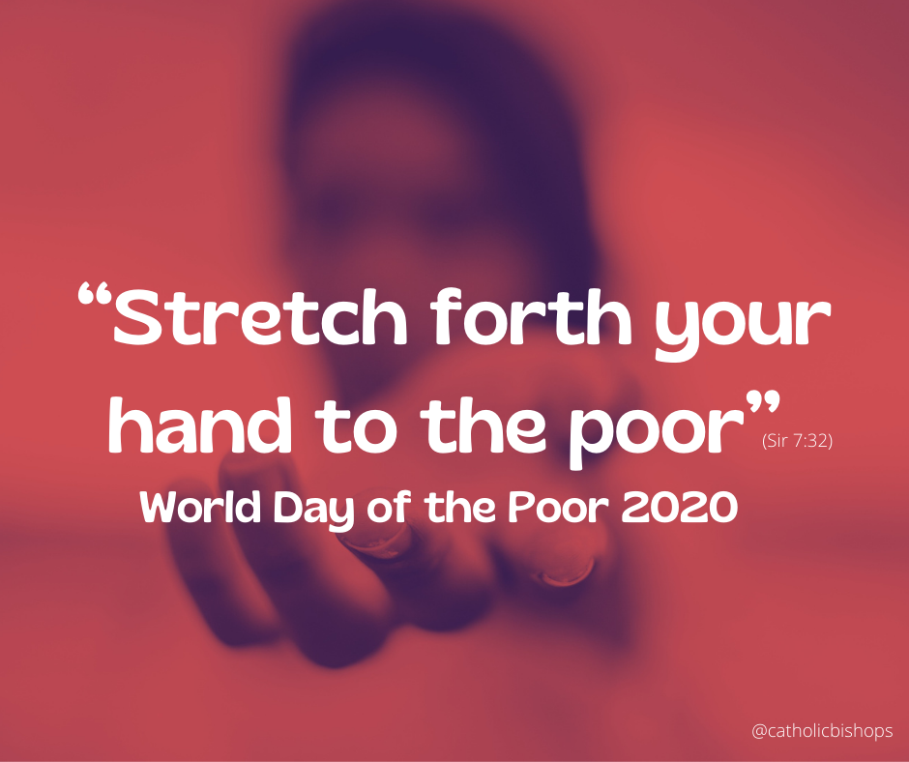
World Day of the Poor
Pope Francis has declared Sunday 15 November 2020 to be the fourth World Day of the Poor.

Slide 2
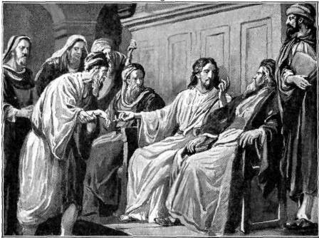
In his message for this World Day of the Poor, Pope Francis draws on the Old Testament Book of Sirach, which calls us to ‘Stretch forth your hand to the poor' (Sirach 7:32).
We are reminded that 'prayer to God and solidarity with the poor and suffering are inseparable.'

Slide 3
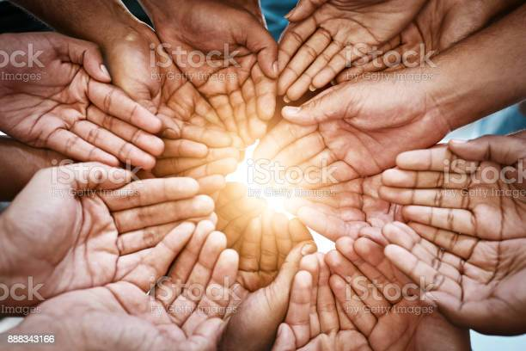
On this day we are invited to offer friendship, solidarity and welcome to the poorest of our sisters and brothers.
As we reach out with love and support, let us hold all members of our global family in our prayers.

Slide 4
This message is so important at the moment, where many of us may know people in difficult financial situations. A hand held out is a sign; a sign that immediately speaks of closeness, solidarity and love. In the midst of this pandemic, how many outstretched hands have we seen? These times have renewed our sense of responsibility for our neighbours - and we continue to love, pray for and support those around us who are most in need.

Slide 5
Our mission - How can we help our neighbours? Could you spare something for the local foodbank from your store cupboard? Have you anyone who is elderly living nearby? Could you leave something on their doorstep? Do you or your family know someone who has lost their job and needs some support?

Slide 6
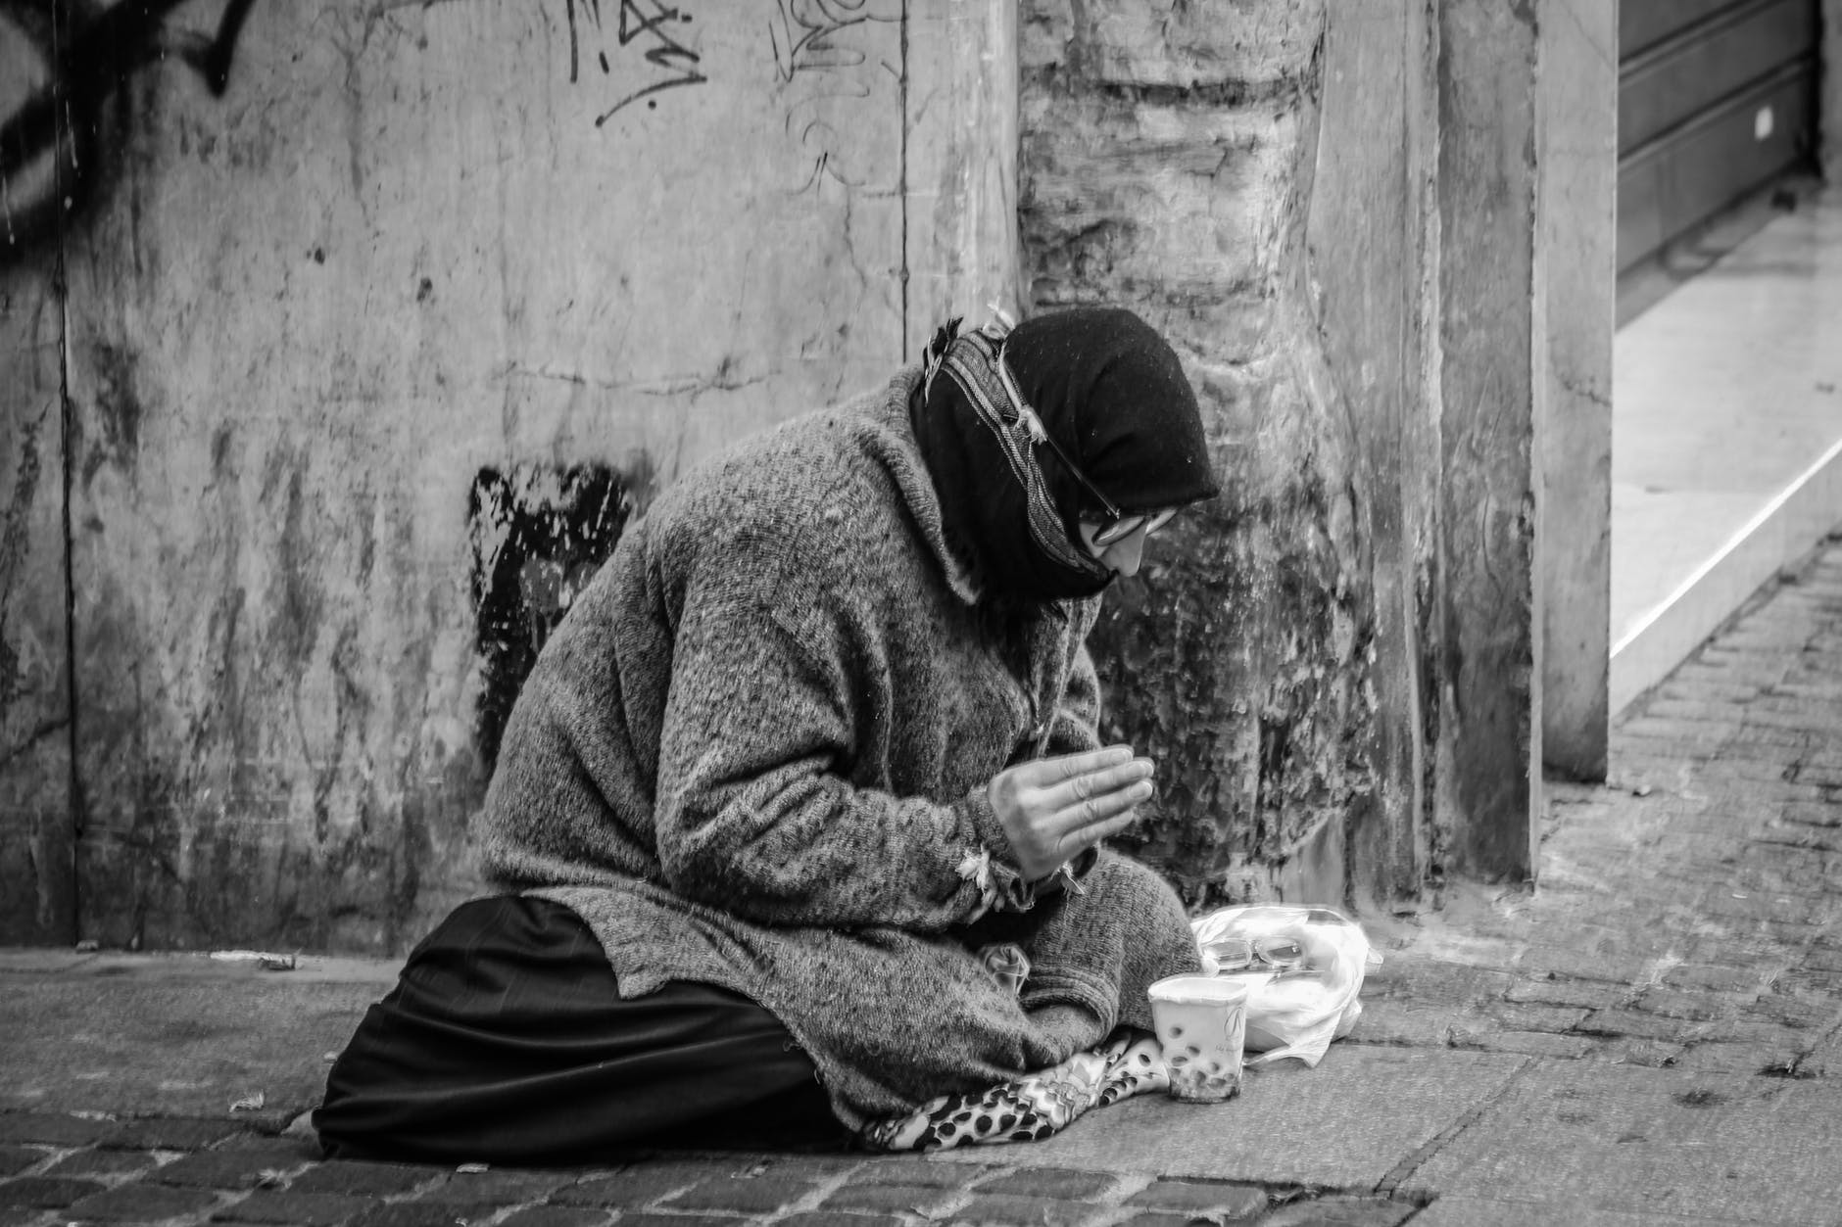
Let us prayer together for a better world:
In the name of the Father, the Son and the Holy Spirit
Generous God, we thank you:
For the gifts you have given us, the abundance of your Creation, and the beauty that surrounds us.

Slide 7
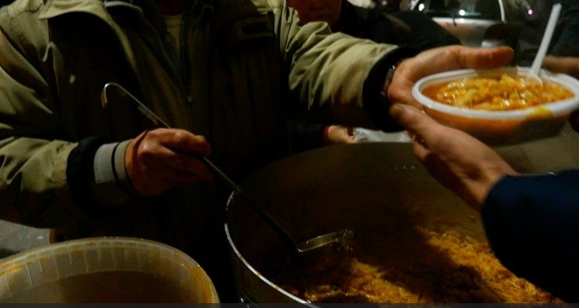
For the people whose lives have touched ours, for the love they show, the burdens they lift, the hopes we share.
Compassionate God, we ask you: to fill us with your love, to place in our hearts a spirit of courage, to move us to reach out to others in need.
And lead us to play our part, so that now and in generations to come all your children may share in our hope for a better world.
We ask this through Christ our Lord,
In the name of the Father, the Son and the Holy Spirit
Amen.

