Slide 1
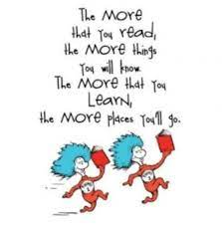
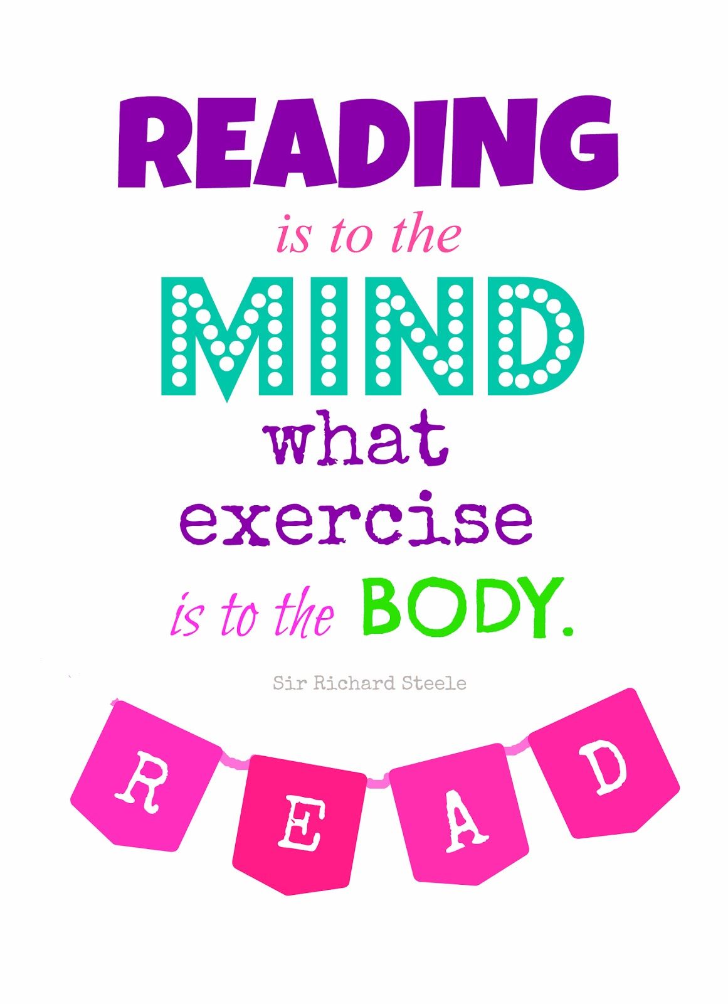
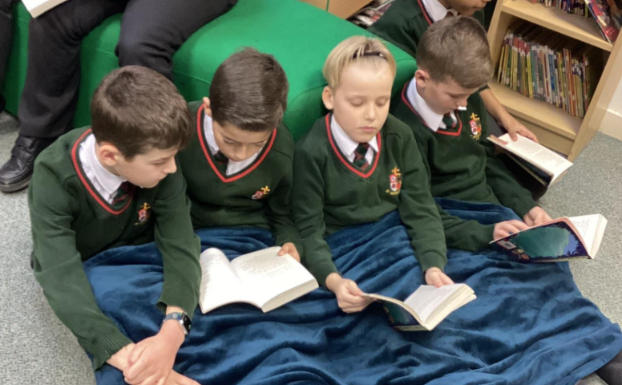
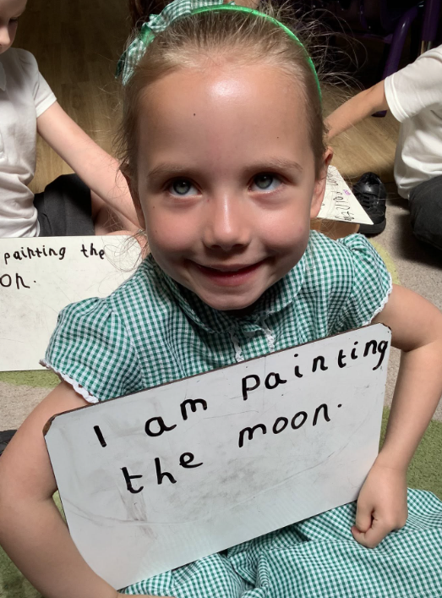
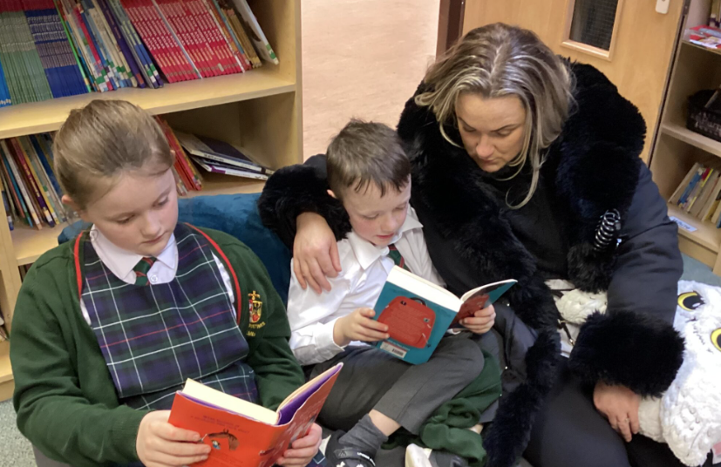
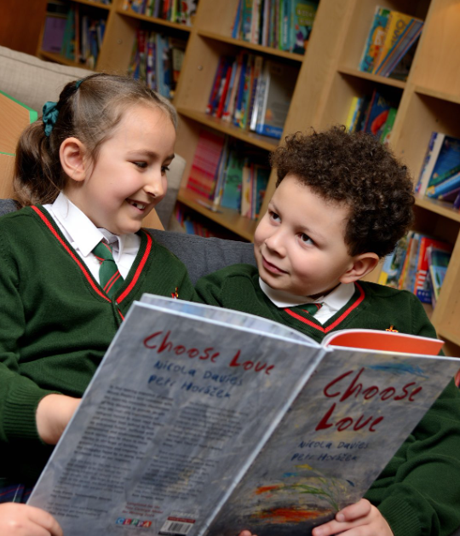
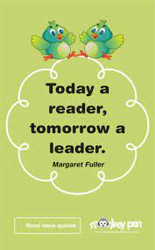
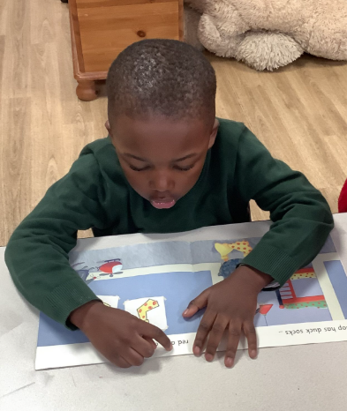
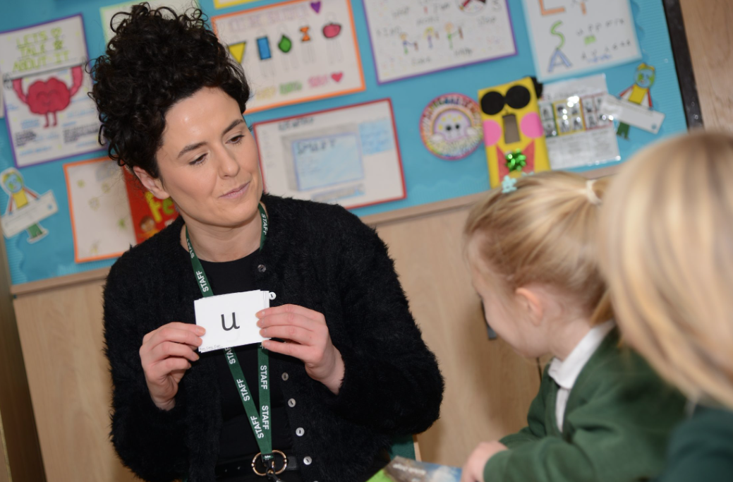
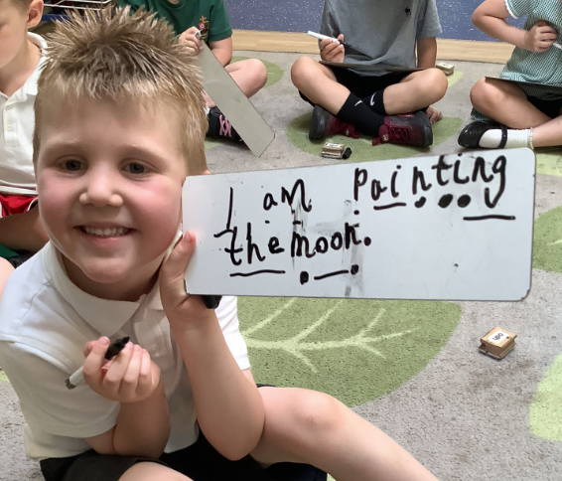
Phonics & Early Reading

Slide 2

Little Wandle
At St. Augustine’s, we teach phonics through a programme called Little Wandle.
It is a government recommended phonics programme, which aims to ensure all children can fluently decode and read texts using phonics by the end of Year 1.
It is a complete synthetic phonics programme with a consistent approach. The programme uses daily phonics teaching sessions along with catch-up interventions and half-termly assessments to ensure that all children achieve this goal.
It is vital that parents/carers understand and support the school through this process as you also play such a significant role in helping your children learn to read.

Slide 3
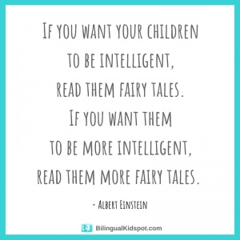
The importance of reading
Research has shown that being able to read fluently by the age of 6 has a strong correlation with future academic success.
If children can read fluently, they are better able to access all areas of the curriculum.
Reading for pleasure is more important for children's cognitive development than their parents' level of education and is a more powerful factor in life achievement than socio-economic background.
Those children who choose to read books for pleasure outside of school are more likely to secure managerial or professional jobs in later life.
Studies have also shown that those who read for pleasure have higher levels of self-esteem and a greater ability to cope with difficult situations. Reading for pleasure was also associated with better sleeping patterns.

Slide 4
How children learn to read – Phonics
‘If we can learn to read, we can read to learn’
In order to be successful readers, children need good word recognition and strong language comprehension skills and research has proven that these should be taught separately initially.
Decoding using phonics is the most reliable method to work out unknown words which is why automatic decoding is the ultimate aim of the programme.

Slide 5
How children learn to read – Phonics
Terminology
Fluency
The ability to read accurately with speed and expression. Fluent readers read words automatically without needing to decode. It is at this point that we see them able to focus on comprehension and make sense of what is being read.
Phoneme
The smallest unit of sound that can be identified in words.
Grapheme
A letter or group of letters used to represent a particular phoneme when writing.
Tricky words
High-frequency words that, although decodable in themselves, cannot be decoded by children using the GPCs they have been taught up to that point.

Slide 6
What has changed?
Children will be expected to use phonics only to work out unknown words and must not be encouraged to guess or work out the word using other cues such as pictures.
In school, children will only be expected to read independently books that they can read at 90% fluency, this means that they only have to decode 1 word out of every 10.
At home, children will only be expected to read books that they are already familiar with and that they can read to 95% fluency. These books will only contain graphemes and tricky words that they have already be taught.

Slide 7
Reading fully decodable books
While they are in school, the children will take part in three Reading Practice Sessions per week during which they will practise their decoding, prosody and comprehension skills with a teacher or TA in a small group.
The book that they have been reading in these sessions will be available online to them on a Friday for parents/carers to share again with their children.
If your child still needs to work on developing their fluency with a particular text, then they may be given the same book again.

Slide 8
Parents’ and carers’ role
It may seem that the book your child has been given is too easy but the whole point is for them to develop their fluency and confidence using the graphemes and tricky words that they have been taught.
Your child should be able to read the practice book with developing confidence and fluency without any significant help.
Your role is to listen with interest and, most importantly, to encourage and praise, enthusiastically acknowledging your child’s achievement (even if, at the early stages, this is only small).
After the child has read the book, it may be helpful to talk about the book, but only so far as the child is interested. It is vital that you keep the reading experience positive and avoid turning it into a test.

Slide 9
Reading for Pleasure
If children are to become lifelong readers, it is essential that they are encouraged to read for pleasure. The desire of wanting to read will help with the skill of reading.
To help foster a love of reading, children will also choose a book to take home that they can share and enjoy with you.
These books offer a wealth of opportunities for talking about the pictures and enjoying the story.
You should not expect your child to read this book independently. The book is for you to read to or with your child.
Again, it is good to talk about the book with the child, but important not to turn the discussion into a test. The goal is enjoyment.

Slide 10
Reading Records
In order to assist the teachers with their assessments of your child’s reading, it would be helpful if you could make a note of any tricky words/graphemes that children were unable to read/decode in their Reading Practice Book.

Slide 11
In summary…
There are two types of reading book that your child may bring home:
1) Reading Practice Book: This will be at the correct phonic stage for your child. They should be able to read this fluently and independently-this will usually be an Ebook.
2) Sharing Book: Your child will not be able to read this on their own. This book is for you both to read and enjoy together.
Reading Practice Book
This book has been carefully matched to your child’s current reading level. If your child is reading it with little help, please don’t worry that it’s too easy – your child needs to develop fluency and confidence in reading.
Listen to them read the book. Remember to give them lots of praise – celebrate their success! If they can’t read a word, read it to them. After they have finished, talk about the book together.
Sharing Book
In order to encourage your child to become a lifelong reader, it is important that they learn to read for pleasure. The sharing book is a book they have chosen for you to enjoy together.
Please remember that you shouldn’t expect your child to read this alone. Read it to or with them. Discuss the pictures, enjoy the story, predict what might happen next, use different voices for the characters, explore the facts in a non-fiction book. The main thing is that you have fun!

Slide 12
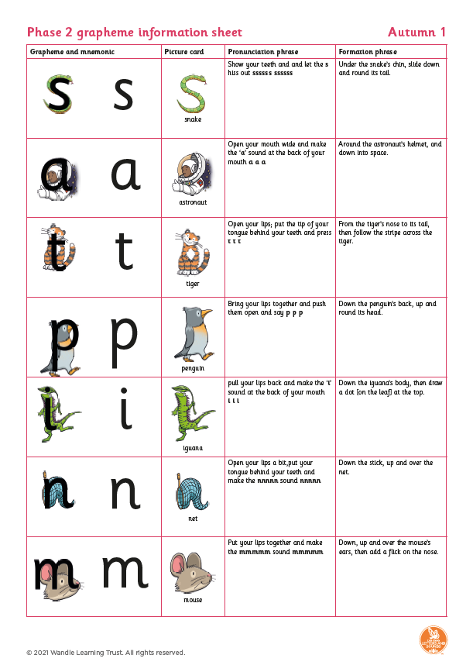
Further support:
https://www.littlewandlelettersandsounds.org.uk/resources/for-parents/

