Slide 2
Vowels and Consonants
There are two types of letters - vowels and consonants.
The five vowels are:
A/a
E/e
I/i
O/o
U/u
The other 21 letters are consonants.

Slide 3
Vowels
We say the vowels with our mouths open.
Try it!
a
e
i
o
u

Slide 4
How Can I Remember the Vowels?
Angry Elephant In Orange Underpants

Slide 5
Let’s Practise
A
E
I
O
U
a
e
i
o
u
Tap the vowels and say the sounds.
Try it again and say the letter names.

Slide 6
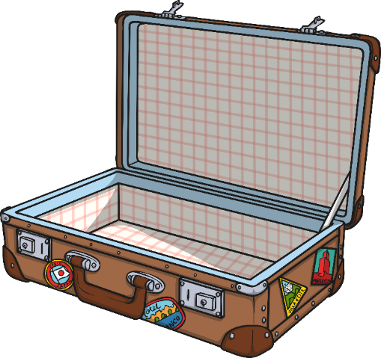
The angry elephant is packing for his holiday.
Tap the uppercase vowels to put them in his trunk.
W
X
Z
A
B
V
C
U
D
T
E
S
F
R
G
Q
H
P
O
I
N
M
L
K
J

Slide 7
Now, tap the lowercase vowels to put them in his trunk, too.
w
x
z
a
b
v
c
u
d
t
e
s
U
O
A
f
E
r
I
g
q
h
p
o
i
n
m
l
k
j

Slide 8
Now tap all of the vowels to add them to his trunk.
W
X
g
A
B
k
u
U
s
q
E
t
c
R
v
o
H
P
O
w
h
M
d
l
J

Slide 9
The angry elephant doesn’t like consonants.
Tap the uppercase consonants so he can stamp on them.
W
X
Z
A
B
V
C
U
D
T
E
S
F
R
G
Q
H
P
O
I
N
M
L
K
J

Slide 10
Now tap the lowercase consonants for him to stamp on, too.
w
x
z
a
b
v
c
u
d
t
e
s
f
r
g
q
h
p
o
i
n
m
l
k
j

Slide 11
Now, tap all of the consonants.
w
x
z
G
b
v
c
e
d
t
P
I
r
F
a
q
Z
p
U
i
n
M
l
K
W

Slide 12
Watch Out for the Tricky ‘Y’!
The letter ‘y’ represents different sounds in different words.
This means it is sometimes a consonant and sometimes a vowel.
‘y’ is a vowel in these words and is made with an open mouth:
my
myth
hymn
‘y’ is a consonant in these words:
beyond
yet
yippee

