Slide 1
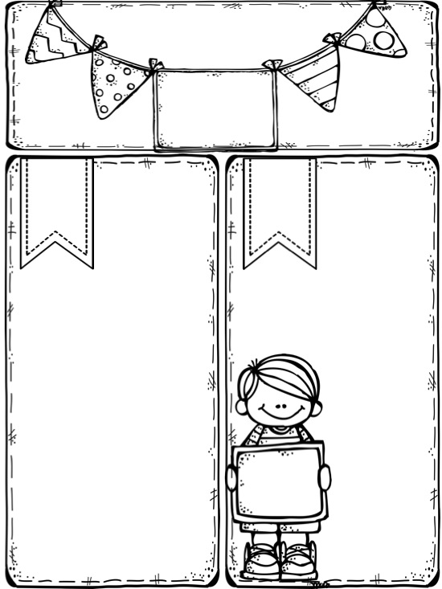

Miss McCarthy
Y2 Autumn Newsletter
Our topic
Key Info
PE
PE is every Monday!
Please have a full PE kit in school all week ☺ Don’t forget joggers as it gets colder.
“What a Wonderful World” is our Autumn term topic!
“God saw all that he had made, and it was very good.” Genesis 1:31
Home challenges:
Literacy – Can you read and write all of your Y1 and Y2 Common Exception Words?
Maths – Do you know your 10 times tables x and ÷ facts in random order?
Science – Can you find living and non-living things around your home?
Geography – Can you name and find the countries and capital cities of the UK?
If you would like to know more about what we are learning, please visit our school website, SMC Facebook page or ask Miss McCarthy ☺
School Uniform
Our winter uniform is
compulsory after October half-term. Please wear a white shirt with a collar, tie and black school shoes.
Water
Bring a water bottle
to school to keep hydrated!
Spelling homework
Spellings are given every Monday. Please practise every night and return on Friday ready for the spelling test.
Maths homework
Maths homework is given on a Monday and should be returned by Friday.
Be the best you can be at SMC!

Slide 2
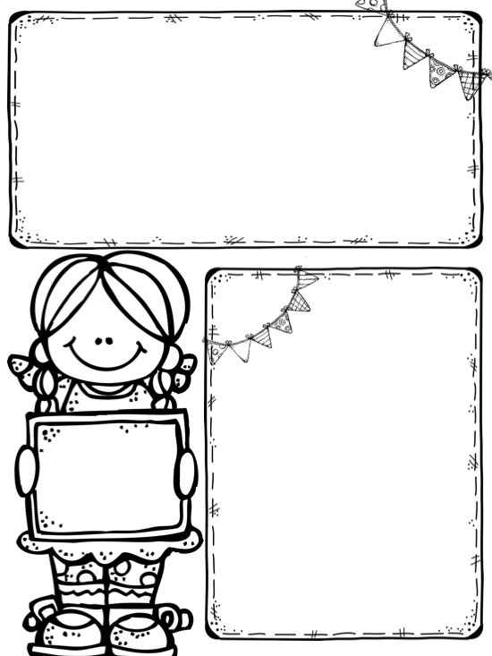
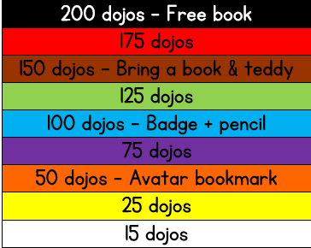




Dojo Reading Rewards!
Every time your child reads at home they will earn a ‘dojo point’ for their very own avatar.
Reading diaries must be brought in and signed to get the points.
20 bonus points if you can read all common exception words!
Certificates and rewards will be given every half-term.
What are you waiting for? Start reading to collect your dojos!
Remember you might only read one or two pages or even your own book. It still counts! ☺
Some of the avatars ready to get some dojos!
Dates for the diary
September
Fri 29th – MacMillan Coffee Morning
October
Thurs 5th – Y2Mc Tiger Who Came to Tea Party @ 2.30pm – Parents invited
Fri 6th – Mass @ 9am – All welcome!
Fri 13th – Individual school photographs
Tues 17th - Y2Mc Stay and Pray @ 2.45pm – Parents invited
Thurs 19th - Break up for half-term holiday
Fri 20th – PD Day – School closed
Mon 30th – Back to school
November
Fri 6th – Mass @ 9am – All welcome!
Tue 7th & Thurs 9th – Parents’ evenings
December
Fri 1st – Mass @ 9am – All welcome!
Fri 8th - Christmas Fayre @ 2.45pm
Fri 15th – KS1 Nativity @ 10am and 2pm
Fri 22nd – Break up for Christmas
(Back to school Mon 8th January)
Happy
Birthday
Lily Mae Florence
Yusuf and Lenox

