Slide 1
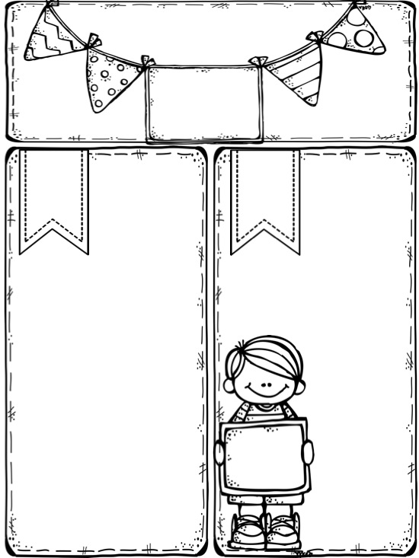


Mrs Stammers
Y2 Spring Newsletter
Our topic
Key Info
PE
PE is every Wednesday with Mr Tye. Please have a full PE kit in school all week ☺ Don’t forget joggers for the cold weather.
‘From Pandas to Penguins’
This half-term we will learn about the Chinese folktale ‘The Dragon and the Phoenix’. Children will explore the country of China and how they celebrate their New Year.
After half-term, we’re off to somewhere colder! We’ll learn lots of interesting facts about the famous explorer, Roald Amundsen and enjoy writing stories based on ‘Lost and Found’.
Y2 Optional Home Project
Imagine you are lost in Antarctica and want to get home. You come across some rubbish and have a great idea.
Your project is to make a vehicle from rubbish at home (cardboard boxes, yogurt pots, straws etc.). You might make a boat, a hot air balloon or even a time travel machine! It’s totally up to you!
If you do try this home project, please bring your escape vehicles in by Monday 26th March
Homework
Spellings and Maths homework are given every Monday. Please return by Friday for your SMC tickets.
School Uniform
Winter uniform should now be worn. Please wear a white shirt with a collar, tie and black school shoes.
Be the best you can be at SMC!
Water
Bring a water bottle
to school to keep hydrated!

Slide 2
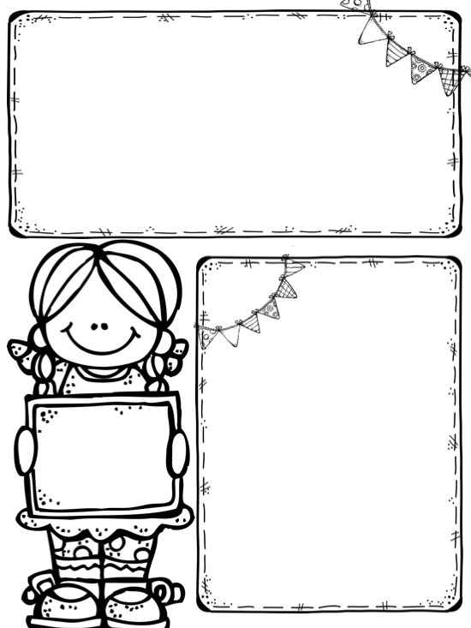





Dojo Reading Rewards!
Y2S are doing brilliantly at collecting dojo points! Remember to keep bringing your reading diary in (signed by an adult) to get the points.
20 bonus points if you can read all common exception words!
I can’t wait to award more certificates this half-term, so keep on reading!
Remember you might only read one or two pages or even your own book. It still counts! ☺
Some of the avatars ready to get some dojos!
Dates for the diary
February
Thursday 1st – Whole class photographs
Friday 2nd – Family Mass @ 9am – All welcome!
Thursday 8th – Break up for half-term
Friday 9th – PD Day – School closed
Monday 19th – Back to school
Tuesday 27th – Parents’ evening
March
Thursday 1st – World Book Day
Thursday 1st – Parents’ evening
Friday 2nd – Mass @ 9am – All welcome!
Tuesday 6th – Y2S Spring activity with parents
Thursday 22nd – Y2S Stay and Pray @ 2.45pm – Parents invited ☺
Thursday 29th – Break up for Easter holidays
Friday 30th – Good Friday – School closed
April
Monday 16th – Back to school
Happy
Birthday
Ellie Fiza Ezekiel Nathan Sienna Layton

