Slide 1
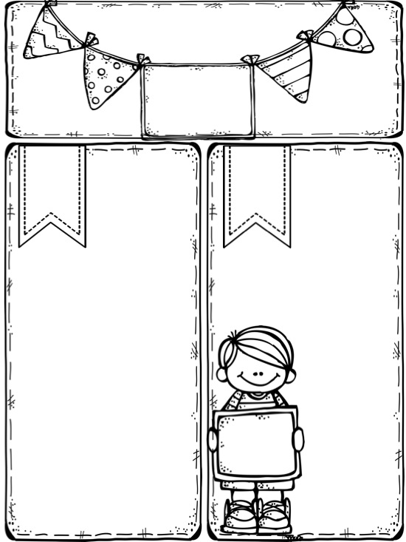


Miss McCarthy
Y2 Spring Newsletter
Our topic
Key Info
PE
PE is every Monday!
Please have a full PE kit in school all week ☺ Don’t forget your outdoor kit to keep warm!
This half-term we will learn about the Chinese folktale ‘The Dragon and the Phoenix’. Children will explore the country of China and how they celebrate their New Year.
After half-term, we’re off to somewhere colder! We’ll learn lots of interesting facts about the famous explorer, Roald Amundsen and enjoy writing stories based on ‘Lost and Found’.
Y2 Optional Home Project
Imagine you are lost in Antarctica and want to get home.
You come across some rubbish and have a great idea!
Your project is to make a vehicle from rubbish at home (cardboard boxes, yogurt pots, straws etc.). You might make a boat, a hot air balloon or even a time travel machine! It’s totally up to you!
If you do try this home project, please bring your escape vehicles in by Monday 26th March
School Uniform
Our winter uniform is
compulsory until the Summer term. Please wear a white shirt with a collar, tie and black school shoes. Don’t forget your tie!
Water
Bring a water bottle
to school to keep hydrated!
Spelling homework
Spellings are given every Monday. Please practise every night and return on Friday ready for the spelling test.
Maths homework
Maths homework is given on a Monday and should be returned by Friday.
Be the best you can be at SMC!

Slide 2
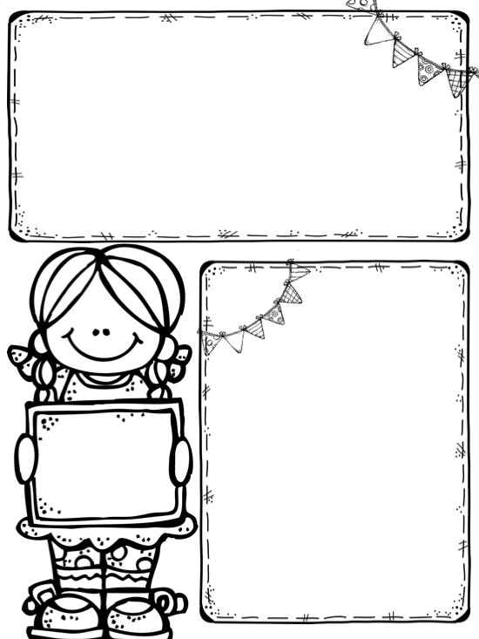
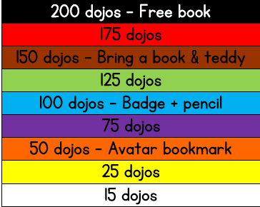




Dojo Reading Rewards!
Y2Mc are doing brilliantly at collecting dojo points!
Remember to keep bringing your reading diary in (signed by an adult) to get the points.
20 bonus points if you can read all common exception words!
I can’t wait to award more certificates this half-term, so keep on reading!
Remember you might only read one or two pages or even your own book. It still counts! ☺
Our Avatars are waiting for their Dojo points!
Dates for the diary
February
Thurs 1st – Whole class photographs
Fri 2nd – Mass @ 9am – All welcome!
Tues 6th – E-Safety day
Thursday 8th – Break up for half-term
Friday 9th – PD Day – School closed
Mon 19th – Back to school
Wed 28th – British Values Day
March
Fri 2nd – Mass @ 9am – All welcome!
Thurs 15th - Y2Mc Spring parent activity afternoon @ 2.30pm
Tues 27th – Y2Mc Stay and Pray @ 2.45pm – All welcome!
Thurs 29th – Break up for Easter holidays
Fri 30th – Good Friday – School closed
April
Mon 16th – Back to school
Happy
Birthday
Darcey, Anthony,
Imtihaz, Rielly,
Isabella, Annie, Aston
and Andrew

