Slide 1
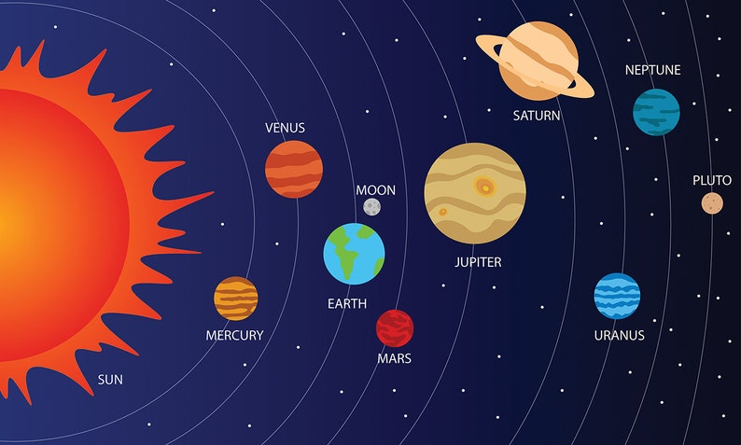
Dear Year 5 parents
We hope you had a lovely half term break. During this half term, our topic is based on Earth and Space. As well as science, many of our other lessons across the curriculum will be linked to this topic. This includes an exciting and ambitious DT project with cams and moving parts. Children will need to bring in a shoe box for this project.
If you fancy some exciting pre-learning for this topic, MOSI in Manchester has an exciting exhibition (on until 19/4) called ‘Cosmic Chaos’ where children can put on their space boots and find out what life is like in an international space station!
We hope you all enjoy the learning journey this half term. Thanks in advance for your support.
Mrs McIvor and Mrs Kennerley
Physical Education
Children need their PE kit on Wednesdays for PE and gymnastics. Games takes place on a Thursday afternoon and is led by Mrs Buchannan and the sports coaches. PE and games kits should stay in school until the half term break.
English
As usual, our writing will be linked to our topic. Our main focus in is news reports where we will use real life events (Artemis 2) and drama to support this space-themed topic. Secondly, we will be writing a persuasive letter and poetry about a fictional planet.
Reading will be taught as mixture a whole class and individual reading. Grammar will be taught once a week separately and consolidated in our reading and writing. Spelling tests will continue on Fridays.
PSHE
During our PSHE sessions, we will be answering the following questions:
Why is sleep important?
How can enjoy the sun safely without harming our skin or health?
How do medicines help us stay safe and what can we do to manage allergies safely?
How can using vaccinations and medicines safely help us stay heathy and prevent illnesses?
What makes up our personal identity and how do our qualities, backgrounds and experiences make us all unique?
How can being active help our emotional and physical wellbeing?
Computing
This half term, we will use Purple Mash for modelling purposes to create space related models.
PLANET X
Supporting your child at home
Thank you for your ongoing support with your child’s learning at home. It is always fun to share things they have made or written at home.
We will continue with the homework grid at the start of every half term. Once you have the grid it is up to you and your child which six activities you decide to complete and when. They can bring completed activities in at any time up to the end of the term. Date for homework completion is Wednesday 20th May.
Please read regularly with your child each week focussing not only on fluency, but comprehension and understanding as well. There will be weekly spell checks. Spelling lists will be sent home each Friday for a check the following Friday. Don’t forget to practise the spellings using the games on ED Shed.
For maths, TTRS can be used at home to help them retain their fluency in recall of their table facts. This is invaluable in helping them with speed and accuracy in the weekly arithmetic tests.
Design Technology
This half term, the children will design, build and decorate an informative moving toy using cams. The purpose of this toy is to teach younger children about the planets of the solar system. Children will need to bring in a shoe box for this activity.
Science
Our whole topic this half term is science based, therefore our learning across the curriculum will be about Earth and space. We will learn about the planets in the solar system, what they are like, how they move and the scientists who studied them. We will also explore why the moon appears to change shape and why night and day occur.
Music
During music, we will be listening and responding to Holst’s The Planets. We will use this as inspiration for our own spaced-themed composition.
Mathematics
This term, we will continue our work on comparing and ordering decimals to three decimal places. We will then look at equivalence between fractions, decimals and percentages. We will look at shape by focussing on angles, translating and lines of symmetry. During the whole half term, we will continue to practise calculations using the four operations

