Slide 1
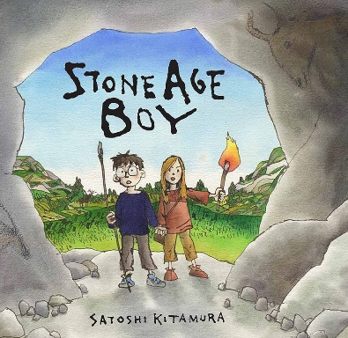
Dear Year 3 parents,
Welcome back to the second half term in year 3. We had a fantastic first half term with the children and are very proud of how they have settled into Key Stage 2. Our topic this half term is ‘Stone Age Boy’. We have planned a set of activities, to help the children understand what life would be like in Stone Age, Bronze Age and Iron Age Britain.
Mr Worth and Mrs Barrowcliff
English
This half term, we will be reading ‘Little Nose Collection – The Explorer’.
We will also be using the book ‘Stone Age Boy’ to help us with our writing. Over the half term we will explore different adventure narratives as well as looking at different features and techniques used in this genre. The children will then write their own short narrative story including dialogue.
Science
This half term, we will be building on the children’s knowledge of plants from Year 2. Having collected different seeds and fruits, we will be exploring methods of seed dispersal using a variety of primary and secondary sources. We will then be carrying out some investigations exploring the parts and functions of plants.
RE
We will be asking the question ‘Why is the bible important to Christians?’.
Art
We will be exploring examples of cave art and the techniques used in them. Taking cave art as our inspiration, we will explore line and texture, recreating these through a variety of printing techniques.
We will then be using different paper sculpture techniques to create a Christmas card.
Computing
This half term, we will be continuing our work on Coding. This will be using the purple mash programme free code chimp. We will then move on to touch typing, as well as some online safety.
Supporting your child at home
Please continue to read regularly with your child each week focussing not only on fluency but comprehension skills as well. We will continue with our weekly spell checks and the spelling lists will be continued to be posted on dojo each Monday for a check the following Monday. The words will help the children learn the Year 3 spelling rules. For maths, TTRS can be used at home to help them develop their fluency in recall of their table facts. The children will continue to have a times table check each week and will move to the next set of times tables when appropriate.
We are really pleased with how the children responded so enthusiastically to the homework grid last half term. We look forward to seeing what they produce this half term. Remember it is up to you and your child which six activities you decide to complete and when. They can bring completed activities in at any time up to the end of the topic and they will receive 2 dojos for every piece that they complete.
Mathematics
As we spent the first half-term consolidating place value and the number system, we are now moving the children onto mental and formal methods of addition and subtraction. The children will then use their multiplication tables to learn some informal methods of multiplying larger numbers. Remember that all our children have access to online learning tools such as TT Rock stars which can be used to consolidate learning in the classroom.
Physical Education
Children need their PE kits on Thursdays for indoor PE. Games takes place Friday afternoon led by Mrs Buchanan. Once they are brought into school, PE and games kits should stay in school until the half term break.
Music
This half term, we will be concentrating on preparation for our Year 3 and 4 carol concert (16.12.2025). We will be learning a variety of Christmas songs based on an adaptation of the novel 'Robin finds Christmas'. You will get more information about the Carol Concert closer to the time.
History
This half term, we will be looking at Stone Age, Bronze Age and Iron Age Britain. We will look at changes between the periods and use timelines to demonstrate timescales and order. We will look at what life would be like for early settlers and find out how events from the past have shaped our current lives.
Spanish
In our Spanish lessons with Mr Stirling, we will be looking at colours, families and Christmas in Spain. We will also be using ‘me gusta’ and ‘no me gusta’ to describe what we like and don’t like.
PSHE
We will continue our work on relationships, before moving on to looking at keeping safe online and respecting boundaries of others.

