Slide 1
Year 2
SATs

Slide 2
Overall Information
Very low key and children are not aware.
Tests can only take place in May – please try to avoid taking children out of school during this time. Any unavoidable absences, please let us know!
Children will take the tests in small groups within the classroom throughout this month.
Familiar adults will be in the classroom to reassure during the process.
Administration and timings are very flexible.
The assessments are reported to the local authority in June.

Slide 3
Assessment
Assessment is on-going
Teacher Assessment:
The teacher’s judgement
All children will receive Teacher Assessment Levels which are passed on to their following class teacher and shared in the end of year reports.
Based on observations, written and oral work in class and KS1 tests.
Judgements made for reading, writing, maths, science and GPS.
SATs (Statutory Assessment Tasks)
SATs tests designed to assess levels of knowledge, understanding and skills gained in English and Maths acquired within KS1.
Just one form of assessment to inform the teacher judgement.
All children sit the same papers.

Slide 4
SATs/Teacher Assessments
Reflect the Year 2 National Curriculum
Working towards the expected standard
Working at the expected standard ( National expectation)
Working at greater depth within the expected standard
An additional category for those pupils that do not meet the ‘working towards’ standard

Slide 5
Assessment Boundaries
Those pupils that do not meet the ‘working towards’ standard | Working towards the expected Standard | Working at the expected standard | Working at greater depth within the expected standard
Scaled Score
 | Less than 100 | 100 | 110
Raw Score Yr2 |  | Maths = 35/60 Reading = 25/40 GPS = 24/40

Slide 6
Science
Writing and Science
Writing at KS1
There is no formal test for writing.
Writing is assessed through ongoing teacher assessments.
The children build up a portfolio of their writing, teachers ensure the children explore different genres, purposes and audiences throughout the year.
During year 2, the children will build upon previously learned and newly taught skills, learning to independently apply these to their writing.
Spellings will also be assessed through the children’s writing.
Science at KS1
This remains an important subject, giving children the opportunity to develop their investigative, communication and reasoning skills.
Science is assessed through teacher assessments.
There is no formal test for science.
Assessments are either working towards or meeting, there is no greater depth for science.

Slide 7
Working at the expected standard in English
The pupil can write a narrative about their own and others’ experiences (real and fictional), after discussion with the teacher:
Demarcating most sentences with: | Capital letters and full stops
And some use of | Question marks
 | Exclamation marks
Using sentences with different forms in their writing: | statements
 | questions
 | exclamations
 | commands
Using some expanded noun phrases to describe and specify
Using present and past tense mostly correctly and consistently
Using co – ordination (or/ and/ but)
Using some subordination (when/if/that/because)
Segmenting spoken words into phonemes and representing these by graphemes, spelling many correctly
Spelling many common exception words
Spelling some words with contracted forms
Adding suffixes to spell some words correctly in their writing eg –ment, -ness, -full, -ly
Using the diagonal and horizontal strokes needed to join letters in some of their writing.
Writing capital letters and digits of the correct size, orientation and relationship to one another and to lower case letters
Using spacing between words that reflects the size of the letters

Slide 8
English SATs Papers
Two reading comprehension tests
One grammar and punctuation test
One spelling test

Slide 9
Reading
Reading
Paper 1:
  Fiction and non-fiction texts
  Text and questions on the same page
  Recommended time to complete: 30 minutes
Paper 2:
  Fiction and non-fiction - more challenging texts
  Read text first, then answer questions about the text in a separate booklet
  Recommended time to complete: 40 minutes

Slide 10
English Grammar, Punctuation and Spelling (GPS)
Paper 1: spelling
  20 words – based on spelling rules taught across the year
Paper 2: grammar and punctuation
Technical aspects of grammar – knowledge of grammatical terms and how to use them.
Precision is important: handwriting, capital letters, apostrophes.
The test is only to inform and support teacher judgements. The children’s work within the class will also be used.

Slide 11
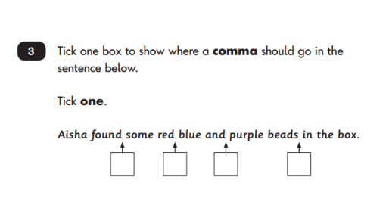
Key Stage 1 GPS example

Slide 12
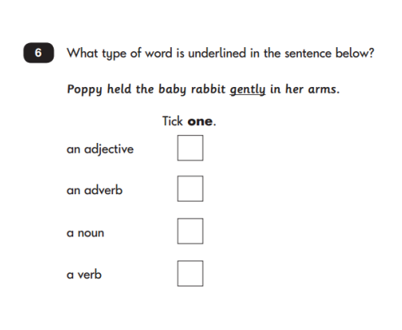
Key Stage 1 GPS example

Slide 13
Maths assessment
Maths SATs Papers
Two maths tests:
  Arithmetic
  Reasoning
Arithmetic Paper
Questions are purely arithmetical: addition, subtraction, multiplication, division and fractions.
Some working out space is given if needed, the children can also utilise their learned mental strategies.
No equipment allowed

Slide 14
Reasoning
Maths SATs Papers
Reasoning Paper
Assesses pupils’ mathematical fluency, problem solving and reasoning skills.
Questions cover place value, the four operations, fractions, geometry, units of measurement and statistics.
First 5 questions are read orally to the children.

Slide 15
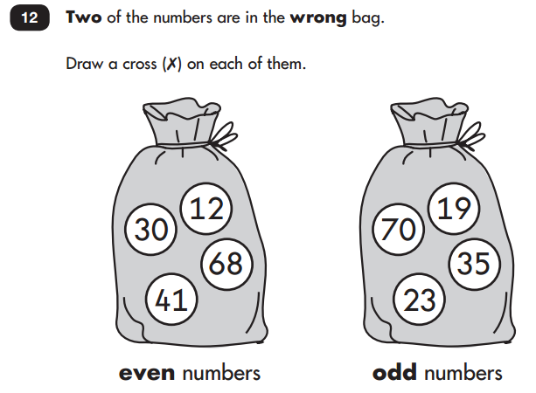
Example

Slide 16
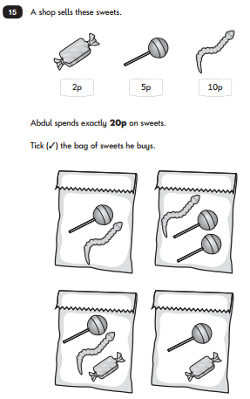
Example

Slide 17
Support your child
How to support your child at home
READ, READ, READ (Retrieve, Infer, Predict, Summarise, Compare)
SPELLING, SPELLING, SPELLING (Common exception, spelling rules)
Place value
Number bonds within 20
x and related ÷ facts for the 2, 5 and 10 times tables
Time, money and measures – practical experiences
Function of words within a sentence- noun, verb, adjective, adverb
Punctuation- ? ! . ,.
Please keep all activities practical and fun

Slide 18
Marking and Moderation
Papers will be marked internally by Miss Aspey and Miss Boughey
All teachers assessments are moderated:
Moderation occurs internally between teachers within year groups and across the school
Moderation occurs within the Heaton’s school cluster
External moderators from Stockport LA may also visit school

Slide 19
What happens to the results?
Results are used to inform the overall teacher assessment.
Key Stage 1 overall teacher assessments are shared with the Year 3 teachers to inform.
Overall teacher assessments are then reported to parents in the end of year report.

Slide 20
Any questions?
Thank you for coming!

