Slide 1
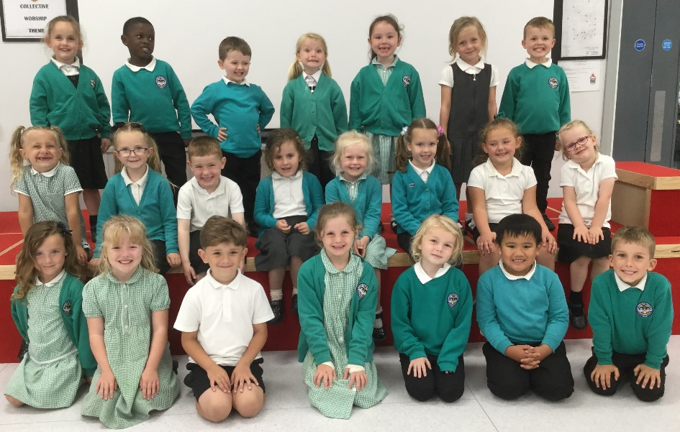
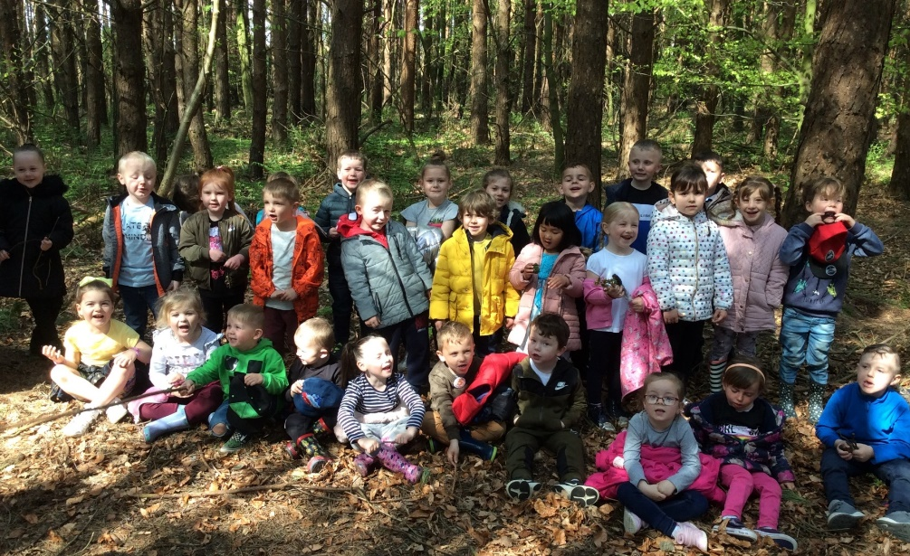
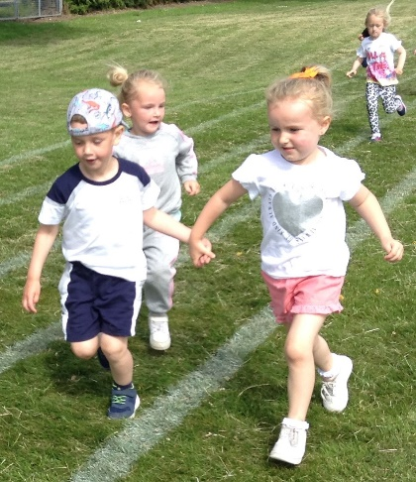
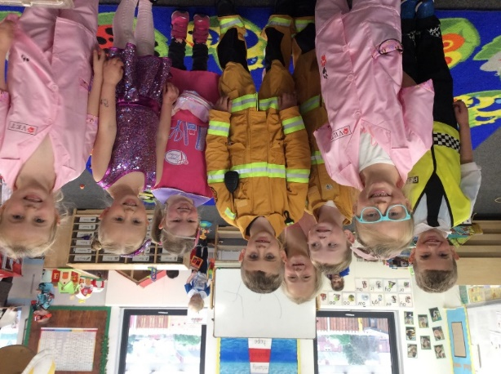
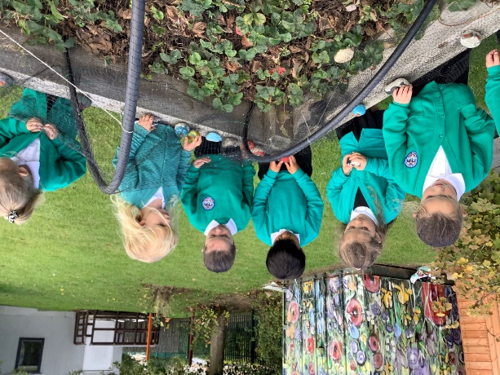

Welcome to Reception
NCEA James Knott C of E Primary

Slide 2
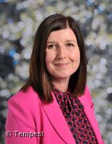
Message from Mrs Mullen
Head teacher
We are looking forward to welcoming your child to our Reception class at James Knott C of E Primary school in September. Starting Reception is a big step in their learning journey and one that we hope your child will find exciting.
We are here to support you as parents/carers through this step too, so please don’t hesitate to contact us with questions or queries.
In this booklet you will find some information and some reminders for the new school year. If you need further information please check our website.
We look forward to seeing you in person soon.

Slide 3
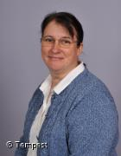
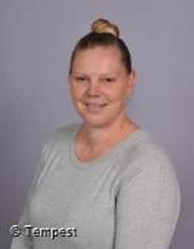
Meet the staff
Mrs Stewart Teacher
Meet
the
Reception Class Staff
Mrs Jobling
Teaching Assistant

Slide 4
We are part of the Early Years Foundation Stage, which is from birth to the end of Reception.
Our Curriculum is made up of seven areas of learning:
Personal, Social and Emotional Development
Communication and Language
Literacy
Mathematics
Understanding the World
Physical Development
Expressive Arts and Design

Slide 5
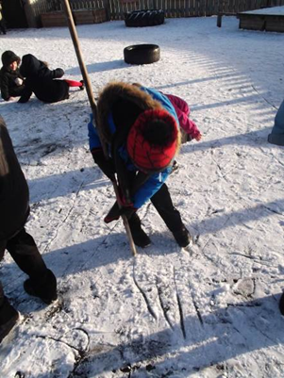
Outdoors
We spend a lot of our time in the outdoors which is a great place to learn and explore.
Children need to bring a coat to school everyday, even if the sun is shining.
School shoes need to be appropriate for all weathers.
We have some spare wellies in school but if a pair of your child’s wellies could stay in school this would help. (Please put their name inside!)
In hotter months please apply sun cream to your child before school and send them in with a sun hat.

Slide 6
Tapestry
We will continue to use ‘Tapestry’ to share your child’s Learning Journeys online.
It is important that you are able to access Tapestry as we will be sending out most of our information via Tapestry. If you are having any difficulties please let us know.
It is a great way for you to see what your child has been learning in school.
The children really like it when you upload photos and videos from home as we share these in school. It also helps us to know what your child has been doing and share their interests together.

Slide 7
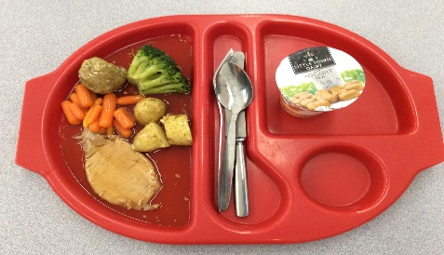
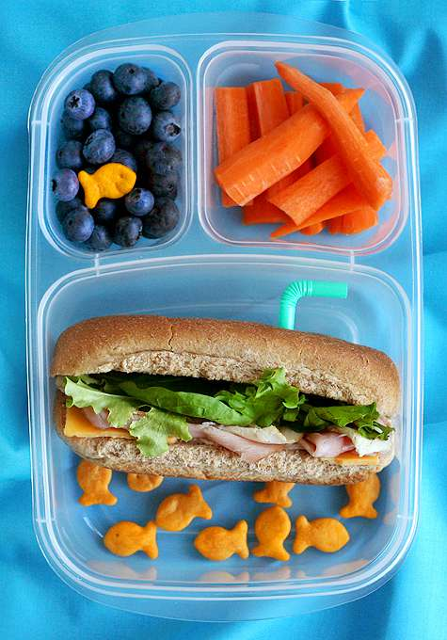
Lunch
Children have a choice each day from 3 options. The menu is always displayed on the door as they come in to help you choose together what your child may like. Children are supported in the hall to collect their lunch and sit at the table. We encourage children to cut up their own food and use their knife and fork- please practise this at home. Children can bring a healthy packed lunch from home. Please limit to one biscuit or packet of crisps. No sweets, fizzy drinks or chocolate.

Slide 8
Water bottles, Milk and Snack
Children will get a healthy snack at school. There is also the option for your child to have milk. Milk is free until the term of their 5th birthday.
We would appreciate a named water
bottle every day, particularly when the
weather is warm.
Please remember – water not juice and
do not put them into book bags.

Slide 9
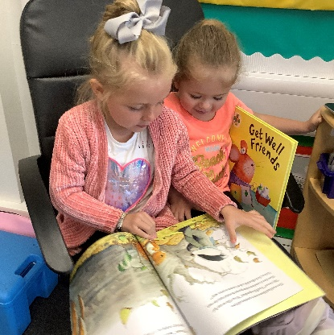
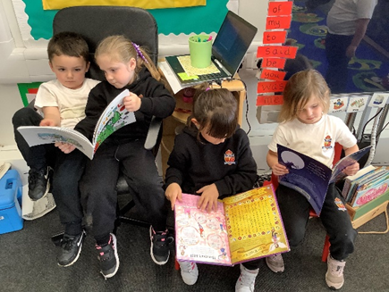
Reading
Reading is so important for children to access all areas of the curriculum.
In the autumn term we will have a phonics meeting to show you how we teach reading in school.
Please purchase a reading folder for your child and make sure they bring it every day.
Personalise it. This can be done by adding a small keyring to the handle.
Children will continue to be able to borrow books from school.
Please read to your child as often as you can and share books together, it makes a huge difference to their learning.

Slide 10
PE
The children will take part in regular PE sessions where we will be exploring movement, dance and games skills.
Children can come to school in their PE kit on PE days
(black hoodie and jogging bottoms, white T shirt and trainers).
If PE lessons include climbing and jumping, it is safer to remove shoes and socks.
Please make sure your child can take off and put on their own shoes and socks independently (shoelaces are difficult!).
Please write names in any clothing that comes to school as well as shoes.

Slide 11
Uniform
All children are expected to wear school uniform.
Children need to wear black shoes that they can manage themselves,
laces are very tricky at this age!
Reception can be a creative and therefore a very messy place!
We do insist that the children wear aprons whilst painting but
they do often get glue or pen on them.
We will do our best to teach your child to be careful, but
accidents will happen.
Uniform is to be ordered online now – please see next page.
Please label all clothing.
Jewellery is not allowed to be worn for school.

Slide 12
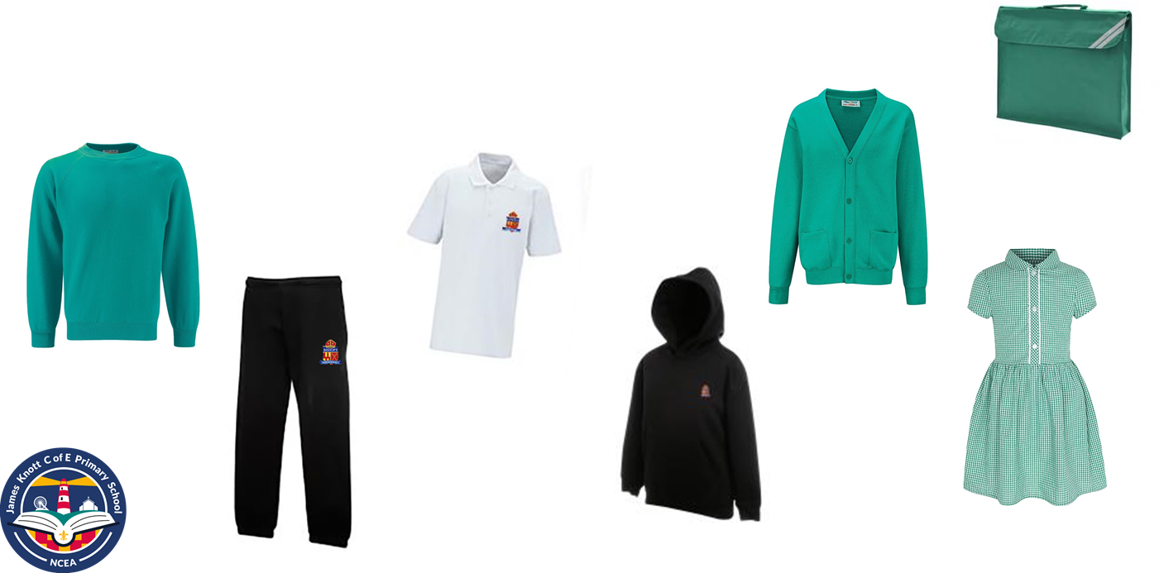
Uniform
Uniform
Order online at: https://www.michaelsehgal.co.uk/ or via a link on our website for branded uniform.
Delivery to school/home available.
You can also order/buy non branded uniform from most supermarkets.
Children should wear:
White polo shirt, black trousers or skirt, jade green sweatshirt or cardigan and black shoes (not trainers)
A black hoodie and jogging bottoms are also available for the days your child does PE.
In the summer green/jade checked dresses are also available.
Your child will also need a book bag every day.

Slide 13

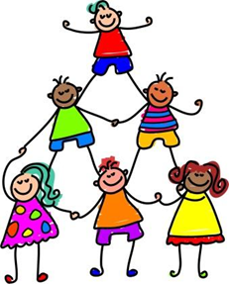
Check List
Name everything.
They will need a PE Kit, reading folder and water bottle.
Read with your child read as often as possible – we need to work together.
Arrive at 8.40am promptly every day.
Attendance - Children need to be in school everyday unless they are ill, please telephone the office to let us know if your child is unwell.
Please help them learn to be independent, washing hands, dressing for PE, fastening zips and shoes.
Sign up for free school meals if entitled.
Any questions, please send your class teacher a message on Tapestry or call the school office on 01670 860267.

